Slide 1
Welcome to you all

Slide 2
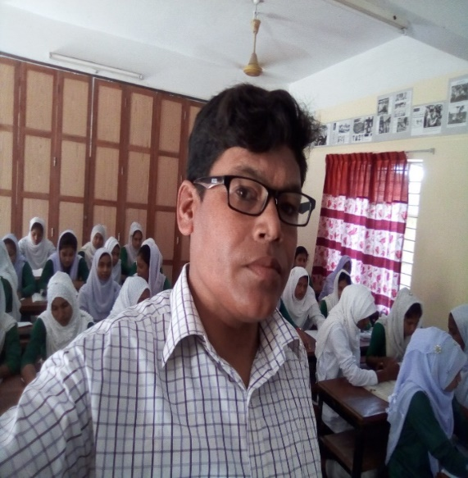
IDENTITY
Md. Abu Abdur Rahman Siddiquee
(M. A, B. Ed)
Senior Asst. Teacher (English)
Jagoroni M. L Girls’ High School
Newashi, Nageswari, Kurigram.
Master Trainer
UITRCE, Nageswari Unit, Kurigram
Email Id: siddiquee1211@gmail.com
English For Today
Class: 8
Section: Polash
Total Ss: 46
Present Ss: 42
Time: 50 Minutes
Date: 17.03.2021

Slide 3
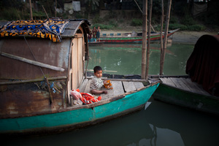
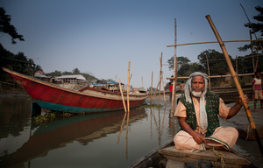
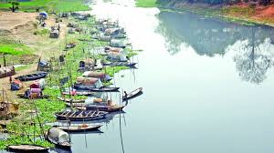
Look at the pictures and talk about these

Slide 4
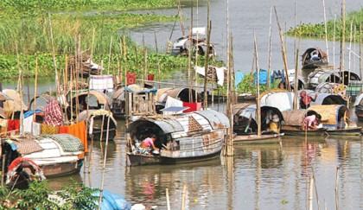
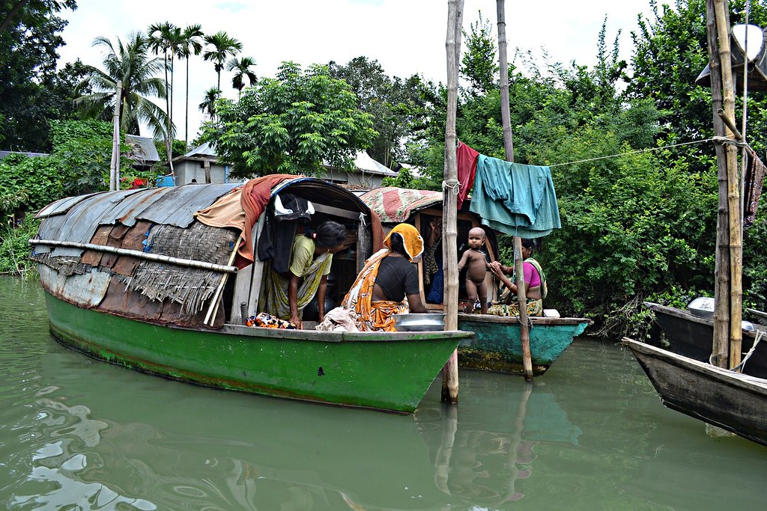
Look at the pictures and talk about these
Can you guess what’s our today’s topic?

Slide 5
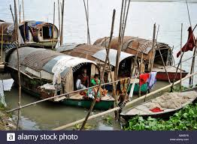
River Gypsies in Bangladesh (i)
Unit: 07, Lesson: 03

Slide 6
Learning Outcomes
After completing the lesson, students
will be able to…
read and understand text through silent reading
listen for information
ask and answer questions
write a short paragraph.

Slide 7
A. Read the passage carefully:

Slide 8
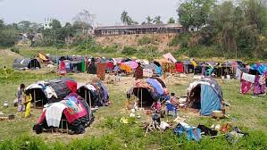
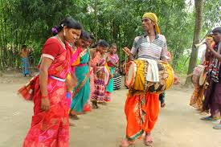
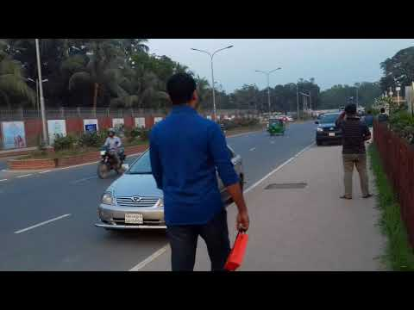
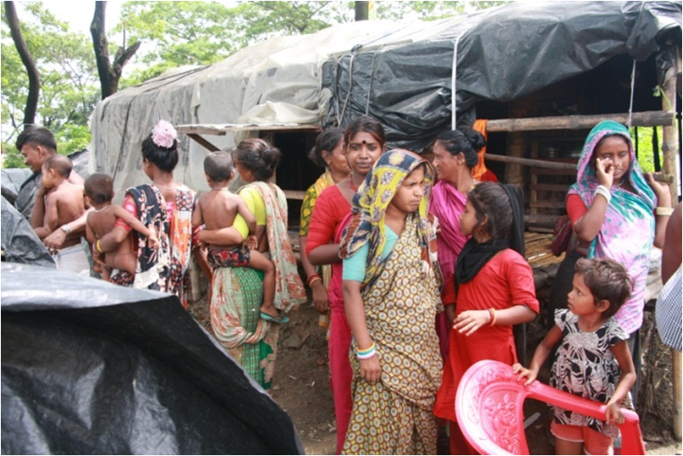
Vocabulary
Gypsy
Ethnic
Nomadic/Bohemia
Exotic
Nomadic
Roam
temporary/Wandering life
Travel/wander

Slide 9
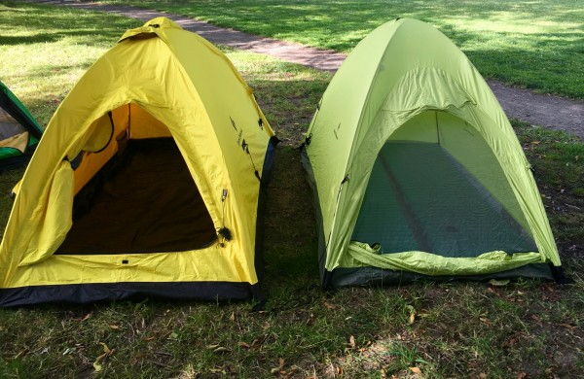
Tarpaulin
Waterproof sheet
Tents
Portable lodge/pavilion
Vend
Sell

Slide 10
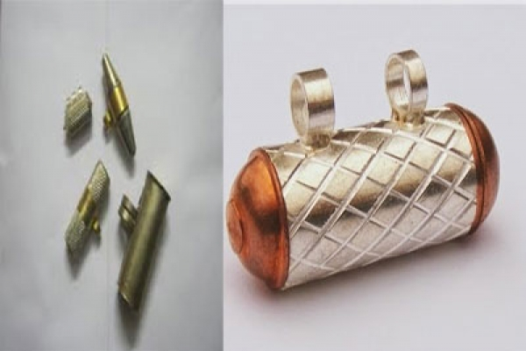
Heal
Cure/Recover
Talisman
Protective charm/
Mail/armor

Slide 11
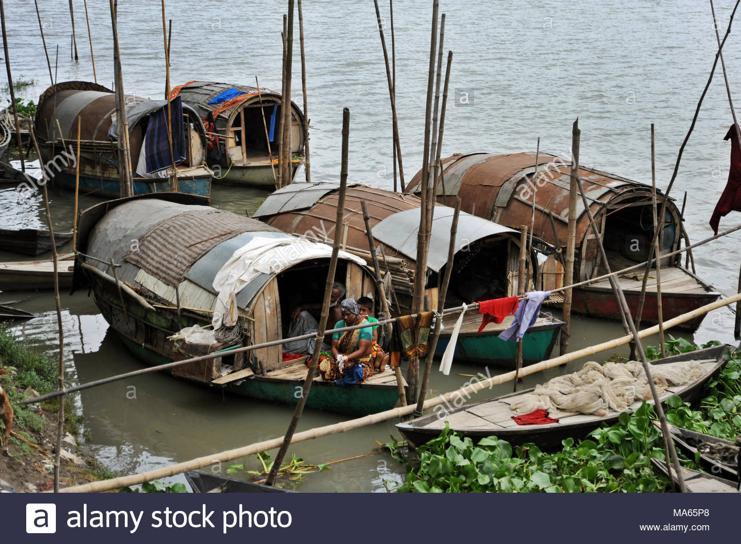
The gypsies roam across our rivers and waters from May to December in small country boats. These boats are their houses and these people are a part of our waters.

Slide 12
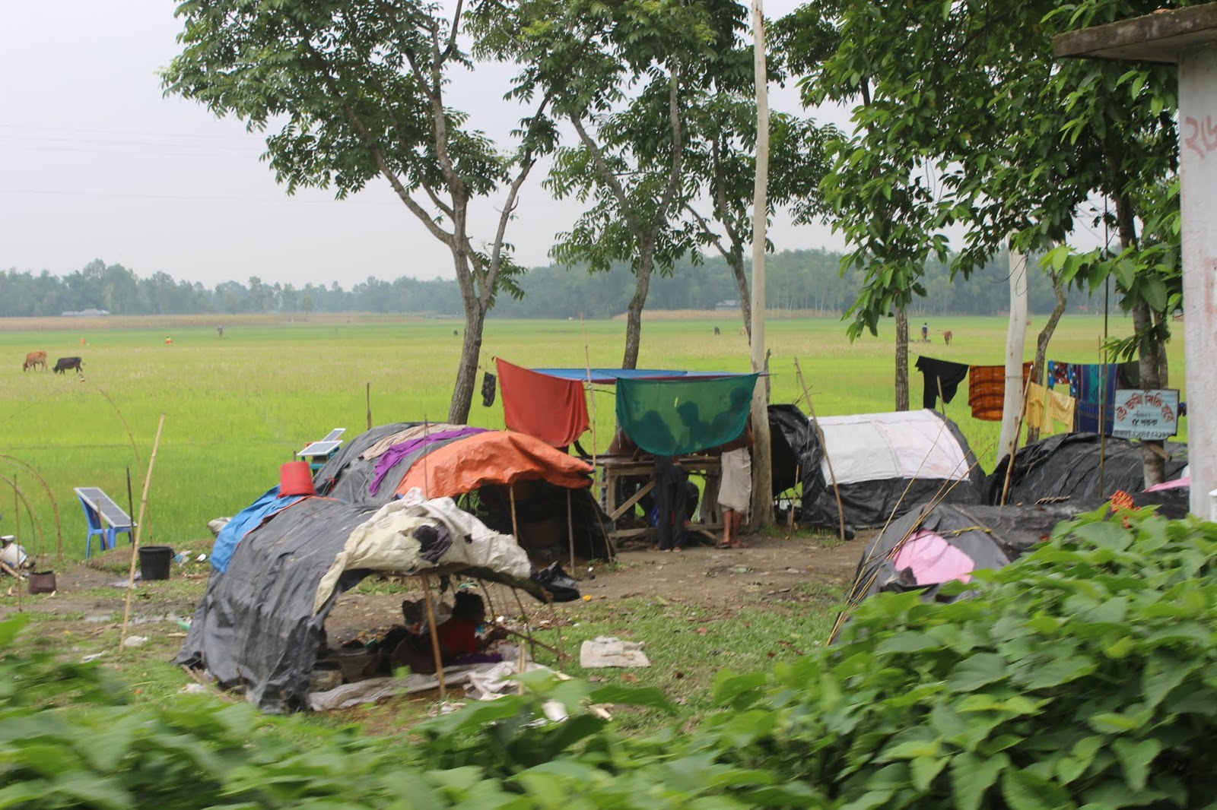
In winter, they return to the mainland and live in make–shift tarpaulin tents on open river banks.

Slide 13
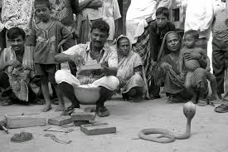
River gypsy men catch snakes and entertain people with snake charming and sell herbal cures.

Slide 14
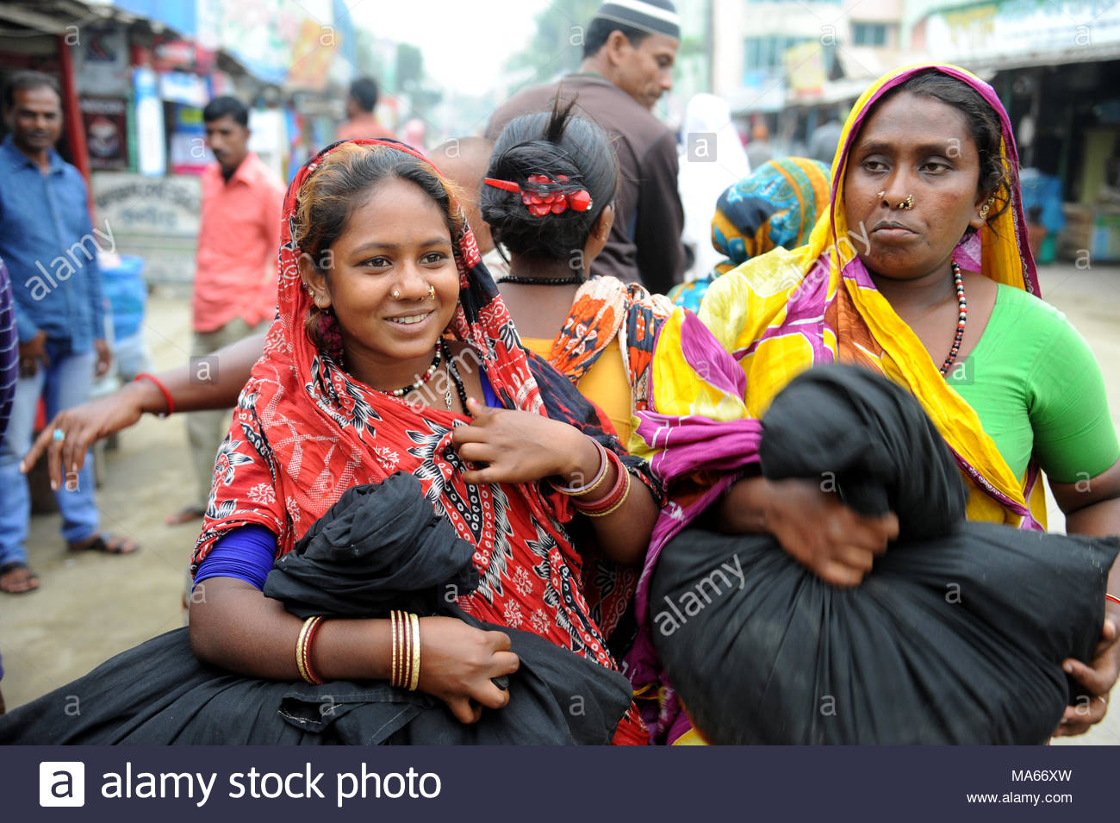
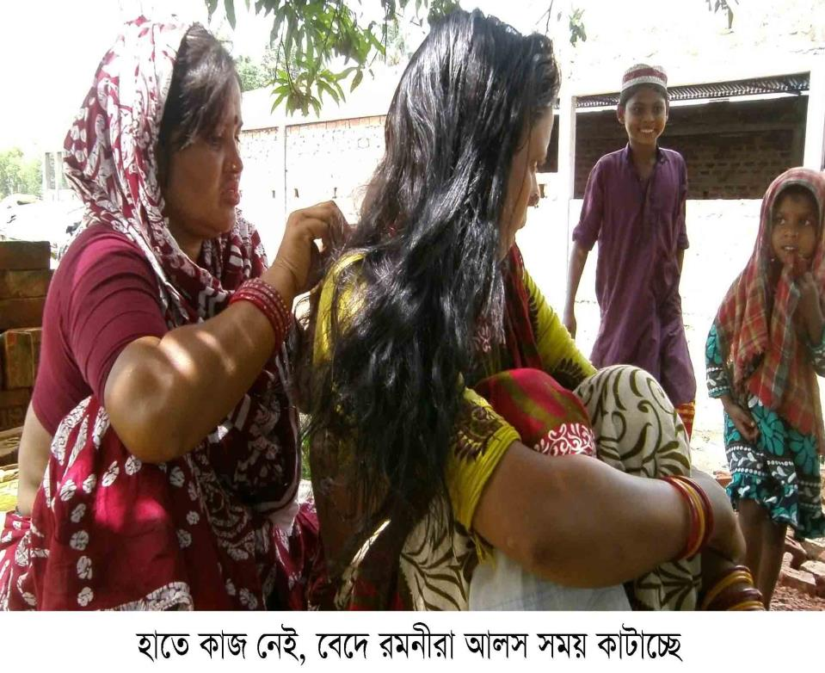
River gypsy women sell bangles, cosmetics and other things from door to door.
Village women pick up lice sitting in a row.

Slide 15
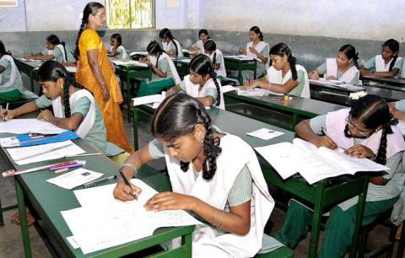
Individual Work
(Time: 07 minutes)
Answer the following questions:
Who are river gypsies?
How do they live?
Where do they live?

Slide 16
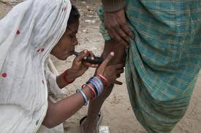
They also try to heal pains of old people often by sucking out blood from their body.

Slide 17
Pair Work
(Time: 05 minutes)
B Discuss with your partner and circle the right answer.
1 The term ‘ethnic’ is connected with
a people. b plants.
c animals. d fishes.
2 River gypsies roam around on their boats about .......months a year.
a six b seven
c eight d nine
3 River gypsies live in tents in
a summer. b winter.
c monsoon. d spring.
4 The term ‘nomadic’ refers to a person
a living permanently at a place.
b travelling from place to place.
c living in one's own house.
d living in a rented house.

Slide 19
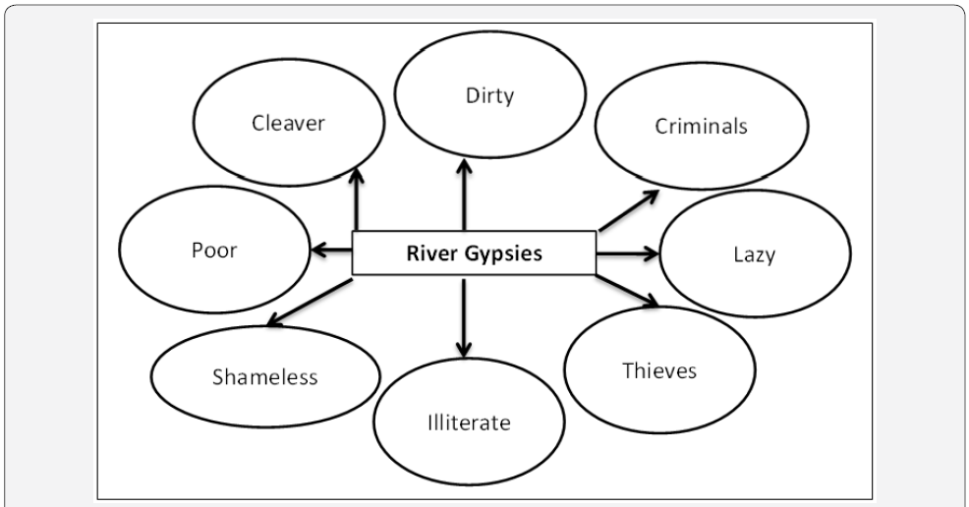
International Journal of Environmental Sciences & Natural Resources Report’s view:

Slide 20
Learning Assessment
(Time: 07 minutes)
Answer the following questions:
1. Who are river gypsies ?
2. What do river gypsy men do?
3. What do river gypsy women do?

Slide 21
Check your answer :
1. River gypsies are ethnic group of people in Bangladesh. They have no permanent living place. They are known as ‘bedey’ to local people.
2. River gypsy men catch snakes and entertain people with snake charming and sell herbal cures.
3. River gypsy women sell bangles, cosmetics and other things from door to door.

Slide 22
Home work
Have you ever seen any gypsies/bedey/snake charmers or any person selling things from door to door in your area? If not, imagine such a scenery and write your experience about any one of them.

Slide 23
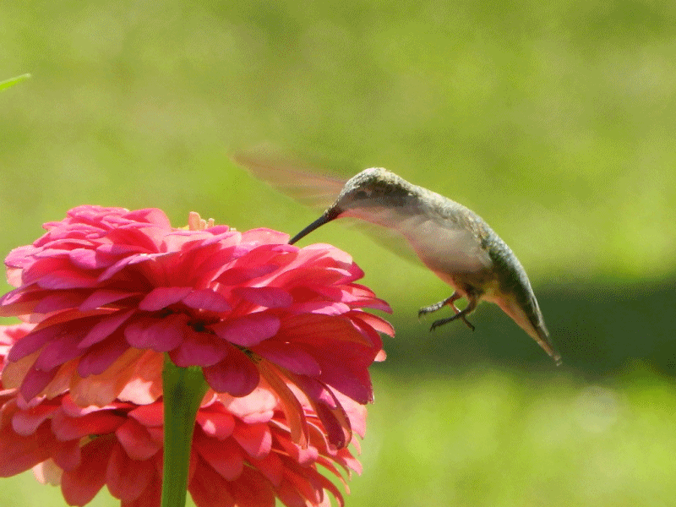
Thanks so much

