Slide 1
To
Multimedia Class

Slide 2
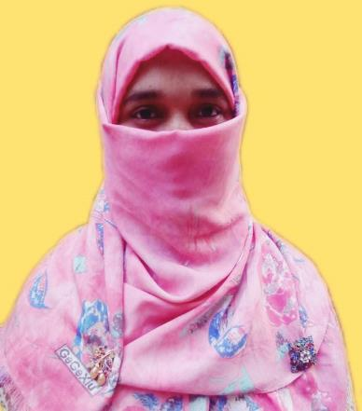
Identity
Mosammat Nelufa Afrose Bithi
Lecturer in English
Khilbaisa Rahmania Fazil Madrasah
Khailbaisa, Sadar , Lakshmipur
E-mail: nelufa.afrose@gmail.com

Slide 3
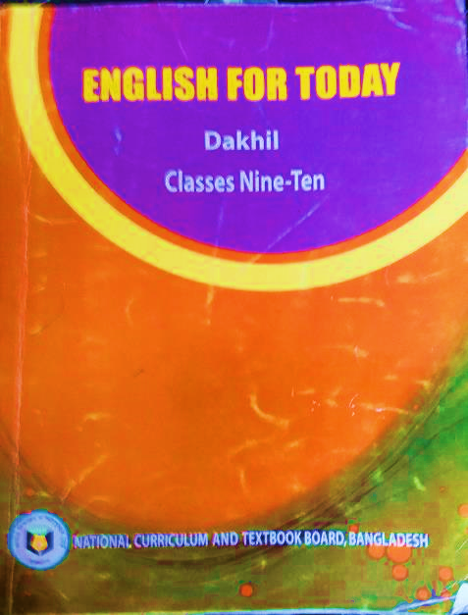
Class : Nine / Ten
Subject English 1st Paper
Unit : Three (Events and festivals)
Lesson : Five
Title :Independence Day

Slide 4
Look at the picture and say-
Q. What can you see in the picture?
Q. Where is it?
Q. Why was it built?

Slide 5
Our Today’s Lesson is
Independence Day

Slide 6
By the end of the lesson students will be able to-
talk about events and festivals
know new words in the sentences.
Ask and answer questions.
Write about personal experience what Independence Day is.

Slide 7
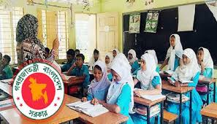
Read with the Teacher.
26 March, our Independence Day, is the biggest state Festival. The day is celebrate every year in the country with great enthusiasm and fervour. It is national……….

Slide 8
How to celebrate our Independence Day
1. The day begins with a 31 gun salute.
2. Early in the morning the president and the Prime Minister on behalf of the national place wreaths at the national Mausoleum at Savar.
3. The leaders, political parties, diplomats, social and cultural organisations, educational institutions and freedom fighters pay homage to the martyrs.
4. People from all walks of life also go there in rallies and processions.
5. In Bangabandhu National Stadium, school children, scouts and girl guides take part in various display.
6. Educational institution , Sport clubs , Bangla Academy, Shilpakala academy etc. holds cultural and sports functions.

Slide 9
Let’s learn some Vocabulary from the text
a) Independence (Noun)
Meaning - freedom from political control by other countries.
b) State (Noun)
Meaning - a politically organized body of people under a single government.

Slide 10
c) Diplomat (Noun):
Meaning - a person whose job is to represent his or her country in a foreign country.
d) Festival (Noun)
Meaning - Joyful celebration.
E) Celebrate (V)
Meaning- to show that a day or an event is important by doing something on it.

Slide 11
Silent reading

Slide 12
Individual Work
Match the words with their meanings.
Fervour Alike Spectator Displays Illuminates | acts of performing skills To light up In a similar way a strong feeling of excitement a person who is watching an event.

Slide 13
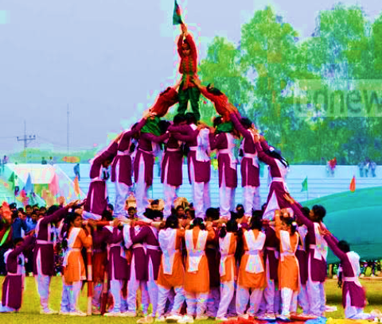
Let’s We see some pictures.
Pictures of Display

Slide 14
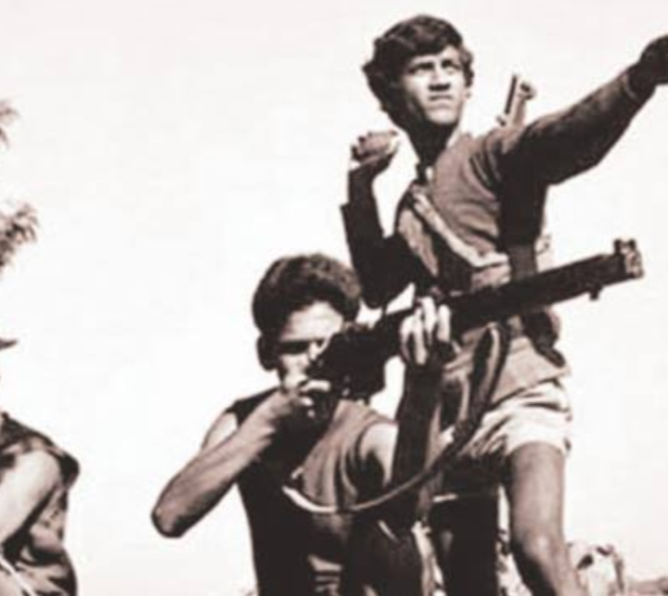
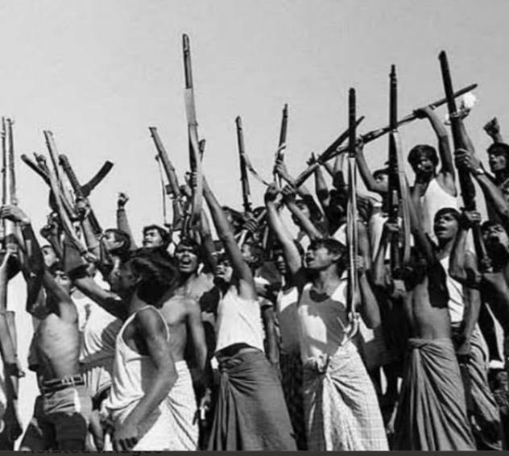
Our Freedomfighter

Slide 15
Evaluation
Choose the best answer.
1
Our state festival is--------------
a) Victory Day b) Shaheed Day
c) Pahela Baishakh. d ) Independence Day
Ans: d ) Independence Day
2
The National Memorial is ----------
a) In Naril b)At Ramana Park.
c) At Savar. d) Near Dhaka Medical College
Ans: c)At Savar.

Slide 16
3
On Independence Day the National Parade is held------
a) at the National Parade ground. b) In the streets
c) In the decorated vehicles. d) In Dhaka
Ans: a) At the National Parade ground..
4
The celebration of Independence Day begins with-----------
Procession b) Placing wreaths at the National Memorial.
c) gunshot d ) the display of parades by defense forces.
b) gunshots.

Slide 17
Pair Work
Q. Why do we observe 26 March ?
Ans: We observe 26 March to commemorate our country’s declaration of Independence from Pakistan in 1971.
Q. Where is National Parade Ground?
Ans: The National Parade Ground is near the National Parliament

Slide 18
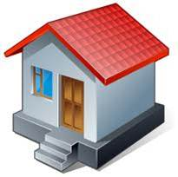
Home Work
Suppose, you have recently joined a rally of Independence Day in your madrasah.
Now write about your experience in your own words about the Day.

Slide 20
Allah Hafez

