Slide 1
Welcome to my class.
Welcome to my class.

Slide 2
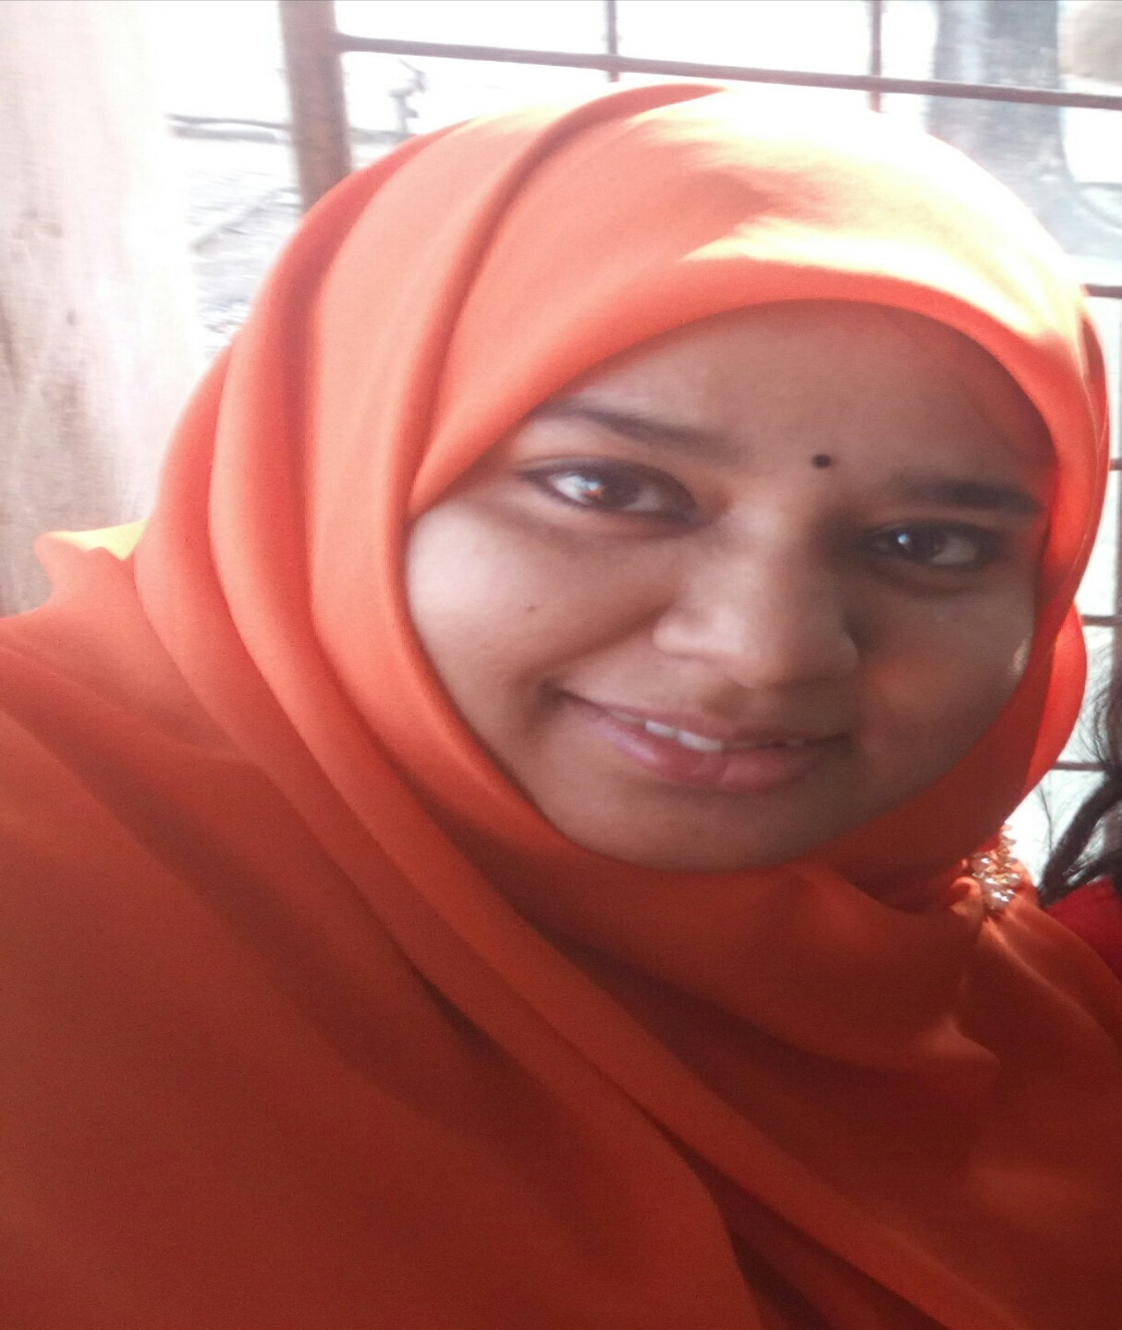
Teacher’s information
Syeda Nusrat Sarmin
Assistant Teacher
Ayjuddin Matubbor Kandi GPS
Faridpur Sadar, Faridpur

Slide 3
Lesson’s information
Class : Five
Subject : English
Unit : 17
Lesson : 1-2
Activity : D & E
Page : 67

Slide 4
Learning outcomes
By the end of the lesson the students will be able to
Listening:
1.4.1 recognize and use intonation patterns for Yes/No and Wh questions.
3.2.1 understand questions about family and friends of students.
3.3.1 understand questions about objects around them.
3.4.1 understand statements made by the teacher and students.
Speaking:
1.1.1 say words, phrases and sentences with proper sounds, stress.
3.1.1 ask and answer Wh questions.
6.2.1 talk about people, objects, events etc.
8.1.1 take part in conversations on appropriate topics.
Reading:
1.7.1 read words, phrases and sentences in the text with proper pronunciation, stress and intonation .
1.7.1 read paragraphs, dialogues, stories, letters and other texts.
5.1.3 read silently with understanding dialogues.

Slide 5
Teaching aids :
Pictures of cricket, cycling, football.
Word cards
Poster paper
Slide
CD drive/ audio

Slide 6
Answer the following questions.
1. Which games and sports does Arousha play or do?
Answer: Arousha plays badminton. She also does swimming and cycling.
2. Which games and sports does Baichong play or do?
Answer: Baichong plays cricket. He also does weightlifting.

Slide 7
Look at the pictures.

Slide 8
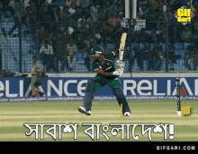
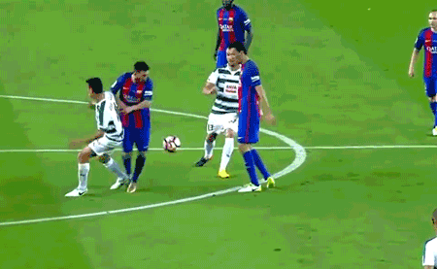
Cricket
Football
Cycling
What do you see in these pictures?
These are very popular sports.

Slide 9
Our today’s lesson is
Sport
Unit: 17, Lesson: 3-4, Activity: D&E;
Page: 67

Slide 10
WCW
Look at the conversation, listen it carefully.

Slide 11
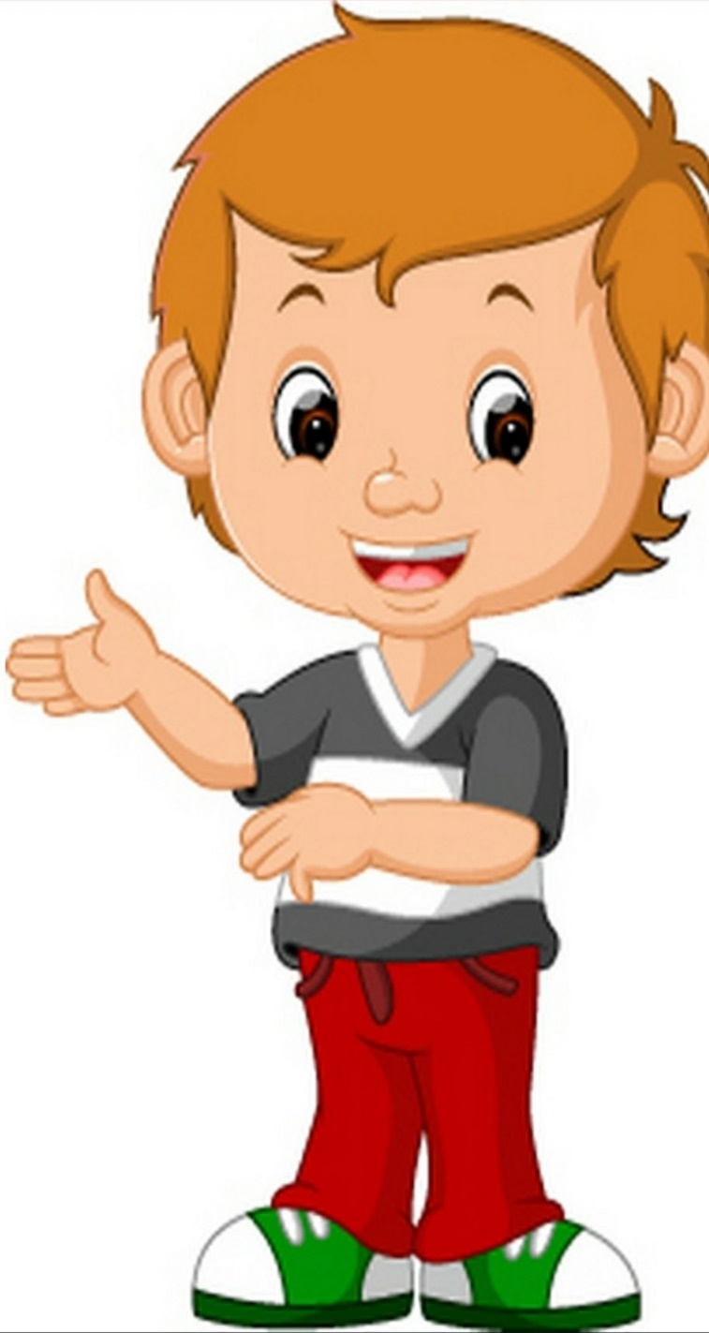
Listen and say.
Do you play or do any sports?
I play cricket, and I do weightlifting.
I love football too, but not as much as cricket. That’s my favourite sport.
I’d like to try kabadi. I’d also like to learn how to play volleyball.
Not very, but I want to get stronger. My brother is very strong.
WCW
Weightlifting! Are you strong?
Volleyball is exciting but I like playing football more.
My brother is strong, too. He plays kabadi and volleyball. He’s good at sports.
I love badminton. I play with my family on weekends. I also go swimming and cycling a lot.
Baichong
Anousha
Baichong
Anousha

Slide 12
Open your EFT book at page 66, read and act the activity B with your pair.

Slide 14
Pair Work.
PW > IW
Act the activity B with your pair.

Slide 17
Now look at your EFT book at page 67, read the activity E and F.

Slide 19
IW

Slide 21
PW > IW
E. Pairwork. Ask and answer the questions.
1. What games or sports do you like?
2. How often do you play or watch the sport?
3. When do you play or watch it?
4. Who do you play or watch the sport with?

Slide 22
What games or sports do you like?
Answer: I Like cricket most.
2. How often do you play or watch the sport?
Answer: I often play it every Friday.
Or, I often watch cricket on sports channel on Friday.
3. When do you play or watch it?
Answer: I play cricket in the afternoon.
Or, I watch cricket on the T.V in the afternoon.
4. Who do you play or watch the sport with?
Answer: I play the sport with my friends.
Or, I watch the sport on TV with my younger brother Sabit.

Slide 23
SGW
Re-arrange the words
1. abadik
- kabadi
2. ketcric
- cricket
3. ballvolley
- volleyball

Slide 24
Evaluation
Write ‘True’ for correct statement or ‘False’ for incorrect statement.
False
Baichong plays kabadi and volleyball.
Baichong’s sister is expert in sport.
Baichong likes to learn how to ride bicycle.
Anousha knows how to swim.
Both Anousha and Baichong like football.
False
False
True
True

Slide 25
Home work
Answer the questions.
What games or sports do you like?
How often do you play or watch that sport?
When do you play or watch it?
Who do you play or watch the sport with?

Slide 26
Look before you leap .
Good bye, dear students.

