Slide 1
Welcome

Slide 2
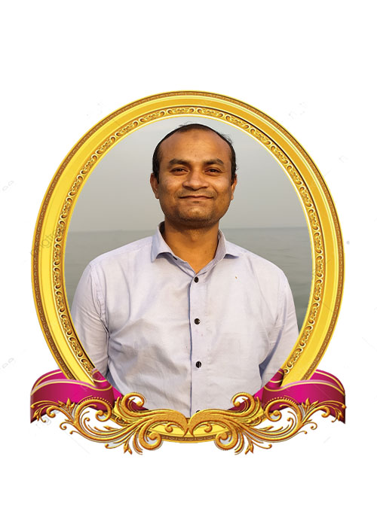
TEACHER’S IDENTITY
Kishore Chakraborty
Assistant Teacher
Madhya Farhad GPS
Feni Sadar, Feni

Slide 3
Class Information
Class: 3
Subject: English
Unit: 1
LESSON: INTODUCING MYSELF

Slide 4
Learning outcomes
udent will be able to
1. say English sound , stress, word, sentence differences in the context of words.
2. word phrase sentence with proper sound stressed introducing Yourself.
words with initial sound,final sound, match word/table etc.
4. write a words ,sentence making ,introducing your self,passage etc.
.

Slide 5
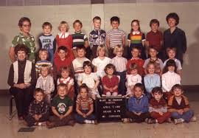

Slide 6
LESSON HEAD LINE
A Student

Slide 8
I`m Riya.

Slide 9
I`m 8 years old.

Slide 10
I`m a student.

Slide 11
I`m in class three.

Slide 12
I study at Gazipur government. primary school.

Slide 13
EVALUATION

Slide 14
How old is Riya?
Riya is 8 years old.

Slide 15
What does she do?
She is a student.

Slide 16
She is in class three.
What class she is in?

Slide 17
What does school does she study in?
She study at Gazipur government primary school.

Slide 18
Pair work
names
age
occupation
classes
Place of study
Hello, I`m -------------------------------.
I `m old---------------------- years old.
I`m a -----------------------------------.
I`m in class----------------------------
I study at------------------------------.

Slide 19
Match the answer
Hello, I`m ----- .
I`m--- years old.
I`m a ------------.
I`m in class----.
I study at---.
Mina
8
student
3
Sreepur govt, primary school

Slide 20
Write 5 sentences about your self.
HOME WORK

Slide 21
GOOD BYE

