Slide 1

Welcome

Slide 2
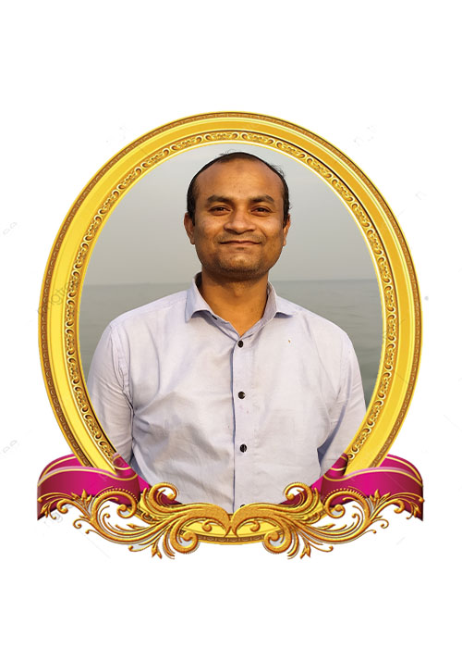
TEACHER’S IDENTITY
Kishore Chakraborty
Assistant Teacher
Madhya Farhad GPS
Feni Sadar, Feni

Slide 3
Class Information
Class: 3
Subject: English
Unit: 4
LESSON 1 - 2
LESSON PART - NUMBERS

Slide 4
Learning outcomes
student will be able to
1. to recognize and read cardinal
numbers up to 5 .
2. to write cardinal number up to 5.
.

Slide 5
Create Emotion

Slide 6
Lesson Declaration
Numbers

Slide 7
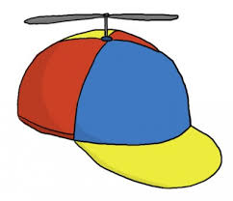
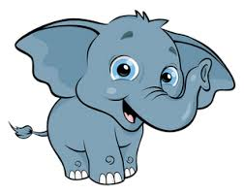
1
2
One
Two

Slide 8
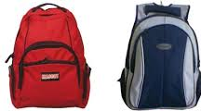

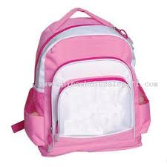
3
4
Four
Three

Slide 9

5
Five

Slide 10
Teacher’s Explanation
1
One
2
Two
3
Three
4
Four
5
Five

Slide 11
5
4
1
Numbers
3
2

Slide 12


Slide 13
Group Work
I will divided all the students in
three groups.
Rose
  1,2,3,4,5 .
  (By word cards)
Lily
  Write the missing numbers
  1 _____3_____5
2
4
Jui
  Write the missing numbers in word
  One_____ three_____ _____
two
four
five

Slide 14
Evaluation
Count and write the numbers.
1
4
5

Slide 15
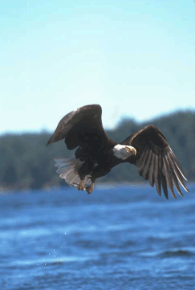
Thank you

