Slide 2
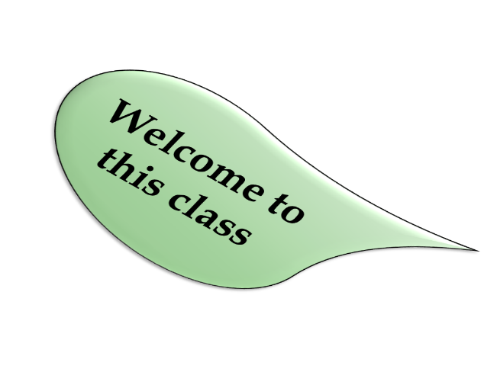
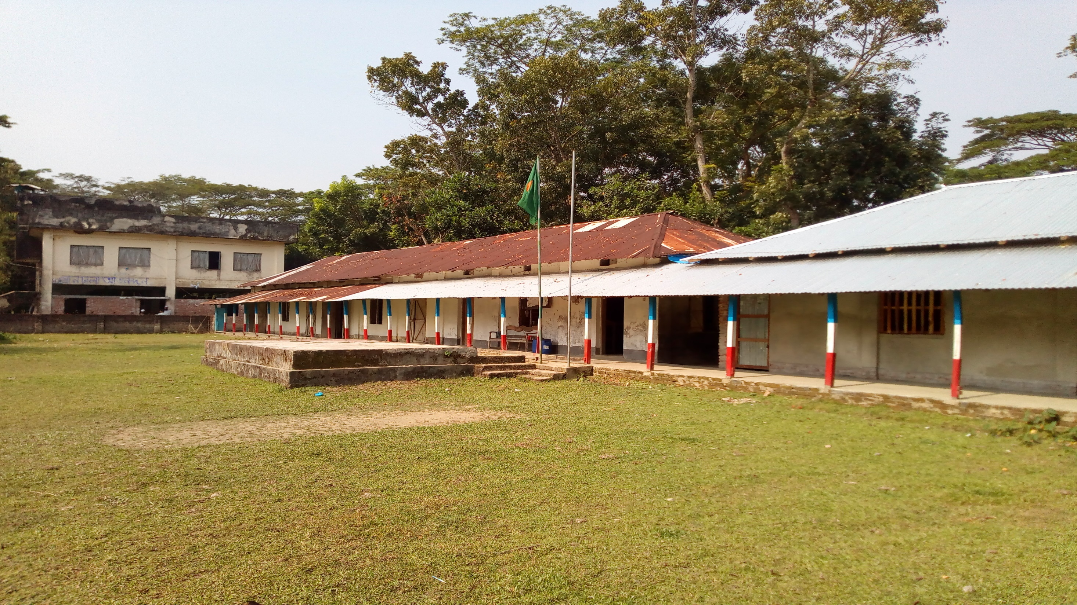
Welcome
TO
OUR
ONLINE CLASS
The best teacher in the earth

Slide 3
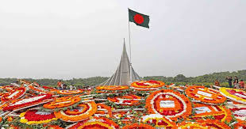
Welcome
TO
Our Multimedia CLASS
Notes:
Welcome slide. This picture is related to the topic. So I have chosen it. Teacher may change it if he wants.

Slide 4
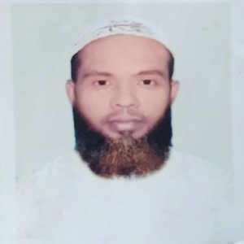
teacher IDENTITY
Muhammad Ahsan Habib
Assistant Teacher
Mohsenuddin Nuria Fazil (Degree) Madrasah
Bauphal, Patuakhali
Mobile-01754755169
E-mail- ahsanhabib251281@gmail.com

Slide 5
Introduction of lesson
Class- Nine & Ten
Subject –English 1st paper
Unit: 3 Lesson: 5
(Independence Day )

Slide 6
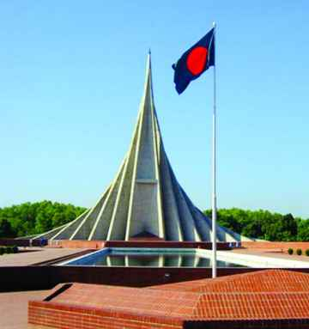
1.What can you see in the picture?
2. Where is it?
3. Why was it built?

Slide 7
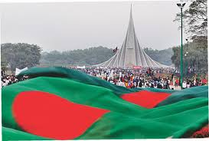
1.The picture is the National Mausoleum?
2.The National Mausoleum is at Saver?
3.It is built Because respect to Freedom Fighters.

Slide 8
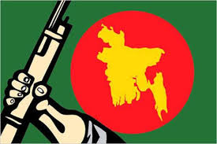
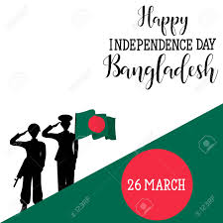
Today’s lesson……
Independence Day

Slide 9
Learning outcomes
After this lesson the students will be able to---
read and understand texts through silent reading.
Talk about events and festivels .
ask and answer questions .
Writing a Paragraph.
Notes:
All the four skills will be focused in this lesson.

Slide 10
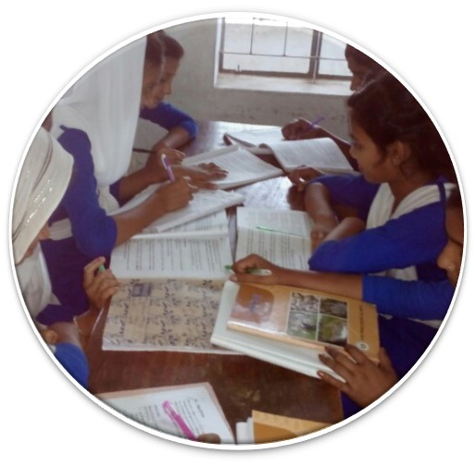
Read
the text
silently
and
carefully
Unit-Three
Lesson-5
Page-36

Slide 11
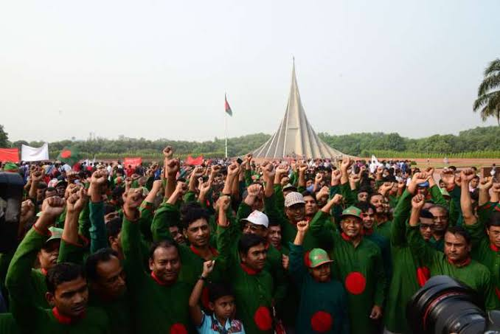
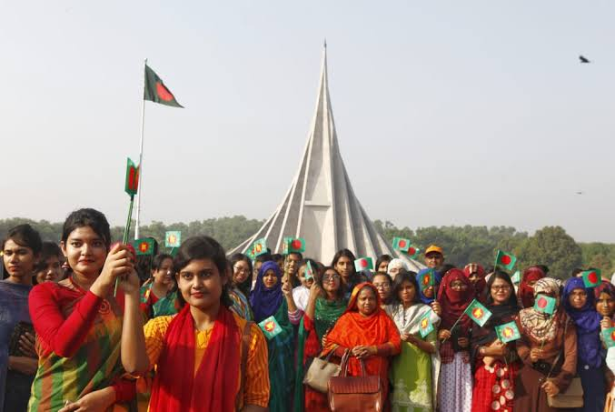
26 March, our Independence Day, is the biggest state festival. The day is celebrated every year in the country with great enthusiasm and fervor.
It is a national holyday. All offices, educational institutions, shops and factories remain closed on this day.

Slide 12
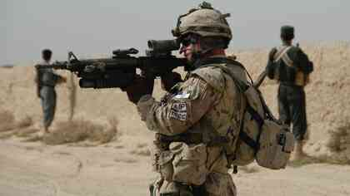
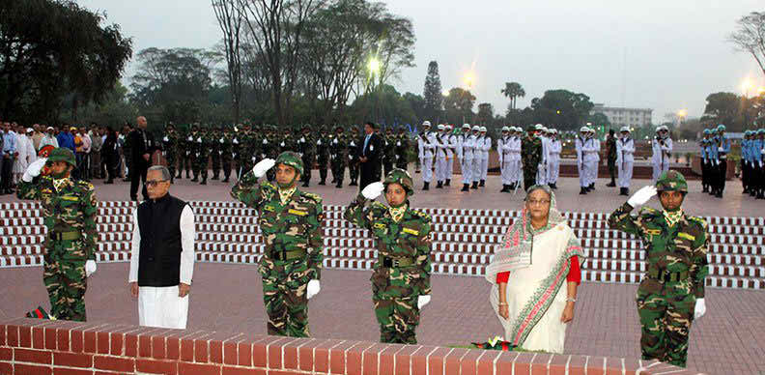
The day begins at 31 gun shots.
Early in the morning the president and the prime minister on behalf of the nation place floral wreath at the at the national mausoleum at savar.

Slide 13
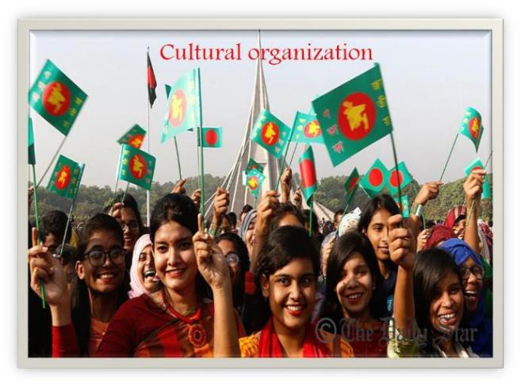
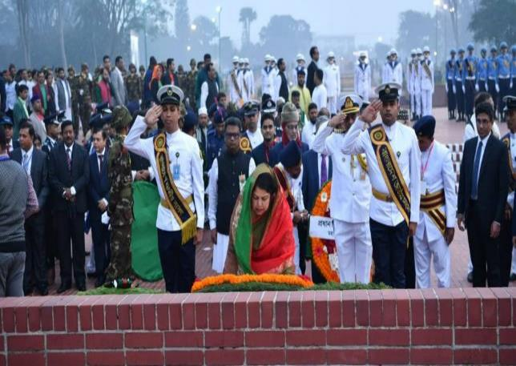
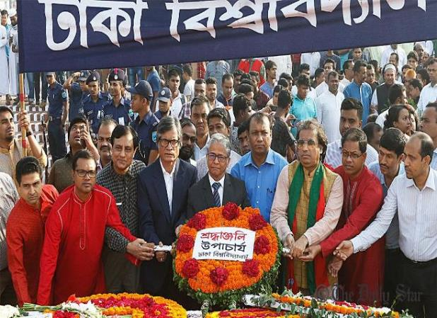
Then other leaders, political parties, diplomats, social and cultural organizations, educational institutions, and freedom fighters pay homage to the martyrs. People from all walks of life also go there in rallies and processions.
There are many cultural programs throughout the day, highlighting the heroic struggle and sacrifice in 1971.

Slide 14
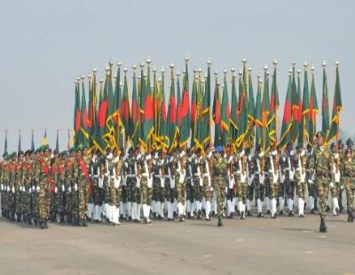
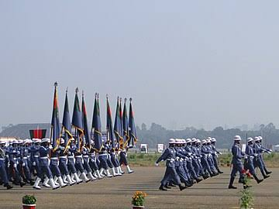
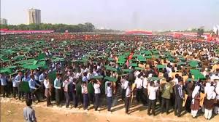
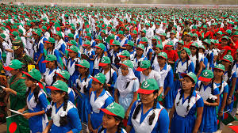
The country also witness a spectacular parade of defense forces, border guards, police, ansars and the VDP (Village Defense Party) at the National Parade Ground near the National Parliament. In Bangabandhu National Stadium, School children, scouts and girl guides take part in various displays to entertain thousand of spectators.

Slide 15
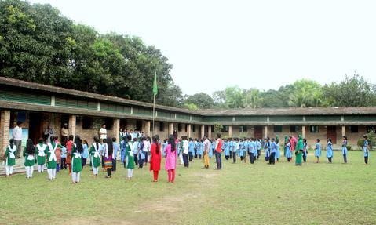
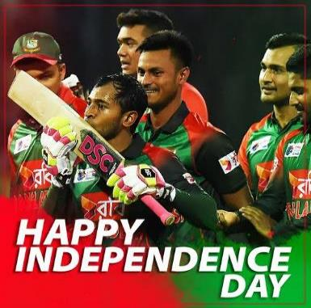
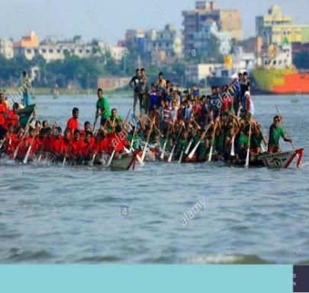
Educational institutions also organize their individual programs. Sports meets and tournaments are also organized on the day, including the exciting boat race in the river Buriganga
In the evening, all major public buildings are illuminated with colorful lights. Bangla Academy, Bangladesh Shilpakala Academy and other socio-cultural organizations hold cultural functions are also arranged in other places in the country.

Slide 16
Individual works.
Ask and answer the Qquestions
1.Which day is independence Day?
2.Why do we observe the Day?
3.Which organisations arrange cultural functions?

Slide 17
Solution:
1. Independence Day is 26 March.
2. We observe the Day begins at national Memorial give the flower.
3. Diplomats,political parties,social and cultural organigations, educational institutions also organize their individual programmes.

Slide 18
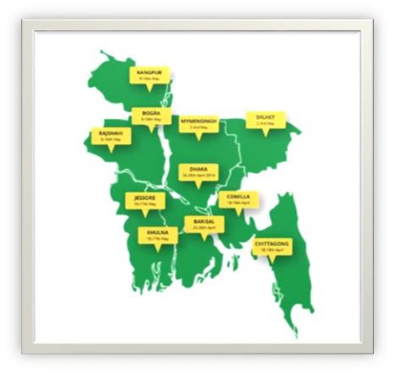
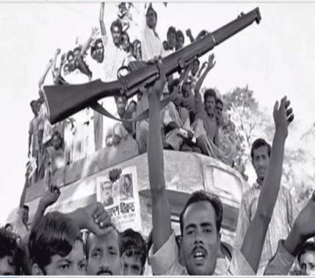
What do you see in this picture
Excitement of independence
Map of independent Bangladesh

Slide 19
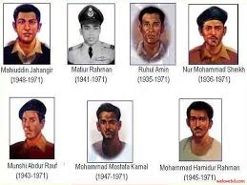

Slide 20
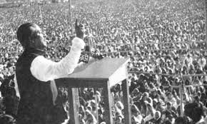
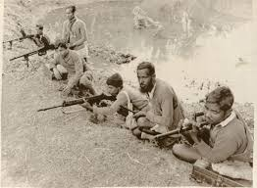
Look at the pictures
The speech of Shiekh Muzibur Rahman
Freedom Fighters

Slide 21
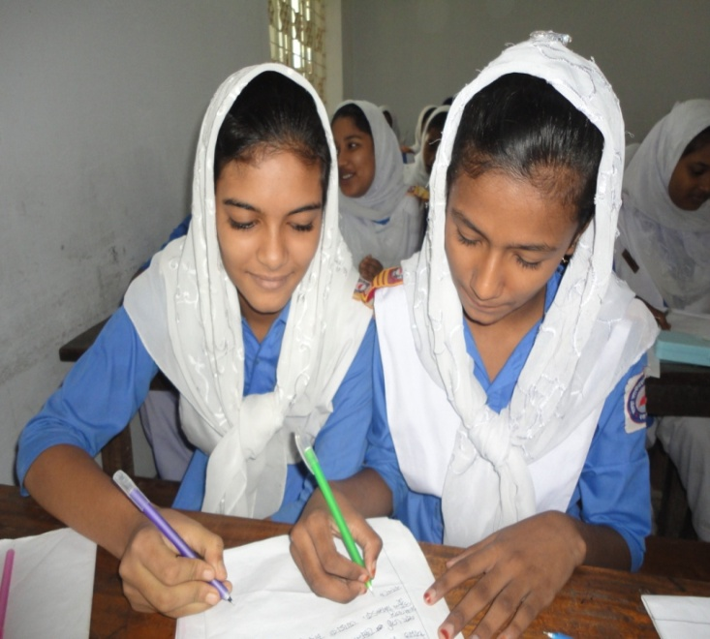
Pair Work
Answer the following questions
How do we pay homage to the martyrs?
2. Which leading organizations of our country organize
cultural programmers' on this day?

Slide 22
Now match your answer Pair Work
We pay homage to the martyrs by placing floral wreaths at the National Mausoleum at Savar.
2. Bangla Academy and Bangladesh shilpakala Academy organize cultural programmes on this day.

Slide 23
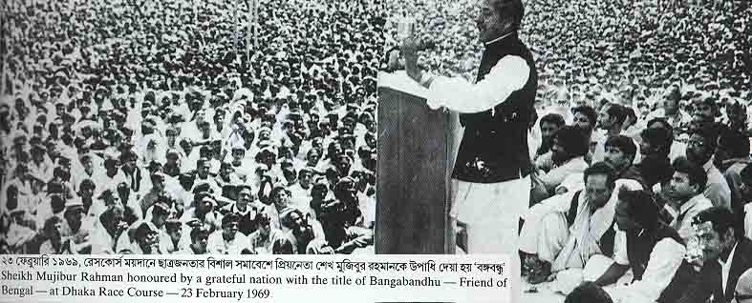
Key Word
announcement
declaration
Sheikh Mujib made the declaration of our independence.

Slide 24
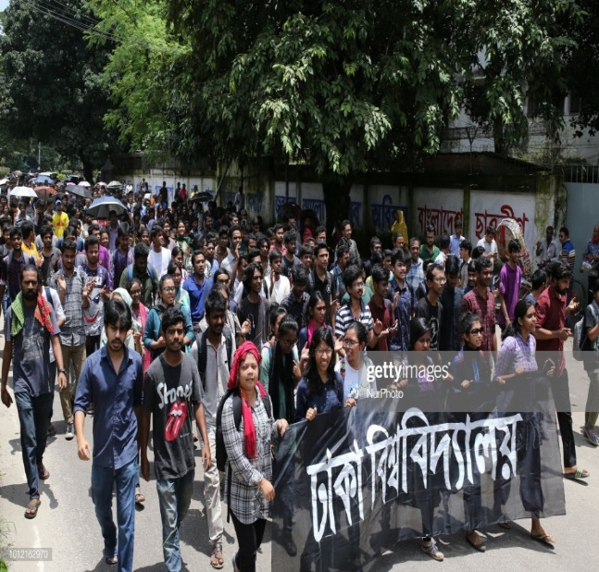
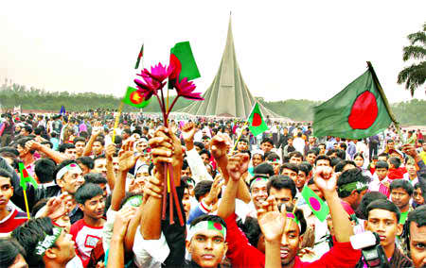
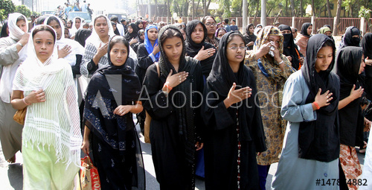
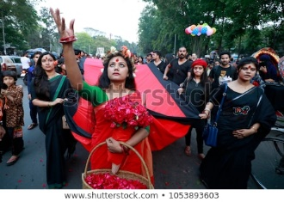
Key Word
Procession
The group of action of a collection of people
noun
People come to National Memorial in procession.

Slide 25
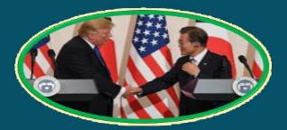
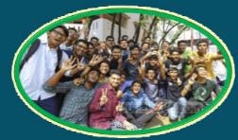
Key Word
Diplomate
government representative abroad
A Korean diplomate is meeting with Trump
Enthusiasm
excited
The students enjoy the result with enthusiasm

Slide 26
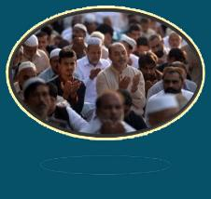
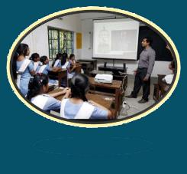
Key Word
very strong feelings about something
Fervour
Eid ul Azha to be celebrated with religious fervour
Illuminate
light up
Education illuminates our life

Slide 27
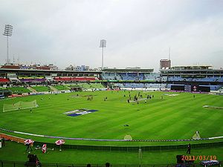
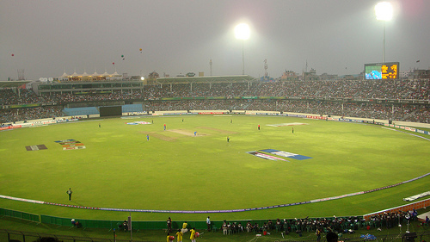
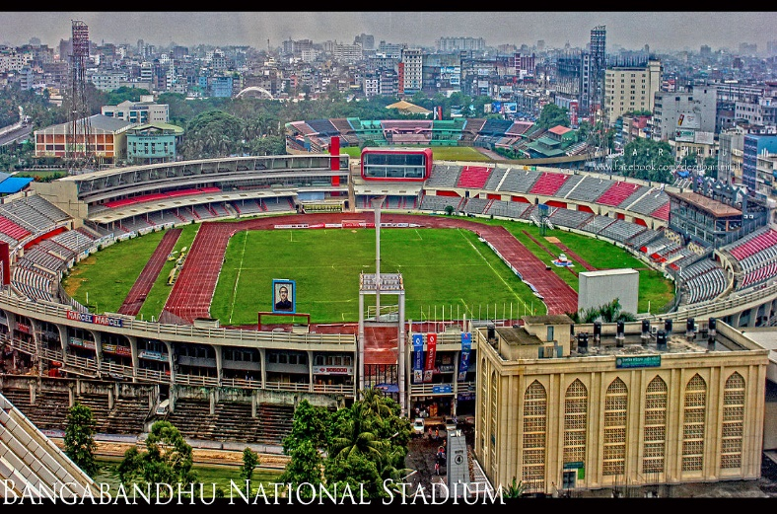
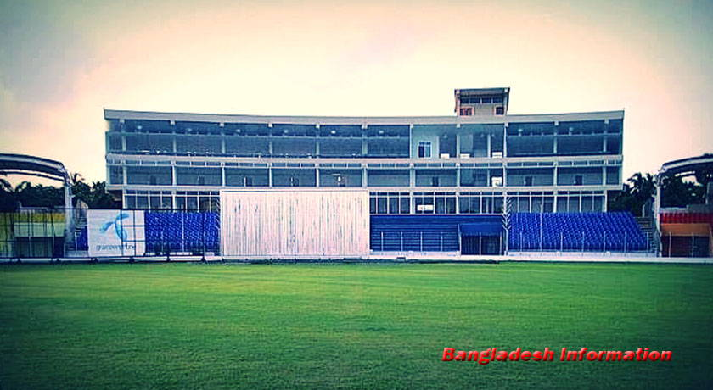
Key Word
A large structure for open air sports
Stadium
noun
Various games and sports are taken place in the stadium.

Slide 28
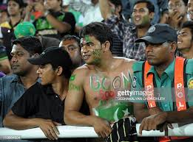
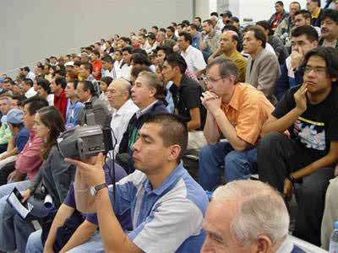
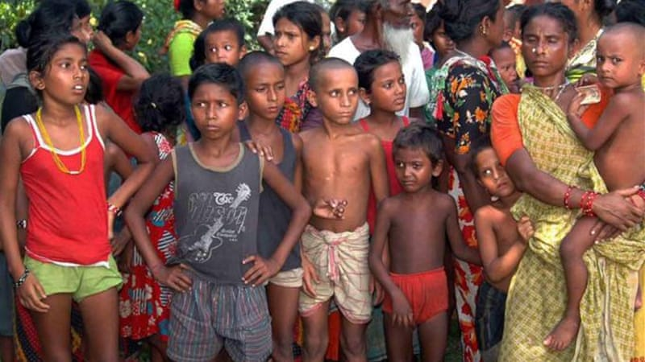
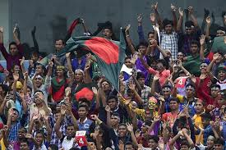
Key Word
Someone who looks at something
Spectator
noun
Many spectator were present in the stadium.

Slide 29
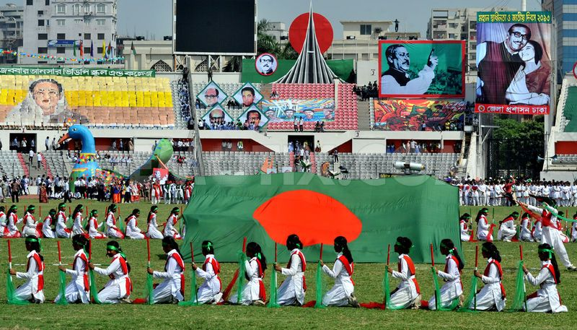
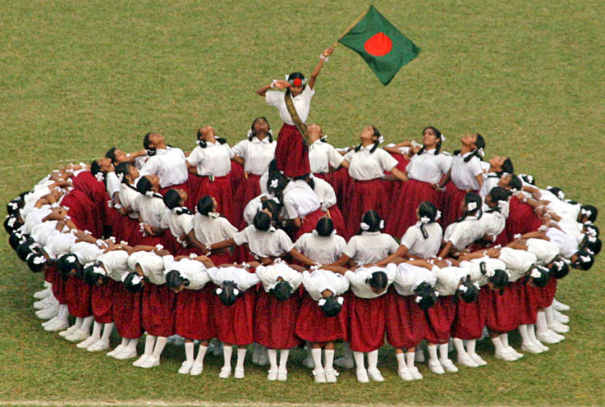
Key Word
Display
To show
VERB
The girls are displaying their performance.

Slide 30
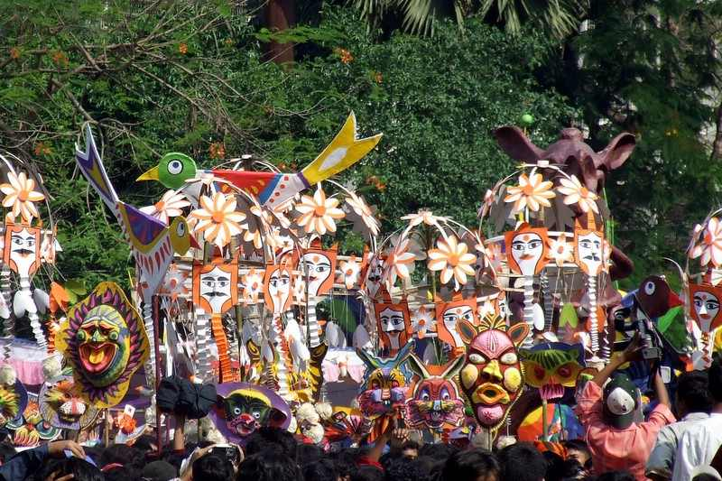
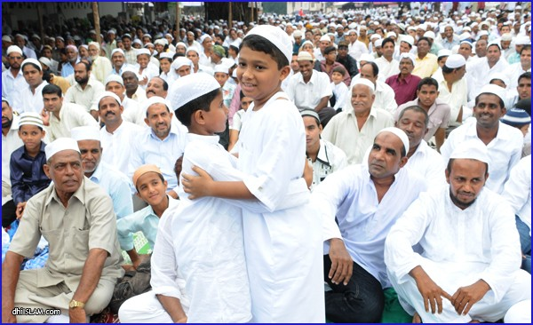
Key Word
A day or period of time arranging for function
Festival
noun
Eid Is a big Festival for Muslims

Slide 31
Group Work
Discuss in a group and answer the following questions.
Q 1. How do you observed the day at first?
Q 2. 2.What happened the day?

Slide 32
Answer Group Work
1. We observed the day at first with the students and teachers give the flower at the National Mausoleum to Freedom Fighters.
2. The day begins with 31 gunshots.Early in the morning the president and the Prim Minister on behalf of the nation places floral wreaths at the National Mausoleum at Saver.In Bangabandhu stadium, school children,scouts and girl guides take part in various displays to entertain thousands of spectators.

Slide 33
Evaluation:
1. Our biggest festival is-------------
a. Victory day Day b. Independence Day c. Shaheed Dibosh
2. The celebreation of Independence Day begins with----------
a. Gunshots b. Processions c. placing wreaths at the national Memorial.
3. On Independence Day a National Parade is held-------------
a. At the National Parade Ground. B. At the Mirpur Stadium
c. In Bangabandhu Stadium.

Slide 34
Home Work
Write a paragraph On “Independence Day”.
Notes:
This is a creative work that the students will perform at home to show the teacher in the nest class.

Slide 35
THANK YOU FOR
YOUR ATTENTION
GOOD BYE
(May allah bless you)

