Slide 1
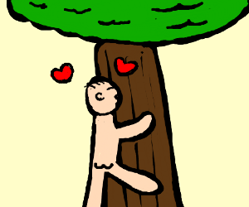
Talk about the picture and read the story

Slide 2
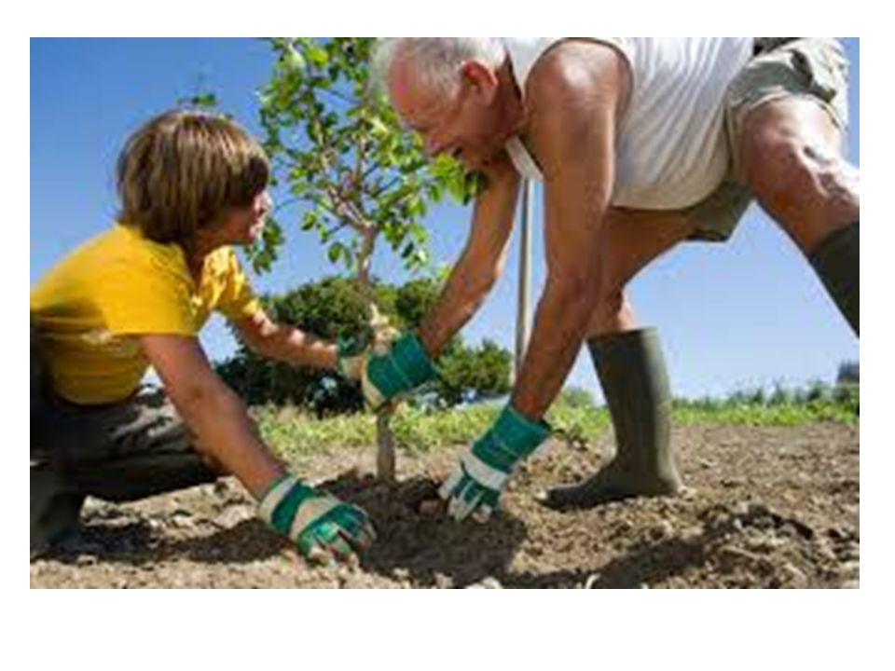

Slide 3
A MAN WHO LOVES TREE

Slide 4
UNIT 5 LESSON -4

Slide 5
KEY-WORD Profession passion mission gigantic

Slide 6
Read the text again and answer the following question 1.who is Kartik poramanik ? 2.How do you understand that he is a nature lover ? 3.Why did he plant trees ?

Slide 7
Home-work Write about a person in your locality who loves nature.

