Slide 1
Welcome
My dear students

Slide 2
Myself
Md Abdul Awal
Ast Teacher
Nuton Bazar dakhil Madrasha
Jatua,Chhatak,Sunamgonj
Mobile :01773682432
abdulawal2479@gmail.com

Slide 3
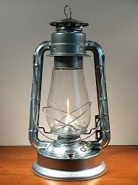
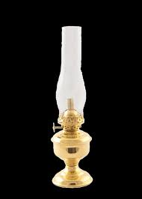
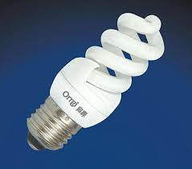
Look, discuss and write their names
Hurricane lamp
Electric bulb
Candle light
Table lamp
Energy saver bulb
Tube light

Slide 4
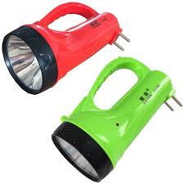
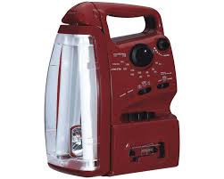
Head light
Stage light
Search light
Charge light
Oil lamp
Gas light

Slide 5
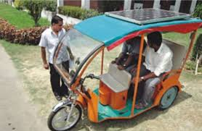
Watch & tell
Rechargeable auto rickshaw

Slide 8
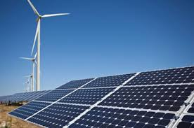
Our todays’ lesson is
Renewable Energy Sources -1

Slide 9
English for today
Unite -11
Lesson – 01
Page no. 158
Class Ten
Tot ss:50
Date:05/10/2019

Slide 10
Learning outcomes
At the end of the lesson you will be able to….
Describe familiar objects
Participate in conversation
Write formal letters

Slide 11
Model reading
Please open your book EFT, page 159

Slide 12
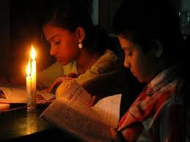
Load Shedding

Slide 13
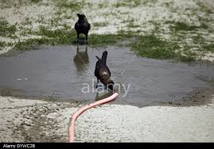
A hot summer day

Slide 14
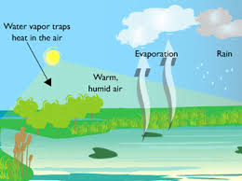
Word meaning
Sticky
Gummy
It is sticky hot night
Humidity
Damp
There is 90% of humidity in the atmosphere

Slide 15
Load shedding
Power cut
Candle light is used when there is load-shedding.
Splash
plash
We splash cold water on our faces

Slide 16
Individual Work
Answer the following questions
a) How was the summer night ?
b) How is a summer day ?
c)What happens during load shedding ?

Slide 17
Pair Work
Complete the columns
A Electricity | B Demand | C Supply | D Deficit
Nation wide
Rural area
Capital city

Slide 18
Pair Work
Answers of the columns
A Electricity | B Demand | C Supply | D Deficit
Nation wide | 6,000 MW | 4,200 MW | 1,800 MW
Rural area | 2,400 MW | 1,200 MW | 1,200 MW
Capital city | 1,400 MW | 650 MW | 750 MW

Slide 19
Complete the dialogue using the information from the table
Group Work
A
Exercise D- 1
Group Work
B
Exercise D-2

Slide 20
Answer
A
X – What’s the rural area’s demand of electricity ?
Y - It’s…about 4,800 MW.
X - How much can the R E B….supply ?
Y - They…can supply only 1,200 MW .
X - How much is the deficit ?
Y - Well,…it’s about 2,400 MW per day .

Slide 21
Answer
B
X – What’s the capital city’s…demand for electricity per day ?
Y – It’s …about 1,400 MW per day .
X – How much can the authority supply ?
Y – They can supply650 MW per day .
X – How much is the deficit ?
Y – Well, it’s almost 750 MW per day.

Slide 22
Evaluation
List of the problems caused by load shedding
In the city | Outside the city
1. Water supply is hampered .
2. Official work and business are stopped
3. CNG can not be refueled
4. Study is hampered
5. Industries stop production
6. Patients suffer much
7. Criminal activities happen.
Irrigation is hampered .
Students also suffer .
Criminal activities increase .
Rice mills and cold stores stop .

Slide 23
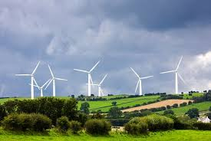
Home Work
Write a letter to an editor of a national daily expressing the sufferings of the people caused by load shedding in your locality

Slide 24
This is all for today
Thank you very much

Slide 25
Good bye students

