Slide 1
WELCOME TO
FULGAON ONLINE
PRIMARY SCHOOL

Slide 2
TEACHER INTRODUCE
AYESHA SIDDIQUA HEAD TEACHER RAMPUR GPS LAKSAM,CUMILLA
asiddiqua1912@gmail.com

Slide 3
Lesson introduce
Class :4
Sub : English
Topics :page-9 U-4-3,4 PARTS OF SPEECH (part-2)
Time : 20 minutes
Notes:
Lesson introduce

Slide 4
Learning Outcomes
The end of the lesson the students will be able to...
Listening 3.4.1 understand statements made by the teacher and students.
Speaking 6.2.1 talk about people, objects, events etc.
Reading 1.4.1 read words, phrases and sentences in the text.
Writing 9.1.1 take dictation of words, phrases and sentences.

Slide 5
Let`s enjoy a video song
https://www.youtube.com/watch?v=c3yJhw7R3fI
What can you see in the video?

Slide 6
Parts of speech
NOUN
ADVERB
PRONOUN
PREPOSITION
VERB
CONJUNCTION
INTERJECTION
ADJECTIVE

Slide 7
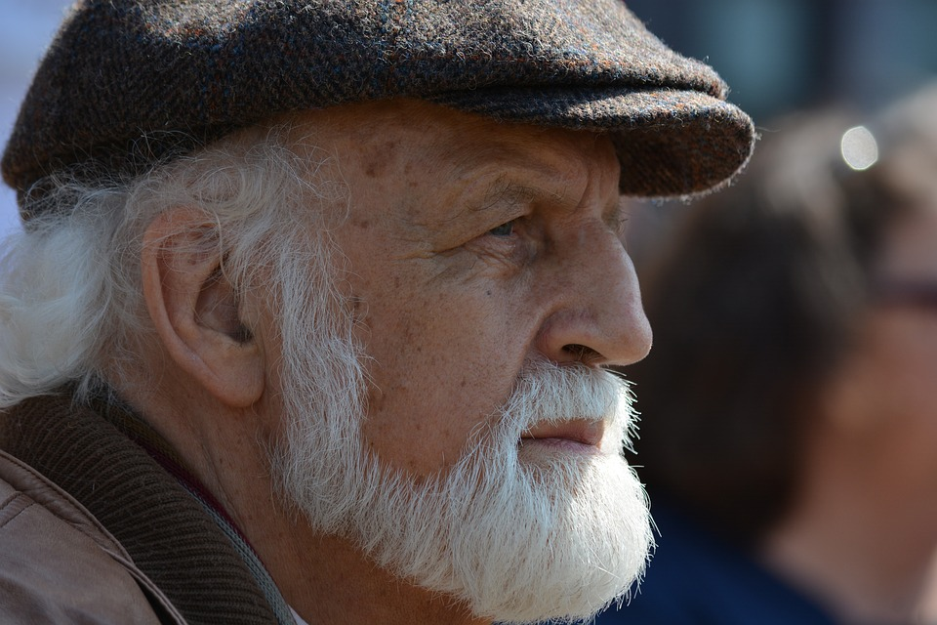
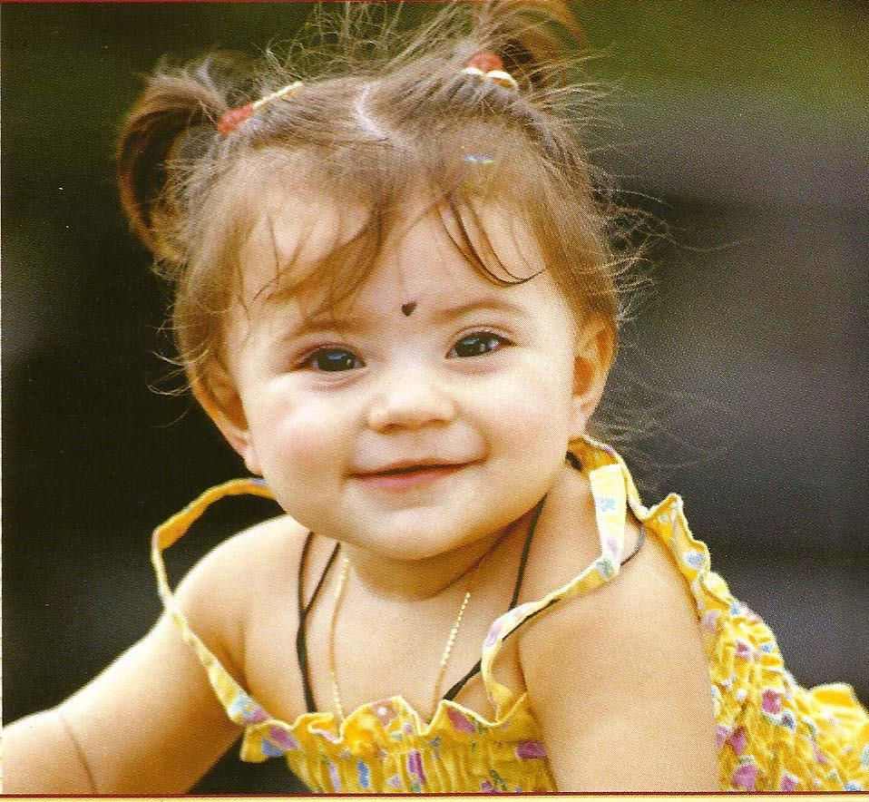
Red rose
Old man
Poor man
ADJECTIVE/বিশেষণ
Five books
Nice baby

Slide 8
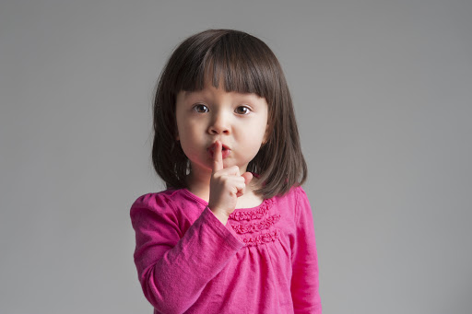
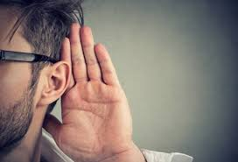
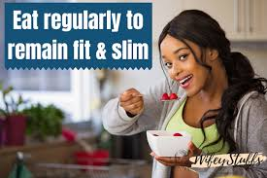
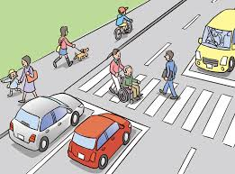
Talk quietly
Talk politely
Speak loudly
ADVERB
/ক্রিয়া বিশেষণ/
বিশেষণের বিশেষণ
Eat regularly
Cross carefully

Slide 9
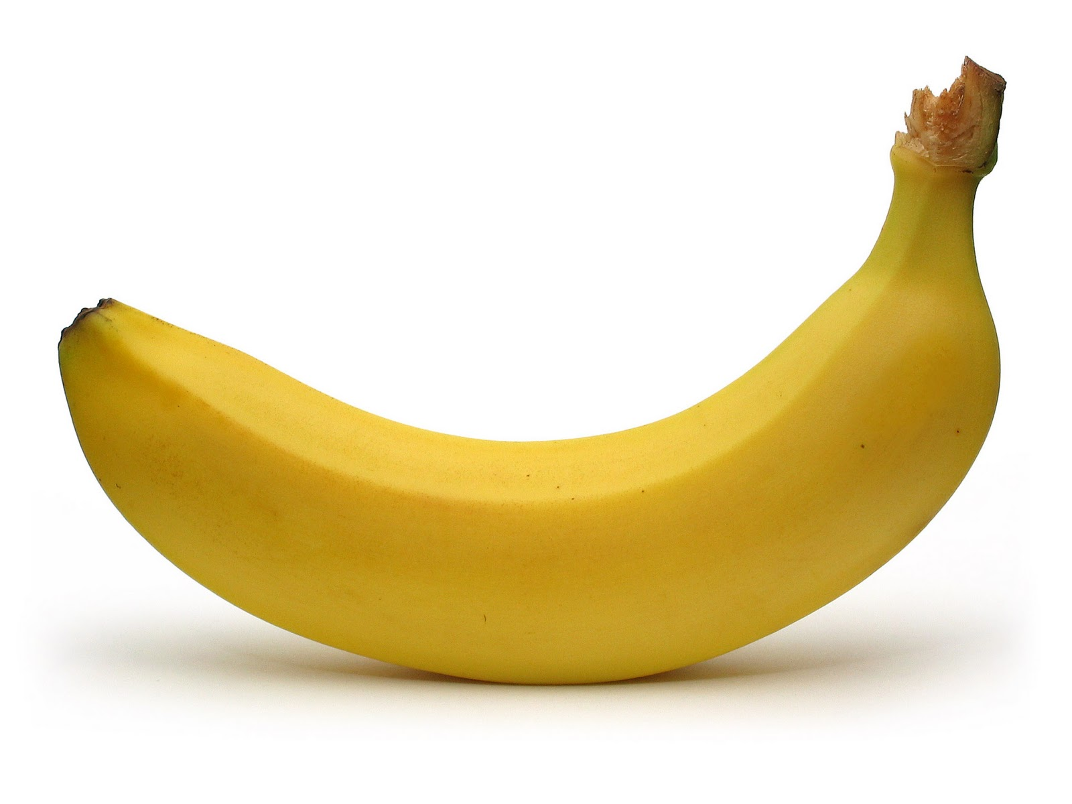
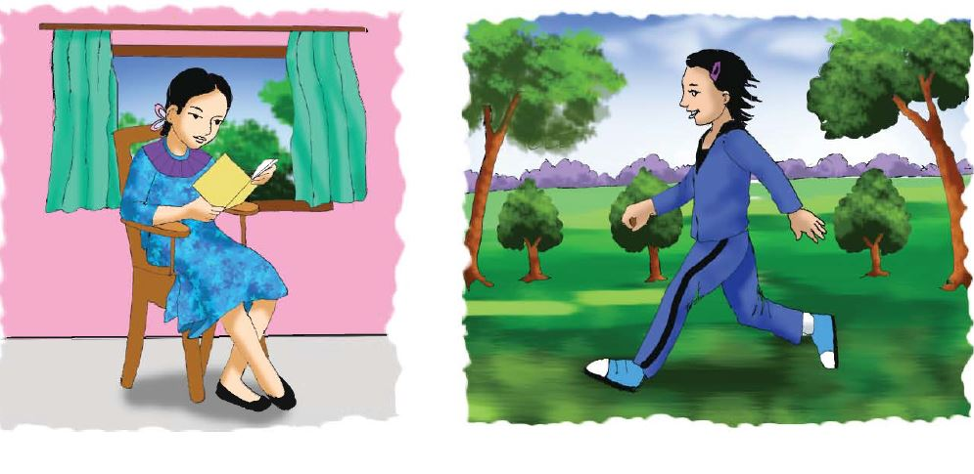
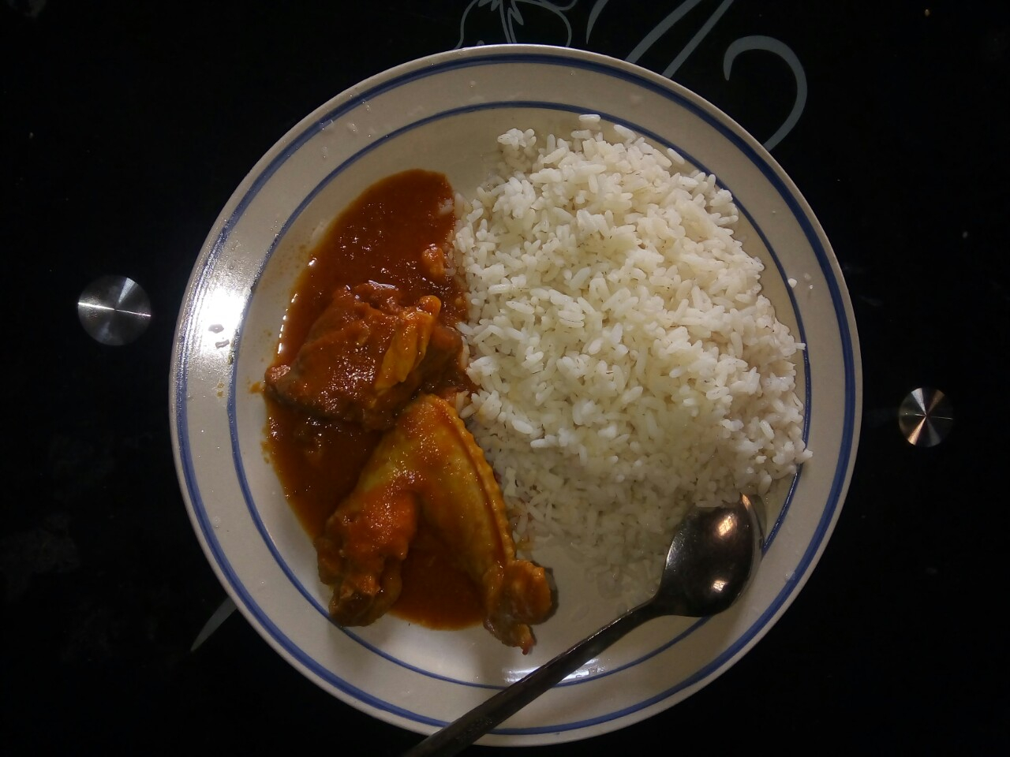
CONJUNCTION/সংযোজক অব্যয়
Take the mango or the banana.
Laila and Bithi are friends, but they are very different.
Rice and chicken

Slide 10
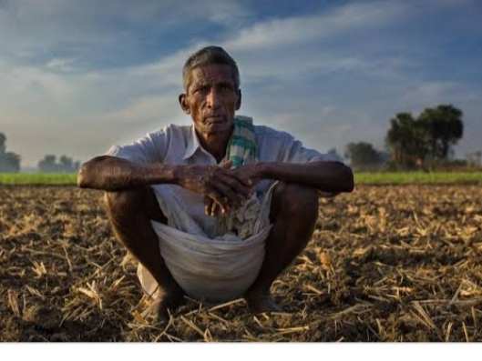
Hurrah! I have got A+.
INTERJECTION/
আবেগসূচক অব্যয়
Alas! I have lost my crop.

Slide 11
Adjective
যে word দ্বারা nounএর- দোষ.গুণ, অবস্থা, সংখ্যা, পরিমাণ ইত্যাদি বোঝায় তাকে Adjective বলে Noun modifier. Such as- honest, good, nice, sorry,
beautiful, useful etc.
Titu is an honest boy.
He talks to us honestly.
Adverb
যে word-এ কোনো verb বা adjective-এর দোষ, গুণ,পরিমাণ, অবস্থা ইত্যাদি প্রকাশিত হয়, তাকে Adverb বলে। Describes a verb, an adjective or an adverb. Such as- after, again, before, more, never, now, always, usually, nicely etc. Most Adverbs structure as ‘Adjective + ly’.

Slide 12
(a, an, the ) Article which is considered a special type of adjective

Slide 13
I am a student and I read in class six.
Conjunction
Do or die
Conjunction
যে word অন্য দুটি word-কে বা sentence-কে যুক্ত করে, তাকে Conjunction বলে। connect word, phrases or clauses in sentences. For example- and, or, but, so, that, If, As etc.
Notes:
Presenting Conjunction.

Slide 14
Hurrah! I have got A+.
Interjection
Alas! I have lost my crop.
Interjection
যে word-এ বক্তার মনের কোনো দুঃখ, কষ্ট, আনন্দ, বেদনা, বিস্ময় ইত্যাদি প্রকাশিত হয় তাকে Interjection বলে।
Express strong emotion and is often followed by an exmlation mark(!). Hurrah! Alas! Oh! Fie! Shame!
Notes:
Presenting Interjection.

Slide 15
Parts of speech | Examples
Adjective | honest, good, nice, sorry, beautiful,old, five useful etc.
Adverb | After, Again, Before, More, Never, Now, Always, Nicely, Carefully, Politely, Quietly, Loudly, Regularly etc.
Conjunction | And, Or, But, So, That, For If, As etc.
Interjection | Ah! Congrats! Wow! Hurrah! Alas! Oh! Fie! Shame! etc.
Examples of adjective, Adverb, Conjunction,Interjection

Slide 16
Group Work
Write down five examples of-
-Adjective
-Adverb
-Conjunction
-Interjection

Slide 17
Indivisual work
Say the names of the parts of speech with the following words?
And, Alas!, Regularly, Loudly, or, but, Oops!, Nice, Nicely, Honest, Before, Wow!

Slide 18
1. Write the name of different kinds of parts of speech.
2. Write 5 examples of each parts of speech.
Home Work:

Slide 19
PARTS OF SPEECH

Slide 20
No more today.

