Slide 1
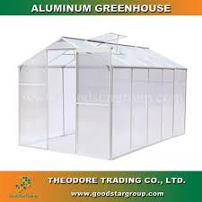
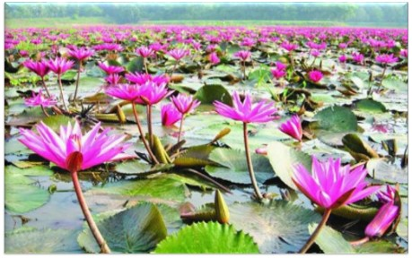
WELCOME

Slide 2

TEACHER’s IDENTIFICATION
Emdadul Haque Milon
Assistant Teacher
Sonapur Model High School
Dowarabazar,
Sunamganj

Slide 3

LESSON IDENTIFICATION
Subject: English
Class- Seven
U-9: Climate change
L- 3: The greenhouse effect
Time 45 min
ENGLISH FOR TODAY
SEVEN

Slide 4
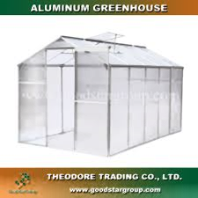
LEARNI NG OUTCOMES
After studied this lesson, students will be able to……..
defination of Green house.
2. how does it work?
3. reads and understand the texts .
4. answer the keyword meaning.
5. answer the question.

Slide 5
LOOK AT THE PICTURE
LET’S SEE A PICTURE
GREEN HOUSE

Slide 6
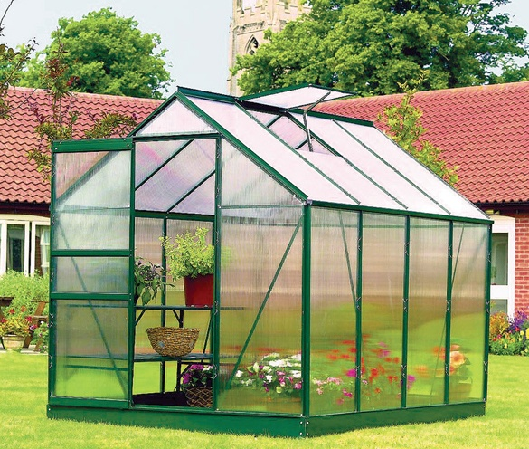
Title of the lesson
GREEN HOUSE

Slide 7
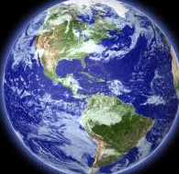
Sun
Atmosphere containing 100 much greenhouse gases.
THE EARTH

Slide 8
GREEN HOUSE
Look at the picture given below
A greenhouse is a house made of glass. It has glass wall and glass roof.

Slide 9
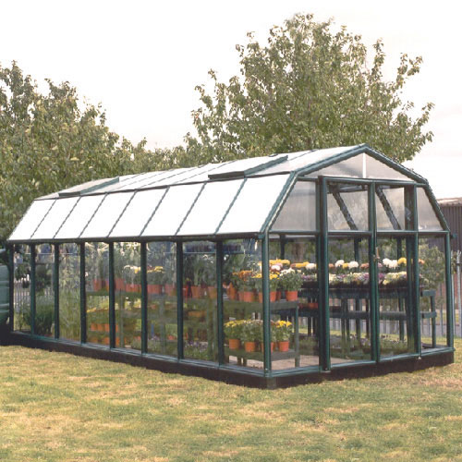
Silent Reading text--A
A greenhouse is a house made of glass. It has glass walls and a glass roof. People grow vegetables and flowers and other plants in them. A greenhouse stays warm inside, even during winter. During the daylight hours, a greenhouse gets warmer and warmer and stays pretty warm at night too. This is because the heat receive from the sun is trapped inside the greenhouse by the glass.

Slide 10
Read in the text A is given below
The earth is like a greenhouse. During the day earths surface warms up in the sunlight. At night, the surface are cool, releasing the heat back in to the air. But some of the heat is traped by gases CARBON-DI-OXIDE in the atmosphere. This gases called greenhouse gases, work like the glass wall and the roof and keep the Earth warm. This is global warming and it is making the Earth a dangerous planet.

Slide 11
Read in the text A is given below
Unfortunately, we are making the Earth too hot. We are using oil, gas and coal for running cars, buses, train, planes, power station and so on. These fuels have CARBON in them. This CARBON and other gases trap the heat in the atmosphere and do not allow the Earth to cool down. As a result, the Earth gets hotter.

Slide 12
Word Meaning
Key Word
Greenhouse
A house made of glass wall and glass roof.

Slide 13
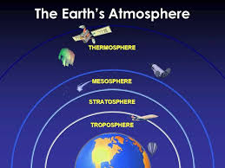
Word Meaning
Key Word
The whole mass of air that’s surrounds the earth.
Atmosphere

Slide 14
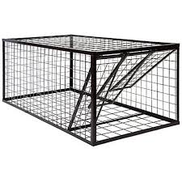
Word Meaning
Key Word
TRAP
Any rickety structure

Slide 15
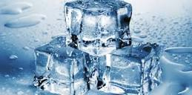
Word Meaning
Key Word
Freeze
Harden in to ice

Slide 16

Word Meaning
Key Word
Shine
Brightness of anything.

Slide 17
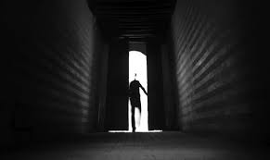
Word Meaning
Key Word
Escape
Pass by

Slide 18
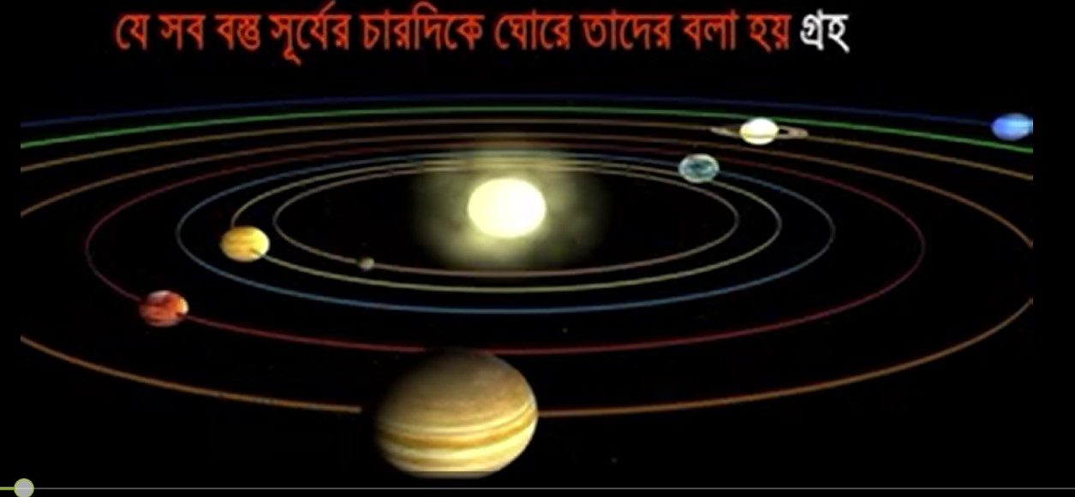
Word Meaning
Key Word
planet
A member of a solar system.

Slide 19
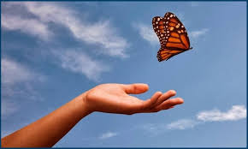
Word Meaning
Key Word
Release
Discharge, Dismiss.

Slide 20
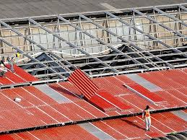
Word Meaning
Key Word
Roof
Upper part of building.

Slide 21
Induvisual work
B. Answer the question below:
What is a greenhouse and how does it work?
2. How is the earths atmosphere similar to a greenhouse?
3. Recently, temperatures on earth have been rising faster than normal. Why is it so?

Slide 22
Read in the gaps using the right word below:
gases | Carbon dioxide | fuels | machines
greenhouse | climate | heat | energy
Carbon dioxide, one of the (1) greenhouse gases , exists naturally in the atmosphere. It is also produce when human use fuels sush as coal, oil and gas. Car, (2)……………………..and factories all burn for(3)………………to make a car to moveor to make a machine to generate electricity. This add more (4) …………………………… to the atmosphere makes a blanket of greenhouse gases surrounding the Earth. This means that the (5) …………… From the sun can not get back out in to space. So, like a thick blanket keeps you warmer at night, the thick blanket of (6) ……………… is warming the Earth up and changing our…………………
machine
fuels
Carbon dioxide
Heat
Gases
Climate

Slide 23
EVALUATION
1. What is greenhouse ?
2. What do you mean by greenhouse?
3. What do you mean by global warming?

Slide 24
Home Work
Write a paragraph not more 150 words about Greenhouse effect.

Slide 25


THANK YOU

Slide 26

Acknowledgement

