Slide 2
You are welcome.

Slide 3
INTRODUCTION
Swandip Banerjee
Assistant Teacher (English)
Pallimangal Secondary School Sonadanga, Khulna.
Mobile: 01718503573
swandipb1@gmail.com

Slide 4
Look at the picture and talk about it.
What do you see in the picture?
Can you relate any historical event to this picture? What happened on this day?

Slide 5
Today’s lesson is…..
MAY DAY
Unit: 03
[Events and Festivals]
Lesson : 2

Slide 6
Learning outcomes
After we have studied this lesson, we will be able to…………..
talk about events and festivals;
ask and answer questions and give opinions in a logical sequence;
infer meanings from the context.

Slide 7
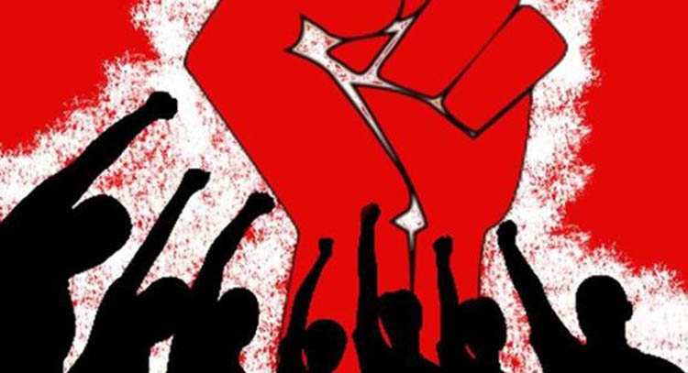
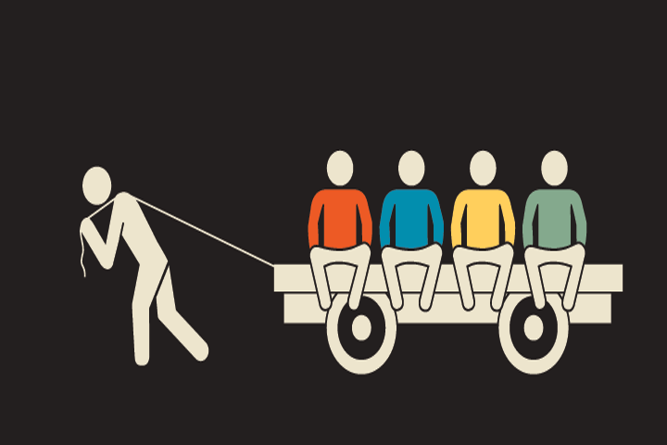
New words
Commemorate
recall and show respect for someone or something
Exploit
to treat somebody unfairly by making them work and not giving them much in return

Slide 8
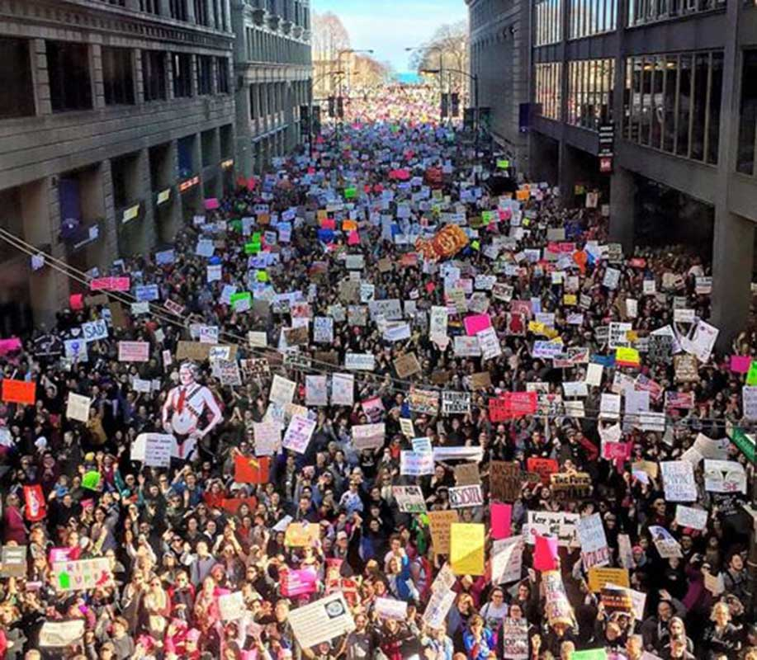
New words
Strike
a refusal to work organized by a body of employees as a form of protest.
Urge
to try earnestly and persistently to persuade someone to do something.

Slide 9
B. Read the text and answer the questions that follow.
May Day or International Workers Day is observed on May 1 all over the world today to commemorate the historical struggle and sacrifices of the working people to establish an eight-hour workday. It is a public holiday in almost all the countries of the world.
Since the Industrial Revolution(1) in the 18th and 19th centuries in Europe and the US, the workers in mills and factories had been working a long shift, fourteen or even more hours a day.
On May 1st in 1886, inspired by the trade unions(2), half of the workers at the McCormic Harvester Company in Chicago went on strike demanding an eight-hour workday.

Slide 10
Two days later, a workers’ rally was held near the McCormic Hervester Company and about 6000 workers had joined it. The rally was addressed by the labour leaders. They urged the workers to stand together, to go on with their struggle and not to give in to their bosses. Just at this moment some strikebreakers started leaving the meeting place. The strikers went down the street to bring them back. Suddenly about 200 policemen attacked them with clubs and revolvers. One striker was killed instantly, five or six others were seriously wounded and many of them were badly injured.
The events of May 1, 1886 is a reminder that workers will continue to be exploited until they stand up and speak out to gain better working conditions, better pay and better lives.
Back

Slide 11
Questions.
What does May Day refer to?
How long did the workers have to work a day before the May 1 strike?
Why did the workers in Chicago go on a strike?
What do you learn from the events of May 1, 1886?
Answer to the question no-1:
May day is a commemoration of the historical struggle and sacrifice of some workers to establish eight-hours workday.
Answer to the question no-2:
They had to work 14 hours or more before it.
Answer to the question no-4:
I learn from the events of May 1, 1886 that workers will be exploited until they stand up and speak out to gain better working conditions, pay and lives.
Answer to the question no-3:
They went on the strike to establish eight-hours working day.
Text

Slide 12
C: Fill in the blanks with the verbs given in the box. Put them into their correct forms.
Group work
add | arrive | begin | do | hear
live | send | support | tread | work
works
Tania is a poor garment worker. She ____ in a big garment factory in Gazipur. She ____ in a slum with a few fellow workers. She works eight hours a day on a monthly salary of Tk. 3000/-. She does overtime to ___ some more money to her income. If she can save something, she ____ it to her father to ________ the family.
One day Tania was busy _____ her work in the factory. Suddenly she ____ someone shouting “Fire! Fire!” The workers were panic-stricken and everyone ____ to rush to the stairs. There were no enough staircases in the factory building. So some workers were _____ under the foot and some other were injured in some other ways. However, the fire brigade ______ there in minutes and nothing untoward happened.
lives
add
sends
support
doing
heard
began
trodden
arrived

Slide 13
D: Now read the completed passage in C silently and answer the following questions in pairs.
Tania is a poor garment worker. She works in a big garment factory in Gazipur. She lives in a slum with a few fellow workers. She works eight hours a day on a monthly salary of Tk. 3000/-. She does overtime to add some more money to her income. If she can save something, she sends it to her father to support the family.
One day Tania was busy doing her work in the factory. Suddenly she heard someone shouting “Fire! Fire!” The workers were panic-stricken and everyone began to rush to the stairs. There were no enough staircases in the factory building. So some workers were trodden under the foot and some others were injured in some other ways. However, the fire brigade arrived there in minutes and nothing serious happened.

Slide 14
Do you think Tania’s monthly salary is enough for her work?
Is the factory safe enough for workers? Why do you think so?
Do you have any suggestions for safety of factory workers? If so, what?
Answer to the question no-1:
No, I don’t think her monthly salary is enough foe her work.
Answer to the question no-2:
The factory is not safe enough for workers to work in because anytime any accident may occur here.
Answer to the question no-3:
Yes, I think the authority should make enough stairs and free-control system.

Slide 15
Evaluation
1. Workers were on strike in --- --- --- --- --- .
a) New York b) Chicago
c) Florida d) Washington
2. A new movement calling for eight-hour workday started in the --- --- --- --- .
a) 1880s b) 1890s
c) 1980s d) 1990s
3. What was the synonym of ‘inspire’?
a) fight b) struggle
c) motivate d) strike

Slide 16
4. Workers got together in a rally near the McCormic Harvester Company on --- --- --- in 1886.
a) 2 May b) 1 May
c) 3 May d) 4 May
5. Since the Industrial Revolution workers had an off period only for --- --- --- a day.
a) 8 hours or more b) 14 hours or more
c) 19 hour or less d) 10 hours or less

Slide 17
Home work
Write a paragraph on MAY DAY.

