Slide 1
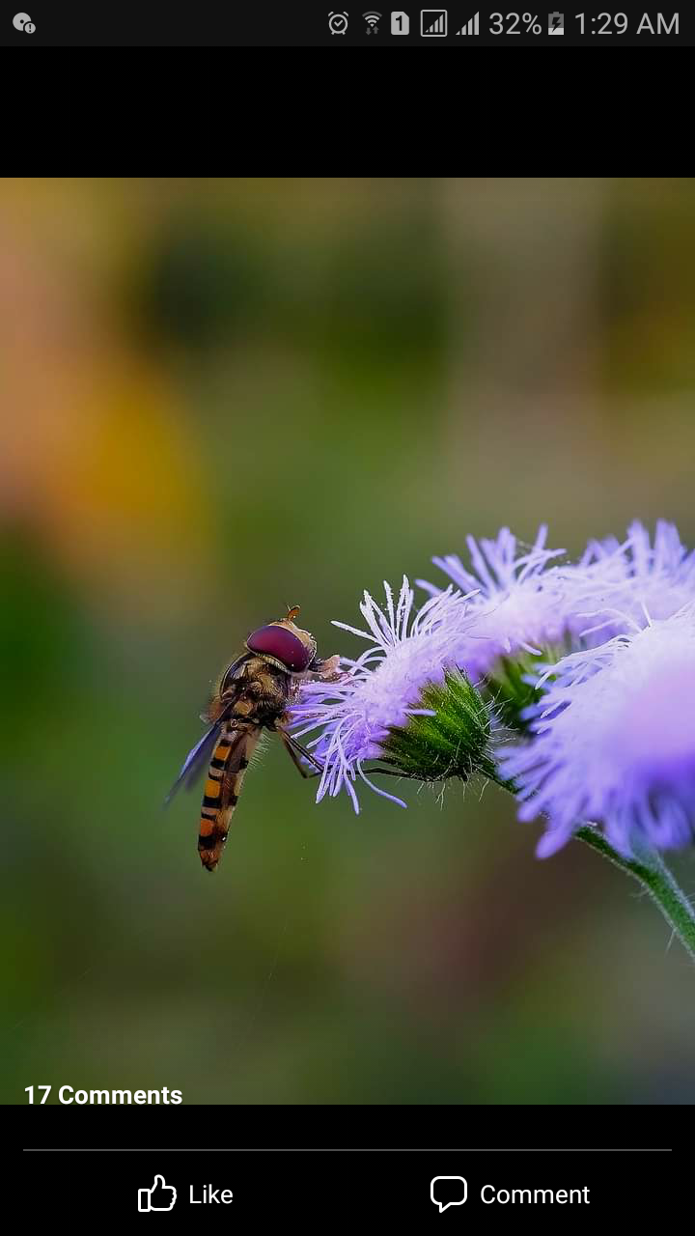
Welcome to
Multimedia Class

Slide 2
Identity
Mosammat Nelufa Afrose Bithi
Lecturer in English
Khilbaisa Rahmania Fazil Madrasah
Sadar, Lakshmipur
E-mail:nelufa.afrose@gmail.com

Slide 3
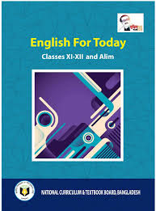
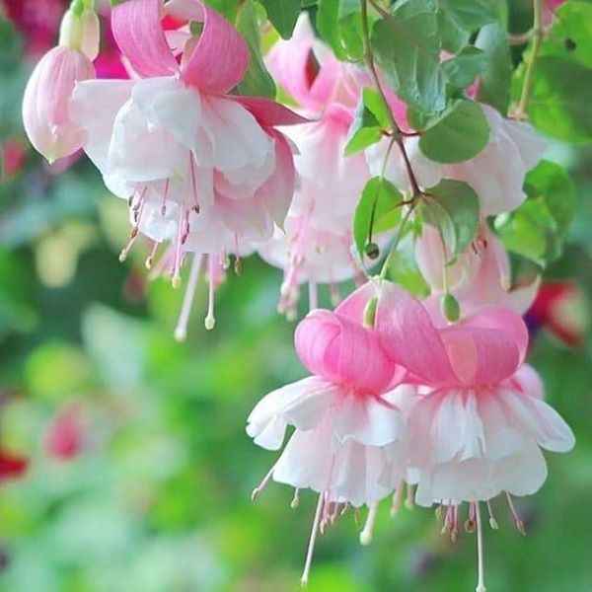
English First Paper
Unit-5, Lesson-3

Slide 4
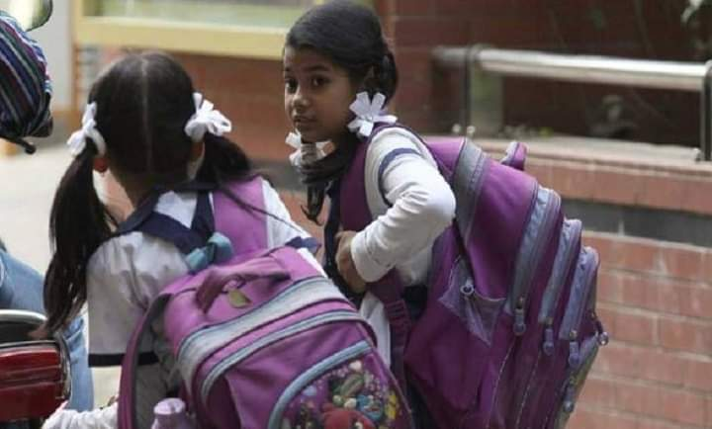
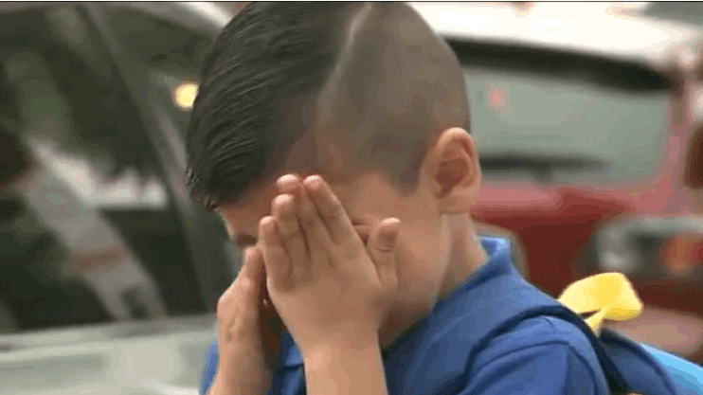
Watch some pictures-
The pictures are about the school going children.
What are the pictures about?

Slide 5
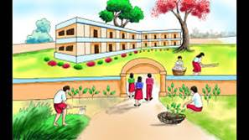
Warm up activities.
Think about your school/Madrasah days. Did you like your school/Madrasah ?
Did you have a different experience? Share one with us.

Slide 6
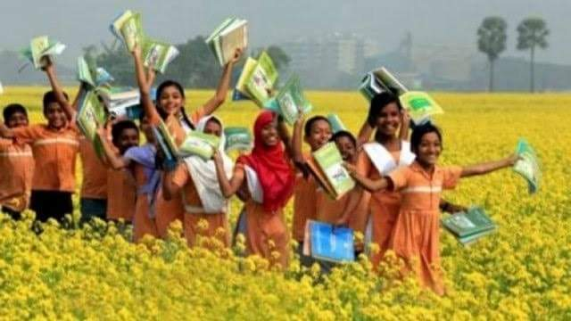
Our today’s topic is -
Unit-5 : Adolescence
Lesson-3 : Why Does a Child Hate School?
Poem: The Schoolboy
-William Blake

Slide 7
Learning Outcomes
After finishing the lesson, the students will be able to -
Know about the poet.
Understand the poem .
Learn word meaning from the text.
Write down the theme of the poem.

Slide 8
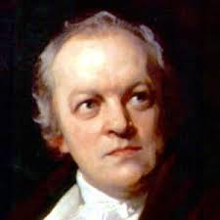
About the poet
William Blake is an English poet and painter, whose favourite subjects included children.
Born: November 28, 1757, Soho, London, United Kingdom
Died: August 12, 1827, London, United Kingdom
Books: Songs of Innocence and of Experience, The Tyger.

Slide 9
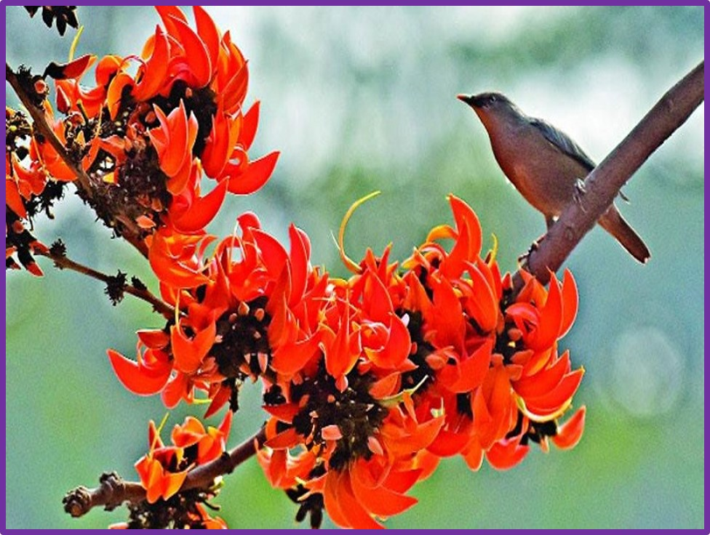
Understanding the poem
The Schoolboy
I love to rise in a summer morn,
When the birds sing on every tree;
The distant huntsman winds his horn,
And the skylark sings with me:
O what sweet company!

Slide 10
But to go to school in a summer morn, -
O it drives all joy away!
Under a cruel eye outworn,
The little ones spend the day
In sighing and dismay.

Slide 11
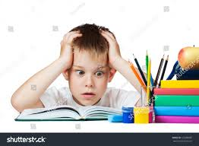
Ah then at times I drooping sit,
And spend many an anxious hour;
Nor in my book can I take delight,
Nor sit in learning's bower,
Worn through with the dreary shower

Slide 12
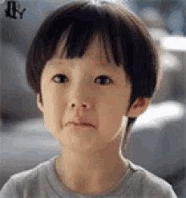
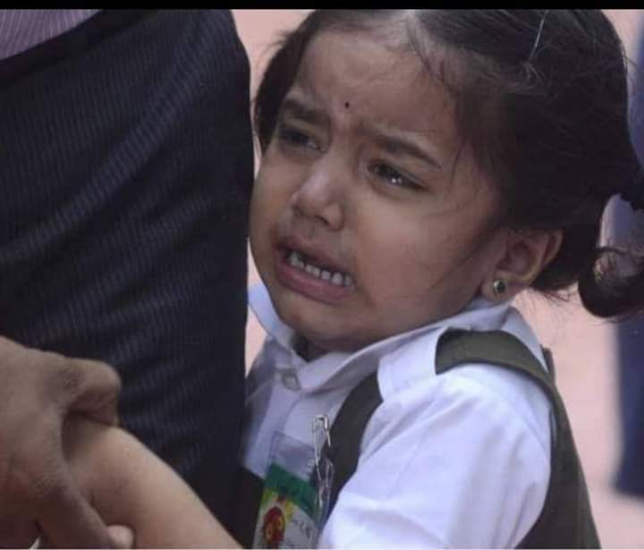
How can the bird that is born for joy
Sit in a cage and sing?
How can a child, when fears annoy,
But droop his tender wing,
And forget his youthful spring!

Slide 13
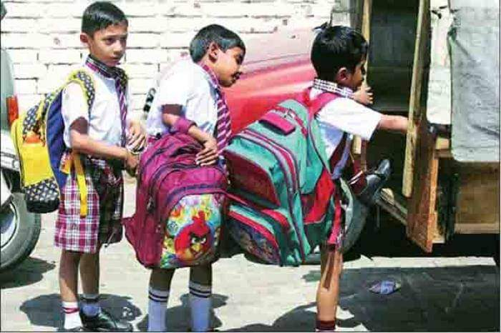
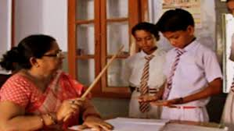
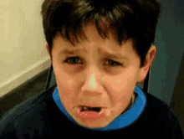
O father and mother if buds are nipped,
And blossoms blown away;
And if the tender plants are stripped
Of their joy in the springing day,
By sorrow and care's dismay,

Slide 14
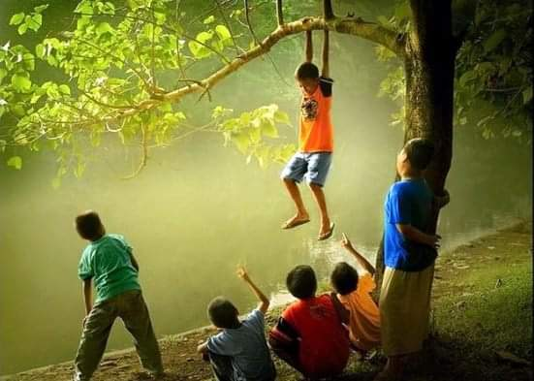
How shall the summer arise in joy,
Or the summer fruits appear?
Or how shall we gather what griefs destroy,
Or bless the mellowing year,
When the blasts of winter appear?

Slide 15
Learn words/phrases meaning from the text
a. Sweet company-The pleasant and entertaining.
b. Dropping sit- weary and so sit tediously.
c. Learning's bower- reading room.
d. Fears annoy- fear and tension that are annoying.
e. Buds and nipped- to destroy something in early age.
f. Mellowing year-adulthood.

Slide 16
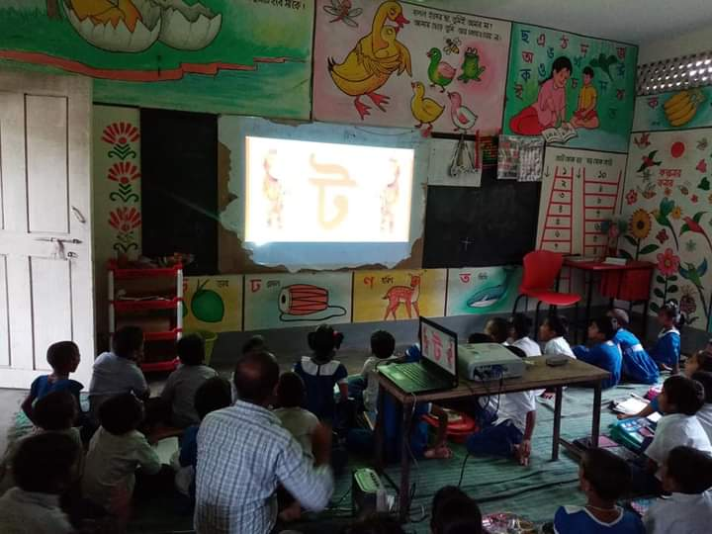
The main theme of the poem
“The Schoolboy” is about a young school boy written by William Blake. The important theme of the poem is the negative sides of formal learning. Children’s right to education implies that they will go to school and learn with friendly environment. But unfortunately this is not general picture in our schools. In the poem , “The Schoolboy” ,the young boy is unhappy with his school where dour-faced teachers give joyless lesson. He would rather like to be outdoors and enjoy the summer day. He pleads with his parents to rescue him from the drudgery of school. Otherwise, he will not be able to learn to achieve happiness, through hardship. Thus the poet suggests to adopt a better education system.

Slide 17
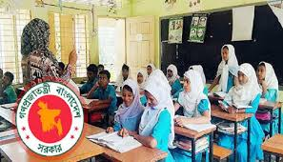
Open the text book at page- 126
&
read the poem silently

Slide 18
Evaluation
Answer what does the following phases refer to-
A cruel eye outworn-
Summer morn-
Dreary shower-
Tender wing-
The blasts of winter-

Slide 19
Individual Work
Write a passage on the importance of joyful learning in childhood.

Slide 20
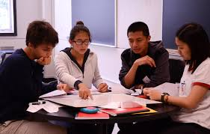
Group work
Write a 5 sentences what you consider to be an ideal learning environment in school.

Slide 21
Home Work
Write a theme of the poem, “The school boy ” by William Blake in 150 words .

