Slide 1
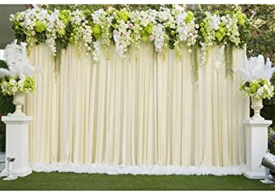

Slide 2
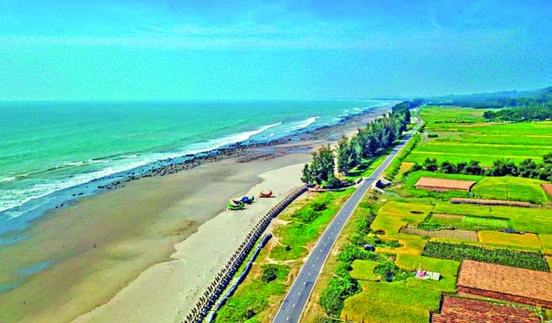
Welcome
To
my class

Slide 3
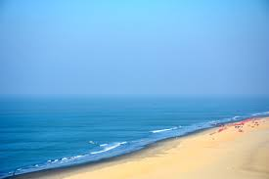
Identity
Md. Sultan kabir
Assistant teacher (English)
Jhenidah Govt. High School
English 2nd paper
Transformation of Sentence

Slide 4
Learning outcome
By the end of the lesson learners will be able to-
Tell the definition of superlative degree.
Identify superlative degree.
Make sentences following the structure.

Slide 5
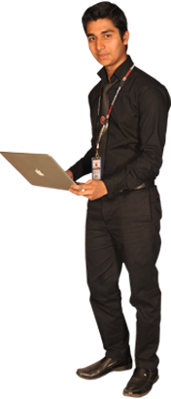
Superlative degree
Rifat is the tallest of all boys.
Structure: Subject + verb + the + superlative (est/most/lest)form of adjective + extension.
The superlative degree refers to the highest quality of things or persons.
Superlative degree is formed adding ‘est’ with an adjective or ‘most/lest’ before an adjective when it is pronounced at least three times break.
Notes:
Use of ‘most and lest’ is the main focus of this slide.

Slide 6
Exceptions
There are some adjectives which do not follow any rule and for this they are called irregular adjectives. Such as--
Positive | Comparative | Superlative
good | better | best
bad, evil, ill | worse | worst
late | later/latter | latest/last
many | more | most
much | more | most
old | older/elder | oldest/eldest
fore | former | foremost, first
Notes:
Exceptions of adjectives shown here.

Slide 7
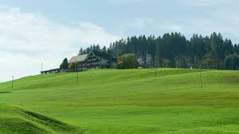
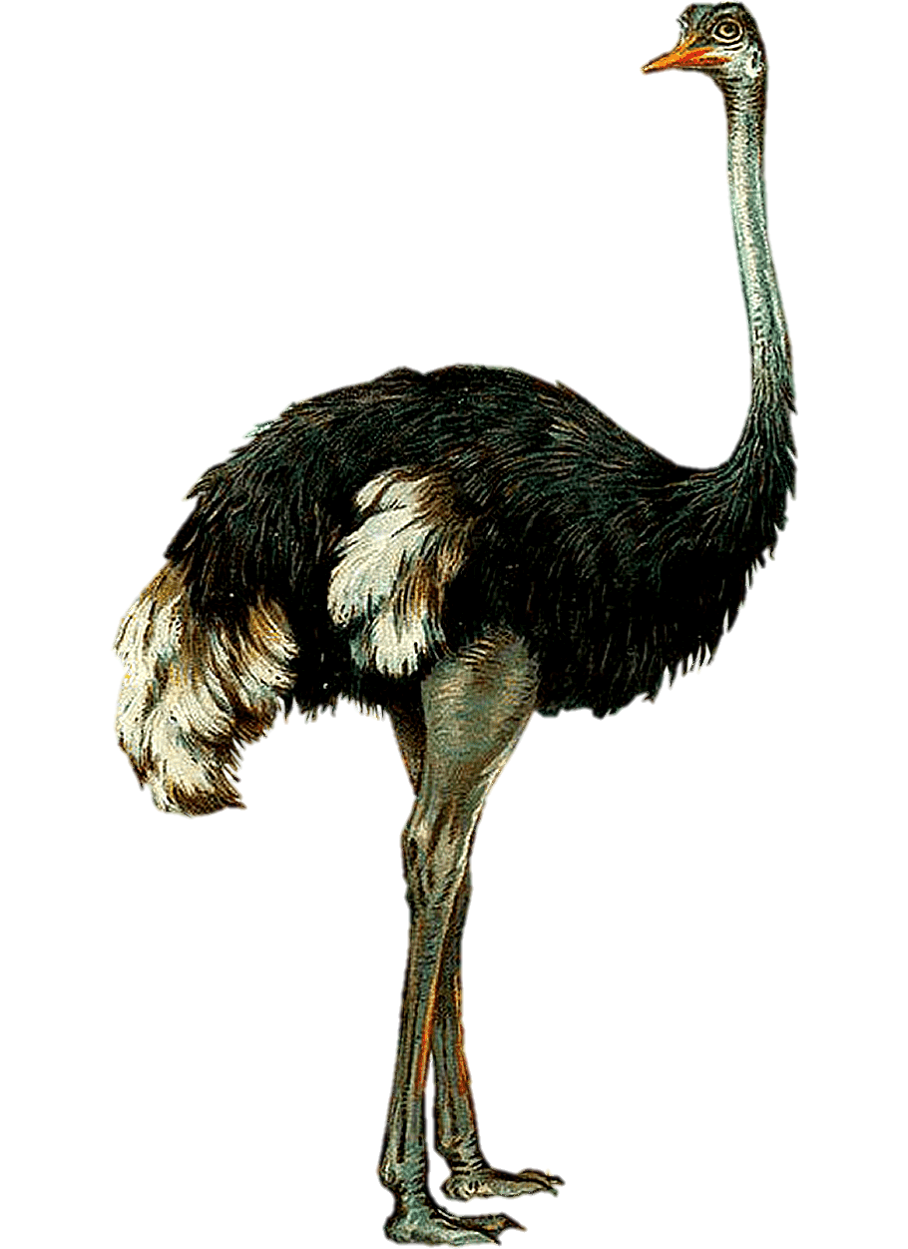
Sentence structure of superlative degree
1 # Subject (NP) + verb + the + Adjective (superlative form) + noun(s) + ext.
most
est
Emu is the largest bird.

Slide 8
Sentence structure of superlative degree
2 # Subject (NP) + verb + one of the + Adjective (superlative form) + noun(pl) + ext.
most
est
The Pyramid is one of the most famous wonders in the world.

Slide 9
1 # Subject(NP) + verb + the + adjective (superlative form) + noun(s).
Sentence structure of superlative degree
2 # Subject(NP) + verb +
one of the + adjective (superlative form) + noun(pl).

Slide 10
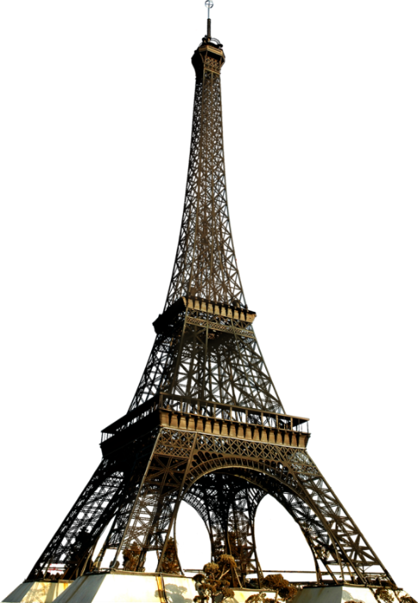
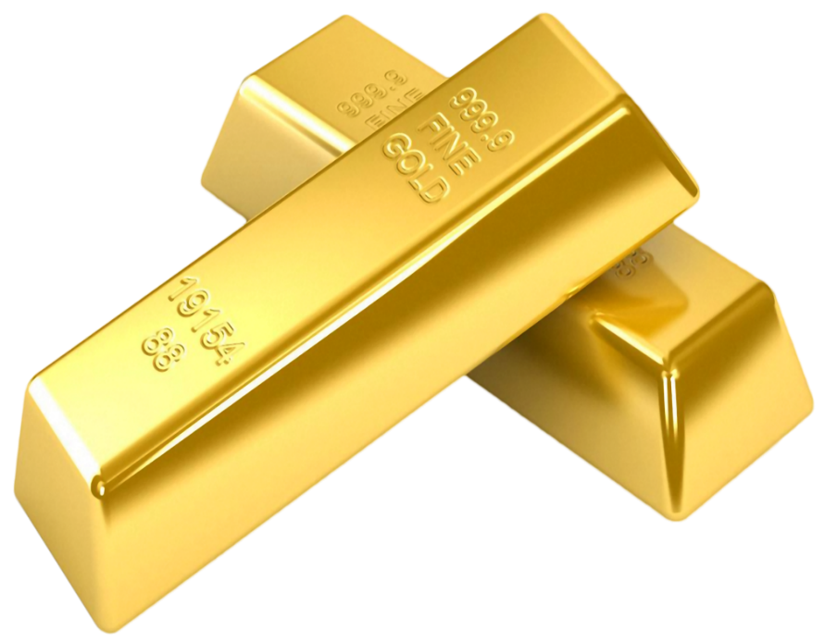
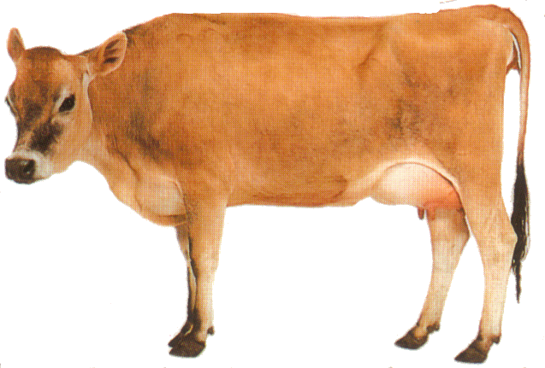
Make sentences with the pictures applying the adjectives in superlative degree.
high
precious
useful
Eifel Tower
Gold bar
The cow
Notes:
Evaluation option.

Slide 11
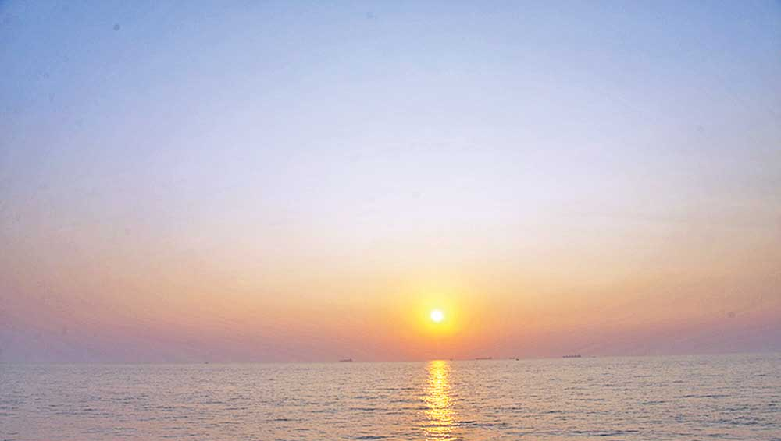
Home work
Make five superlative sentences with the given word.
Big ,
bad,
handsome, intelligent,
busy

Slide 12
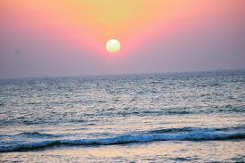
Allah hafiz

