Slide 1
Wel come

Slide 2
Teachers Identity
Md:Saidur Rahman ,AssistantTeacher ,
65no Dhullbari Govt.Primary.School
Sadar ,Tangail .

Slide 3
Lesson Identity
Class:One
Sub:English Unit:10
Lesson: 1-3.

Slide 4
Learning Outcomes
By the end of the lesson students will be able to
Be familiar with English sound by listening to common English word.
Follow simple commands and instructions
Enjoy the rhythm and music of simple rhymes.
Recite rhymes individualy.

Slide 5
Lets see a video

Slide 6
Todays Lesson
Rhyme
Look Left Look right

Slide 7
Teachers recitation

Slide 8
Students recitation along with teacher
Students recitaion in groups and pairs
Students recitation individually

Slide 9
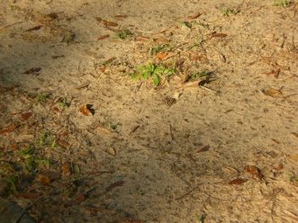
New words
Left
Right
Ground
Sky
Bird

Slide 10
Task
Matching the words with the picture

Slide 11
Home work
Recite rhyme with activities.

