Slide 1
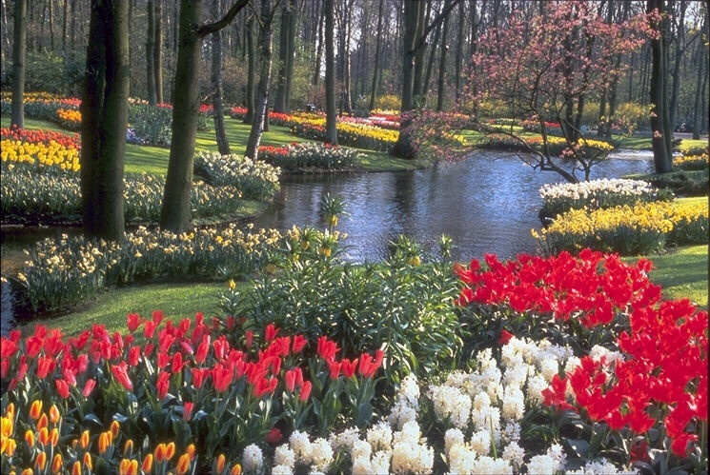
W E L C O M E

Slide 2
INFORMATION
Mahmudul Hoque Mahmud
Assist.Teacher(B. Studies)
T & T High School
Agrabad, Chattogram.
Voice: 01814 940263
Class : Seven Subject : English for today
Unit : 03
Lesson : 02 Time : 45 minutes Date : 09/03/2021

Slide 3
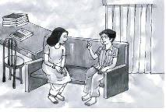
Look at the picture

Slide 4
Our today’s lesson-
Flora’s first day at school (1)

Slide 5
Learning out come
After completing the lesson SS will be able to-
read and understand texts.
write short paragraph by the most suitable word of the texts.
write answers to the questions.

Slide 6
Individual work
Read the text saliently and choose the most suitable heading for answer to the questions and a paragraph.

Slide 7
Some key-words and meaning
words | Bangle meaning | Synonyms
recall | স্মরণ করা | remember, come to mind
add | যুক্ত করা | Attach
chat | খোস গল্প | a friendly conversation
excited | উত্তেজিত করত | animated, stimulated
started | আরম্ভ করেছিল | began, set out
bath | গোসল | swim, shower
composition | রচনা, প্রবন্ধ | essay
conversation | কথোপকথন | discussion
friendly | বন্ধুভাবাপন্ন | helpful, kind
statement | বিবৃতি | declaration

Slide 8
Look at the picture and write short composition answering the following questions.
Q1: Do you remember your first day at school?
Q2: How old were you at that time?
Q3: What is the name of the school you went to?
Q4: What did you put on?
Q5: How did you fell before you started for the school?
Q6: Who did you go with?

Slide 9
My First Day at School
I can very well recall the first day of my school. Then I was six years old. My parents decided to send me to T & T High School. It is a good school in Chattogram District. I was feeling a lot of excitement. One fine morning my mother prepared me for the school. She dressed me in my best clothes. Before I started for school I got nervous thinking about the new place and new faces. The school was a walking distance from our house. I walked catching my father’s hand.

Slide 10
Evaluation
Fill in the blanks with suitable words:
Flora is a student. She is ------------- class 7. She can remember her ---------------- day at school even today. She ---------------- to school in 2006. Her mother --------------- her to school. The school was ---------------- a long way from their house. ----------------- Flora walked to school ----------------- her mother.
in
first
went
took
not
so
with

Slide 11
Home work
You will bring to write 10 meaningful sentences about “My First Day at School”.

Slide 12
THANK YOU EVERYBODY

