Slide 2
Presented by
Hafiza Khanam. Assistant teacher.
99 No. Nilokhi G.P.S.
Gopalganj Sadar,
Gopalganj.
khanamhafiza@gmail.com
Class: Three Subject: English
Unite : 38.
Cleanliness.
Lesson:1-2,
Page : 76

Slide 3
Let’s watch a video
We were watching a video.
Now tell me what about the video is?

Slide 4
Today’s lesson
Cleanliness

Slide 5
Learning Outcomes
Students will be able to :
Speaking:
j
1.1.2 say words and phrases and sentences with proper sound and stress.
Reading:
5.1.3 read text.

Slide 6
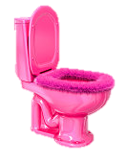
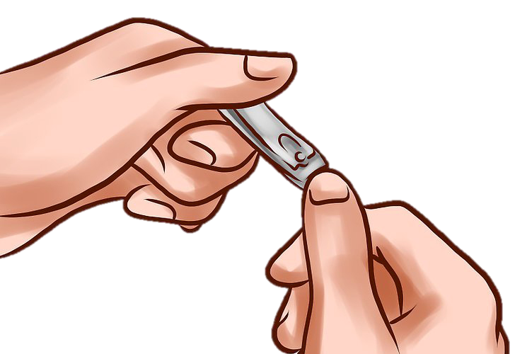
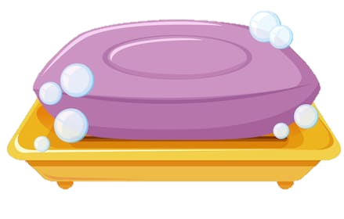
Say me the meaning of words
Notice some pictures
Listen to an audio
Soap
Nails
Clip
Toilet

Slide 7
New word & one day one word
Clip = clip (কর্ত্তিত বস্তু)
This is a clip.

Slide 8
Say me what is the rules to follow to be healthy ?
Look carefully at the poster of activity B.
What dose the poster look like?
Have you ever seen like the poster ?
What is the title of the poster?

Slide 9
Listen carefully

Slide 10
Pair work
Read in pair what is written on the poster.
Read the poster each other in English.

Slide 11
Open at page 76

Slide 12
Evaluation
Which rule of cleanliness do you think relates to photography?

Slide 13
Homework
What do you do to stay clean? Write four sentences.

Slide 14
Good
bye

