Slide 1
Welcome
Well come

Slide 2
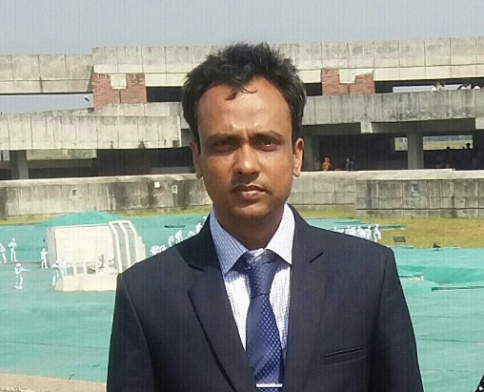
English 2nd tp
Top0ic: aff/neg agreement
Time 45 mnts
30/4/21
Md Hasanul Kabir
Lec in English
H. A, Harindia Alim Madrasa
Harindia , Kotchandpur, Jhenaidah

Slide 3
Lesson declaration
Affirmative and negative agreement.

Slide 4
Learning outcome
At the end of the lesson
A student will be able to
know the structure
make sentences of agreement and disagreement.

Slide 5
Agreement means to be in same point for the speakers and listeners

Slide 6
Agreement is of two kinds
1 affirmative agreement
Ex: সে কাজ টি করবে, আমিও।
2. Negative agreement
সে কাজটি করবে না , আমিও না।

Slide 7
How to make the sentences
If you follow the structure , it will be easy for you to make the sentence.
Affirmative agreement:
হা/ও = so + hv+sub
sub+ hv+ too/also

Slide 8
আমি সেখানে যাইতেছি, তুমিও
He is going there, and so are you./you are too.
তেমনি ভাবে
He came here and so did she
He has come and so have you
I wanted to see you, and you did too
He was in the market and so were you.

Slide 9
Negative agreement
Neither + hv+sub/ s+ hv+not+ either
আমি তোমাকে দেখিনি, তুমিও না।
I have not seen you and you have not either.
He will not do the work and you will not either.
He did not come and netiher did you
I have not played well and you have not either.
She was not here and I was not also.

Slide 10
Individual work
Write the structure of the affirmative agreement and negative agreement.

Slide 11
Group work
Try to translate the following sentences into English.
সে যাবে না, আমিও না।
সে এসেছিলো ,আমিও
হাসান সেখানে যাবেনা আমিও না।
রহিম তোমাকে দেখতে চাই, আমিও
করিম ঢাকা গিয়েছিলো,তুমিও।

Slide 12
Home work
Complete the following sentences
He has come and she………………..
You will not do the work and neither…………………..you
We have done this and you…….
You took tea and you ……..
Jemi in not at home and …………………he
I came to see you and neither ………she
He read the book and ………did you.

Slide 13
No more today, when more again.

