Slide 1
WELCOME TO THE CLASS

Slide 2
PRESENTED BY
MD. AFSAR ALI
SENIOR TEACHER(ENGLISH)
MAJHIRA MODEL HIGH SCHOOL
SHAJAHANPUR, BOGURA
01757966577

Slide 3
INTRODUCTION
ENGLISH FOR TODAY
CLASS: NINE-TEN
uNIT: 1 lesson: 1

Slide 4
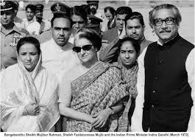
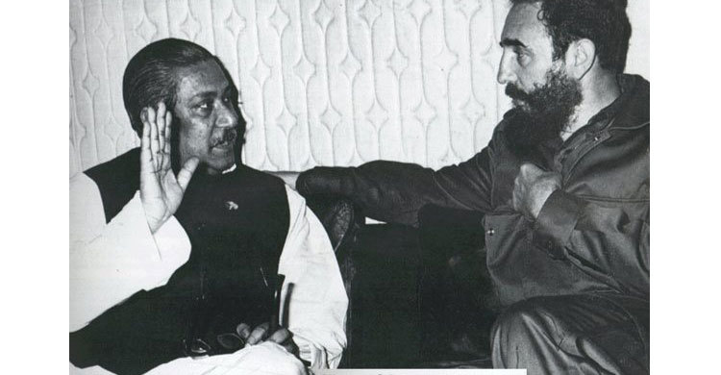
Look at the pictures below and discuss the following questions in pairs
Who can you see in the picture?
Ans-1: There are Bangabandhu Sheikh Mujibur Rahman, Begum Mujib and the then Prime Minister of India, Mrs Indira Gandhi.
3. What do you think are the relationship among them?
2. Both Indira Gandhi and Fidel Castro were eorld leaders like Bangabandhu.
3. There was a very friendly diplomatic relationship among these leaders.
2. How are they related to Bangabandhu?

Slide 5
So, today we are going to learn a very important topic . Can you guess it?
Bangabandhu's relationship with other countries
Unit-1
Lesson-4

Slide 6
After this lesson the students will be able to …
read and understand text
narrate incidents and events in a logical sequence
participate in conversation, discussion and debates
tell stories

Slide 7
Let us introduce with some key words
Meaning
word
Impact
Impression
Influence
effect
An effect produce on somebody.

Slide 8
Meaning
word
Indicate
Reflect
Show
Display
He reflected with sadness on the unhappiness of his marriage

Slide 9
Meaning
word
Spite
Malice
Malevolence
Hostility
I bear no malice toward anybody

Slide 10
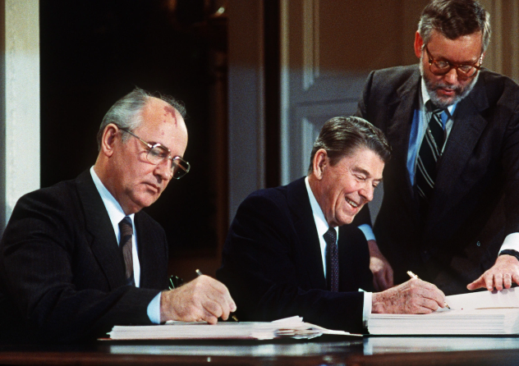
Meaning
word
Spite
Treaty
Malevolence
Hostility
He said the treaty was unfair.

Slide 11
Let’s read the text attentively

Slide 12
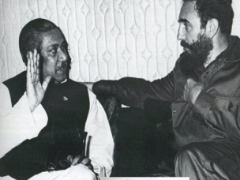
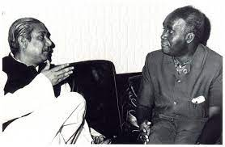
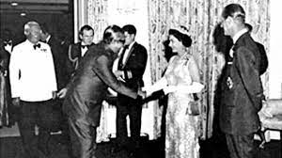
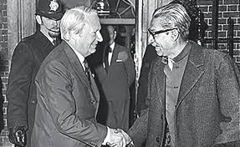
B. Read the text and answer the questions that follow.
“I have not seen the Himalayas. But, I have seen Sheikh Mujib. In personality and in courage this man is the Himalayas. I have thus had th experience of witnessing the Himalayas”-said Fidel Castro, the then Prime Minister of Cube in 1973, when he first meet Bangabandhu.
Any country has to determine its mode of dealing with other countries of the world. The constitution of Bangladesh of 1972 celarly reflects the philosophy, “friendship for all, malice to none.” Bangabandhu let new government decided to maintain friendly ‘co-existence’ with other countries based on this principle.
Such was the impression Bangabandhu left on the minds of world leaders. He owned the position in the heart of people across the world by his selflessness, courage and greatness.

Slide 13
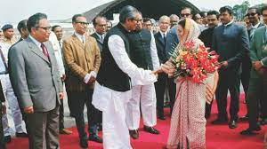
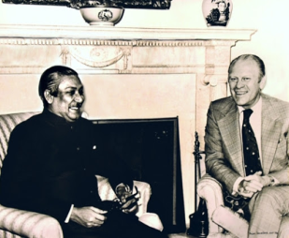
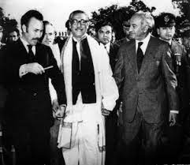
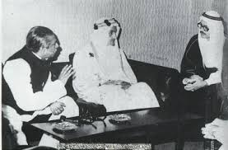
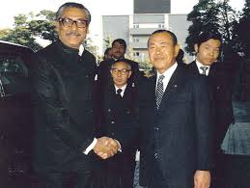
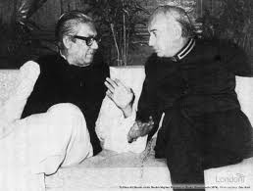
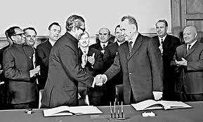
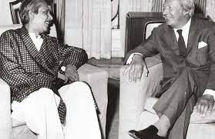
The charismatic leadership of Bangabandhu inspired India to come forward to extend its support during the Liberation war even in his absence. It played an active role to convince the world leaders about sufferings of the people of Bangladesh and their right to be free.
However, Bangabandhu’s foresightendess, courage and mental strength were evident in his query to Indian Prime Minister when she would withdraw her army from Bangladesh. However, Bangabandhu’s foresightendess, courage and mental strength were evident in his query to Indian Prime Minister when she would withdraw her army from Bangladesh.
Mrs Gandhi soon replied, “Any time when you wish.” Noticeably, the great leader Bangabandhu had a strong personality to ask for any clarification from any other leader of the world! Consequently, very soon, before Bangabandhu’s next birthday, the withdrawal was completed.
Moreover, this country supported the freedom fighters with its army fithing the Pakistani occupation forces in a frontal war. Not only that, Bangabandhu was given a warm welcome at Palam Airport a Delhi by Mrs. Indira Gandhi on the occasion of his way back home from Pakistan jail via London.

Slide 14
During his period 1972 and1975, Bangladesh signed more than seventy treaties, agreements, memoranda and contracts with different countries of the world. Managing entry into OIC (Organisation of Islamic Cooperation) and attending its conference at Lahore filled up a major gap in diplomacy of Bangladesh. It opened opportunities to explore all the possibilities of trade and other potentials with the Islamic world. Bangabandhu charmed common people all over the world.
Bangabandhu had an open mind to maintain good relationship with all countries irrespective of their capitalist, democratic or socialist ideologies. He left no stones unturned to make entry into different global organisations.

Slide 15
He was such a leader for whom the Brithch Prime Mnister Edward Heath broke all the protocols to welcome him at Claridge’s Hotel on 8 January, 1972 while Bangabandhu was returning from Pakistani prison. His elegance was reflected in the voice of a renowned journalist, “The courage and charm that flowed from him made him a unique superman of these times.”
His speech in different summits revealed that Bangadesh did not only think about its own self, it was also concerned about injustices prevailing in the rest of the world. Bangabandhu sent a medical team to Egypt and Syria for the treatment of the war victims of Arab-Israel war.
He always used to say, “Today the world is divided into two parts-the oppressors and oppressed.” This kind of strong voice and wisdom made his position firm as a global leader.

Slide 16
Consequently, wherever he went, he cast a very positive influence on the leaders of those countries. Among the world leaders who admired him were India’s Prime Minister Mrs. Indira Gandhi, Palestinian leader Yeasir Arafat and Cuba’s President Fidel Castro. His leadership, wisdom and personal relationship with world leaders made him a successful politician of international repute.
Bangabandhu’s philosophy of secular democracy honoured him with a firm position in the world. The period from 1972 to 1974 was actually a bright and busy era for Bangabandhu Government, when he visited many countries of Asia, Africa, Europe and Latin America. He made those visits to gain support from those countries and to promote friendly relationships with them.

Slide 17
C. Work in groups. Ask and answer the following questions based on the text you have read at Section B. Then write the answers individually.
a. What did Fidel Castro compare Bangabandhu with? Why?
Ans: Fidel Castro compare Bangabandhu with the Himalays. He admired him very much for his courage and strong personality. Castro compared him with the Himalaysa as it is the symbol of firmness and undaunted spirit similar to the persona of Bangabandhu.
b. What do you understand by ‘Friendship to all, malice to none.’
Ans: The statement ‘Friendship to all, malice to none.’ is the essential philosophy adopted by Bangabandhu regarding the relationship Bangaladesh would pursue with other countries after the Liberation War.
c. How did India help us during Liberation War?
Ans: India helped us in many ways during our our Libaration War. It made the world leaders aware of the sufferings of the Bangalees during the Libaration War and urged them to support their cause. It also extended its help by sending troops to join the Mukti Bahini in their fight against the Pakistan army.

Slide 18
d. Why did Bangabandhu try to join different alliances?
Ans: Bangabandhu try to join different alliances, because he knew that as a newly born country, Bangaleshsh would require economic and diplomatic support from them. He successfully signed more than 70 treaties, agreements, memoranda and contracts with different countries of the world.
e. What was the purpose of Bangabandhu’s visit to different countries?
Ans: Bangabandhu visited many countries of Asia, Africa, Europe and Latin America during the period of 1972 to 1974. His purpose was to strengthen bilateral relationship with those countries based on mutual support and friendship.

Slide 19
D. Here are some words from the reading text. Find the opposite worlds and write on the blank spaces. You can take help of a dictionary. Then make meaningful sentence with each of those words.
Charismatic
evident
harmony
wisdom
capitalist
Given words | Opposite words | sentences
Charismatic | ordinary | I find the man quite ordinary.
evident | ambiguous | The message of the film seems pretty ambiguous.
harmony | conflict | Conflict among the neighbouring countries is the least desired thing.
wisdom | ignorance | The true purpose of education is to replace ignorance.
capitalist | communist | Godwin was a communist worker and so were most of his friends.

Slide 20
E. Look at the third paragraph of the passage and identify the connecting /linking words. Observe how they have connected one sentence to another. Write the purposes of their use in the next chart. The first one is done for you.
Connecting or linking word | Place of use
For instance | to give example of what was said before.
Moreover | to add something to what has been said before
Not only that | to emphasize a previously mentioned statement by adding a similar one.
However | to show contrast or concession with the previous statement
Noticeably | to indicate something in a way that is easily seen or noticed
Consequently | to indicate the result or aftermath of a previously mentioned action.

Slide 21
G. Group work
F. Successful man or woman has to maintain good relationship with others, for example, family members, friends, neighbours, etc. In groups discuss on ways of improving relationship with your neighbours.

Slide 22
HOME WORK
Write a paragraph on ‘How to Maintain Good Relationship with Our Neighbours.’ Use linking words as needed.

Slide 23
Thank you for joining me

