Slide 1
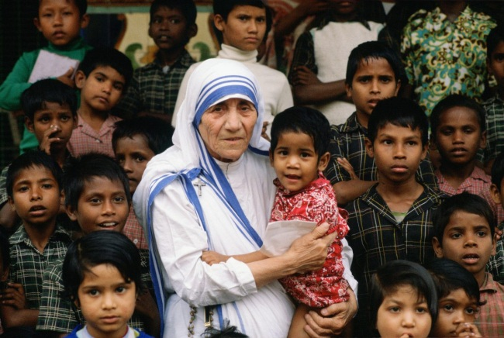
Welcome

Slide 2
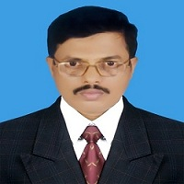
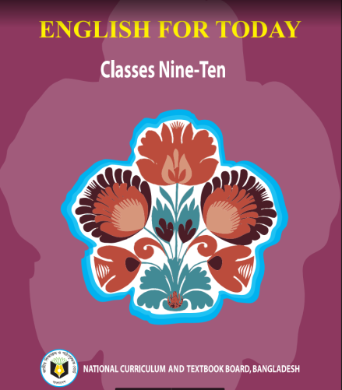
Md. Saiful Islam Chowdhury
Senior Teacher
C. J. M High School,
Mohara , Chandgaon , Chattogram.
saifulcjm@gmail.com Mob: 01991945882
ENGLISH FOR TODAY
Class : Nine-Ten
Unit- Seven , Lesson – Four
Time: 40 minute

Slide 3
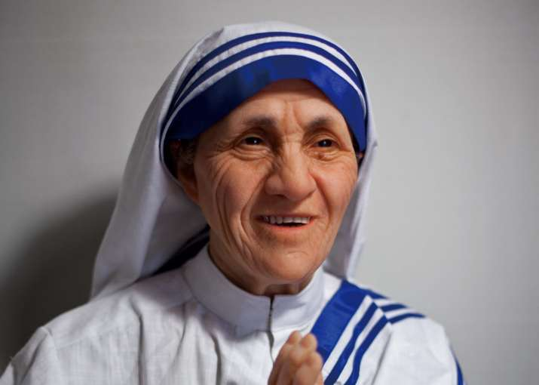
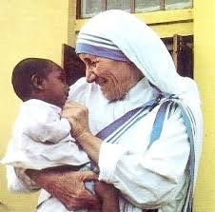
Look at the pictures
T: Do you know of the lady?
S: She is Mother Teresa

Slide 4
She is Mother Teresa
The mother of humanity
Every action has a starting .
Thus the journey of becoming the mother of humanity also has a good start.

Slide 5
Today our Lesson is
The Beginning (Mother Teresa)
Unit-Seven ; Lesson – Four

Slide 6
Learning outcomes
After completing the Lesson students will be able to –
1. Read and understand texts through silent reading ;
2. Ask and answer questions.;
3. Listen to an audio text for specific information ;
4. Write a dialogue.

Slide 7
Listen the text attentively.
Teacher’s Model reading.
It was late summer, 26 August 1910. A little girl was born to a rich Catholic merchants' family of Albanian descent in a small town called Skopje, Macedonia. She was the youngest of the three siblings and was named Agnes Gonxha Bojaxhiu. Who could imagine at the time that this little girl would one day become the mother of humanity, loving and serving the poorest of the poor. Yes, we are talking about none other than Mother Teresa.
At the age of 12, she heard a voice from within that urged her to spread the love of Christ. She decided that she would be a missionary. At the age of 18 she left her parental home. She then joined an Irish community of nuns called the Sisters of Loreto, which had missions in India.
After a few months of training at the Institute of the Blessed Virgin Mary in Dublin, Mother Teresa came to India. On May 24, 1931, she took her initial vows as a nun. From 1931 to 1948, Mother Teresa taught geography and theology at St. Mary's High School in Kolkata (then Calcutta). However, the widespread poverty in Kolkata had a deep impact on Mother Teresa and in 1948 she received permission from her superiors to leave the convent and devote herself to caring for the poorest of the poor in the slums of Kolkata.

Slide 8
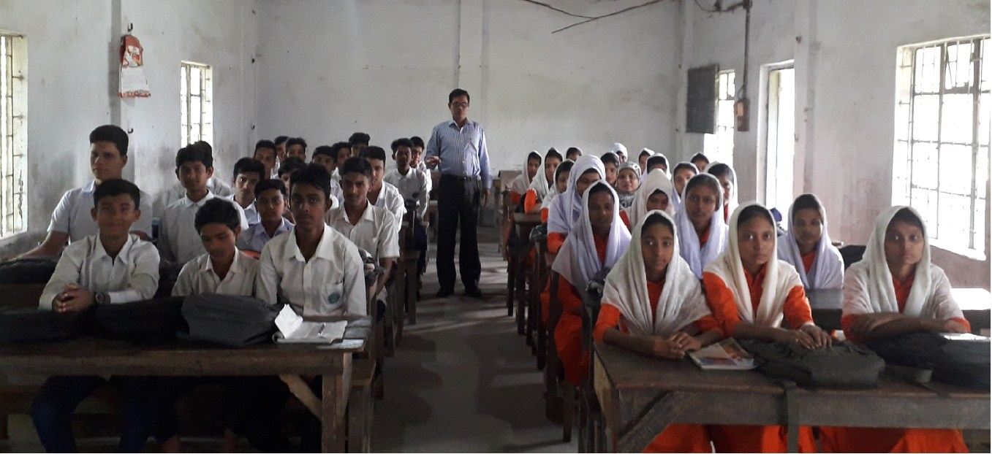
Student’s Model reading.
Go to the section “A” and start silent reading.

Slide 9
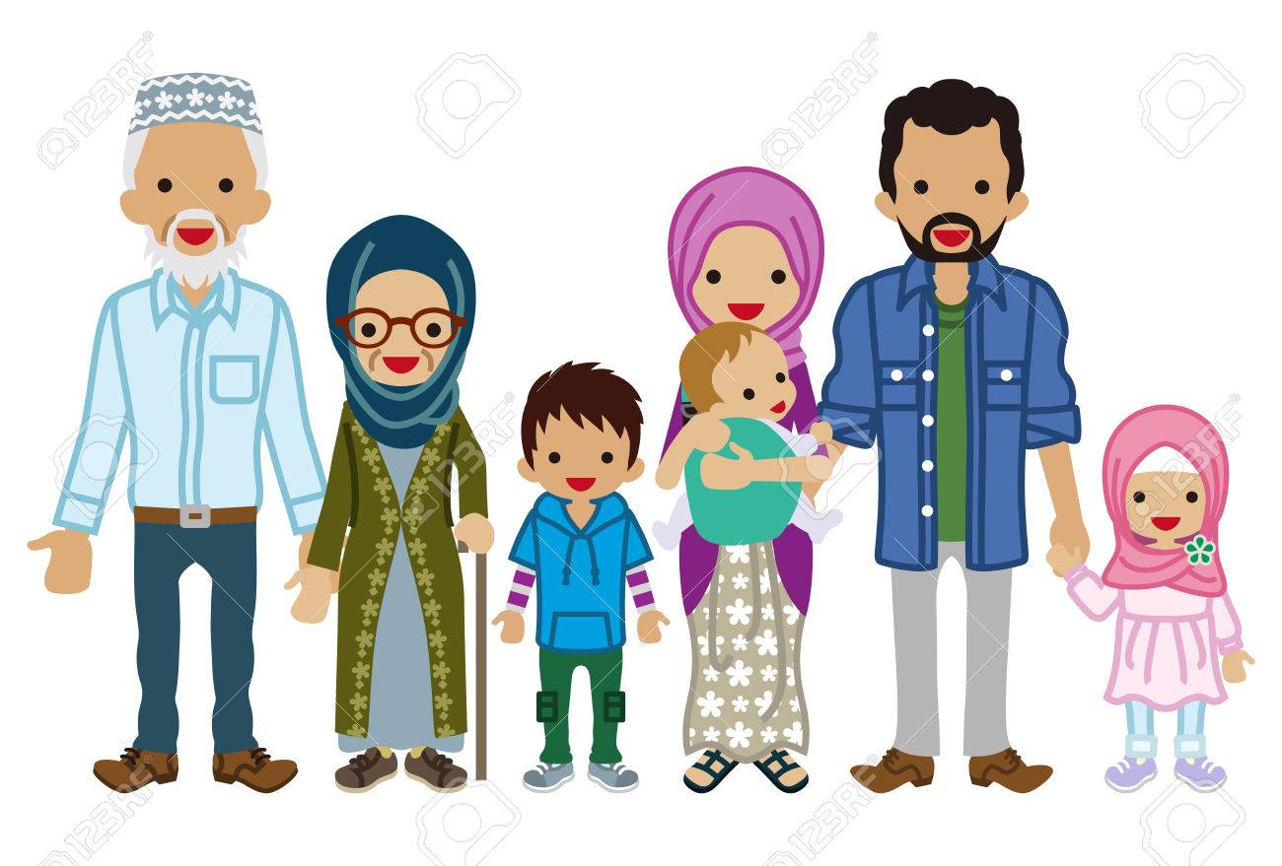
Vocabulary
Key word
Descent
Meaning:
A persons family origins
We are the descents of our grand parents.

Slide 10
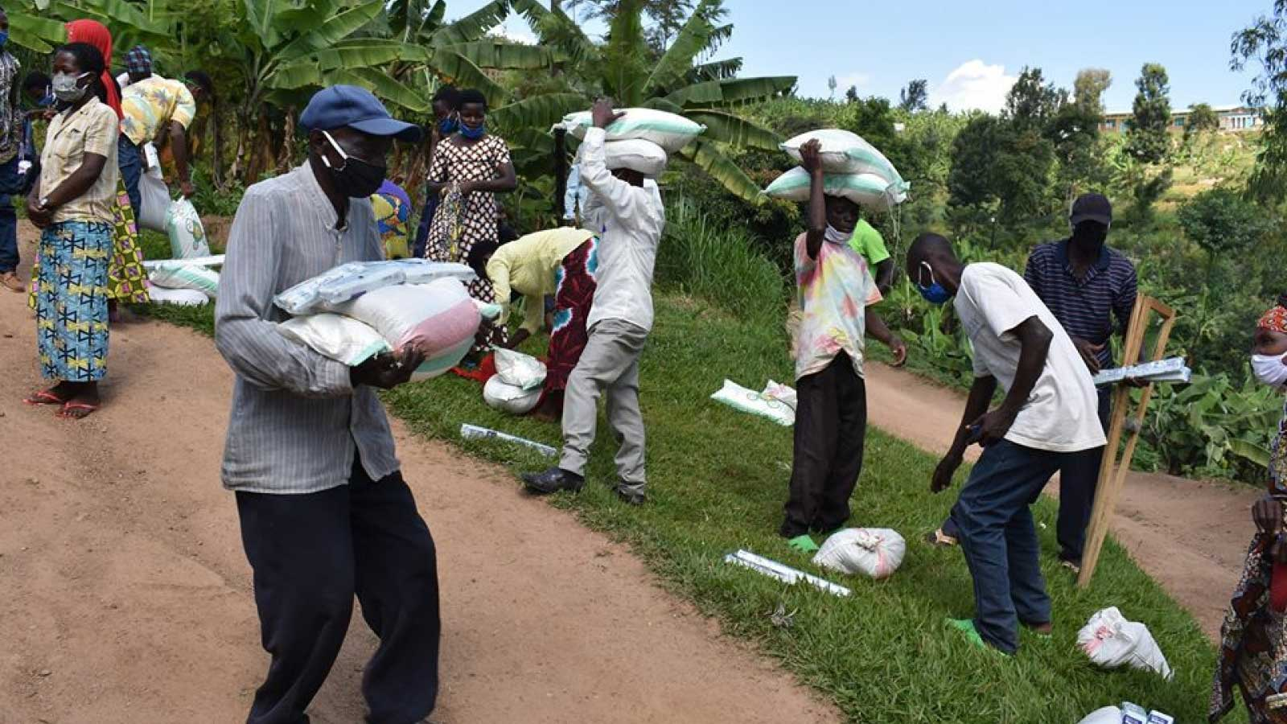
Vocabulary
Key word
Humanity
Meaning:
Kindness
Mother Teresa become the mother of humanity.

Slide 11
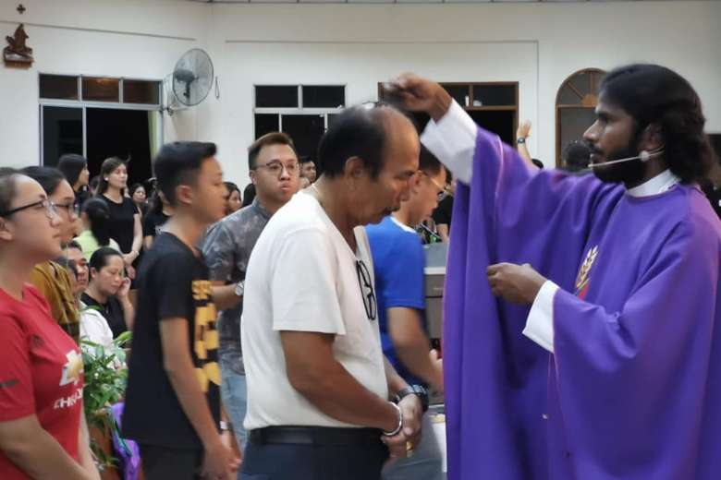
Vocabulary
Key word
Missionary
Meaning:
Evangelist
Mother Teresa decided that she would be a Missionary

Slide 12
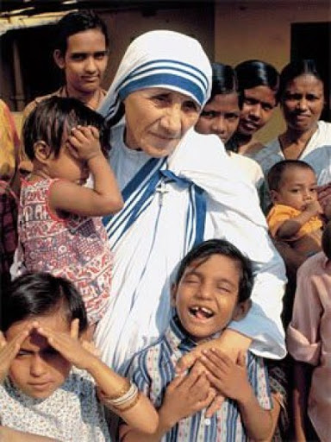
Vocabulary
Key word
Devote
Meaning:
Dedicate, Sacrifice
She devote herself to caring for the poorest of the poor in the slums.

Slide 13
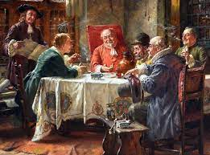
Vocabulary
Key word
Merchant
Meaning:
Trader, Dealer
My uncle is a merchant .

Slide 14
Choose the correct answer from the alternative.
Individual work
1.Which of the following has the closest meaning of the word “descent”?
ascend
citizen
clan
missionary
2. The suffering of the poor in Kalkata moved Mother Teresa -
not much
now and then
To some extent
tremendously

Slide 15
Choose the correct answer from the alternative.
3. Mother Teresa was directed by ____to serve the humanity.
her parents
her inner urge
whims
her teachers
4.The prevailing poverty ____ Teresa to work for the poor.
drove
set
engaged
sent

Slide 16
Choose the correct answer from the alternative.
5. Mother Teresa left home when she was____..
18
12
21
38
6. The term “widespread poverty” refers to____.
the felling of anxiety
the state of being of poor
the condition of a poor
a kind of disease

Slide 17
Choose the correct answer from the alternative.
7. What is the theme of the passage?
a) the biography of a celebrity
b) the story of a celebrity
c) a call for the humanitarian service
d) poverty and its causes

Slide 18
Group Work.
Read the passage carefully and answer the following questions.
1. Why did Mother Teresa decide to be a missionary?
2. What is the Sisters of Loreto?
3. Why did Mother Teresa leave the convent?
4. How did Mother Teresa become the mother of humanity?
5. Do you support the statement “ the widespread poverty in Kolkata had a deep Impact in Mother Teresa.” Why/ Why not?

Slide 19
Compare with your answer
1. Why did Mother Teresa decide to be a missionary?
1. Mother Teresa decided to be a missionary because she heard a voice from within that urged her to spread the love of Christ.
2. What is the Sisters of Loreto?
2. The members of Institute of the Blessed Virgin Mary, a Roman Catholic religious congregation of women, are commonly known as the Sisters of Loreto..

Slide 20
3. Why did Mother Teresa leave the convent?
3. The prevailing poverty in Kolkata had a deep impact on Mother Teresa’s mind. She decided to devote herself to work among the poorest of the poor in the slims of Kolkata . So, she left the convent.
4. How did Mother Teresa become the mother of humanity?
4. At her early age, Mother Teresa heard a voice from within that urged her to spread the love of Christ. Throughout her life , She served the poor and loved them like a mother. Thus, Mother Teresa became the mother of humanity.

Slide 21
5. Do you support the statement “ the widespread poverty in Kolkata had a deep Impact in Mother Teresa.” Why/ Why not?
5.Yes, I support the statement. The widespread poverty in Kolkata had a deep impact on Mother Teresa. She wanted to serve the distressed people as a servant humanity to spread the love of Christ.

Slide 22
Fill in the gaps with suitable word.
Soul
life
inner
spread
parental
Mother Teresa had a dedicating (a) ----------- and served the sick and helpless throughout her (b)------------. At the age of Twelve, an (c) ------------- voice urged her to (d)--------------the love of Christ. At the age of 18, she left her (e) ----------------home.

Slide 23
Look at the picture and talk about her in pairs.
S-1 :
How old is she ?
S-2 :
I guess she is more than eighty years old.
S-1 :
Why do you think so?
S-2 :
I think so by seeing her wrinkled face.
S-1 :
What is she wearing ?
S-2 :
She is wearing a white sari with blue border . It is the dress of a nun.
S-1 :
How has she worn it?
S-2 :
She has worn it by hiding her hair.

Slide 24
Evaluation
1. Where did Mother Teresa’s ancestors come from?
Ans. Mother Teresa’s ancestors come from Albania .
2. Where was her father’s home?
Ans. Her father’s home was at Skopje in Macedonia.
3. What did Mother Teresa do in the first seventeen years in India?
Ans. In her first seventeen years in India, Mother Teresa taught geography and theology at St.Mary’s High school in Kolkata.

Slide 25
Home Work
Do you know any one in your locality who helps the needy and does so to make others happy? Write short composition about him/her.

Slide 26
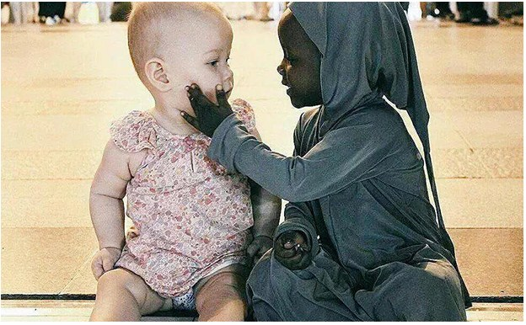
Kindness is the best form of humanity .
Thank you all

