Slide 1




Slide 2
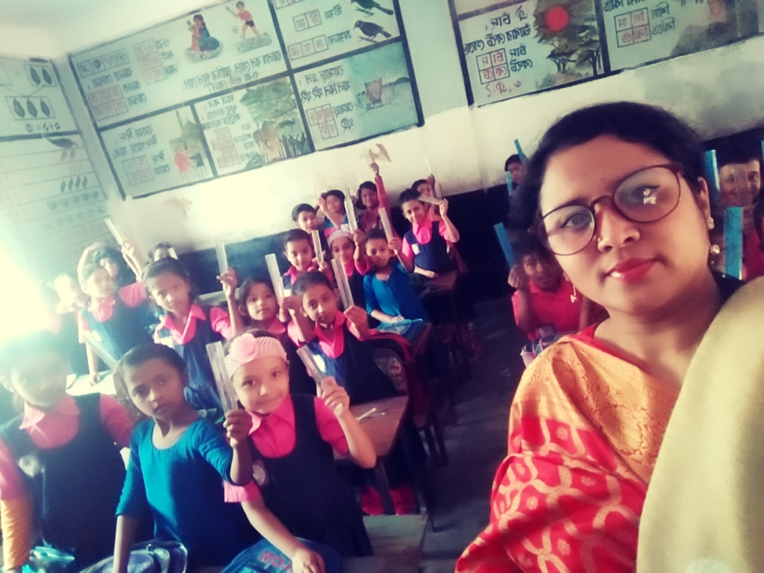
Teacher’s identity
Shahnaz ferdushi jui
Assistant teacher
Madhobpur Govt.primary school
Chhatak, Sunamgonj.

Slide 3
Lesson’s identity
Class:4
Sub:English
Today’s Lesson
Unit:39- occupations
Lessons 1

Slide 4
Lesson outcomes
speaking
1.1.1 repeat after the teacher and say words, phrases and
sentences with proper sounds and stress.
3.1.1 ask and answer Wh questions
6.2.1 talk about people, objects,
events etc.
Writing
Reading
3.1.1 write words, phrases and
sentences using non-cursive
capital and small. letters
  1.4.1 read words, phrases and
sentences in the text.
  1.5.1 read words, phrases and
  sentences in the text with
  proper pronunciation,
  stress and intonation.
  1.6.1 recognize and read
statements, commands,
greetings, questions and answer.

Slide 5

Today ?
How many members of your family and who do they do ?

Slide 6
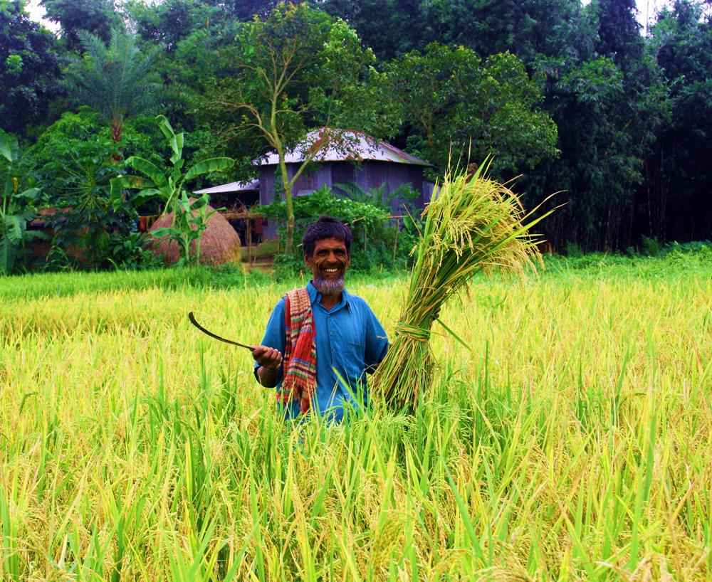
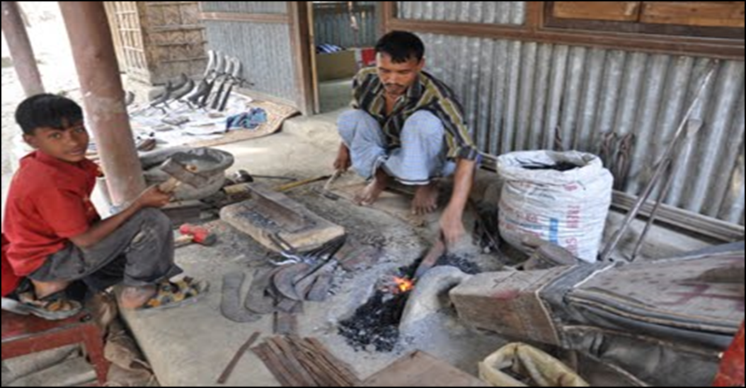

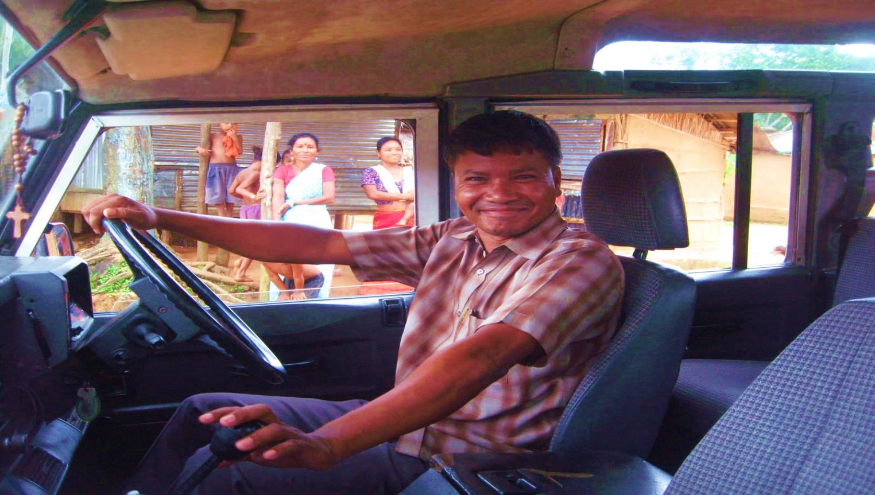
What can you see in these pictures?

Slide 7
Lesson Declaration
Occupations

Slide 8


Do you know who they are ?
doctor

Slide 9
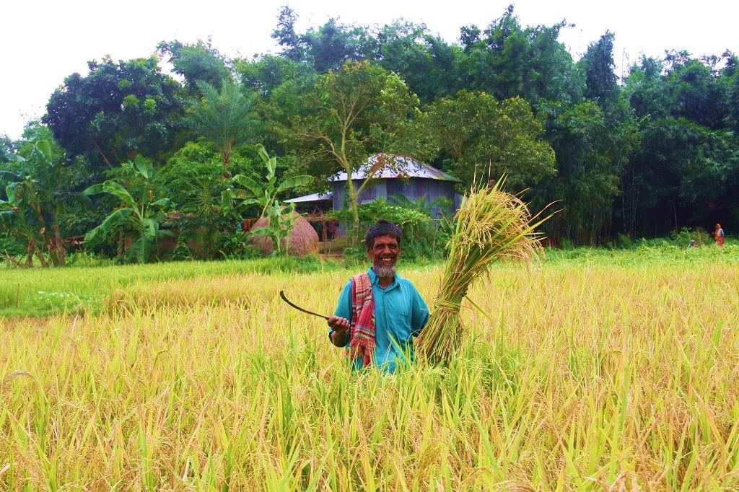
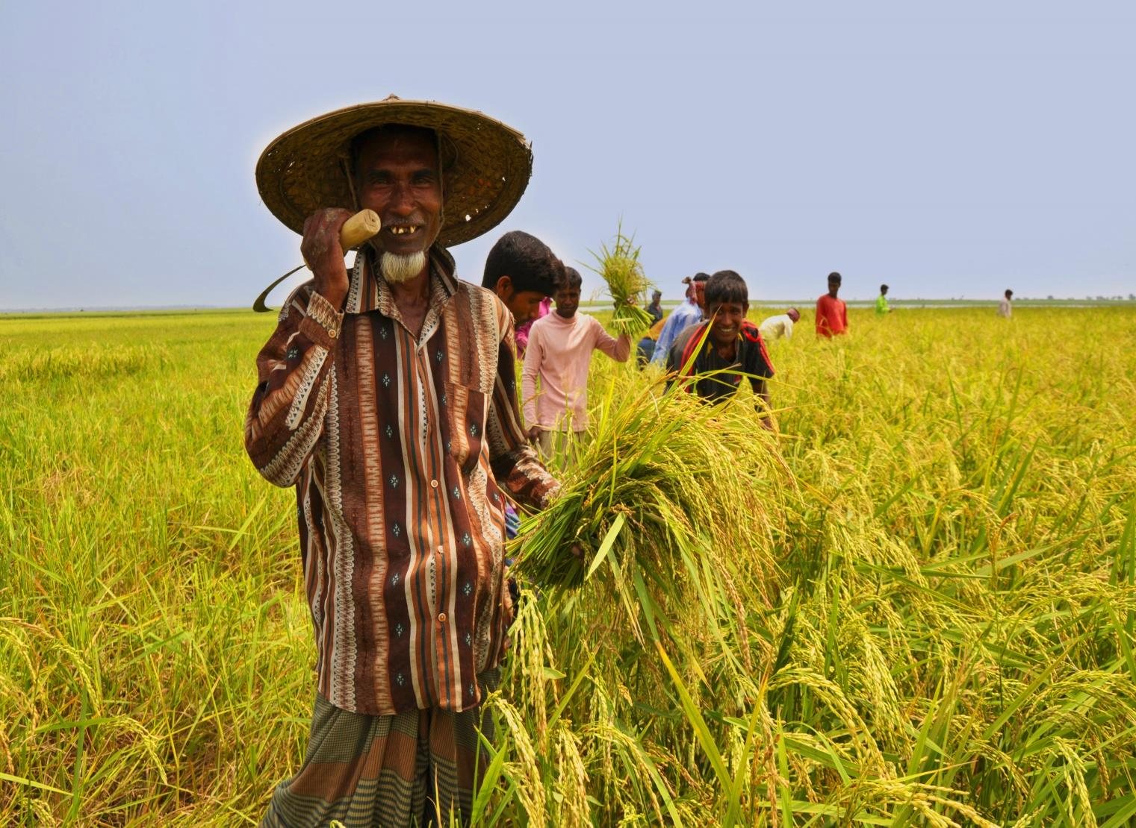
Do you know who they are ?
farmer

Slide 10

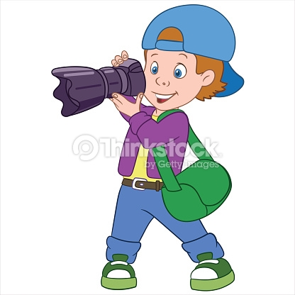
Do you know who they are ?
Photographer

Slide 11
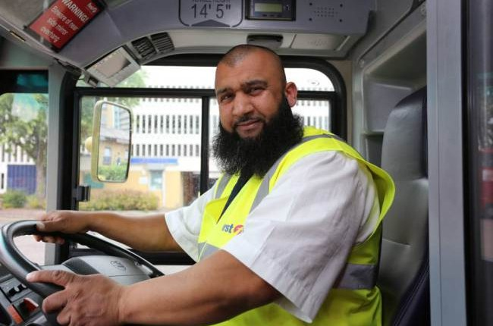
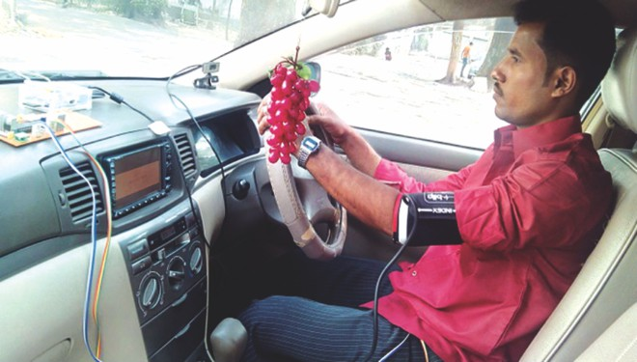
Do you know who they are ?
Driver

Slide 12
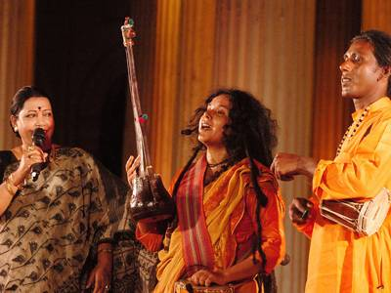
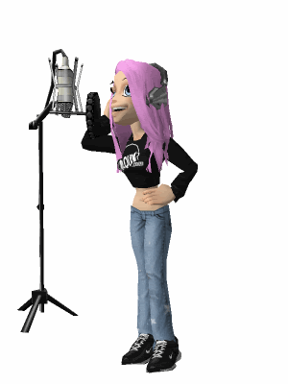
Do you know who they are ?
Singer

Slide 13
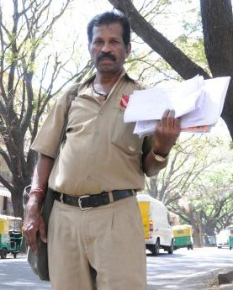
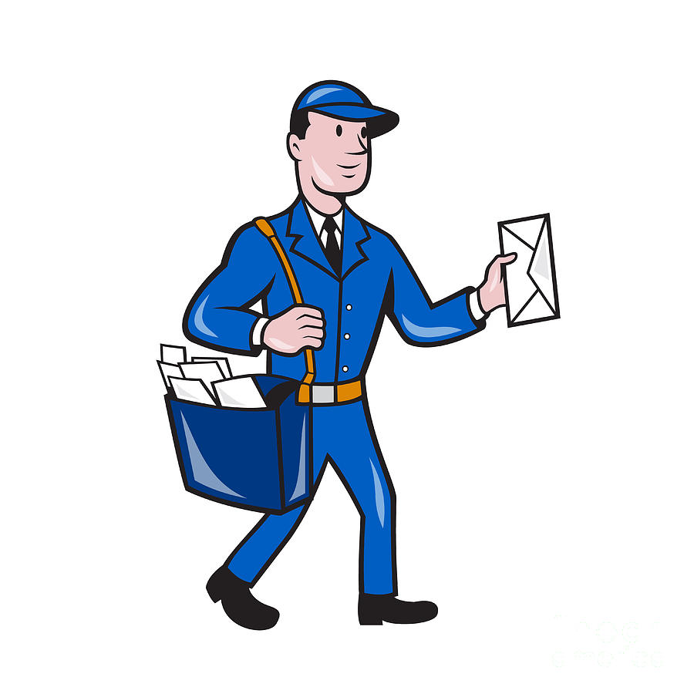
Do you know who they are ?
Postman

Slide 14

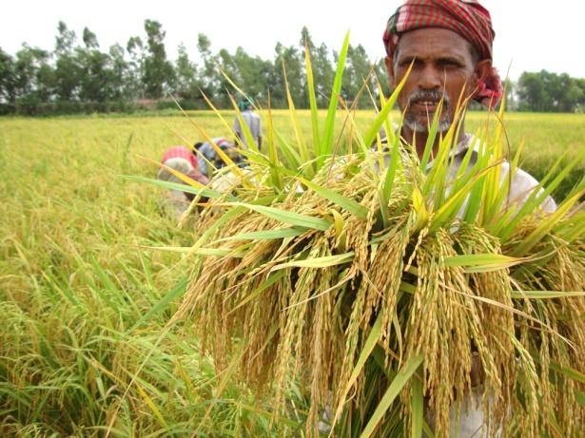
Teaching Vocabularies
A doctor
helps people.
A farmer
grows food.

Slide 15
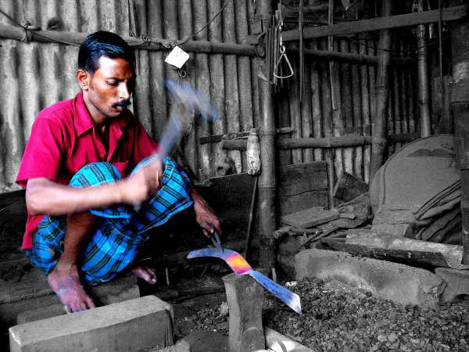
Teaching Vocabularies
A driver
drives a bus.
A blacksmith
makes things from metal.

Slide 16
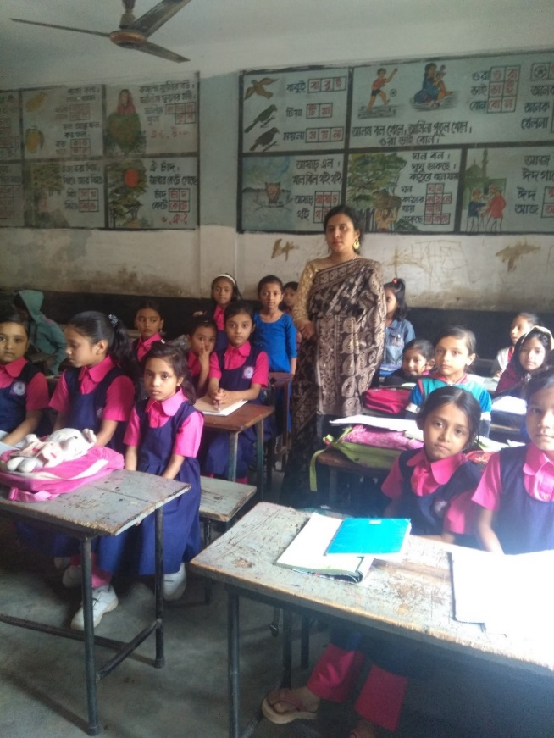
Teachers loud reading
Unit:39
Occupations
Lessons 1
page:78

Slide 17
Practice of pronunciation
Singer
Doctor
Farmer
Postman
Driver
Photographer

Slide 18

I.W
Student’s loud reading
Answer the following questions:
Who grows food?
Who helps sick people?
Who brings letters to people?
Who takes photo?
Who drives a car or a bus?
Who sings songs ?

Slide 19

What do you want to be when you will grow up? Now we play a game.
farmer
doctor
driver
Singer
postman
Photographer

Slide 20


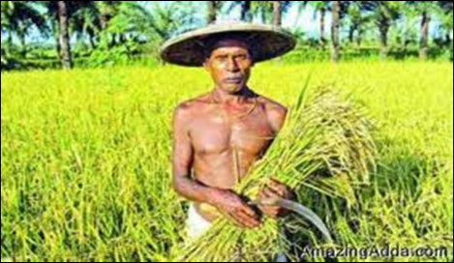
Pair Work
Match pictures with person
A farmer
A doctor
A driver
Singer

Slide 21
Group work
Group-A
Who is a farmer ?
Group-B
Who is a doctor ?
Group-C
Who is a driver?

Slide 22
Evaluation
Choose the correct answer:
Who grows food?
(i) A doctor (ii) A farmer
(iii) A postman (iv) A driver
(B) Who helps sick people?
(i) A postman (ii) A farmer
(iii) A doctor (iv) A driver
2. Fill in the gaps:
A _____________ takes photos.
A ____________ drives a car or a bus.
3. Read and match:
a) Singer i) brings letter to the people
b) Photographer ii) sings songs
c) Postman iii) takes photos
√
√
photographer
driver

Slide 23
Home work
Write 4 occupations name that you have learned today .

Slide 24
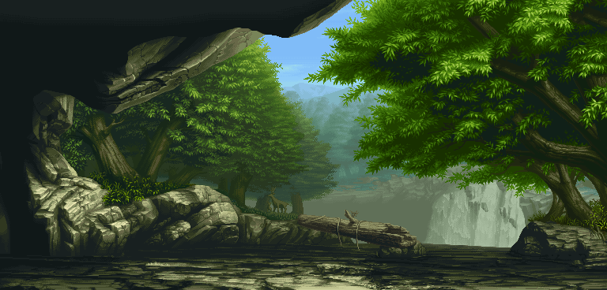

Goodbye
Good bye

