Slide 1
DEAR MY STUDENTS

Slide 2
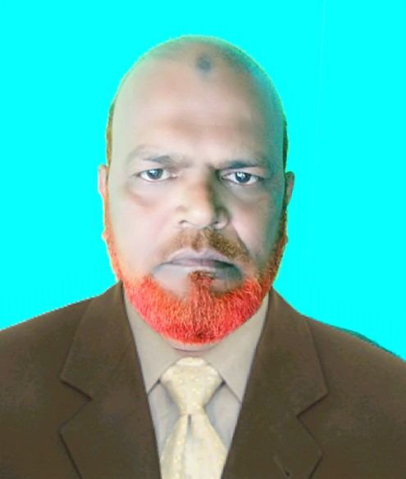
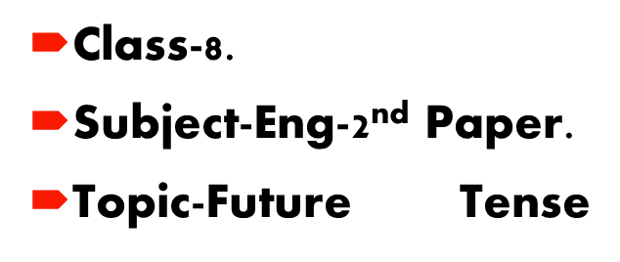
INTRODUCTION
MD.KHALILUR RAHMAN
Assistant Teacher.
AtghariaHigh School
Haripur,Thakurgaon.

Slide 3
FUTURE TENSE
The future tense is a verb tense used for a future activity or a future state of being.
For example:-
He promises that he will pay attention in the future.

Slide 4
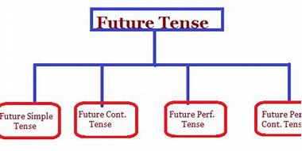

Slide 5
Future Tense
Simple Future Tense is used to express an action that will occur or happen in the future. The simple future tense refers to a time later than now, and expresses facts or certainty
form the simple future:
Subject + will + base form of verb

Slide 6
How is the future simple verb tense used?
Decisions - to make decisions that are made at the time of speaking
We will eat dinner today at 6:00PM
You will clean your room when you come home from school.
Desires - Willingness - to state desire or willingness for something or someone
The girls will be happy to go on holiday for a few weeks.
I will be happy to help you today.
Facts - to state a fact about the future
My teacher will be happy the whole class passed the test.
The phone bill will be very very high, my father will be very upset.

Slide 7
Predictions - to predicate a future event or action​
I think it will rain this afternoon.​
My sister will be a great teacher.​
Formal Statements - to make a formal statement about a future action or event​
The president will make a public announcement on Tuesday at 8:00PM.​
The school will be closed for a few days.​
Suggestions - to make suggestions or state ideas​
We will be happy drive you to the store.​
Will we go to the store tonight or tomorrow morning.​
Requests - to make a request
Will you come with me to the store?​
You will do your homework now.

Slide 8
The formula for Simple Future Tense when the First Person is Singular or Plural is that the sentence starts with the subject i.e I/ We, then a verb in its 1st form, followed by an object which is optional. So, we can say that the formula for Simple Future Tense for First Person Singular is as follows -
I/ We + shall + verb (1st form)+ object (optional)
Let us see some example sentences with formula for Simple Future Tense when the First Person is Singular/ Plural:
1) I shall study hard for exams
.The formula for Simple Future Tense when the Second Person, Third Person Singular/ Plural are involved is that the sentence starts with You/ He/ She/ Common or proper nouns/ They, with will and then a verb in its 1st form followed by an object which is optional. So, we can say that the formula for Simple Future Tense for Second Person, Third Person Singular/ Plural is as follows -
You/ He/ She/ Common or proper nouns/ They + will + verb (1st form)+ object (optional

Slide 10
The future continuous tense, sometimes also referred to as the future progressive tense, is a verb tense that indicates that something will occur in the future and continue. For an expected length of time.
It is formed using the construction will + be + the present participle (the root verb + -ing).
Future Continuous Tense

Slide 12
EXAMPLE:

Slide 13
‘Future Perfect Tense’ purely talks about the incidents those are supposed to be taking place in future; similarly, ‘Future Perfect Continuous Tense’ are used to describe actions that are happening in present and will continue in future till a specified time.
What is future perfect tense?

Slide 15
