Slide 2
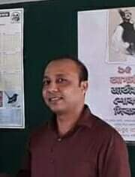
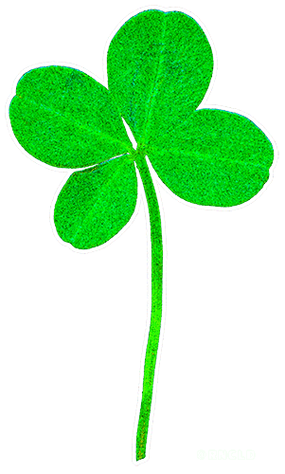
Teacher’s Identity
Satyajit goswami
Head Teacher
Betory GPS
Sadar,Moulvibazar.

Slide 3
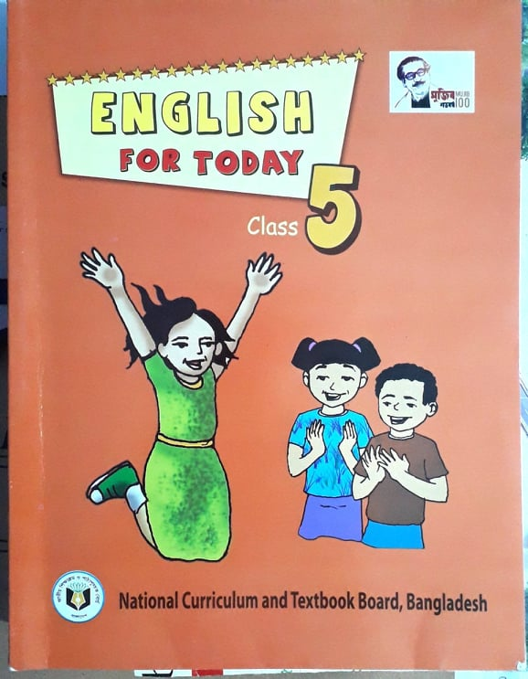
Lesson Identity
Subject: English
Class : Five
Unit:15
Happy Birthday

Slide 4
Learning outcomes
At the end of this lesson Students will be able to
Listening:
1.2.1 – recognize which syllable in a word in stressed.
3.4.1 understand statements made by the teacher and students.
Speaking: 1.1.1- repeat words, phrases and sentences after the teacher with proper sounds and stress.
1.1.2- say sentences with proper intonation .
Reading: 1.5.1- read words, phrases and simple sentences with proper pronunciation , stress and intonation.

Slide 5
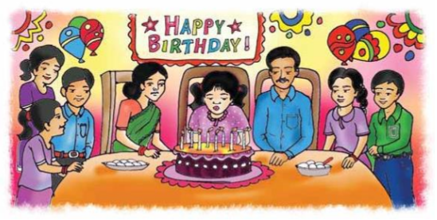
What do you see in the picture
What are they doing?

Slide 6
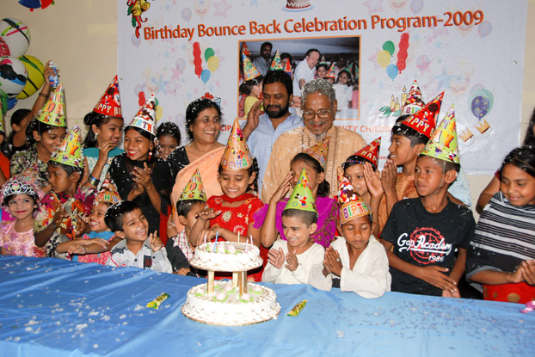
Let’s enjoy our today’s lesson about-
Happy Birthday

Slide 7
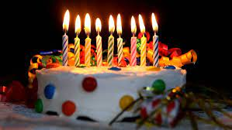
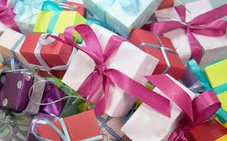
Look at the following pictures
Birthday cake
Gift
Do you know when your birthday?

Slide 8
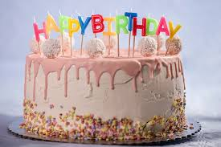
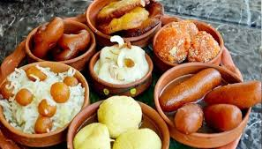
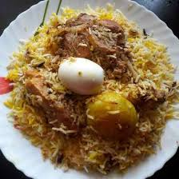
What things are needed to celebrate birthday
Cake
Sweets
Special food

Slide 9
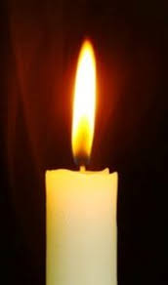
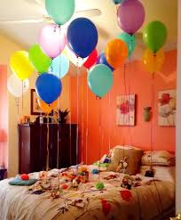
Candle
Balloon

Slide 10
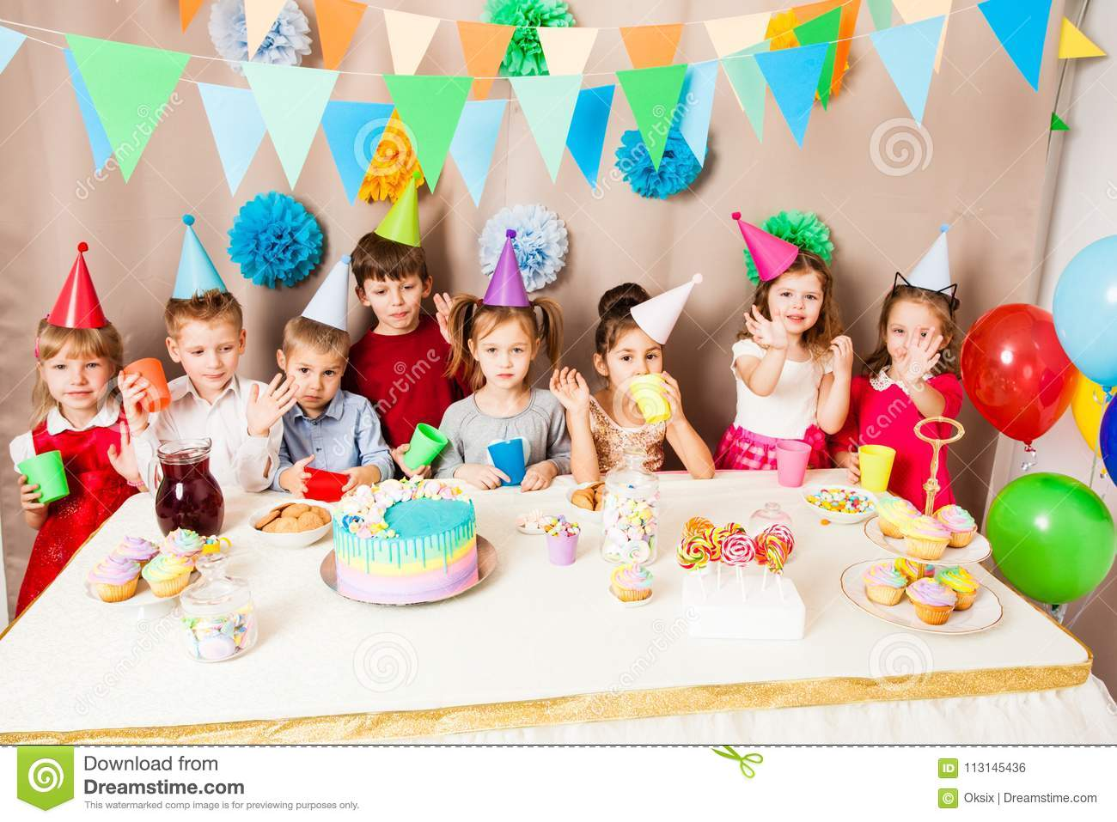
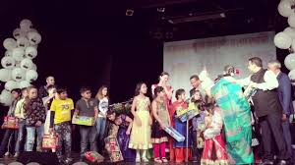
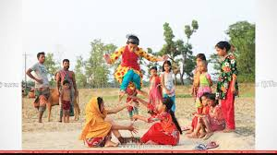
Birthday Activity
The children celebrate birthday with a cake, play
games and sing.

Slide 11
The friends often bring birthday gift.

Slide 12
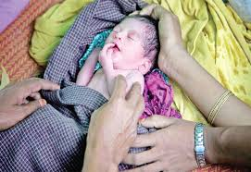
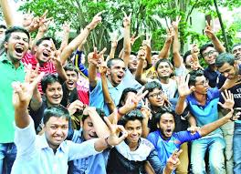
New Word, Meaning and Making sentence
Birthday
জন্মদিন
The day when a child is born.
Sentence : Today is my birthday.
Enjoy
উপভোগ করা
Pleasure in an activity or occasion.
Sentence : We enjoy swimming.

Slide 13
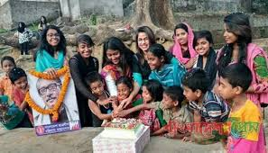
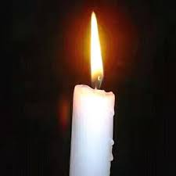
Celebrate
পালন করা, উদযাপন করা
Observe a happy day or event.
Sentence : We will celebrate our birthday.
Candle
মোমবাতি
Block of wax with a wick.
Sentence : I have a colour candle.

Slide 14
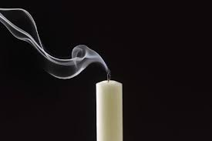
Blow out
ফুঁ দিয়ে নেভানো
Put out fire by air.
Sentence : The person blows out the candles.

Slide 15
Listen the text and match with your book

Slide 16
Group Work
Fill in the blanks with the following words:
candles, each, around, wrapped, play, often, spend.
1)People _________ the world celebrate birthdays.
2)There are __________on the cake.
3)There is one candle for __________ year of the persons
birthday.
4)The children __________ games and sing song.
5)The gifts are ___________ in colourful paper.
around
candles
each
play
wrapped

Slide 17
Pair Work
Write ‘True’ for correct statement and ‘False’ for incorrect statement.
People around the world celebrate birthdays in the same way.
2. A birthday is a special day.
3. People sing a birthday song for the birthday person.
4. The friends do not bring any gift for the birthday person.
5. The most important thing is to enjoy the day.
False
True
True
False
True

Slide 18
Evaluation
1.What is the most important thing for a birthday?
Ans: The most important thing is to enjoy the day and spend time with friends and family.
2. What do the children do on a birthday party?
Ans: The children play games and sing.

Slide 19
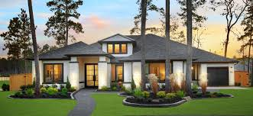
Home work
Write a short composition at least in 10 sentences about
Your birthday

Slide 20
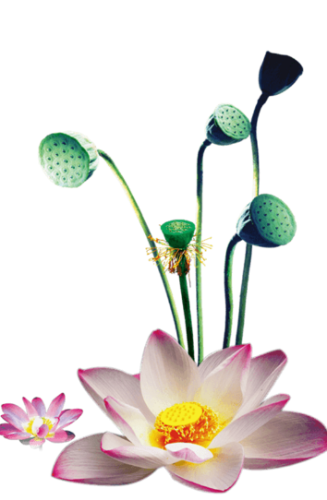
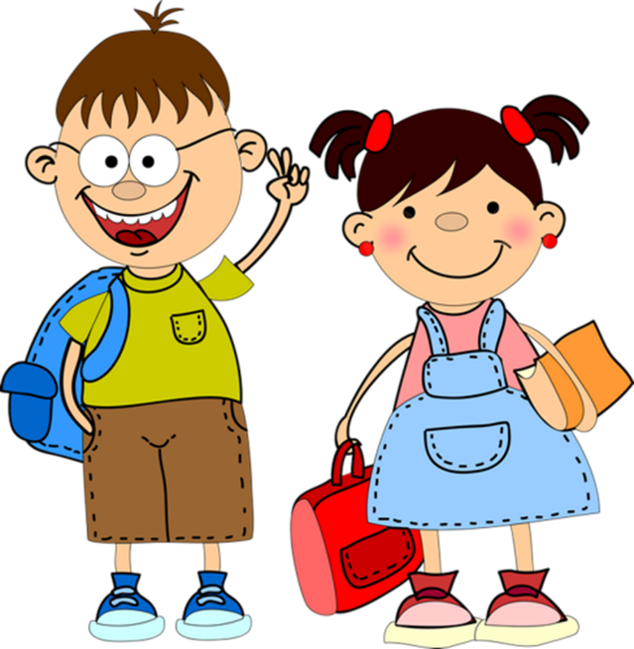
Thank you

