Slide 2
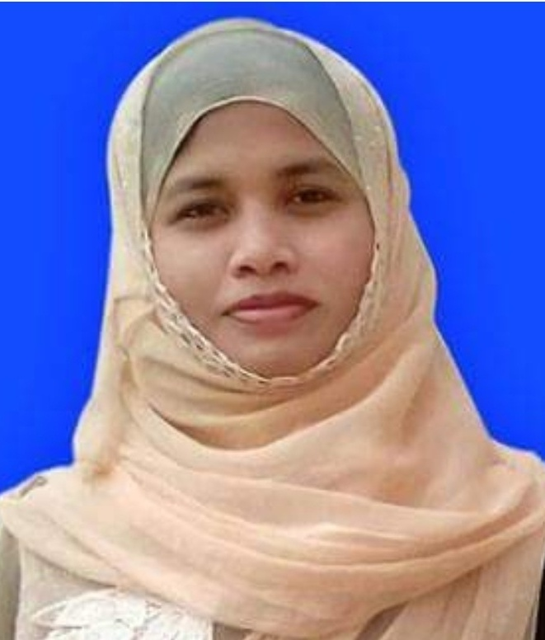
Teacher Introduction
Kuhinur Jannat
Assistant teacher
Fakirakhata Govt. Primary School
Moheshkhali, Cox’sbazar

Slide 3
Lesson Introduction
English For Today
Unit : 2
Lesson : 5-6
Activity : G
Title : See you!

Slide 4
Learning Outcomes
At the end of the lesson students will be able to
Listening :
1.4.2 recognize and use intonation patters for greetings and statements.
Speaking :
2.1.1 exchange greetings and farewells.
2.1.2 make introductions.
Reading :
1.5.1 read words, phrases and sentences in the text with proper pronunciation, stress and intonation.
1.6.1 recognize and read statements, commands, greetings, questions and answers.

Slide 5
Mr. Kuhinur Jannat
Mrs. Kuhinur Jannat
Am I a man?
Am I a woman?
I am a woman

Slide 6
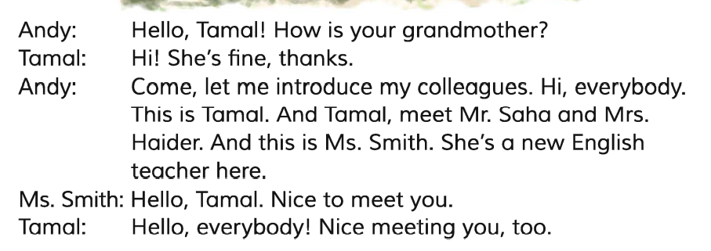
Open your Book at page 7 & look at the Dialogue

Slide 7
Mr. Saha
Is he man/ woman?
Mrs. Haider
Ms. Smith

Slide 8
Married

Slide 9
Use of “Mrs”

Slide 10
Use of “Ms”

Slide 11
Use of “Miss”

Slide 12
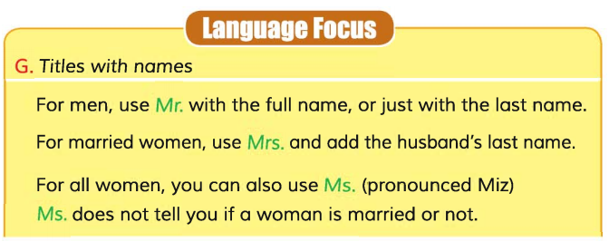
Teachers loud reading

Slide 13
Students silent reading

Slide 14
Practice
Come here any one
Write your name.

Slide 15
Assessment

Slide 16
What have we learnt from the lesson?
“We’ve learnt how to address men and women. As well as how to address married and unmarried women.”

