Slide 1
WELCOME

Slide 2
Teacher introducing
Abu said chudhury
Assistant teacher
Horitola Govt primary schoo
Bahubol.

Slide 3
Lesson Introducing
Class: One
Subject: English
Unit- 27 Lesson: 1-3
Activity- Rhyme (B)

Slide 4
Learning Out Comes
Students will be able to-----------
Listening 1.1.1 become familiar with English sounds by listening to
common English sounds.
4.1.1 enjoy the rhyme and music of simple rhymes.
Speaking 1.1.1 repeat after the teacher simple words and phrases.
1.1.2 say simple words and phrases.
4.1.1 repeat rhymes after the teacher.
4.1.2 recite rhymes individually.

Slide 5
Greetings
Teacher :Good morning, students.
Student : Good morning, teacher.

Slide 6
Let’s sing a song with me
W
A
R
M
U
P
Good morning ,Good morning
How are you today?
I am fine? I am fine
I wish you a good day

Slide 7
Let’s see some cards
1
2

Slide 8
Title declaration
Today we will read about
Rhyme 1,2

Slide 9
P
R
E
S
E
N
T
A
T
I
O
n
1
2
Put on your shoe

Slide 10
3
4
Close the door

Slide 11
5
6
Pick up sticks

Slide 12
7
8
Lay them straight

Slide 13
9
10
Draw a hen

Slide 14
Open your book and go to page no 54

Slide 15
Today we read about
1,2 ryhme

Slide 16
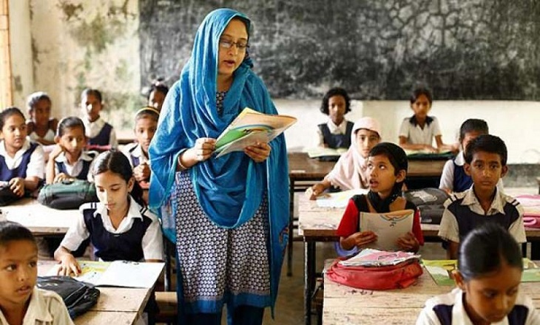
T
E
A
C
H
E
R
S
R
E
A
D
I
N
G

Slide 17
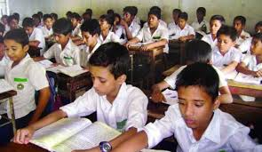
S
T
U
D
E
N
T
S
R
E
A
D
I
N
G

Slide 18
Chain drill
1, 2
put on your shoe
3,4
Close the door
5,6
Pick up sticks

Slide 19
PRACTICE

Slide 20
Group work
Every five make a group
Recite the rhyme in group.

Slide 21
Check & learning
Tell students to recite the rhyme individually.

Slide 22
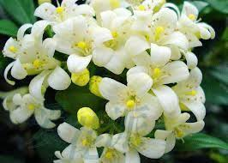
Good bye

