Slide 2
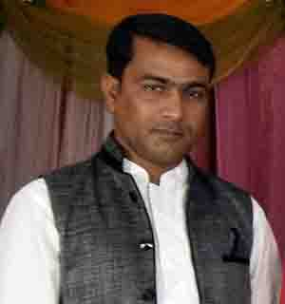
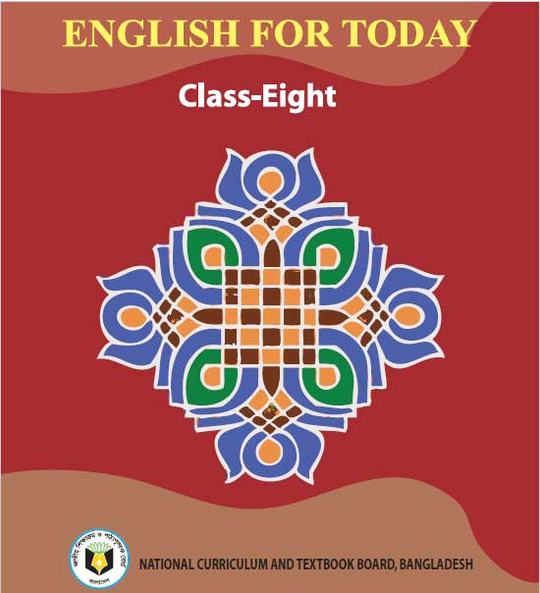
Identity
Muhammad Rehan Uddin
Assistant Teacher
Pakshail Ideal High School
Barlekha, Moulvibazar.
Mobile: 01742823363
Email: mdrehanuddin17@gmail.com
Subject: English 1st Paper
Class: Eight
Unite: One, Lesson: Four
Time: 50 Minutes

Slide 3
Learning Outcomes
After we have studied this lesson we will able to…
Read and Understand text
Choose the best answers
Write a conversation
Write answer to questions
Write a short composition

Slide 4
Let’s see some pictures

Slide 5
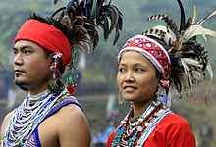
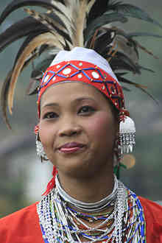

Slide 6
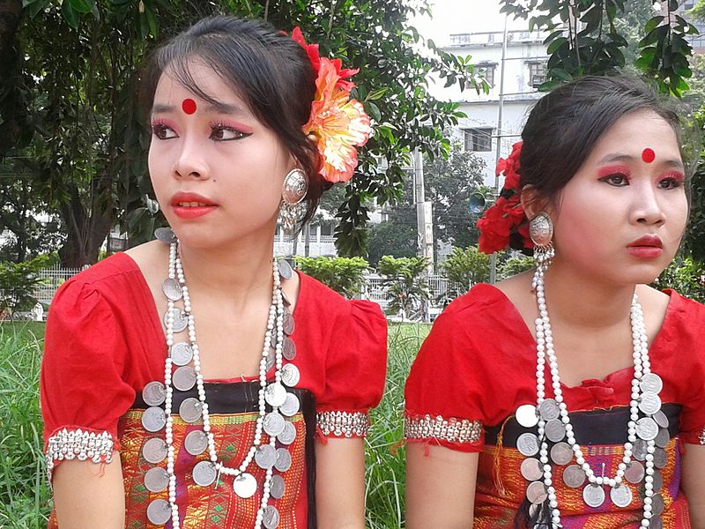

Slide 7
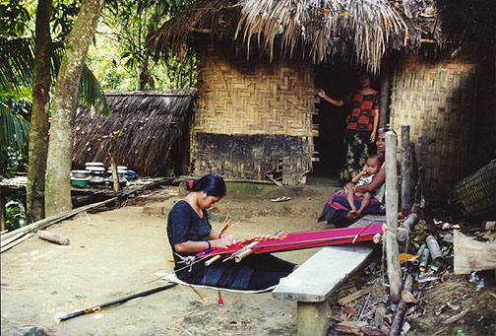
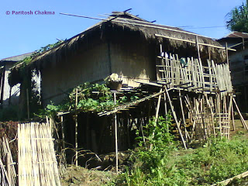

Slide 8
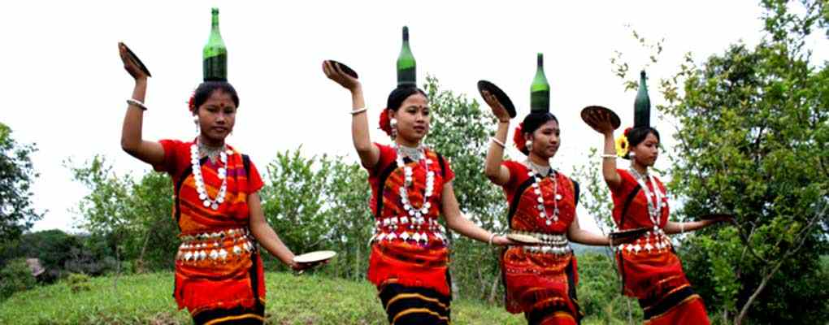

Slide 9
Today’s our lesson is ----
“Our ethnic friends(2)”

Slide 10
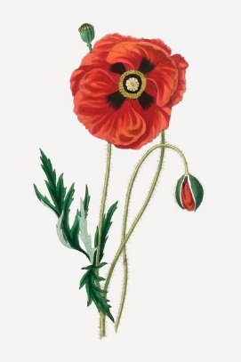
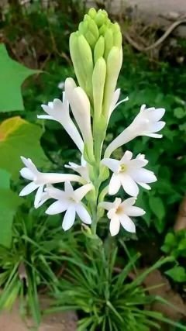
Read some information about it.

Slide 11
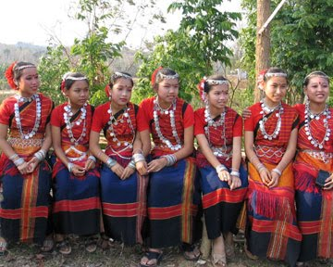
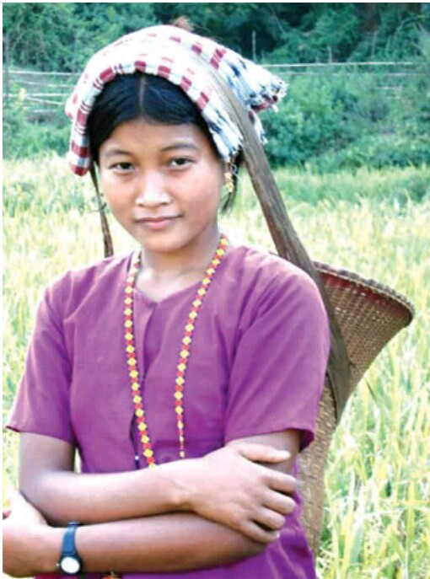
Most of these ethnic people living in Bangladesh have some common characteristics. They have their own lifestyles.

Slide 12
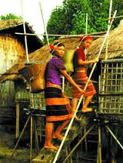
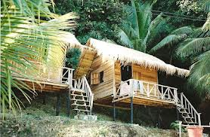
They build their houses on bamboo or wooden platforms called ‘ machang ’.

Slide 13
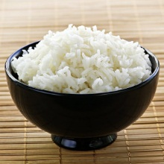
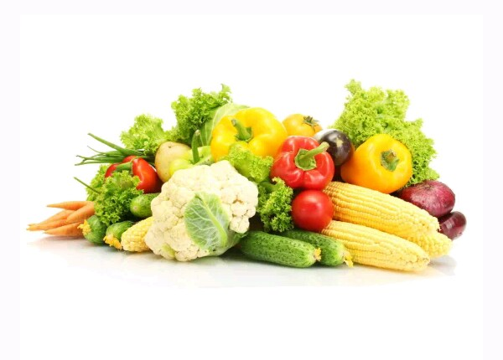
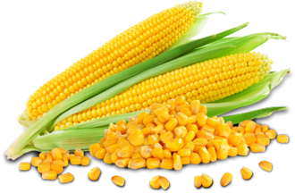
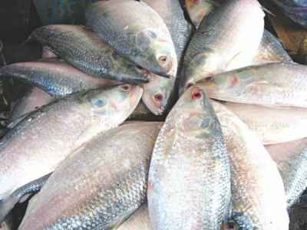
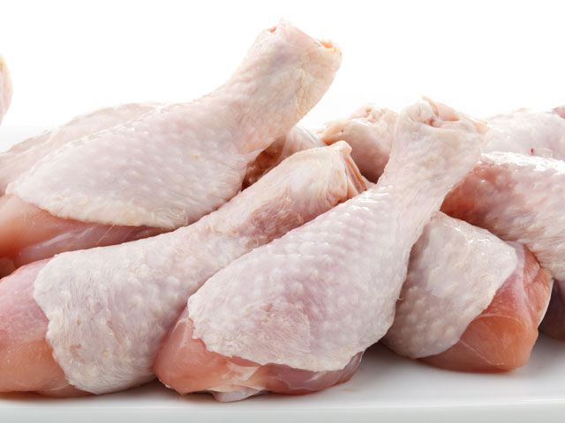
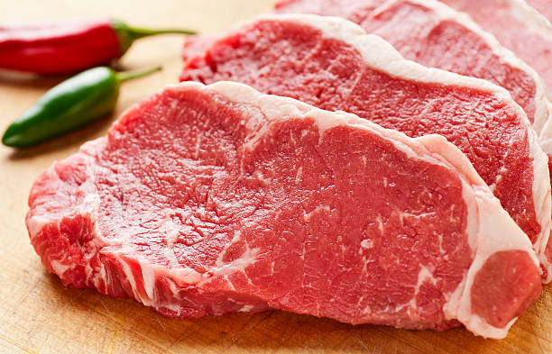
Rice is their staple food. They eat vegetables , maize and fish, poultry and meat.

Slide 14
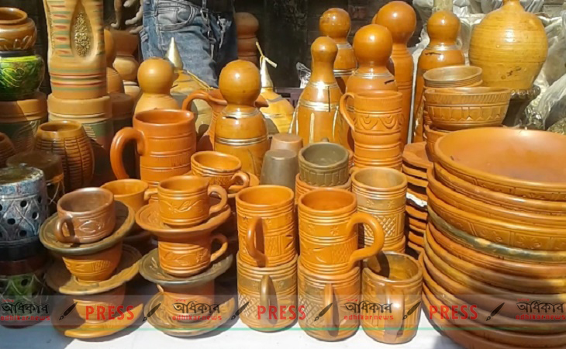
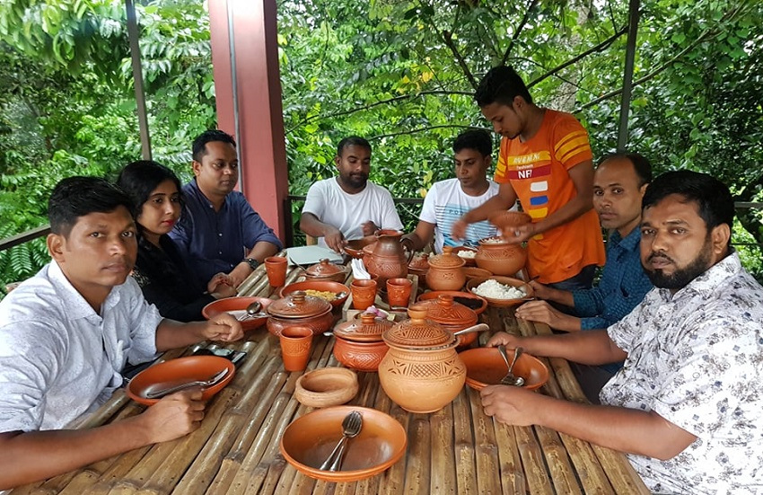
Their kitchen utensils are bamboo , wooden and earthen pots which they make themselves.

Slide 15
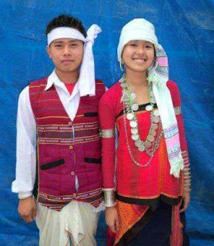
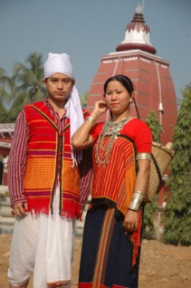
Men wear lungis and women wear thamis or sarongs and angis.

Slide 16
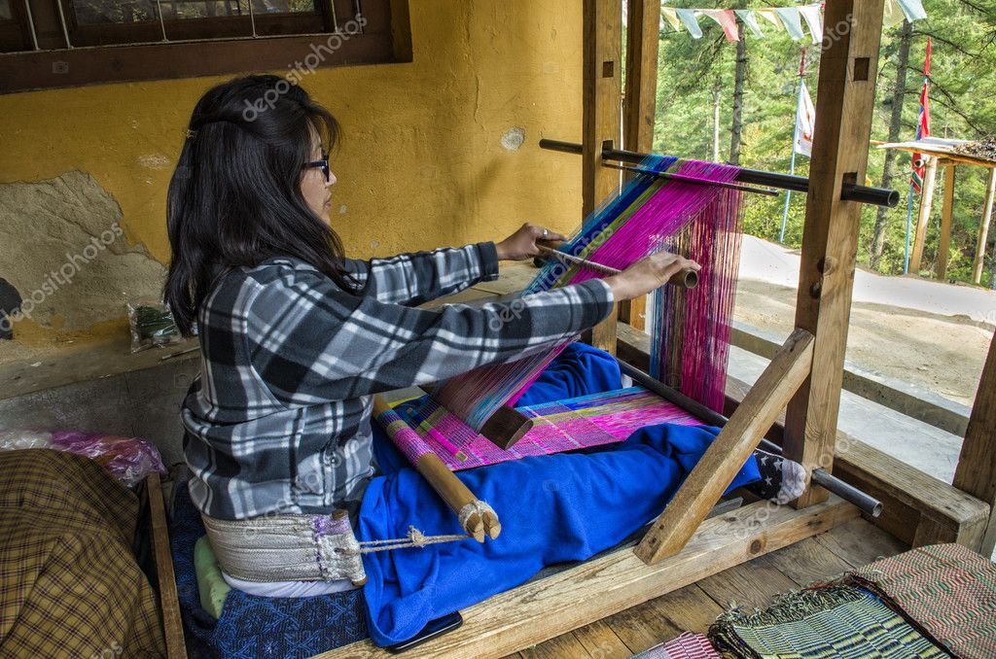
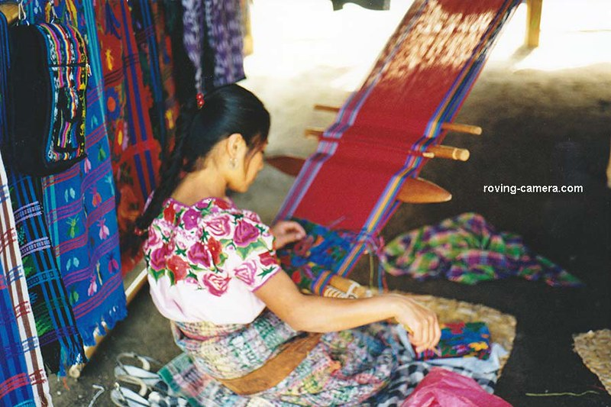
Women weave their own clothes.

Slide 17
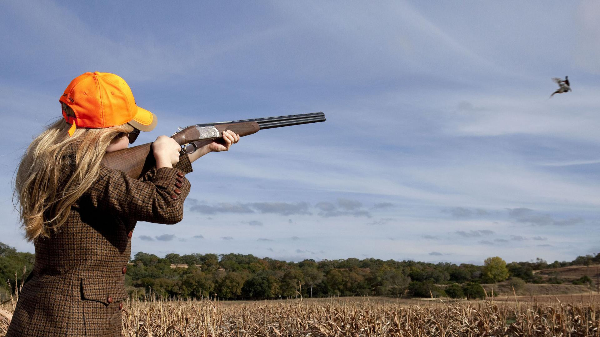
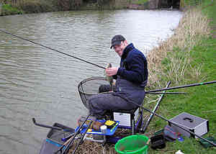
Hunting and fishing are favorite pastimes.

Slide 18
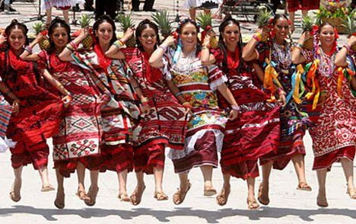
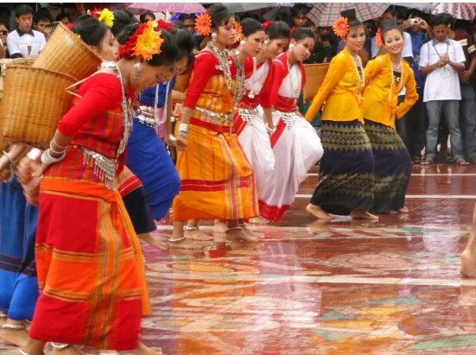
They are fond of songs , music , dances , theatre and fairs.

Slide 19
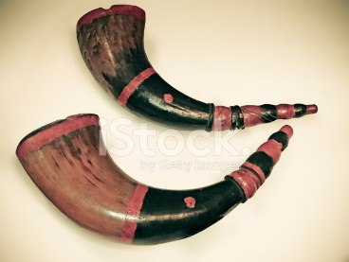
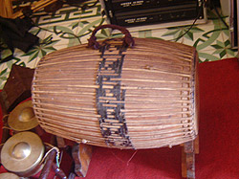
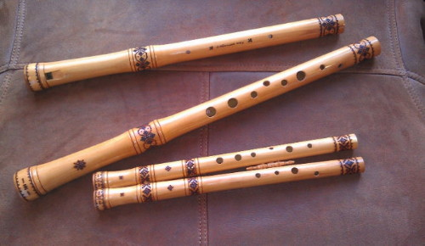
Traditional musical instruments used are bugles made from buffalo horns , drums and bamboo flutes.

Slide 20
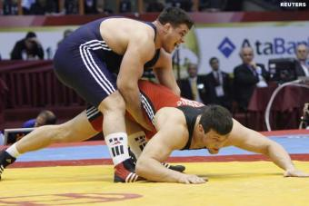
Wresting is a popular sport for them.

Slide 21
Word
Meaning
One kind of corn
Maize

Slide 22
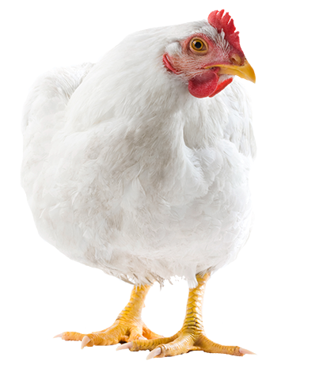
Poultry
Domestic/raised fowl

Slide 23
People with common backgrou-nd
Communities

Slide 24
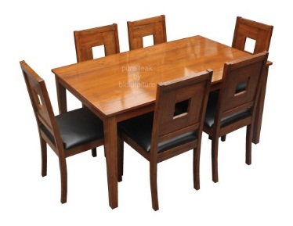
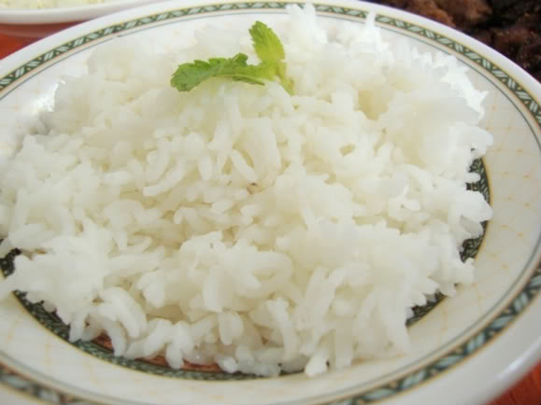
Wooden
Made of wood
Staple
Main

Slide 25
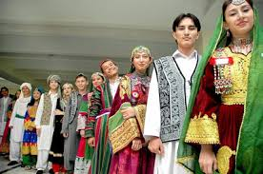
Tribal
Ethnic
Way of life
Lifestyle

Slide 26
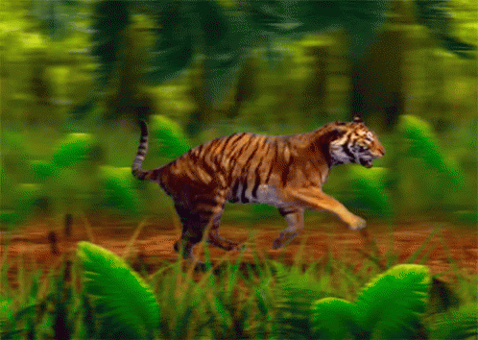
Characteristics
Uniqueness

Slide 27
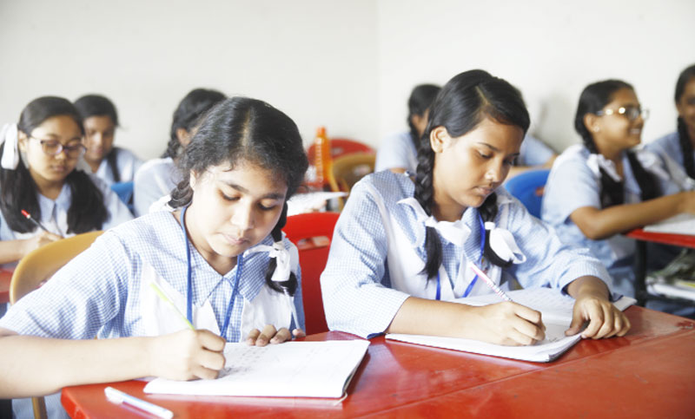
Individual Work
Choose the best answer from the alternatives:
-----usually weave the clothes that they use.
(i) Men (ii) women (iii) children (iv) All
(b) Songs and music are very ----- to them
(i) Favorite (ii) Disgusting (iii) Uncommon
(iv) Rare

Slide 28
The earthen pots are made by-------
(i) Leaders (ii) Professionals (iii) Themselves
(iv) Children
(d) The ethnic people practice their---lifestyle.
(i) Unusual (ii) Modern (iii) Own (iv)
Neighbors'
(e) Hunting is -----pastimes for the ethnic
people.
(i) One of the (ii) Never a (iii) The only (iv)
Should be the

Slide 29
Pair Work
Imagine you are Rohan and you have a Marma Friend called Masing. Now write a dialogue between you and your friend Masing about their dress , food , sports and pastimes.

Slide 30
Answer
Rohan: Hi Masing! What are you humming sitting on the
staircase?
Masing: oh, Rohan! Actually it is one of our tribal songs,
we Marmas like this very much.
Rohan: Would you please tell me about the dress , food ,
songs , sports and pastimes?
Masing: Of course. Our men wear lungis and women wear
thamis or Sarong and angis.
Rohan : What is your staple food?

Slide 31
Masing: Our staple food is boiled rice. We also eat
vegetables, maize fish and meats.
Rohan: What about your songs, sports and pastimes?
Masing: We like song and music very much. We use
bugles made from buffalo horns, drums and
bamboo flute as traditional music instrument.
Wrestling is the most popular sport with us.
Hunting and fishing are our favorite pastimes.
Rohan: I could know much about your culture. Thank you
very much.
Masing: You are welcome.

Slide 32
Group Work
What is the staple food of the ethnic people?
What do their women wear?
What are their traditional musical instruments?
What are their favorite pastimes?
What are their kitchen utensils?

Slide 33
Answer
Rice is the staple food of the ethnic people.
Their women wear thamis or sarong and angis.
Their traditional musical instruments are bugles, drums, and bamboo flutes.
Their favorite pastimes are hunting and fishing.
Bamboo, wooden an earthen pots are their kitchen utensils.

Slide 34
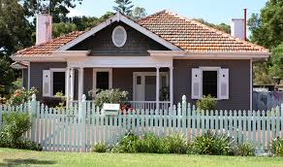
Homework
Write a short paragraph about
“ The lifestyle of ethnic people”.

Slide 35
Thanks for
all

