Slide 1
Dear Learners
Welcome To Today’s Multimedia Class

Slide 2
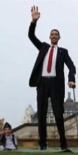
Smallest
Biggest
Smallest
highest
shortest
tallest

Slide 3
Yes,
Degrees of Comparison: Section One
1.0. Degree: Superlative To Positive
Positive Degree: No other + Noun
Positive Degree: No other + Noun

Slide 4
Learning Outcomes
Students can able to:
identify superlative and positive degree;
develop the idea of applying “superlative and positive form of Degree of Comparison -Adjective”;
feel relax to get the examples of public exam questions.

Slide 5
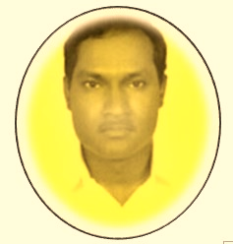
- Identity -
Lesson’s
Teacher’s
Class: Nine
Sub: English
(Degrees of Comparison )
Time: 50 Minutes
M. Alam Miah
Assistant Teacher English
Shilakotha High School
Dohar, Dhaka.

Slide 6
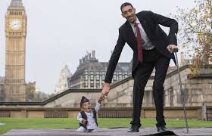
Degrees of Comparison: Section One
1.1. Degree: Superlative To Positive
Superlative Degree : He is the tallest boy.
(boy)
Subject
Verb
Superlative Form
Noun
If we want to convert the above Superlative Sentence into Positive, we should write:
Positive Degree: No other + Noun

Slide 7
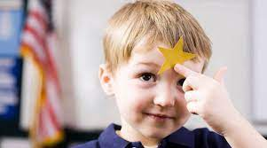
Degrees of Comparison: Section One
1.2. Degree: Superlative To Positive
boy
Superlative Degree : He is the best boy.
he.
is
as
good
as
Subject
Verb
Superlative Form
noun
Subject
Verb
noun
Po. Deg : No other + noun + Veb + as + Positive form + as + Sube ct
Po. Deg : No other
No other

Slide 8
Degrees of Comparison: Section One
1.3. Degree: Superlative To Positive
boy
Superlative Degree : He is the smallest boy.
he.
is
as
small
as
Subject
noun
Subject
Verb
Superlative Form
noun
Verb
Po. Deg : No other + noun + Veb + as + Positive form + as + Sube ct
Po. Deg : No othe
No other

Slide 9
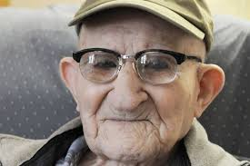
Degrees of Comparison: Section One
1.4. Degree: Superlative To Positive
Superlative Degree : Raj is the oldest man.
Raj.
is
as
old
as
man
Subject
noun
Subject
Verb
Superlative Form
noun
Verb
Po. Deg : No other + noun + Veb + as + Positive form + as + Sube ct
Po. Deg : No other
No other

Slide 10
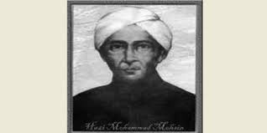
Degrees of Comparison: Section One
1.5. Degree: Superlative To Positive
Superlative Degree : Mohsin was the greatest person.
Mohsin.
was
as
great
as
person
Subject
noun
Subject
Verb
Superlative Form
noun
Verb
Po. Deg : No other + noun + Veb + as + Positive form + as + Sube ct
Po. Deg : No other
No other

Slide 11
Degrees of Comparison: Section One
1. Degree: Superlative To Positive
From Public Exam Questions
Superlative
To
Positive

Slide 12
Degrees of Comparison: Section One
1.6. Degree: Superlative To Positive
Superlative Degree : Education is the greatest wealth.
education.
is
as
great
as
wealth
Subject
noun
Subject
Verb
Superlative Form
noun
Verb
Po. Deg : No other + noun + Veb + as + Positive form + as + Sube ct
Po. Deg : No other
No other

Slide 13
Degrees of Comparison: Section One
1.7. Degree: Superlative To Positive
way
Superlative Degree : Honest way is the best way.
honest way.
is
as
good
as
Subject
noun
Subject
Verb
Superlative Form
noun
Verb
Po. Deg : No other + noun + Veb + as + Positive form + as + Sube ct
Po. Deg : No othe
No other

Slide 14
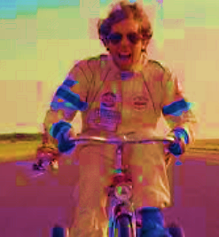
Degrees of Comparison: Section One
1.8. Degree: Superlative To Positive
man
Superlative Degree : A successful man is the happiest man.
a successful man.
is
as
happy
as
Subject
noun
Subject
Verb
Superlative Form
noun
Verb
Po. Deg : No other + noun + Veb + as + Positive form + as + Sube ct
Po. Deg : No othe
No other

Slide 15
Degrees of Comparison: Section One
1.9. Degree: Superlative To Positive
as
person
Superlative Degree : A corrupt man is the most hated person.
a corrupt man.
is
hated
as
Subject
noun
Subject
Verb
Superlative Form
noun
Verb
Po. Deg : No other + noun + Veb + as + Positive form + as + Sube ct
Po. Deg : No other
No other

Slide 16
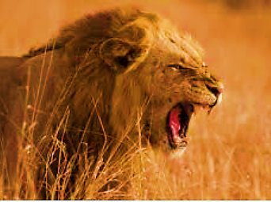
Degrees of Comparison: Section One
1.10. Degree: Superlative To Positive
animal
Superlative Degree : A lion is the most ferocious animal.
a lion.
is
as
ferocious
as
Subject
noun
Subject
Verb
Superlative Form
noun
Verb
Po. Deg : No other + noun + Veb + as + Positive form + as + Sube ct
Po. Deg : No other
No other

Slide 17
Degrees of Comparison: Section One
1.11. Degree: Superlative To Positive
thing
Superlative Degree : Child abuse is the most disgraceful thing.
child abuse.
is
as
disgraceful
as
Subject
noun
Subject
Verb
Superlative Form
noun
Verb
Po. Deg : No other + noun + Veb + as + Positive form + as + Sube ct
Po. Deg : No othe
No other

Slide 18
Degrees of Comparison: Section One
1.12. Degree: Superlative To Positive
man.
creation
Superlative Degree : Man is the most intelligent creation.
is
as
intelligent
as
Subject
noun
Subject
Verb
Superlative Form
noun
Verb
Po. Deg : No other + noun + Veb + as + Positive form + as + Sube ct
Po. Deg : No othe
No other

Slide 19
Pair Work

Slide 20
Pair Work
1. She is the laziest woman in the family.
2. Ice is the coldest substance.
3. Mira was the best student in the class.
4. Cox’ Bazar is the longest sea beach in the world.

Slide 21
Home Work
1. He is the happiest man in this area.
2. Hamim is the most popular leader in our country.
3. Mohsin was the kindest man in the world.
4. The scenery is the most wonderful scenery in the garden.
5. My grand mother was the wisest woman in the village.

Slide 22
U s e M a s k
S t a y S a f e t y
Thanks for Watching This Video

