Slide 1
You’re welcome

Slide 2
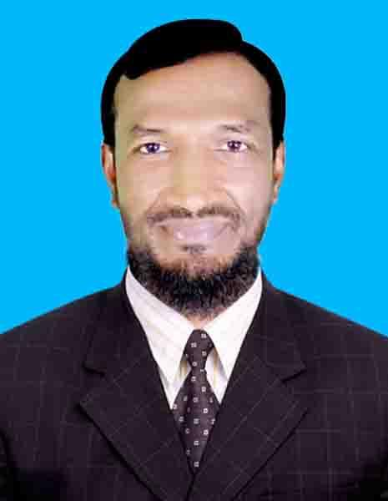
Teacher’identy
Name of the Teacher:
Mst:Tahazzuma Begum.
Assistant teacher,
09 No: Farakkabad Govt. Primary School.
Birol, Dinajpur.

Slide 3
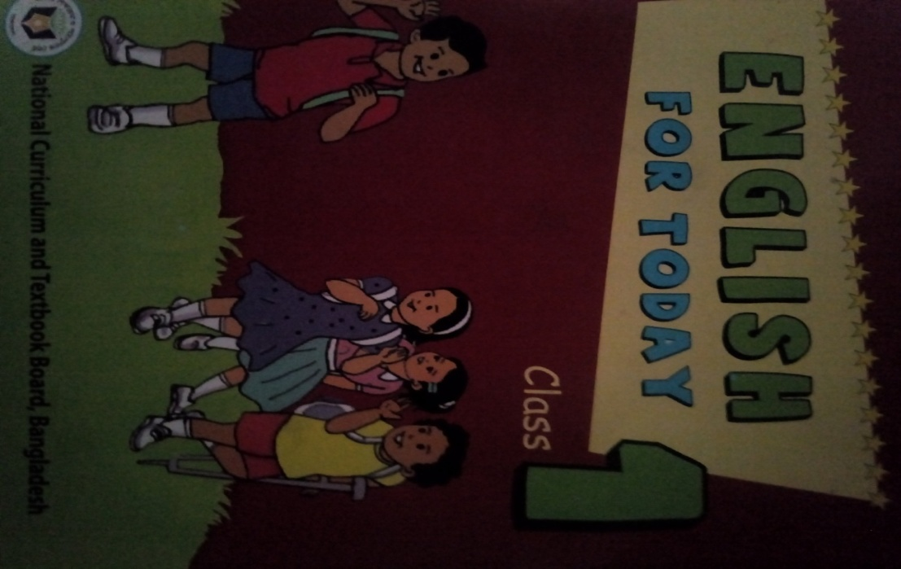
Todays lesson
Class: One
Subject: English
Lesson Title- Pre-writing and alphabet song
Lesson duration- “a b c ……… with me.”
Unit: 1
Lessons: 4-6
Time: 45 Minutes
Date: 15-05-2021

Slide 4
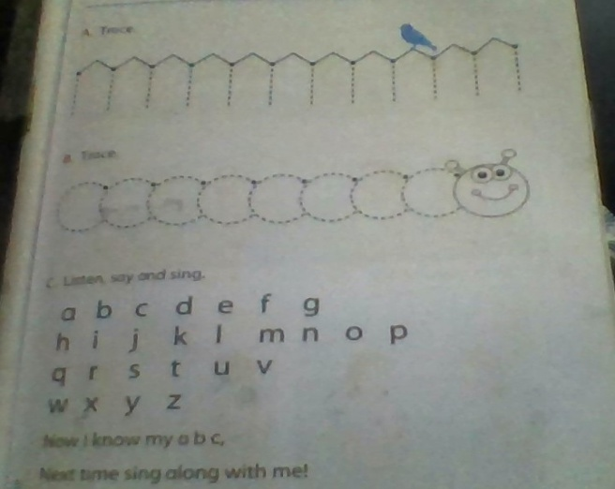
Learning outcomes
Learning outcomes: Students will be able to ………..
Listening: 1.1.1become familiar with English sounds by listening to common English words. Speaking: 1.1.3 Sing the alphabet song.

Slide 5
A B C

Slide 6
Alphabed Song

Slide 8
Repeat after me again
L
A | B | C | D | E
F | G | H | I | J
K | L | M | N | O
P | Q | R | S | T
U | V | W | X | Y
Z
L
L

Slide 9
Let’s sing the alphabet song A B C D E F G H I J K L M N O P Q R S T U V W X Y Z Now I know my a b c Next time sing along with me

Slide 11
আমার কনটেন্ট দেখে আপনার মূল্যবান মতামত,রেটিংওলাইক প্রদান করার জন্য বিনীত অনুরোধ করছি।ঘরে থাকুন,সুস্থ থাকুন।নিরাপদে থাকুন।ধন্যবাদ,মন্তব্য করুন ।

