Slide 1


Wel Come

Slide 2

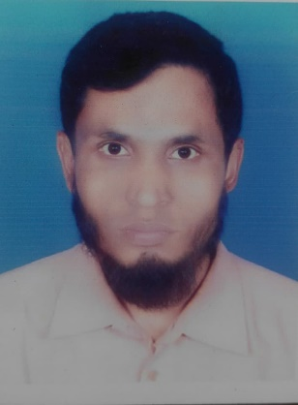
PRESENTED BY
Belayet Hossain
Assistant Teacher
05 No South Jonardondi Government Primary School
Kalkini, Madaripur.
Gmail : belayet01715205765@gmail.com

Slide 3
Lesson Identity
Class : Two
Subject : English
Lesson : 4-6
Unit : 1

Slide 4
Learning Outcomes
By the end of the lesson the students will be able to--------
1.1.1 Become familiar with English sounds by listening to common English words.
1.1.1 Repeat after the teacher similar words and phrases with proper sounds and stress.
1.2.1 recognize and read the alphabet both small and capital. (non-cursive)
1.2.1 write non-cursive small letters.

Slide 5
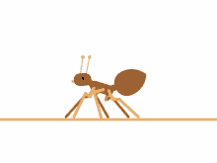
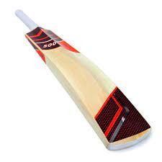

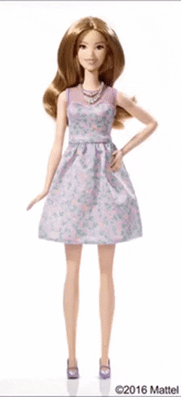

Look at the picture
ant
bat
cup
doll
egg
What are this?
This are Alphbet

Slide 6
Today’s lesson
Alphabet
Aa…….Ee

Slide 7
Look at the picture
Say and read loudly
Aa
ant

Slide 8
Look at the picture
Say and read loudly
Bb
bat

Slide 9

Look at the picture
Say and read loudly
Cc
cup

Slide 10
Look at the picture
Say and read loudly
Dd
doll

Slide 11
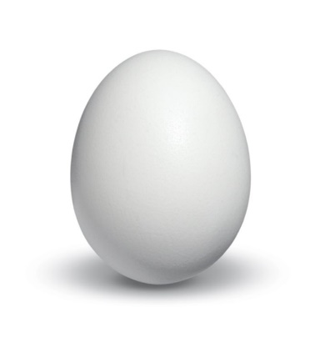
Look at the picture
Say and read loudly
Ee
egg

Slide 12
Read and say
Read and say loudly
ant
bat
cup
doll
egg

Slide 13
Read and say
ant
bat
cup
doll
egg

Slide 14


Look and say. Write.
ant
bat
cup
egg
doll

Slide 15


Thanks to All.
Good Bye, Tata.
Thanks to All.

