Slide 1
Welcome

Slide 2
INTRODUCTION OF A TEACHER
Shaheen Ahmed
Assistant Teacher
Singraoli GPS
Biswanath, Sylhet
Mob: 01712332117
E-mail: shaheen332117@gmail.com

Slide 3
INTRODUCTION OF THE LESSON
Class: Three
Sub: English
Unit: Two
Lesson: 1-3
Time: 45 minutes

Slide 4
Let’s enjoy a video

Slide 5
LEARNING OUTCOMES
Reading:
1.5.1 Read simple sentences with proper pronunciation and stress.
Writing:
8.1.1 write words from the textbook or model.
Listening:
3.1.1 understand simple question about student family and friends. 3.1.1 understand statemends.
speaking :
3.1.1 ask and answer Wh – question.

Slide 6
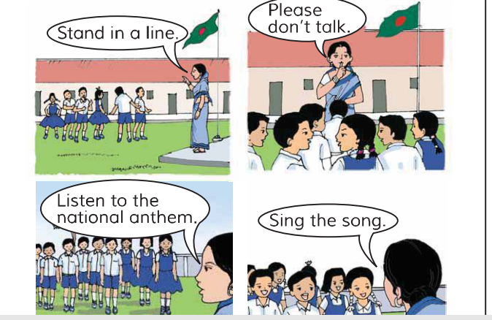
Creating learning environment

Slide 7
How many people in this picture?
Where does he work?
What does he do?
He looks like.

Slide 8
Who is he?
Where does he work?
What is your father do?

Slide 9
Lesson declaration
Our todays lessonis-------------------

Slide 10
Teacher, The, Primary, He’s, In, School (ETC)

Slide 11
Teacher model reading

Slide 12
Student Reading loudly

Slide 13
Discussing Question and answers

Slide 14
Pairwork
What is the person’s name?(knowledge)
More question words
1
where
when
How old is he ?(knowledge)
2
What does he do?(Understanding) (UNDERSTANDING)
why
3
Where does he work?(Application)
4

Slide 15
Group work
1-Green group
2- Blue group
3- Yellow group
Presentation

Slide 16
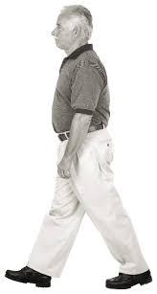
Suppose, He is Robin Hood now fill the gaps.
T eacher , 30 , English
1 Robin Hood Is a ……………… .
2 He is …………. Years old.
3 He teaches……………… .
Ans: 1. Teacher 2. 30 3 Engiish

Slide 17
Group work presentation
Meaning the words
Primary, years, school, old

Slide 18
Assesment evualation

Slide 19
HOME TASK
Short question,new words,simple sentence

Slide 20
THANKS TO ALL

