Slide 1
Welcome my English Class

Slide 2
Teacher Information
Lesson Information
Hasina Momotaj Assistant head Teacher
Raja GC high School
Sylhet
Email-
hasinalovely76@gmail.com
Class -- Nine
Sub -- English for Today
Unit --- One
Lesson – Three
Time -- 50 minutes

Slide 3
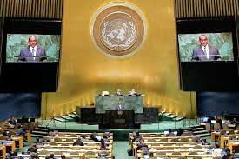
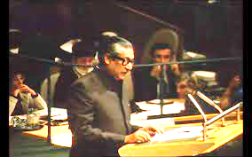
At first look at the pictures.
UN Ministry
Bangabandhu’s speech in UN
UN Logo
Can you imagine what lesson today we are going to read ?
Who is in the picture?
Where was Bangabandhu give speech ?
What do you see in the pictures?

Slide 4
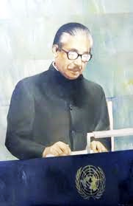
So ,Today we are going to learn
BANGABANDHU AT THE UN

Slide 5
Learning Outcomes
At the end of the lesson students will be able to say -----
Read and understand text .
narrate incidents and events in a logical sequence.
Participate in conversations ,discussions and debates.
Tell stories .

Slide 6
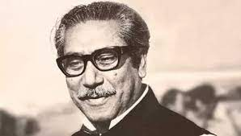
Pair Works
Work in pairs and discuss the following questions.
What do you know about the UN ?
What do you know about Bangabandhu’s speech at the UN ?

Slide 7
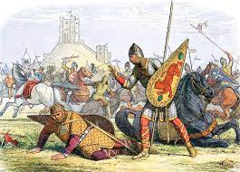
Before reading text let’s learn some new words.
Example: ‘his work is influential in feminist psychology.’
Influential
Having great influence or something .
Example: ‘he has finally conquered his fear of spider.’
To deal with successfully fight against a problem or an unreasonable fear.
Conquered

Slide 8
Before reading text let’s learn some new words.
To make known or show something that is surprising or that was previously secret.
Revealed
Example: she felt oppressed and discouraged in such an unfriendly environment.
To make a person feel uncomfortable or anxious.
Example: her biography revealed that she was not as rich as everyone thought.
Oppressed

Slide 9
Before reading text let’s lean some new words.
Example: ‘the assembly denounced the use of violence.’
Denounced
Publicly declare to be wrong or evil.
Example: his father emphasized the wrong words in his sentence.
Give special importance or value to (something) in speaking or writing .
Emphasized

Slide 10
Silent Reading
Individual Work
Read the text silent . Time 10 minutes.
Bangabandhu’s speech at the United Nation’s General Assembly is a matter of great pride for us. He delivered the speech on 25 th September 1974, just after a week Bangladesh become a member of the UN . To be a member of the UN was not an easy go as some influential countries were opposing the membership for Bangladesh. So it was another war that Bangabandhu had to wage .

Slide 11
Silent reading
The Father of the Nation added that Bangladesh would look forward to such a world where peace and justice would take their rightful place . It was essential to justify the sacrifice of the countless martyrs . In his speech, Bangabandhu expressed his utmost gratitude to the UN and the international community for standing beside Bangladesh with their aids and support in the reconstruction of the war-ravaged country, relocation of 10 million war-refugees who took shelter in India during the Liberation War. The leader of the country reminded the world how Bangladesh stood on the ruins and debris of a war where people were just struggling for survival. However, the repeated national calamities were making people even didn’t have a minimum intake of food for a day.
Goning beyond Bangladesh, he expressed solidarity for all the oppressed people around the world and denounced racism, discrimination ,imperialism, and the use of force to stop people’s justified movements for their rights. Referring to the struggle of the people in Africa, Asia ,Latin America, Namibia, Palestine and Zimbabwe, he expressed his worry about peoples plight to achieve their ownrights. The leader of the oppressed noted – when millions of people were destitute with unending miseries, only a handful of people were enjoying the highest luxuries. He emphasized quick measures for global financial management based on justice. Bangabandhu warned that an absence of such asystem would lead the world to experience an unprecedented misery of the history.
The leader of the world countries expressed his deep concerns over a global recessions and inflation, unemployment , unequal distribution of wealth and opportunities, and the gap between the rich and the poor countries. He described how those had hit the development plans in many poor countries of the planet.To Bangabandhu ,it was a global responsibility to fight these problems and take concerted efforts to put an end to these.
Before he concluded his speech,Bangabandhu declared that Bangladesh would follow the paths of togetherness brotherhood and mutual respect and cooperation. He expected the UN would take substantial roles in solving the prevailing human crisis in the subcontinent as well as in other countries.
But finally, Bangabandhu won . He won not only the UN membership , but also everyone who listened to his ever first speech at the UN. It was a veni vidi vici experience for him– he came,he saw and he conquered everyone .Bangabandhu was the first person in the history of the UN to deliver a speech in Bangla, the language of the seven and a half crore Bangalees,the language of the language martyrs. The poet of oration , the icon of carrismatic leadership touched another milestone and so did the Bangalees through him. It was a speech that revealed Bangladesh’s stand on national and international issue before the global community.
Identifying the UN as the parliament for the humankind . Bangabandhu recognized the moment of delivering this speech historical. He mentioned that the very moment justified the country – long struggle and sacrifice of the Bangalees for self- rule, independence, dignity and co-existence along with other nations.He assured that Bangladesh would follow the ideology of mutual respect,national sovereignty, regional integrity, and non-interference into internal issues of other countries. Bangabandhu explained Bangladesh’s absolute pledge to the UN charter and reminded how the people of his country made the highest sacrifice to achieve the same.

Slide 12
Group Works
Read the text again and work with your group ask and answer the following questions.
How did Bangabandhu pay tribute to the language martyrs?
Why did Bangabandhu seek for togetherness and global partnership ?
What foreign policy did Bangabandhu formulate in his speech?
Why did the text term Bangabandhu as a leader of the oppressed and leader of the third world?

Slide 13
Evaluation
Choose the best answer.
6. Bangabandhu expressed his utmost gratitude to the UN … for standing beside …. The war- ravaged country. The meaning of the underlined phrase is -----
(a) attracted by the war
(b) disturbed by the war
(c) developed by the war
(d) damaged by the war
1.So it was another war that Bangabandhu had to wage . Here the meaning of the underlined word is ---
Salary
currency
carry on
pay
5. It was essential to justify the sacrifice of the countless martyrs. The meaning of the underlined phrase is ----
(a) number of people who sacrificed their lives.
(b) number of people who sacrificed their lives but not counted.
(c) number of people who sacrificed their lives and has been counted.
(d) number of people who sacrificed their lives and it’s impossible to count them .
3. It was a veni vidi vici experience for him . The meaning of the underlined phrase is ---
(a) He came , he spoke, he won
(b) He spoke, he ran , he saw
(c) He ran, he came , he won
(d) He came, he saw, he conquered.
2. He expressed his worry about people’s plight to earn their own rights. The word meaning of the underlined word is----
Suffering
flying
crying
fighting
4. Bangabandhu clarified Bangladesh’s absolute pledge to the missions of the UN charters. The meaning of the underlined word is ----
(a) determination
(b) position
(c) narration
(d) situation

Slide 14
Write an email to your friend giving him/her the information that you have gathered about Bangabandhu’s speech at the UN.

Slide 15
Thank you all.

