Slide 1
Welcome

Slide 2
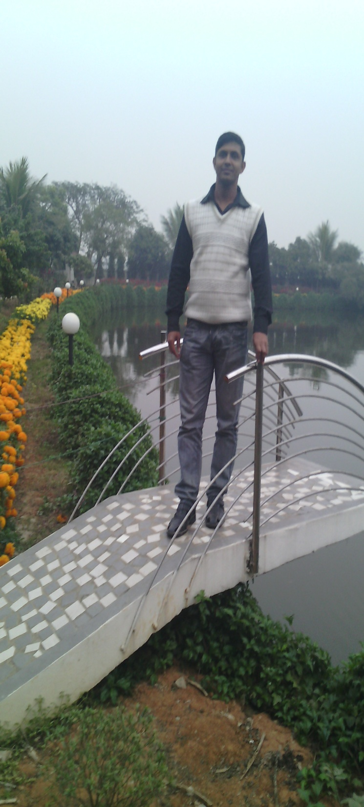
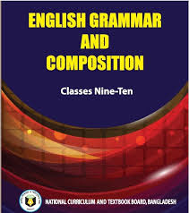
Ujjal Kumar Ghosh
Assistant Teacher (English)
Chuadanga Krishnanagor high school
Panjia, Keshabpur,Jassrre

Slide 3
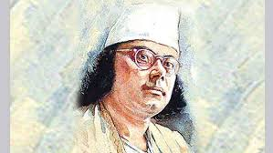
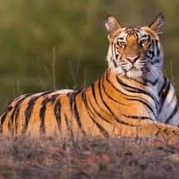
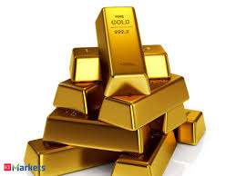
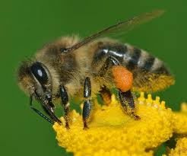
Nazrul
Tiger
Gold
Bee
Poet
animal
metal
insect
Nazrul is greater than most other poets in our country.
Tiger is the most ferocious animal.
Very few metals are as/so precious as Gold.
No other insect is as/so industrious as the bee.

Slide 4
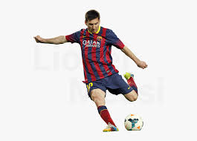
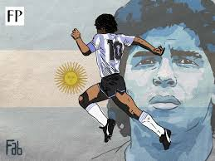
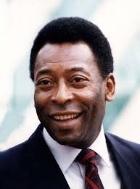
greater
great
greatest
Very few footballers are so great as Neymar
Messi is greater than most other footballers.
Maradona is the greatest footballer.
Pele is the greatest of all footballers.
greatest of all times

Slide 5
Yes, we are going to start Comparison of Adjective
(Degree)

Slide 6
Lesson introduction
Comparison of Adjective
Unit-3
Page number-22
Class-9,10

Slide 7
Learning Outcome
By the end of the lesson, learners will be able to -
Identify positive , comparative and superlative degree.
Make positive to superlative .
make comparative to positive
make superlative to comparative.

Slide 8
Comparison of adjectives or Degree refers to different forms of the adjective.
It is divided into three types:
Positive Degree:
Superlative Degree:
Comparative Degree:
The form of an adjective which depicts a noun or pronoun’s quality, flaw or state is called Positive degree.
The form of adjective which compares two nouns’ or pronouns’ quality, flaw or state is called Comparative degree.
The form of an adjective which is used to compare among many is called Superlative Degree.

Slide 9
Lets take some idea aboutComparison of Adjective
Positive
Comparative
Superlative
Good
better
best
bad
worse
worst
great
greater
greatest
popular
more popular
most popular
lovely
lovelier
loveliest

Slide 10
Change of Degrees:
Superlative Degree into Positive Degree
Rules of changing Superlative Degree into Positive Degree
Rule 1:
No other+ the latter part of the given Superlative in the sentence+ verb+ so/as +a positive form of the Superlative degree+ as+ given sentence’s subject.
Superlative: Saira is the tallest girl in the class.
Positive: No other girl is as tall as Saira.

Slide 11
Rule 2:
Rule of changing Superlative Degree having one of the, all other, many other, most other, very few, few other, into Positive Degree:
Very few+ the latter part of the given Superlative in the sentence+ verb’s plural form+ so/as+ a positive form of the Superlative degree+ as+ given sentence’s subject.
Superlative: Adil is one of the best players on the team.
Positive: Very few players in the team are as good as Adil.

Slide 12
Positive Degree into Superlative Degree
Rule 1:
Rule of changing Positive degree having no other, into Superlative degree:
Main sentence’s subject situated at the last+ verb+ the+ Positive degree’s Superlative form+ the part of the sentence between No other and the verb.
Positive: No other student in the class is as brilliant as Adil.
Superlative: Adil is the most brilliant student in the class.

Slide 13
Rule 2:
Rule of changing Positive degree having very few, into Superlative degree:
Main sentence’s subject situated at the last+ verb+ one of the+ Positive degree’s Superlative form+ the part of the sentence between Very few and the verb.
Positive: Very few students in the class is as brilliant as Sohana.
Superlative: Sohana is one of the most brilliant students in the class.

Slide 14
Comparative Degree into Positive Degree
Rule 1:
Rule of changing Comparative Degree having than any other/ all other, into Positive Degree:
No other+ the latter part of any other/ all other in the sentence+ verb+so/as+ a positive form of the Comparative degree+ given sentence’s subject.
Comparative: Aruba is sweeter than all other singers in the program.
Positive: No other singers in the program is as sweet as Aruba.

Slide 15
Rule 2:
Rule of changing Comparative Degree having than, into Positive Degree:
The latter part of than in the sentence+ verb+ not+ so/as+ Comparative degree’s positive form+ as+ given sentence’s subject.
Comparative: Lisa is taller than Raisa.
Positive: Raisa is not as tall as Lisa.

Slide 16
Rule 3:
Rule of changing Comparative Degree having than most other/ than few other, into Positive Degree:
Very few+ The latter part of most other/few other in the sentence+ verb’s plural form+ so/as+ Comparative degree’s positive form+ as+ given sentence’s subject.
Comparative: Adil is more intelligent than most other students in the academy.
Positive: Very few students in the academy are as intelligent as Adil.

Slide 17
Rule 4:
Rule of changing Comparative Degree having No less/ not less, into Positive Degree:
As’ is placed in the places of “No less/ not less” and “than”, other things remain unchanged in the sentence.
Comparative: Karim is no less active than Rahim.
Positive: Karim as active as Rahim.

Slide 18
Rule 5:
Rule of changing Comparative Degree having No sooner had…. than, into Positive Degree:
As soon as is placed in the place of No sooner had+ subject+ verb’s past form+ former part of than+ a comma (,) is placed in the place of than+ rest of the sentence.
Comparative: No sooner had he listened to it than he started laughing.
Positive: As soon as he listened to it, he started laughing.

Slide 19
Positive Degree into Comparative Degree
Rule of changing Positive Degree having no other, into Comparative degree:
Rule 1:
Main sentence’s subject situated at the last+ Positive degree’s Comparative form+ than any other+ latter part of “No other” up to the verb.
Positive: No other student in the class is as brilliant as him.
Comparative: He is more brilliant than most other student in the class.

Slide 20
Rule of changing Positive Degree having very few, into Comparative degree:
Rule 2:
Main sentence’s subject situated at the last+ verb+ Positive degree’s Comparative form+ than most other+ latter part of “Very few” up to the verb.
Positive: Very few men are as honest as Mr. Abu Taleb.
Comparative: Mr. Abu Taleb is more honest than most other men.

Slide 21
Rule 3:
Rule of changing Positive Degree having As….as, into Comparative degree:
Main sentence’s subject situated at the last+ verb+ not+ Positive degree’s Comparative form+ than+ Main sentence’s first subject.
Positive: She is as honest as her sister.
Comparative: Her sister is not more honest than her.

Slide 22
Comparative Degree into Superlative Degree
Rule 1:
Subject+ verb+ the+ Comparative’s Superlative form+ latter part of other in the sentence.
Comparative: He is more brilliant than any other student in the class.
Superlative: He is the most brilliant student in the class.
Comparative: He is more brilliant than of all students.
Superlative: He is the most brilliant of all students.

Slide 23
Rule of changing Comparative degree having than most other/ than few other, into Superlative degree:
Rule 2:
Subject+ verb+ one of the+ Comparative’s Superlative form+ latter part of most other/ few other in the sentence.
Comparative: Arif is stronger than most other boys on the team.
Superlative: Arif one of the strongest boys on the team.

Slide 24
Superlative Degree into Comparative Degree
Subject+ verb+ Superlative degree’s Comparative form+ than any other+ rest of the sentence.
Rule 1:
Superlative: She is the most active member of the group.
Comparative: She is more active than any other member of the group.
If there is “of all” than all other is placed in the place of “All of”.
Superlative: He is the most honest of all men.
Comparative: He is more honest than all other man.

Slide 25
Rule 2:
Rule of changing Superlative Degree having one of the, into Comparative degree:
Subject+ verb+ Superlative’s comparative form+ than most other+ rest of the sentence.
Superlative: Sohana is one of the most brilliant students in the class.
Comparative: Sohana is more brilliant than most other students in the class.

Slide 26
Identify the following degree
Group work
a) Saira is the tallest girl in the class.
Superlative
b) No other girl is as tall as Saira.
Positive
c) Adil is one of the best players on the team.
Superlative
d)Very few players in the team are as good as Adil.
Positive
e)Aruba is sweeter than all other singers in the program.
Comparative
f)No other singers in the program is as sweet as Aruba.
Positive

Slide 27
Home work.
1. A freedom fighter is the greatest son of the soil. (Make it comparative sentence)
2. Books are the greatest friends. (Make it positive)
3. He was one of the best cap makers with palm leaves. (Make it Positive)
4.He is more honest than all other man.(Make it Superlative)
5. Sohana is one of the most brilliant students in the class.(Make it Comparative)

Slide 28
Goodbye

