Slide 4
Lesson Introduce
Class:- One
Sub:-- English
Lesson Title:- In the village.
A . Look ,listen and say
Time: 40 minute

Slide 5
Learning Outcomes
Student will be able to-
Listening:1.1.1 To become familiar with
English sound by listing to common words.
Speaking 1.1.1 To repeat after the teacher
And say simple words and phrase.

Slide 6
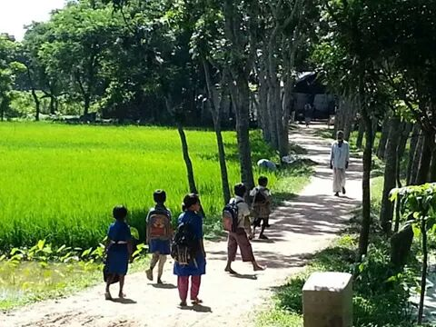
Creating Emotion
Let’s see some picture
Here is road , village, students and field.
What’s are in the pictures?

Slide 7
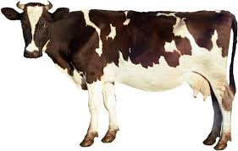
Presentation
cow
What is this?

Slide 8
Presentation
Tub
What is this?

Slide 9
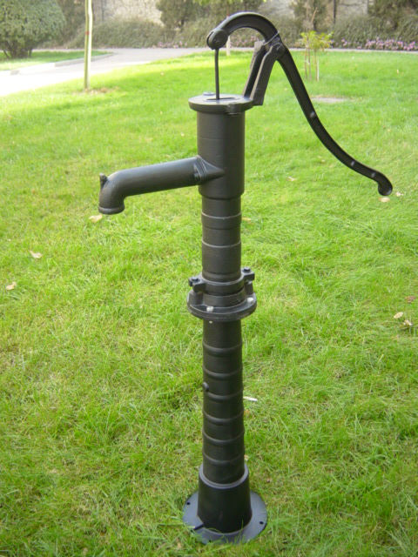
Presentation
Tube well
What is this?

Slide 10
Presentation
Kitten
What is this?

Slide 11
Practice
Please repeat after me.
This is cow

Slide 12
Practice
Please repeat after me.
This is tub

Slide 13
Practice
Please repeat after me.
This is tube well

Slide 14
Practice
Please repeat after me.
This is kitten

Slide 15
Practice
Group Work

Slide 16
Practice
Group green
Point and say the name of the picture

Slide 17
Practice
Group red
Point and say the name of the picture

Slide 18
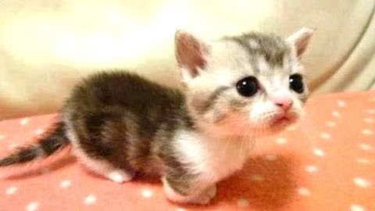
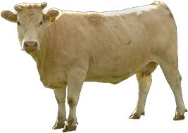
Evaluation
Look and say the name of the picture

Slide 19
Homework
Draw a tub

