Slide 1
WELCOME

Slide 2
Introduction
Teacher
Lesson
Shaheen Ahmed
Assistant Teacher
Singraoli GPS
Biswanath, Sylhet
Mob: 01712332117
E-mail: shaheen332117@gmail.com
Class - 3
Subject- English
Unit-2
Lesson-1-3

Slide 3
Let us we enjoy a video

Slide 4
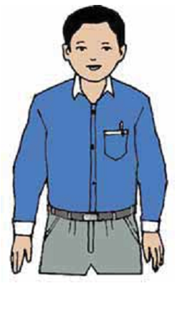
Todays lesson
Introducing a teacher

Slide 5
Learning outcomes
3.1.1-Students will be able to understand simple question about familiar object/person.
3.2.1-Students will be able to make simple self information.
3.3.1-Understand statements (Students will be able to write Mahbub alam’s information).

Slide 6
1.Look at the picture and think about it

Slide 7
This is Mahbub Alam
He’s an English teacher
He’s 30 years old
He works in a primary school in Narail

Slide 8
Introducing new words and make sentence.
1.Old
2.Teacher
3.works
Mahbub Alam is 30 years old.
He’s an English teacher.
He works in a primary school.

Slide 9
Group work
Group- A
Group- B
Fill in the gaps
1.Mahbub Alam is ------- years old.
2.He,s an --------- teacher.
Multiple choose question
Who is English teacher?
SaikaIslamt b. Mahbub Alam. C. Jahangir Alam
2. What is his occupation?
a. Teacher b. doctor c.farmer.

Slide 10
Pair work
Write a short composition about your teacher (at list 4 sentence).

Slide 11
Individual work
Everybody complete the table with
Mahbub Alam information.
Name
Age
Job
Work place
Mahbub Alam
30 years
English teacher
Primary School in Narail

Slide 12
Evaluation
How old is Mahbub Alam?
What is his occupation?
Write 4 sentence about your English Teacher.

Slide 13
THANK YOU

