Slide 1
WELCOME

Slide 2
Introduction
Teacher
Lesson
Class - 3
Subject- English
Unit-2
Lesson-1-3
Mujibur Rahman
Assistant Teacher
Eklimiah GPS
Biswanath, Sylhet

Slide 3
Create safety environment
Let us we enjoy a video

Slide 4
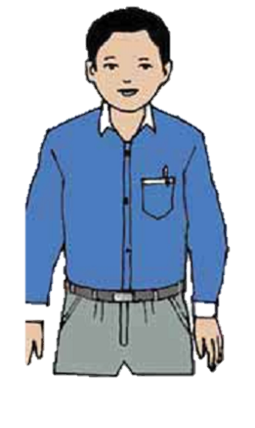
Todays lesson
Introducing a teacher

Slide 5
Learning outcomes
3.1.1-Students will be able to understand simple question about familiar object/person.
3.2.1-Students will be able to make simple self information.
3.3.1-Understand statements (Students will be able to write Mahbub alam’s information).

Slide 6
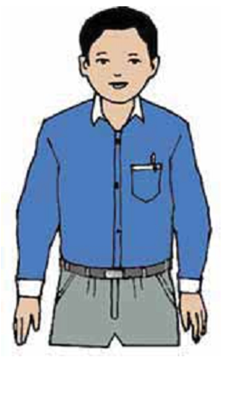
Presentation
1.Look at the picture and think about it

Slide 7
This is Mahbub Alam
He’s an English teacher
He’s 30 years old
He works in a primary school in Narail

Slide 8
Introducing new words and make sentence.
1.Old
2.Teacher
3.works
Mahbub Alam is 30 years old.
He’s an English teacher.
He works in a primary school.

Slide 9
Group work
Group- A
Group- B
Fill in the gaps
1.Mahbub Alam is ------- years old.
2.He,s an --------- teacher.
Multiple choose question
Who is English teacher?
SaikaIslamt b. Mahbub Alam. C. Jahangir Alam
2. What is his occupation?
a. Teacher b. doctor c.farmer.

Slide 10
Pair work
Write a short composition about your teacher (at list 4 sentence).

Slide 11
Individual work
Everybody complete the table with
Mahbub Alam information.
Name
Age
Job
Work place
Mahbub Alam
30 years
English teacher
Primary School in Narail

Slide 12
Evaluation
I shall evaluate by giving some question
How old is Mahbub Alam?
What is his occupation?
Write 4 sentence about your English Teacher.

Slide 13
THANK YOU

