Slide 1
WEL
COME

Slide 2
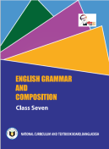
IDENTITY
S.M.Mozammel Kabir
Asst. Head Teacher
Bhowal Baria Union High School
Gazipur Sadar,Gazipur.
Mobile: 01770633593
E-mail: mozammelkabir777@gmail.com
Subject: English Grammar
Unit: 9 Lesson: 1
Class: Seven. Date: 01/05/2021

Slide 3
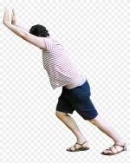

Slide 4
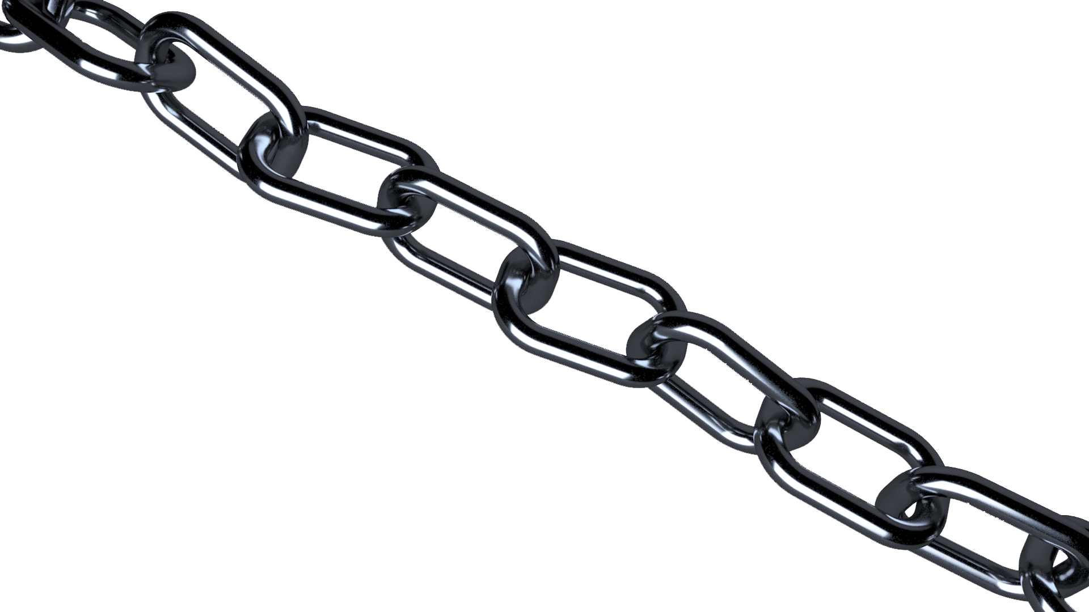
Today’s Topic
Article

Slide 5
Objectives
By the end of the lesson students will have…….
To know what is Article
To know the kinds of Articles
To understand the use of Articles.(a & an)

Slide 6
What is article?
Articles are words that define a noun as unspecific or specific.
Article
How many kinds of it?
Indefinite
Definite
A , An
The

Slide 7
What is indefinite article?
An article in Indefinite is an article that refers to an indefinite person, object or animal without specifically referring to a particular person or animal.
In English, the two indefinite articles are a and an.

Slide 8
Like other articles, indefinite articles are invariable. You use one or the other, depending on the first letter of the word following the article, for pronunciation reasons. Use a when the next word starts with a consonant, or before words starting in u and eu when they sound like you. Use an when the next word starts with a vowel (a,e,i,o,u) or with a mute h.

Slide 9
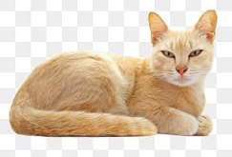
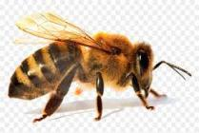
Teacher
Cat
Lamp
The first letter of the word is consonant Sound.
Bee

Slide 10
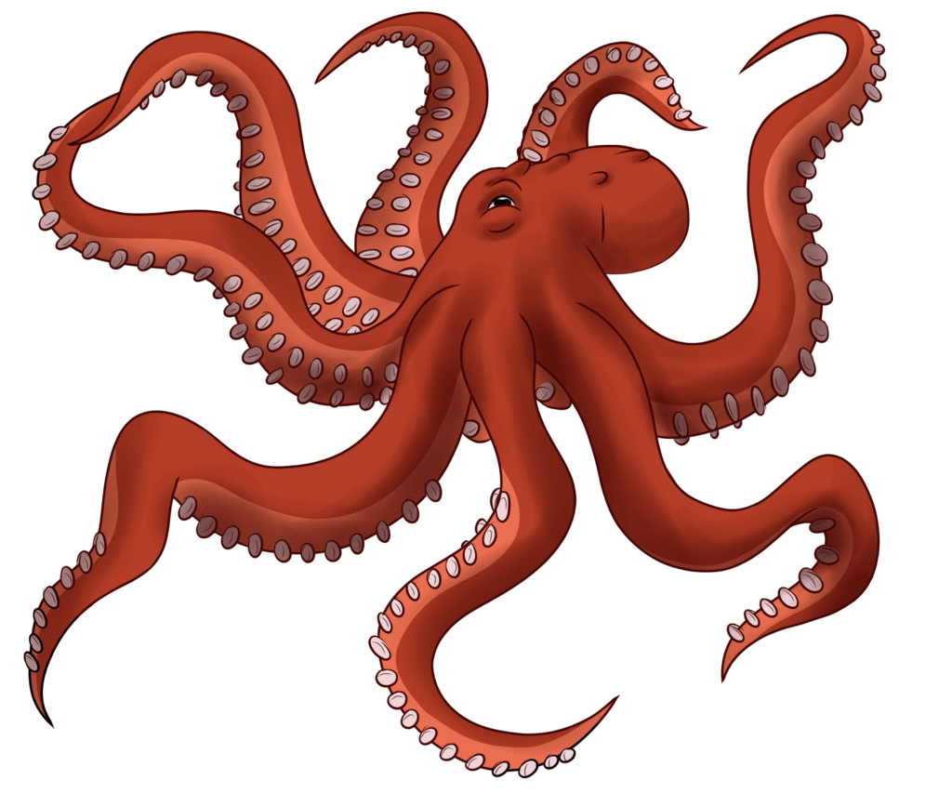
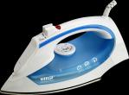
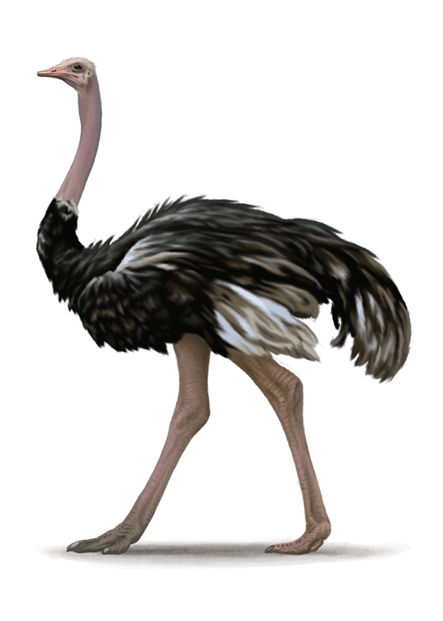
Iron
Octopus
The first letter of the word is vowel Sound.
‘A & An’ are indefinite article.
Ostrich
E Mail

Slide 11
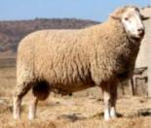
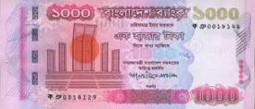
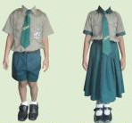
Special uses
of ‘a’
Ewe
One thousand taka note
The words
shall be
Pronounced
as ‘u’ or ‘oa’.
One eyed man
Uniform.

Slide 12
hour
honorable person
Here ‘h’ is silent.
It is vowel Sound
Special uses of ‘an’.

Slide 13
an apple
Pair work
a car
a helicopter
an elephant
Which ones are wrong? Mention the reason
an apple
a car
an helicopter
an elephant
an university
an unit
a hour
a honor
an big elephant
a itchy sweater
a ugly duck
an European
a big elephant
an itchy sweater
an ugly duck
a European
a university
a unit
an hour
an honor

Slide 14
Group Work:
A
An
Fill in the blanks with A or An .
An
Nuba is (a)….... Good student. She is also (b)……. Intelligent girl. She wants to be (c )…… engineer. Her mother is (d)..….. B.A. Her father is also (e)….... Honest man and he is (f)……. Book of wisdom. Nuba eats (g)..…. Apple every day. She reads the Quran for (h)……. Hour daily. She is so stylish like (i)…… European. She sent (j)…... Email to her grandfather for a new dress.
A
An
A
An
An
A
An

Slide 15
Home Work
Write the rules of using article A and An with examples.

Slide 16
Follow the rules of hygiene,
safe from covid-19.
Thanks
To all

