Slide 2
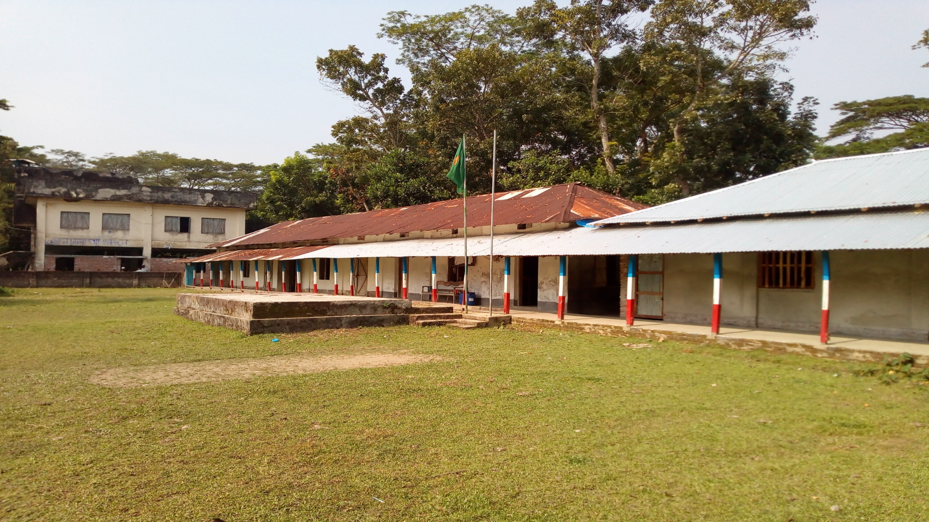
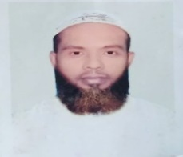
Welcome
TO
OUR
ONLINE CLASS
The best teacher in the earth
Muhammad Ahsan Habib, Assistant Teacher , Mohsenuddin Nuria Fazil Madrasah, Bauphal, Patuakhali, Mob- 01754755169, E-mail-ahsanhabib251281@gmail.com

Slide 3
teacher IDENTITY
Muhammad Ahsan Habib
Assistant Teacher
Mohsenuddin Nuria Fazil (Degree) Madrasah
Bauphal, Patuakhali
Mobile-01754755169
E-mail- ahsanhabib251281@gmail.com
Muhammad Ahsan Habib, Assistant Teacher , Mohsenuddin Nuria Fazil Madrasah, Bauphal, Patuakhali, Mob- 01754755169, E-mail-ahsanhabib251281@gmail.com

Slide 4
SUBJECT MATTER
Class- Nine & Ten
Subject –English 1st paper
(Q.11 - Formal /Informal letter (E-mail) )
Muhammad Ahsan Habib, Assistant Teacher , Mohsenuddin Nuria Fazil Madrasah, Bauphal, Patuakhali, Mob- 01754755169, E-mail-ahsanhabib251281@gmail.com

Slide 5
Part-D: Writing
Q.8 - Paragraph with answering Question =10
Q.9 - Completing story =10
Q.10- Graphs / Charts writing =10
Q.11- Formal /Informal letter (E-mail) =10
Q.12- Dialogue Writing =10
Muhammad Ahsan Habib, Assistant Teacher , Mohsenuddin Nuria Fazil Madrasah, Bauphal, Patuakhali, Mob- 01754755169, E-mail-ahsanhabib251281@gmail.com

Slide 6
Learning outcomes
After completing this lesson, students will be able to---------
“Write Letter easily”
Muhammad Ahsan Habib, Assistant Teacher , Mohsenuddin Nuria Fazil Madrasah, Bauphal, Patuakhali, Mob- 01754755169, E-mail-ahsanhabib251281@gmail.com
Notes:
All the four skills will be focused in this lesson.

Slide 7
Q-11-Letter
.............. ,.............
10/10/2020
Dear ...............
First take my salam. How are you? Hope you are well. I am fine.
..............................................................................................
..............................................................................................
..............................................................................................
No more today. Give my salam to your Parents and love to the
Younger. Good bye.
Ever
............
From Name: Vill: P.O: P.S: Dis: | To Name: Vill: P.O: P.S: Dis:
Stamp
Muhammad Ahsan Habib, Assistant Teacher , Mohsenuddin Nuria Fazil Madrasah, Bauphal, Patuakhali, Mob- 01754755169, E-mail-ahsanhabib251281@gmail.com

Slide 8
Individual works.
1. Tell me how many parts in a letter.
2. Where is the address of the letter writer.
Muhammad Ahsan Habib, Assistant Teacher , Mohsenuddin Nuria Fazil Madrasah, Bauphal, Patuakhali, Mob- 01754755169, E-mail-ahsanhabib251281@gmail.com
Notes:
This slide only for mind set up. Teacher can ask another questions for grow class arrange.

Slide 9
Example-1
Q-11- Write a letter to your father send some money to buy some books.
Damra , Dhaka
10/10/2020
Dear Father
First take my salam. How are you? Hope you are well. We are fine. I need some money to buy some new books for my new class. Please send me 500 tk as soon as possible.
No more today. Give my salam to your parents and love to the younger. Good bye.
Ever
Habib
Stamp
From Name: Habib Vill : Damra P.O : Damra P.S : Damra Dis : Dhaka | To Name : Mamun Vill : Bauphal P.O : Bauphal P.S : Bauphal Dis : Patuakhali
Muhammad Ahsan Habib, Assistant Teacher , Mohsenuddin Nuria Fazil Madrasah, Bauphal, Patuakhali, Mob- 01754755169, E-mail-ahsanhabib251281@gmail.com

Slide 10
Example-2
Q-11- Write a Letter to your friend about how you enjoyed last summer vacation.
Damra , Dhaka
10/10/2020
Dear Mamun
First take my salam. How are you? Hope you are well. We are fine. Last summer vacation I went to cox’s bazar. It is a historical place. I learn many thing from there. It is the leargest sea beach in the world. I enjoy the tour very much.
No more today. Give my salam to your parents and love to the younger. Good bye.
Ever
Habib
From Name: Habib Vill : Damra P.O : Damra P.S : Damra Dis : Dhaka | To Name : Mamun Vill : Bauphal P.O : Bauphal P.S : Bauphal Dis : Patuakhali
Stamp
Muhammad Ahsan Habib, Assistant Teacher , Mohsenuddin Nuria Fazil Madrasah, Bauphal, Patuakhali, Mob- 01754755169, E-mail-ahsanhabib251281@gmail.com

Slide 11
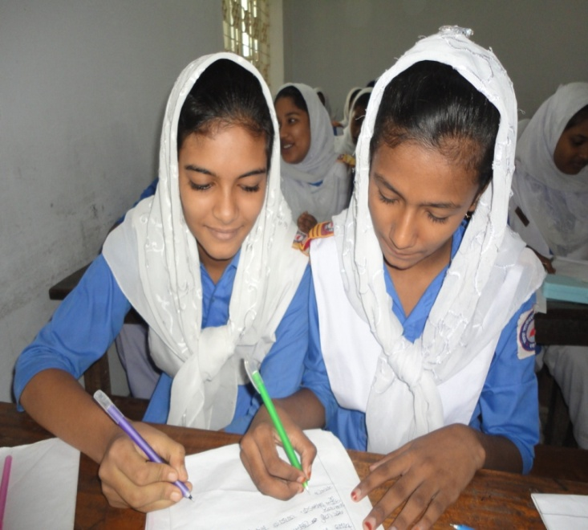
Pair Work
Discuss in pairs and write an answer the following questions:
What is a letter ?
Where is the address of a letter reciver?
Muhammad Ahsan Habib, Assistant Teacher , Mohsenuddin Nuria Fazil Madrasah, Bauphal, Patuakhali, Mob- 01754755169, E-mail-ahsanhabib251281@gmail.com

Slide 12
Example-3
Q-11- Write a letter to your friend inviting marriage ceremony of your elder sister.
Damra , Dhaka
10/10/2020
Dear Mamun
First take my salam. How are you? Hope you are well. We are fine. My elder sister marriage ceremony will be held on 10/11/2020. I invite you to join the marriage ceremony of my elder sister. Please come as soon as possible.
No more today. Give my salam to your parents and love to the younger. Good bye.
Ever
Habib
Stamp
From Name: Habib Vill : Damra P.O : Damra P.S : Damra Dis : Dhaka | To Name : Mamun Vill : Bauphal P.O : Bauphal P.S : Bauphal Dis : Patuakhali
Muhammad Ahsan Habib, Assistant Teacher , Mohsenuddin Nuria Fazil Madrasah, Bauphal, Patuakhali, Mob- 01754755169, E-mail-ahsanhabib251281@gmail.com

Slide 13
Group Work
Write down the parts in a letter .
Muhammad Ahsan Habib, Assistant Teacher , Mohsenuddin Nuria Fazil Madrasah, Bauphal, Patuakhali, Mob- 01754755169, E-mail-ahsanhabib251281@gmail.com

Slide 14
Evaluation
1.How many parts in aletter?
2.Where is the address of the letter resever?
Muhammad Ahsan Habib, Assistant Teacher , Mohsenuddin Nuria Fazil Madrasah, Bauphal, Patuakhali, Mob- 01754755169, E-mail-ahsanhabib251281@gmail.com

Slide 15
Home Work
Write a letter to your Mother about preparation for the final examination .
Muhammad Ahsan Habib, Assistant Teacher , Mohsenuddin Nuria Fazil Madrasah, Bauphal, Patuakhali, Mob- 01754755169, E-mail-ahsanhabib251281@gmail.com
Notes:
This is a creative work that the students will perform at home to show the teacher in the nest class.

Slide 16
THANK YOU FOR
YOUR ATTENTION
GOOD BYE
(May allah bless you)
Muhammad Ahsan Habib, Assistant Teacher , Mohsenuddin Nuria Fazil Madrasah, Bauphal, Patuakhali, Mob- 01754755169, E-mail-ahsanhabib251281@gmail.com

