Slide 1
Good morning

Slide 2
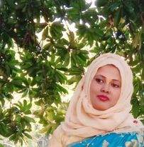
Teacher’s Introduction
Mst.Sharmin Akter
Assistant teacher
Matain Govt. Primary School
Hajiganj, Chandpur
E-mail:
mstsharminakter1985@gmail.com

Slide 3
Lesson Identity
Class : Five
Subject : English
Lesson :3-4
Unit:2
Activity: D
Time : 40 min
A
e
r
G

Slide 4
Learning Outcomes
Student’s will be able to-
Listening:1.3.1-recognize which words in a sentence are stressed.
Speaking:1.1.1-say words and phrases and sentences with proper sounds and stress.
Reading:1.5.1-read words , phrases and sentences with proper pronunciation , stress and intonation.
Writing:5.1.3-read silently with understanding dialogue.

Slide 5
We can see here many people are in the book fair.
What can you see in the picture ?

Slide 6
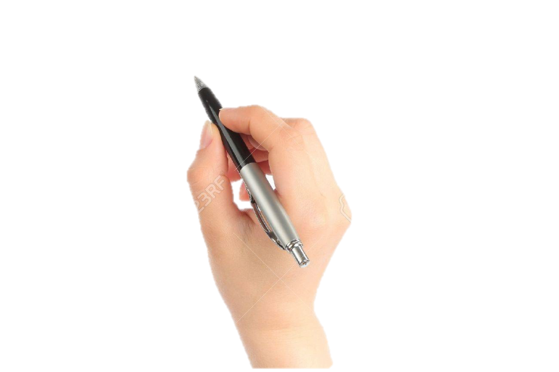
Lesson declaration
Our todays lesson is See you !

Slide 7
New word
meet
grandmother
introduce
everybody
colleague

Slide 8
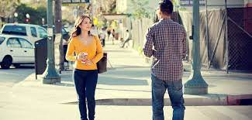
Meet
see
Nice to meet you.

Slide 9
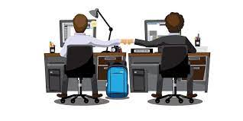
colleague
partner
He is my colleague.

Slide 10
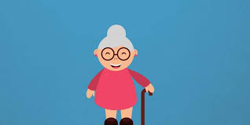
grandmother
grandma
I love my grandmother.

Slide 11
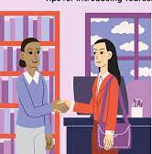
introduce
apprise
May I introduce myself ?.

Slide 12
everybody
everyone
Everybody loves me.

Slide 13
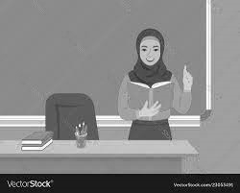
Teacher’s Reading

Slide 15
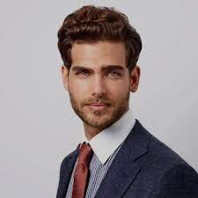
Andy: Hello , Tamal ! How is your grandmother?
Tamal: Hi ! She’s fine, thanks.

Slide 16
Andy: Come, let me introduce my colleagues. Hi, everybody.
This is Tamal. And Tamal, meet Mr. Saha and Mrs. Haider.
And this is Ms. Smith. She’s a new English teacher here.

Slide 17
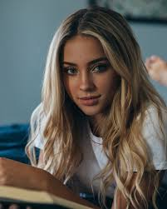
Ms Smith : Hello, Tamal. Nice to meet you.
Tamal : Hello, everybody ! Nice meeting you too.

Slide 18
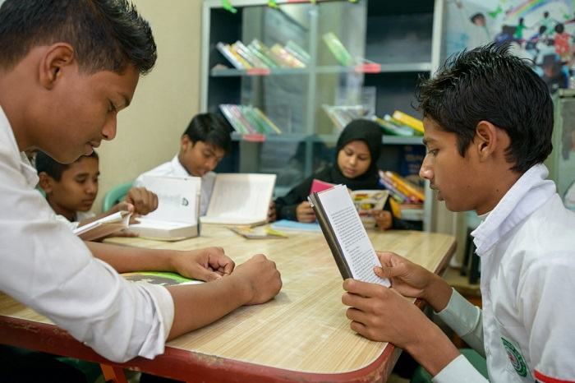
Group reading

Slide 19
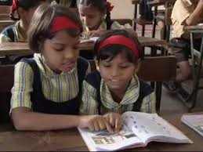
Read in pair

Slide 20
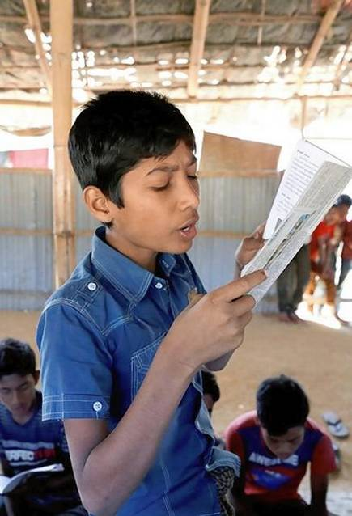
IW
Student’s reading

Slide 21
Practise the conversation with your partner.

Slide 22
Questions:
1.Where are Andy and Tomal ?
2. How is Tamal’s grandmother now?
3.Who are the new person there?
4.What is Ms Smith ?
gw

Slide 23
Answers:
1.Andy and Tamal are in the book fair.
2.Tamal’s grandmother is fine now.
3.Mr. Saha,Mrs. Haider and Ms Smith are the new person.
4.Ms Smith is a new English teacher.
gw

Slide 24
Bingo game
everybody
thanks
fine
hello
meet
chat
colleague
English
introduce
come

Slide 25
One day one word
chat-খোশগল্প

Slide 26
That’s all for today.

