Slide 1
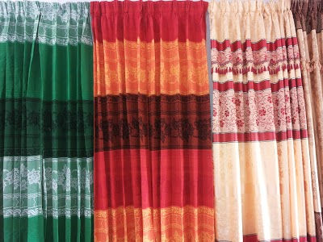

Slide 2
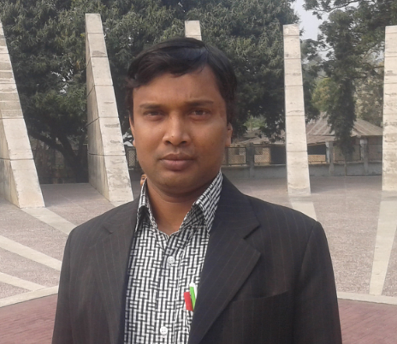
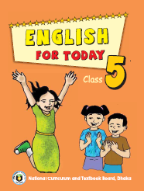
INTRODUCTION
Md. Faruq Hossain
Assistant teacher
Anandabash Govt. primary school.
Mujibnagar, Meherpur.
Mobile no- 01717406029
E-mail- faruqbd01@gmail.com
Class: Five
Subject: English
Caption of the lesson: Happy Birthday.
Today`s Lesson: A person`s birthday……friends and family.

Slide 3
What did you watch ?
Let`s watch a video
https://www.youtube.com/watch?v=pf0wzf2oSog&ab_channel=CVS3DRhymes%26KidsSongsCVS3DRhymes%26KidsSongs
A Birthday party

Slide 4
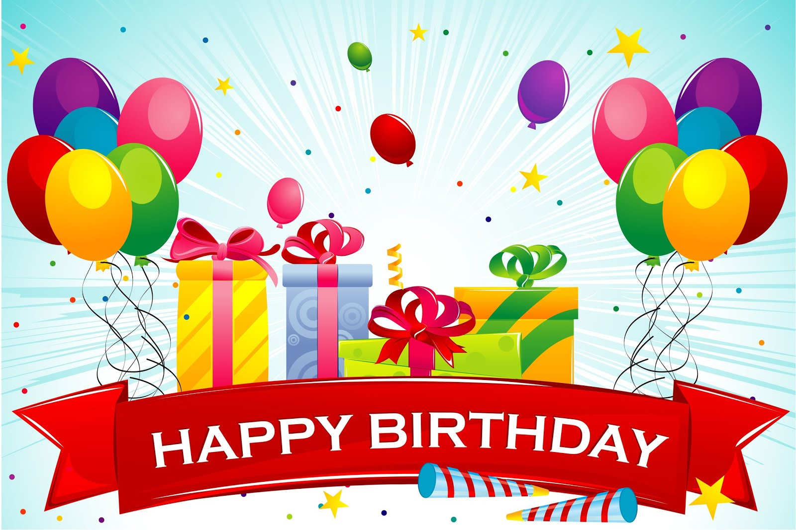
TODAY`S LESSON
A persons birthday……….friends and family.

Slide 5
LEARNING OUTCOMES
By the end of the lesson,the students will be able to -------
Listening :3.4.1 :Understand statements made by the
Teacher and students.
Speaking :6.2.1 : Talk about people , objects , events etc.
Reading : 1.5.1: Read words, phrases and sentences in the
texts with proper pronunciation , stress and
intonation.
5.1.1: read silently with understanding paragraphs.
Writing: 3.1.1: Write words , phrases and sentences
using cursive capital and small letters.
3.1.2 : write words , phrases and sentences using
non cursive capital and small letters.

Slide 6
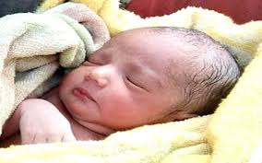
Think about the picture
Suppose, the baby`s date of birth is 10-06-2020. So, in every year the baby will celebrate his/her birthday on 10th June.
A person`s birthday is a special day.
A baby

Slide 7
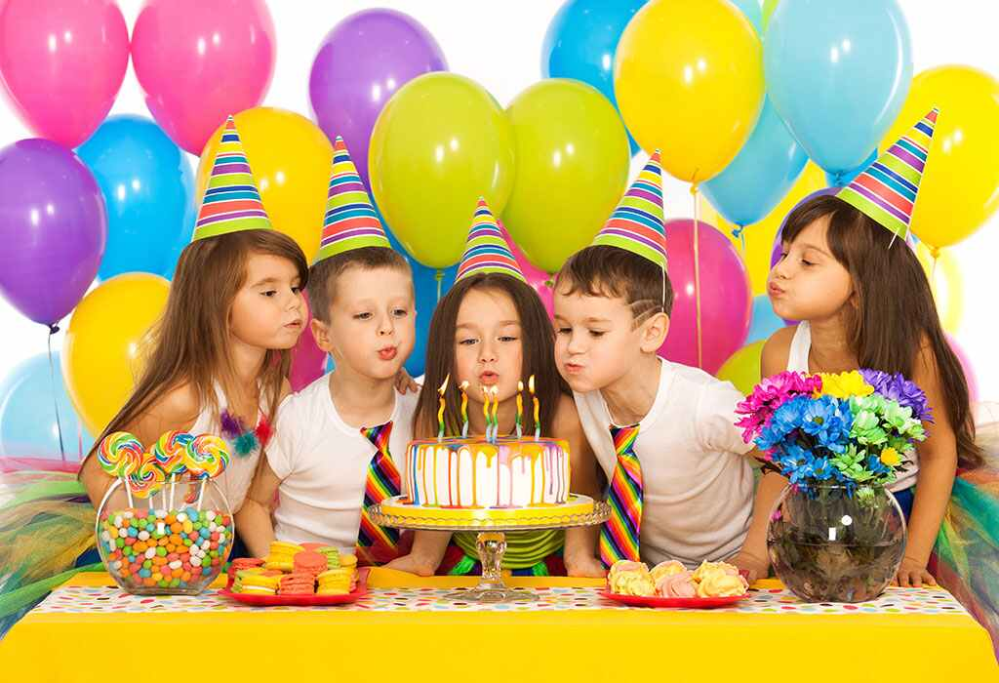
Think about the picture.
What do you see here?
People around the world celebrate birthdays in different ways.
A birthday party

Slide 8
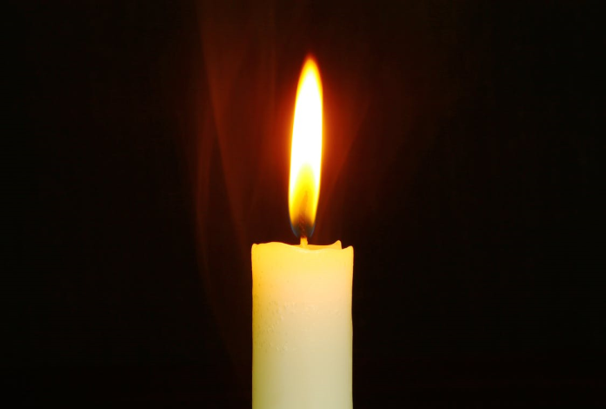
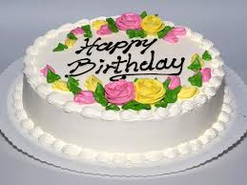
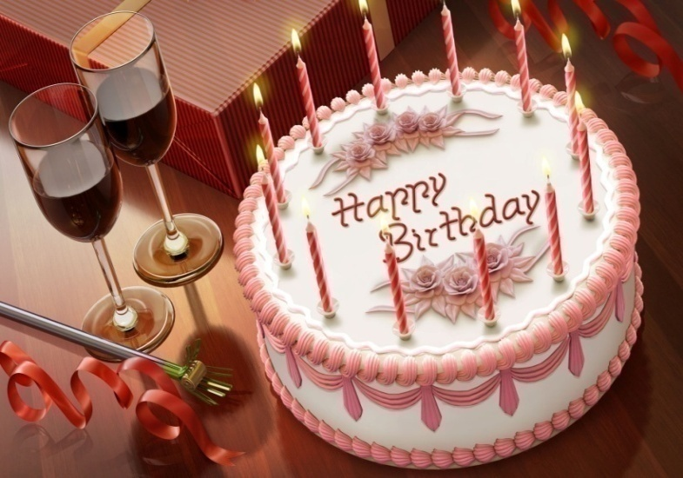
Think about the picture
What are these?
Candle
Cake
Candles are on the cake

Slide 9
Group work
Answer the following questions
Group-A: How is a birthday?
Ans: A persons birthday is a special day.
Group-B: How do people around the world celebrate birthday?
Ans: In different ways.

Slide 10
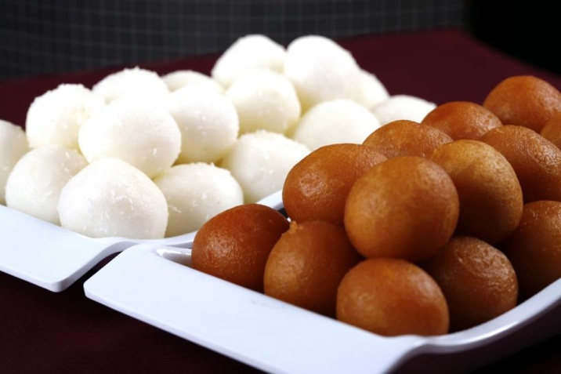
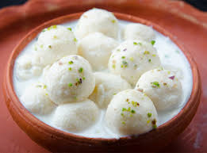
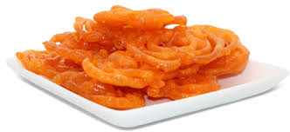
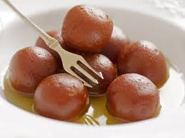
Think about the picture
What are these?
Sweets

Slide 11
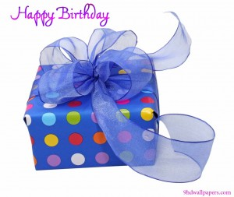
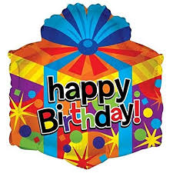
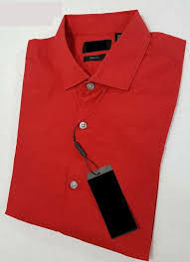
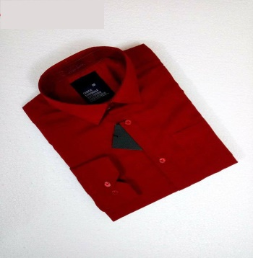
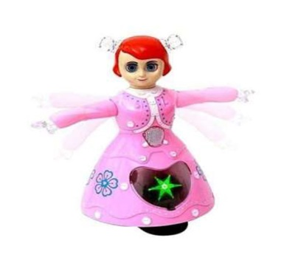
What are these?
Think about the pictures
A toy
A book
Some cloths
Birthday gifts

Slide 12
Pair work
Answer the following questions
1. What do the friends often bring?
Ans: The friends often bring a birthday gift for the child.
2. What do the children do to the birthday party?
Ans: The children play games and sing.

Slide 13
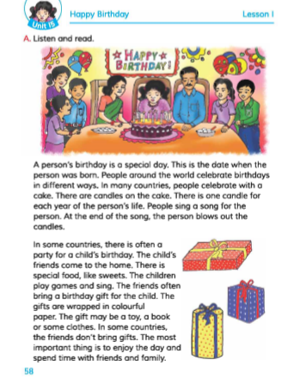
Open your English book at the page no-58.

Slide 14
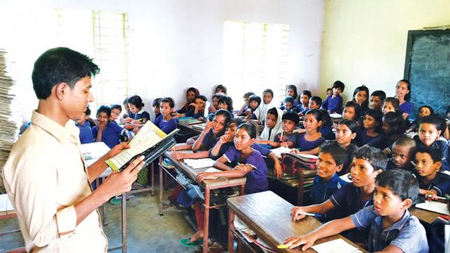
Loud Reading

Slide 15
Some word meaning:
Birthday
The date when a person was born
(জন্মদিন)
( অসাধারণ/বিশেষ)
Special
Different from what is usual.
Different
(বিভিন্ন/পৃথক)
Not the same.
Party
A gathering for pleasure.
( ভোজ/আসর)
Celebrate
To show that a day is important by doing some on it.
(উদযাপন করা)
(মিষ্টি)
Sweet
Having the pleasant taste.

Slide 16
Evaluation
a) Read the sentences. Write T for true or F for false:
T
1. A birthday is the date when a person was born.
2. People celebrate birthdays in the same way around the world.
F
b) What are the necessery things to celebrate a birthday party?
Ans: A birthday cake, candel etc. .
c) Write the names of three things as birthday gifts?
Ans: A toy, a book or some cloths.

Slide 17
Home-work
Write a short composition about “Your birthday”.

