Slide 1
Wellcome
WEllcoame
V

Slide 2
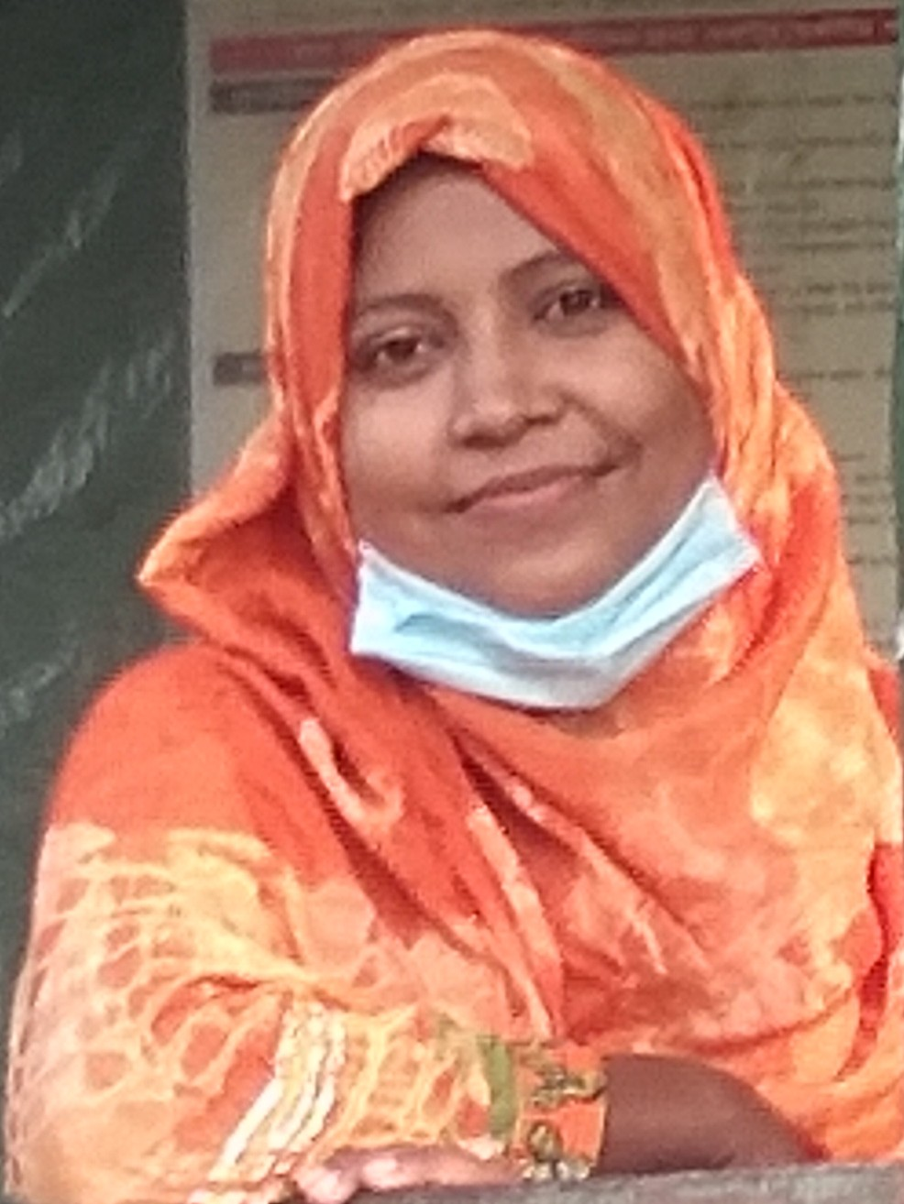
Teacher’s introduction
Sukhinur Akter
Assistant teaher
Wari Government Primary School
Louhajing,Munshigonj.

Slide 3
Introduction of Lesson
Class : 5
Sub :English
Unit :6(Eat healthy)
Lesson :4-6(What food......our health)

Slide 4
Learning outcomes
Listening
1.3.1.Understand statemants made by the teacher and students.
Speaking
1.1.2. Say sentences with proper intonations.
Reading
5.1.1.Read silently with understanding paragraph.

Slide 5
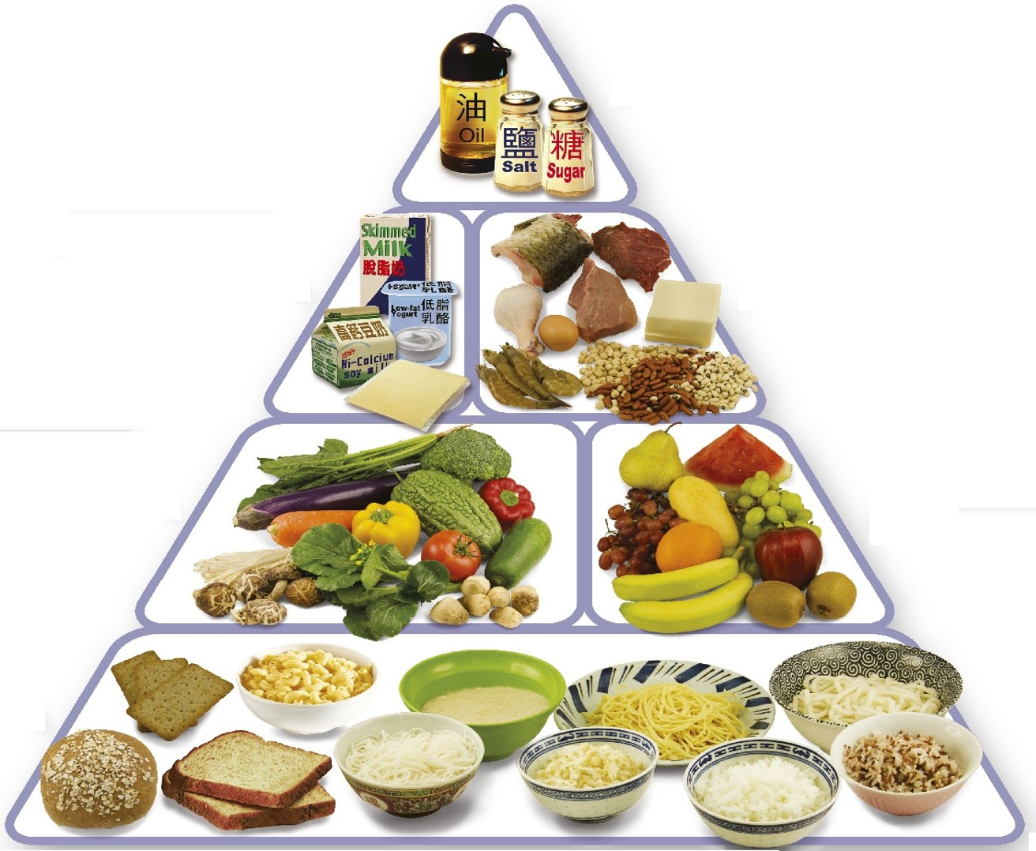
Look at the picture bellow

Slide 6
Can you say what is our today’s topic
Eat healthy

Slide 7
Let’s practice new words
Some-times often
Py-ra-mid large building of Egypt
Dif-fe-rent divers
Bot-tom lowest part
Grain corn
Si-mi-lar same
E-ner-gy strength

Slide 8
Connection with text
Open page 24,please

Slide 9
Loud reading of teacher

Slide 10
Combine reading of teacher and student

Slide 11
Pair reading and teacher’s monitoring

Slide 12
Question\answer
1.What does the food pyramidhelp us to understand?
2.What foods are made of grain?
3. Why are fruit and vegetables are important?

Slide 13
Study of the content of the first paragraph
Content of the second paragraph

Slide 14
Taxk
5 sentences about the food we eat

Slide 15
Thanks
to
all

