Slide 1
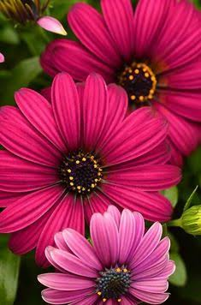
WELCOME

Slide 2
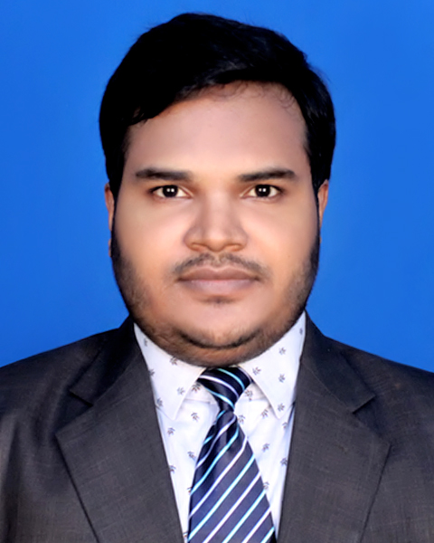
Introduction
Class: 9-10
Subject : English 2nd Paper
Topic: Right forms of verbs.
Mostafizur Rahman
Assistant Teacher (English)
Chunarughat Pilot Girls High School
Chunarughat, Habigonj

Slide 3
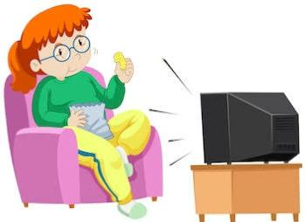
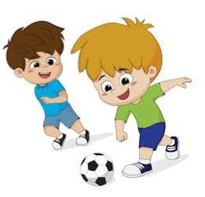
Mita watches TV.
They are playing football.

Slide 4
What is the parts of speech of the words in red colours?
1.Rana sings a song.
2.The flowers look beautiful.
3.You eat rice.
Verb

Slide 5
Today Our Topic is,,,,,,
Right forms of verbs

Slide 6
Learning Outcomes
After this lesson students will be able to-
write the sentences using right forms of verbs.
fill the gaps with right forms of verbs (with clues).

Slide 7
Look at the sentences.
Mother loves her child.
The sun rises in the east.
Trees give us oxygen.
If the sentence is Universal truth, it will be Present Indefinite Tense.

Slide 8
Look at the sentences.
He reads the Holy Quran everyday.
They attend the class regularly.
Truth always reigns in the world.
If in the sentence there is everyday/always/regularly/
occasionally/usually/often/sometimes/generally , the sentence will be Present Simple Tense.

Slide 9
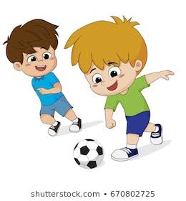
Look at the sentences.
They are playing football now.
At present Bangladesh is facing unemployment problem.
If in the sentence there is now/at this moment/at present/at this time , the sentence will be Present Continuous tense.

Slide 10
Look at the sentences.
I have recently visited Cox’s Bazar.
The train has just reached the station.
This problem already has created an alarming dimension
If in the sentence there is recently/already/just/just now/lately , the sentence will be Present Perfect tense.
Notes:
The teacher can give more example of the placement of the words recently/already/just/just now/lately/ever/yet .

Slide 11
Look at the sentences.
It has been raining since morning.
They have been playing football for one hour.
If in the sentence there is for/since+ time the sentence will be Present Perfect Continuous Tense.

Slide 12
Pair work
Give answers using right forms of verbs.
1. They already (leave) the station.
Ans: They have already left the station.
2. I just (receive) your letter.
Ans: I have just received your letter.
3. My cousin lately ( join) the party.
Ans. My cousin has lately joined the party.

Slide 13
Home work
Give answer using right forms of verbs.
A good boy (prepare) his lessons regularly.
He (play) cricket at this moment.
I just ( finish) my work.
I (play) football for two hours.
The sun (rise) in the east.

Slide 14
