Slide 1
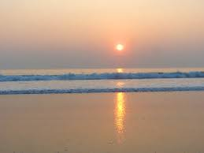

Slide 2
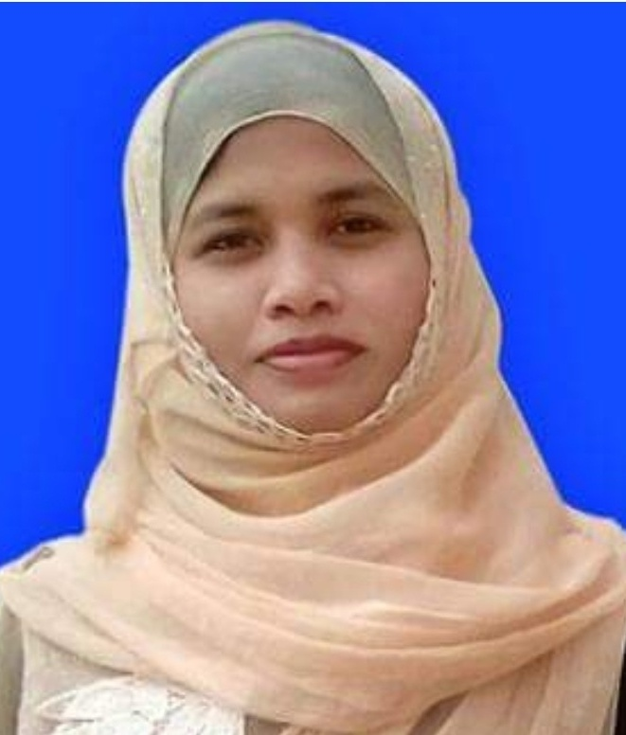
Presented by
Kuhinur jannat
Assistant Teacher
Fakirakata Govt. Primary School
Moheshkhali, Cox’sbazar

Slide 3
Lesson Introduction
English For Today
Unit : 3
Lesson : 1-2
Title : Saikat’s Family
Activity : C

Slide 4
Learning Outcomes :
At the end of the lesson Students will be able to

Slide 5
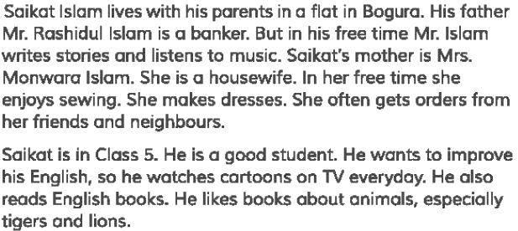
Student’s silent reading

Slide 6
Answer the following questions:
Who is Saikat?
Where does he live?
What is his fathers’ occupation?

Slide 7
Teachers loud reading :

Slide 8
Answer the following questions:

Slide 9
Pair work
Answer the following question in pair:

Slide 10
Assessment

Slide 11
What have you learnt from this lesson?
“We’ve learnt about Saikat’s family.”

Slide 12
Good Bye

