Slide 1
Wellcome

Slide 2
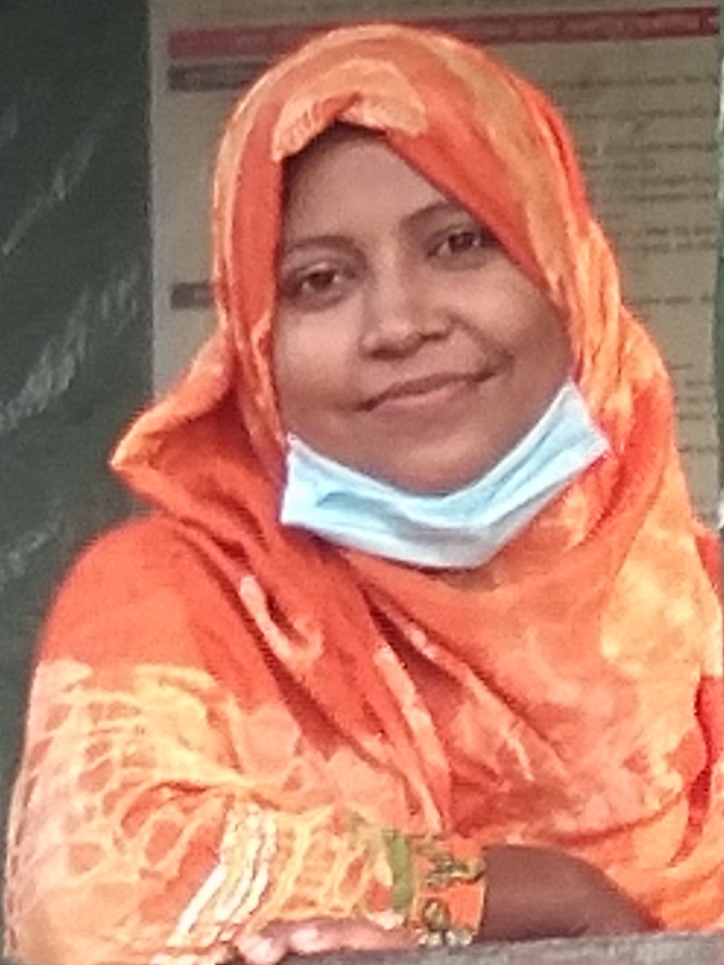
Teacher’s introduction
Sukhinur Akter Assistant teaher Wari Government Primary School Louhajing,Munshigonj

Slide 3
Introduction of Lesson
Class : 5
Sub :English
Unit :6(Occupation)
Lesson :1-2(3rd para)

Slide 4
Learning outcomes
Listening
1.3.1.Understand statemants made by the teacher and students.
Speaking
1.1.2. Say sentences with proper intonations.
Reading
5.1.1.Read silently with understanding paragraph

Slide 5
Lets watch a picture

Slide 6
What can you see here?
Some people
Do you know what’s their name?
Zainul Abedin,Syed Nazrul Islam,and others.

Slide 7
Last day we have read My home district
Now we will read its 3rd para

Slide 8
New words
Famous popular
Painter artist

Slide 9
Teachers loud reading
2 or 3 times

Slide 10
Pair reading
And
Monitoring

Slide 11
Students silent reading

Slide 12
What are two things you can see in the town?
Who are two famous person in the town?
Who is our first acting president?

Slide 13
What have we learnt today
We have learnt about Kishoregonj district’in details.

Slide 14
Thank you

