Slide 1


Slide 2



Introduce
AYESHA SIDDIQUA
HEAD TEACHER
RAMPUR GPS
LAKSAM,CUMILLA
Class : One
Sub : English
Unite : 17 ( Rhyme )P-34
Lesson : 1- 3
Topics : Rain, rain, go away.
Time : 30 minutes

Slide 3
Let’s see a video
https://www.youtube.com/watch?v=Zu6o23Pu0Do

Slide 4

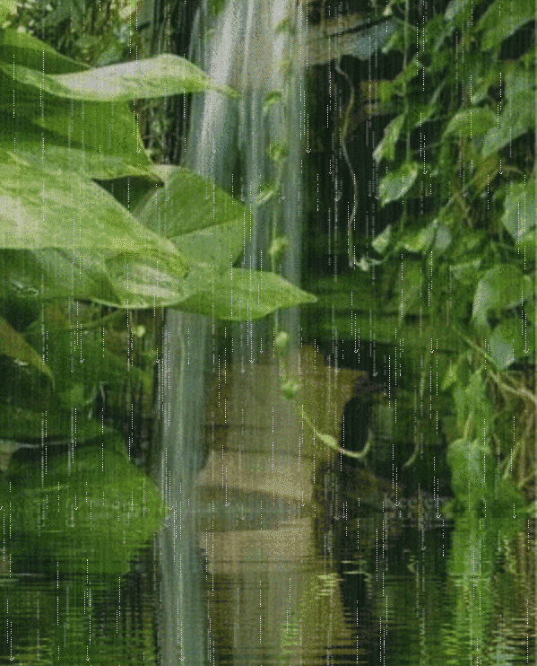
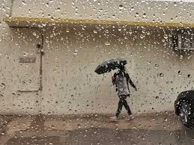
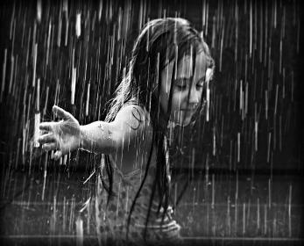
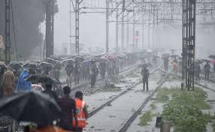
Look at the pictures with great attention:

Slide 5

Today’s lesson:
Rhyme

Slide 6
LEARNING OUTCOMES
After finishing the lesson students will be able to-
Listening:
1.1.1 recognize sound differences in the context of words.
Speaking:
4.1.1 Recite this rhymes with correct pronunciation.

Slide 7
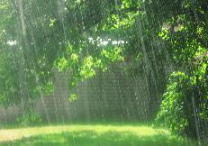
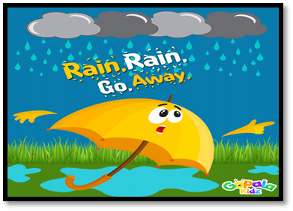
Let’s see some picture
rain
go away
Rain, rain, go away.

Slide 8


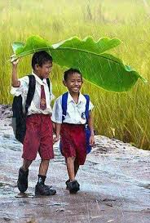
Come
Day
Come again another day.

Slide 9
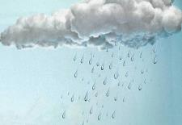
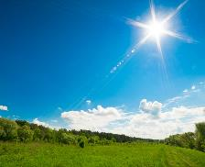
Individual Work
Match The words With Picture
Day
Rain

Slide 10
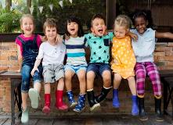
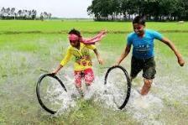
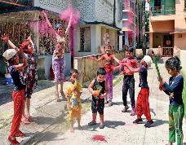
Little children
Play
Little children want to play

Slide 11
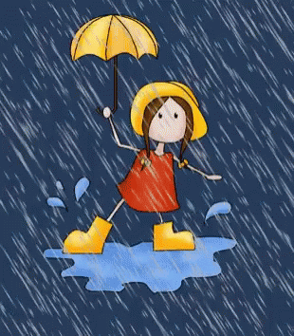
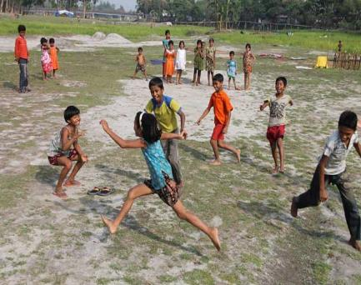
Rain, rain, go away.

Slide 12
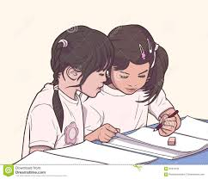
Pair work
Recite the rhyme in pair.

Slide 13

Open Your Book
Open at page 34

Slide 14

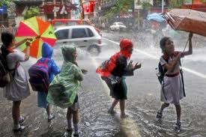
Dear children recite the rhyme with me
Rain, rain, go away.

Slide 15

Group work
Recite the rhyme in group.

Slide 16



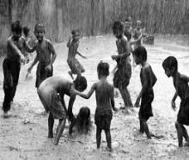
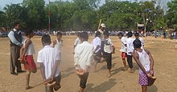
Say the pictures name
Rain
Children
Play

Slide 17
Home work
Recite the rhyme.

Slide 18


