Slide 1
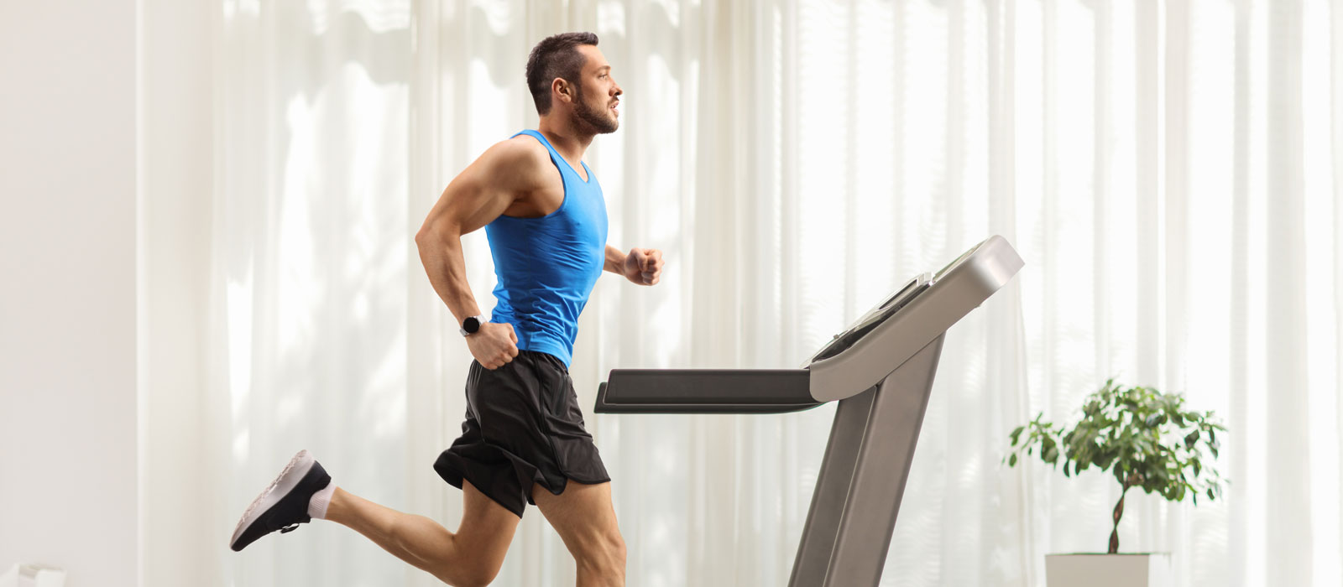
Welcome dear learners

Slide 2
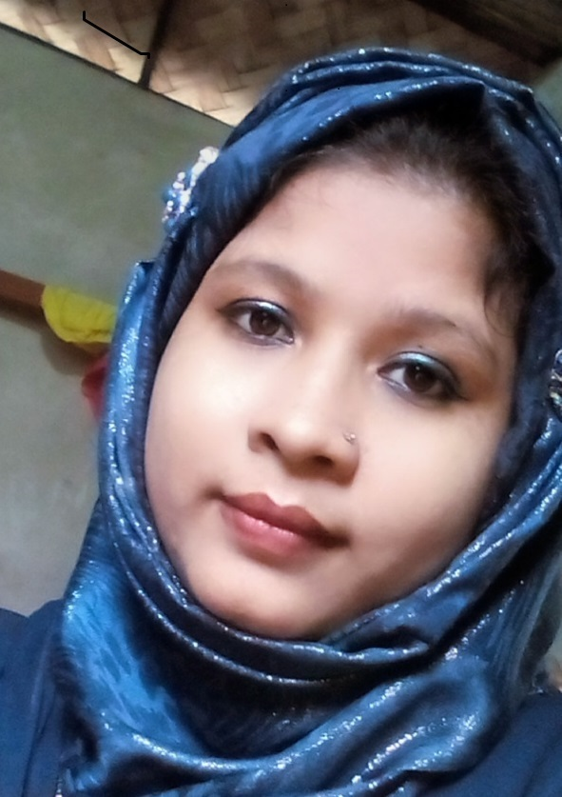
Introduction
Teacher’s Introduction
English 1st Paper
Class: Eight
Unit: Three
Lesson : Six
Amena Ferdosi (Nizum)
Assistant Teacher (English)
Bhimpur High School
Chatkhil, Noakhali.

Slide 3
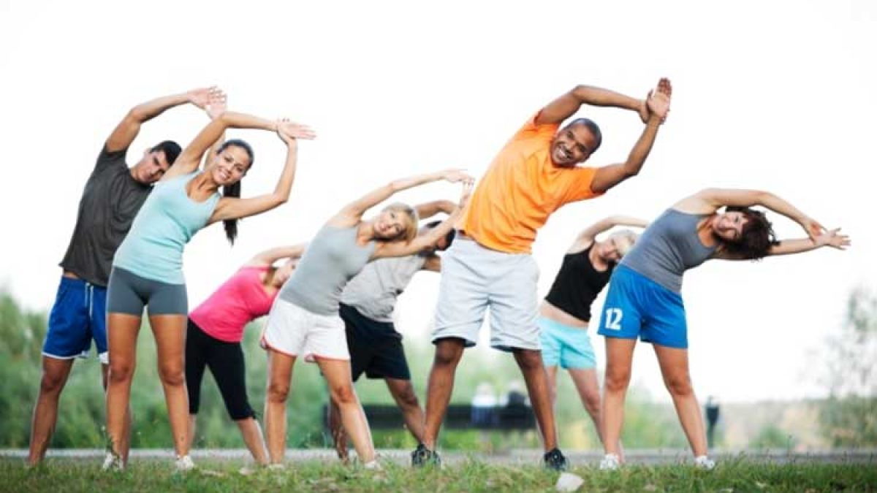
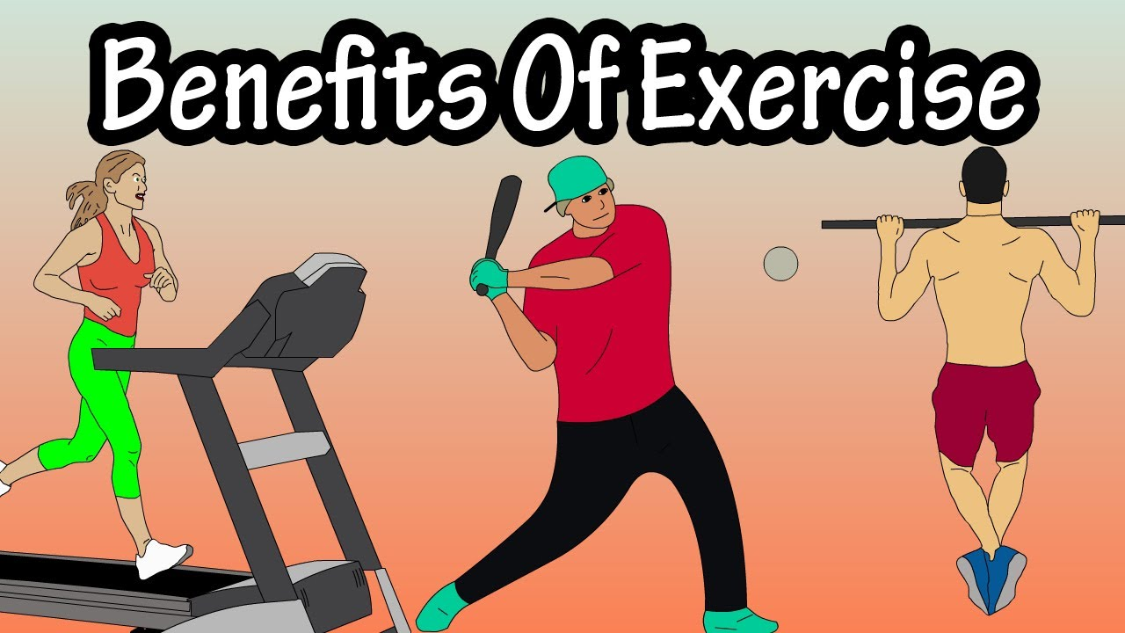
Look at the pictures and answer the questions.
what can you see in the pictures?
Do you go to play ground daily?
Do you take physical exercise regularly?

Slide 4
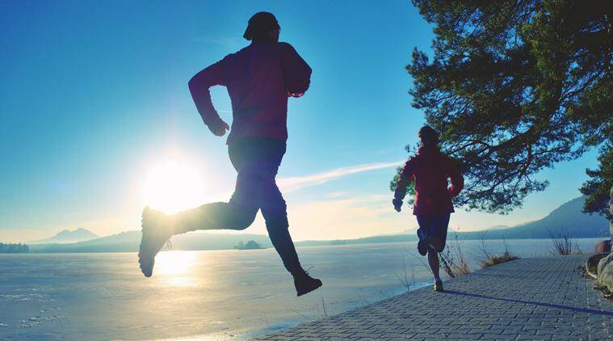
Our lesson topic is,,,,,,,
Physical exercise

Slide 5
Learning Outcomes
By the end of the lesson the learners will be
able to…
ask and answer questions
explain the text
write the usefulness & importance of physical exercise

Slide 6
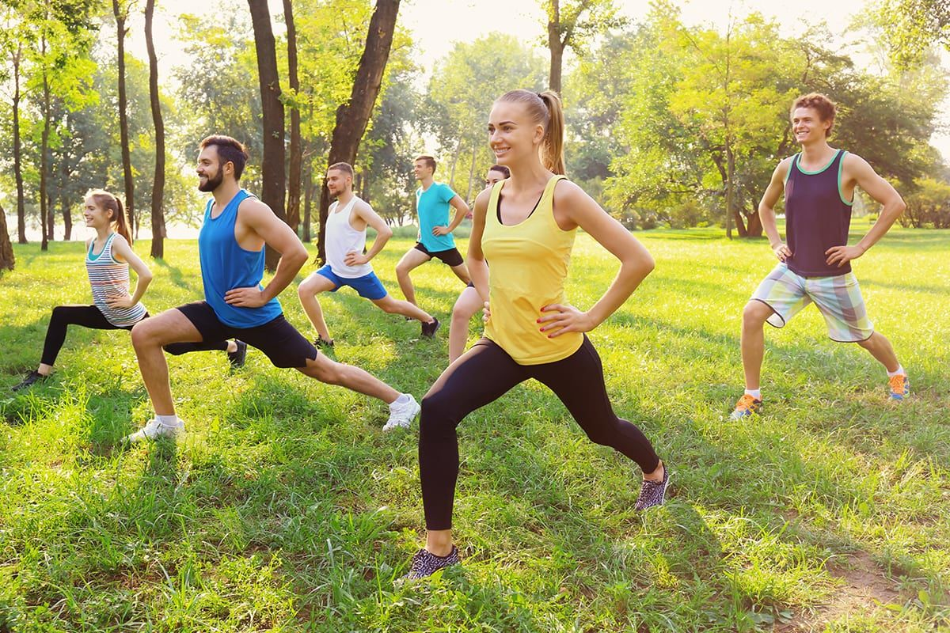
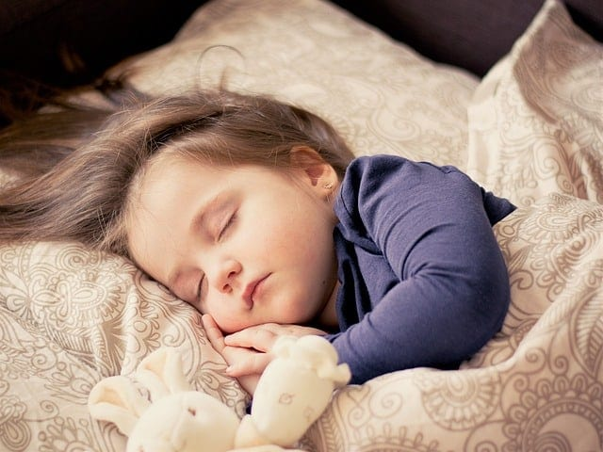
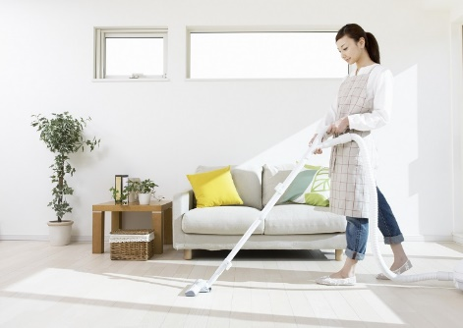
What things are necessary for good health?
We need healthy food, proper rest and sleep. We also have to be clean and tidy.

Slide 7
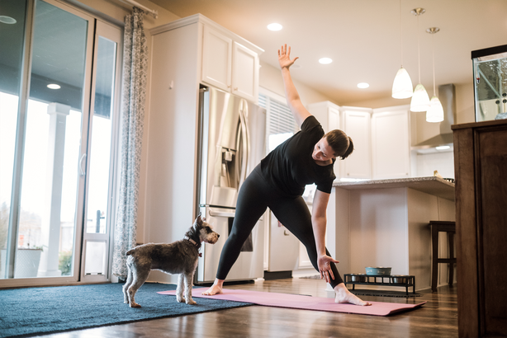
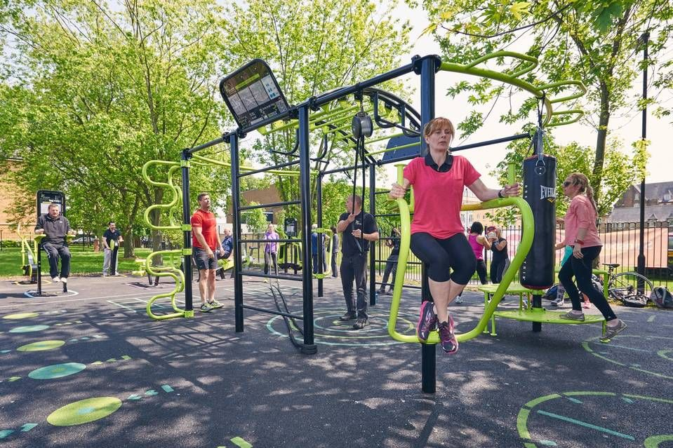
What types of physical exercise can we do?
We can do them indoors as well as outdoors. In the house we can do some free hand exercise. Outsides, we can play, swim or simply walk.

Slide 8
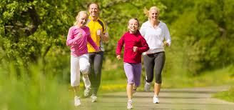
Why do we need physical exercise?
The benefits of physical exercise are many. The greatest of them is that it keeps you fit for work . It also gives us energy, and makes us strong and cheerful.

Slide 9
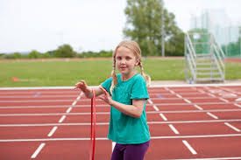
Let us know some keywords.
Benefit
Advantage

Slide 10
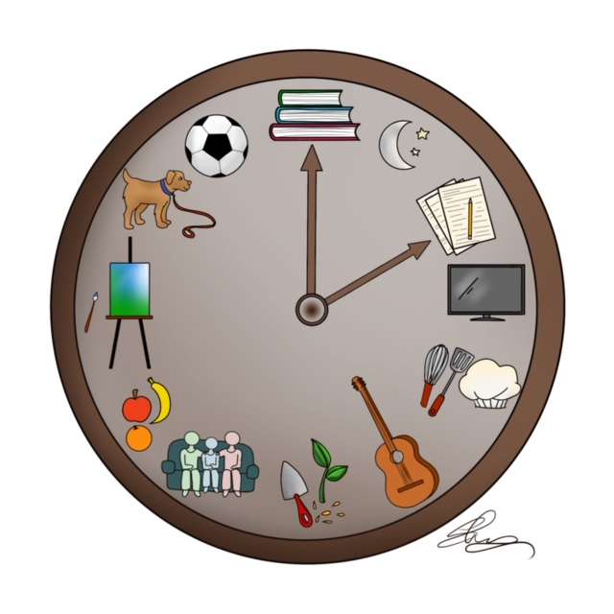
Regularity
Punctuality

Slide 11
Cheerful
Glad

Slide 12
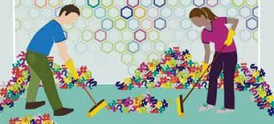
Tidy
Clean

Slide 13
Answer the following questions.
Which things are necessary for good health?
Name the different types of physical exercises?
Why do we need to take physical exercise ?
What type of physical exercise do we do?

Slide 14
Pair in work
Look at the picture and talk about it with your partner. After that, answer the following questions.
1.Who can you see
in the picture?
2.What is he doing ?
3.Can you tell me
what it is called?

Slide 15
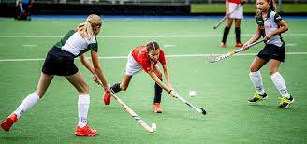
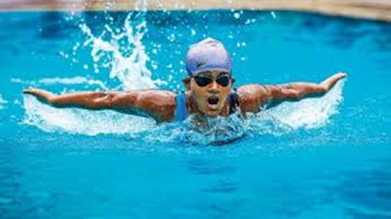
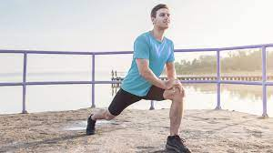
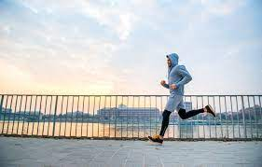
Here is a list of some physical exercise. Write in your notebook which ones are indoor exercises and which are outdoors and which ones can be done both indoors and outdoors.
Playing sports
Swimming
Skipping
Jogging
Walking
Stretching

Slide 16
Home Work
What’s your favorite sport? Do you take
part in it? If so , where do you play it and
who with? Now write a paragraph on it
answering the above questions?

Slide 17
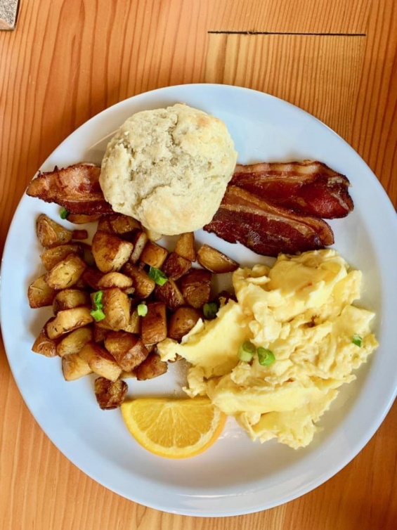
TAKE EXERCISE, PROPER REST AND SLEEP,
EAT GOOD FOOD
&
REMAIN HEALTHY.

Slide 18
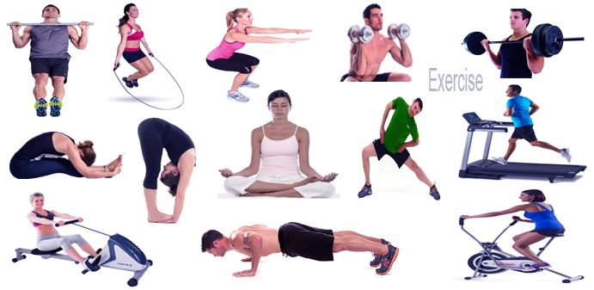
Thanks lot

