Slide 1
Welcome

Slide 2
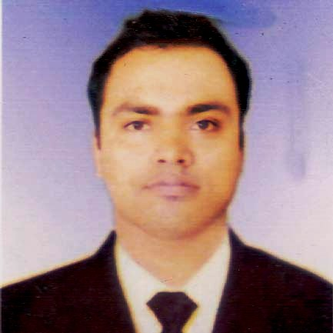
Introduction
Md. Masum Billah
Assistant Teacher(English)
Nengurahat School And College,
Manirampur,Jashore.
E-mail: masumbillah1740@gmail.com
Subject:English
Class:Seven
Time:45 Minutes
Date:29/05/2021

Slide 3
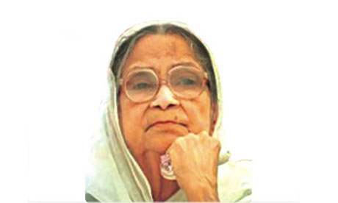
Begum Sufia Kamal

Slide 4
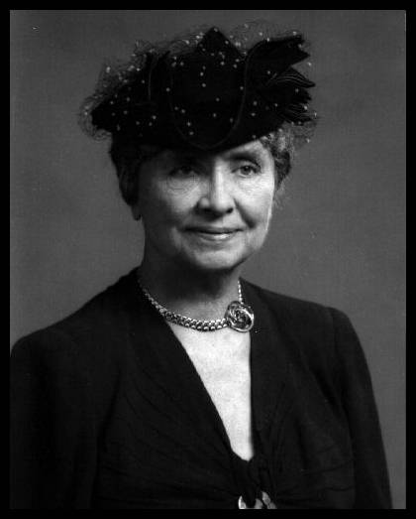
Helen Keller

Slide 5
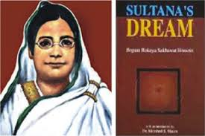
Begum Rokeya

Slide 6
Learning Outcomes
By the end of the lesson, the students will be able to . . .
1.Ask and answer questions
2.Talk about people
3.Write answers to questions.
4.Practise dialogue

Slide 7
Born in 1880
Birth place in Rangpur
Married in 1896
Died in 1932

Slide 8
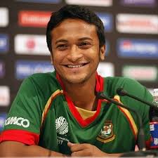
Popular
Famous

Slide 9
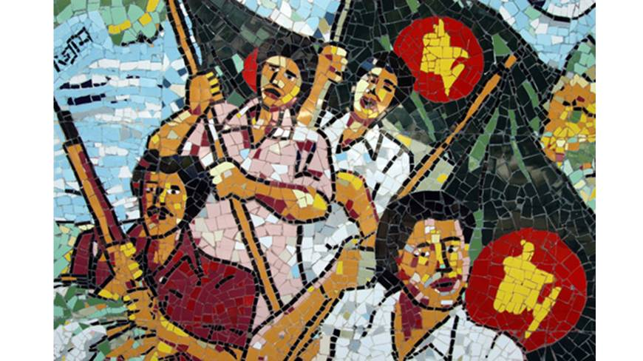
War
Fight

Slide 10
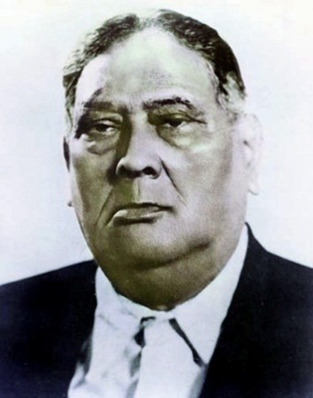
Famous
Great

Slide 11
Read about Begum Rokeya

Slide 12
Pair Work
Make a dialogue between
You and your classmate about Begum Rokeya.

Slide 13
EVALUATION
1.What kind of family did Begum Rokeya come from?
2.What was her belief?
3.What did she fight for?

Slide 14
HOME WORK
Write a Paragraph on Begum Rokeya about 100 words
Maintaining the following key words:undivided,marry,education,
born and love.

Slide 15
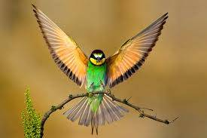
THANK YOU

