Slide 1
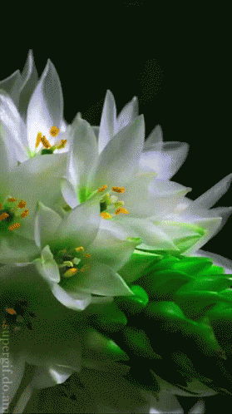
Welcome
welcome
welcome
MS English Online Class

Slide 2
Madhu
Sudan Das.
BA (H), English,
MA (Double),
ELL & ELT; M.Ed.
Bakalia Adarsha Girls’
High School.
Introduction
Candidates
and
Nine-Ten

Slide 3
After completing the lesson we will be able to:
Use prefix
Use suffix
Fill the blanks
Use right form of verbs
Transform the sentences as directed
Learning outcomes:

Slide 4
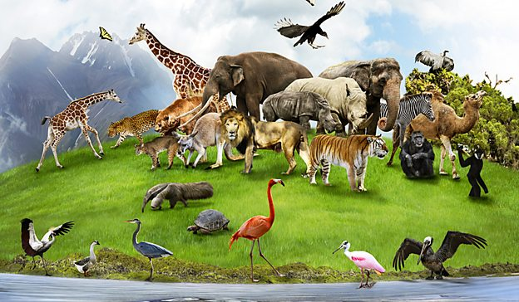
Use suffix or prefix or both:
(a) — (kind) is a noble virtue. We mustn't be (b) — (kind) to the poor. Even we must be kind to the (c) — (low) animals. Some boys beat animals (d) — (whimsical). This is quite (e) — (moral). Animals are very (f) — (use). Some of them are very (g) — (faith). Dogs are the most (h) — (glare) example of (i) — (faith). So we must be (j) — (mercy) to all living beings. Without (k) — (be) merciful we won’t be (l) — (be) to understand the animals. In fact, they feel no (m) — (hesitate) to risk their (n) — (life) for our protection.
0.5×14=7
Individual work
Look at the picture
Madhu Sudan Das. BA (Hon’s), English; MA (Double); ELL & ELT, M.Ed.
a. Kindness
d. whimsically
e. immoral
f. useful
b. unkind
c. lower
g. faithful
h. glaring
i. faithfulness
j. merciful
k. being
l. able
m. hesitation
n. lives

Slide 5
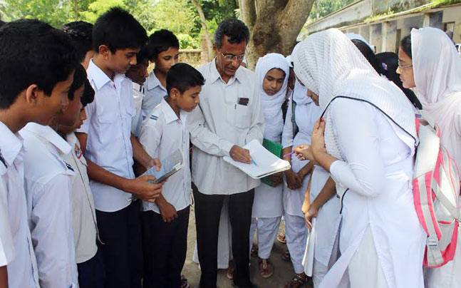
Use right form of verbs
Group work
understand
owe
respect
acquire
forget
form
consider
take
succeed
admit
Look at the picture
In an educational institution teacher-student relationship (a) --- to be the most important matter. It is such a relationship that is (b) --- on the basis of mutual (c) ---. A student always (d) --- to his teachers because he cannot but (e) --- help from them in case of (f) --- knowledge. The sensible students never (g) --- their teachers. Moreover, they (h) --- their memorable teachers role which help them (i) --- in life. So, they always (j) --- their teachers.
Madhu Sudan Das. BA (Hon’s), English; MA (Double); ELL & ELT, M.Ed.
a. is considered
b. formed
c. understanding
d. owes
e. take
f. acquiring
g. forget
h. admit
i. succeed
j. respect

Slide 6
Change the sentences according to direction
Pair work
Look
at
the picture
Madhu Sudan Das. BA (Hon’s), English; MA (Double); ELL & ELT, M.Ed.
1. Man is the best creation of God. (Positive)
1. No other creation of God is as good as man.

Slide 7
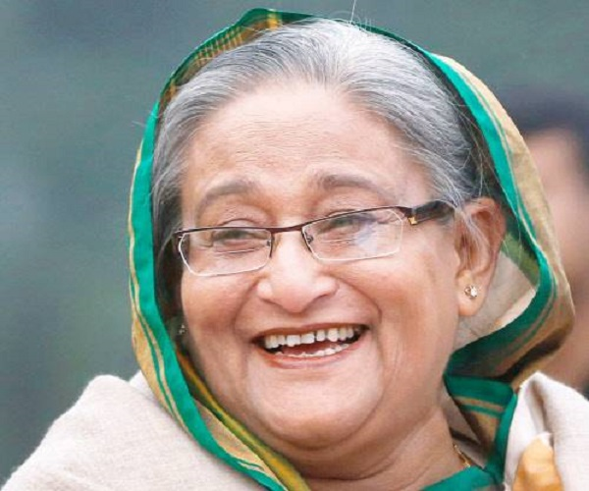
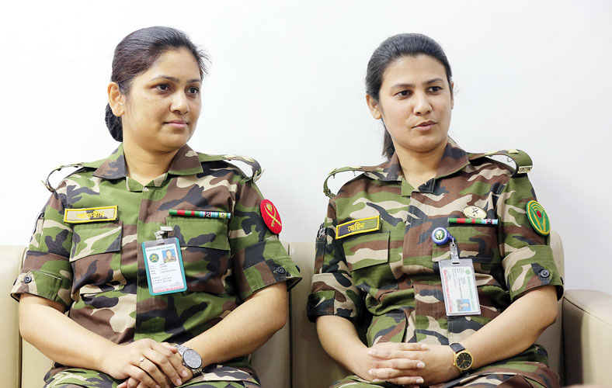
Look at the pictures and change the sentence
Pair work
Madhu Sudan Das. BA (Hon’s), English; MA (Double); ELL & ELT, M.Ed.
2. She is the wisest of all creature. (positive)
Ans. No other creature is as wise as she.

Slide 8
Look at the pictures and change the sentence
Pair work
Madhu Sudan Das. BA (Hon’s), English; MA (Double); ELL & ELT, M.Ed.
3. Our life is not measured by months or years. (Active)
Ans: We do not measure our life by months or years.

Slide 9
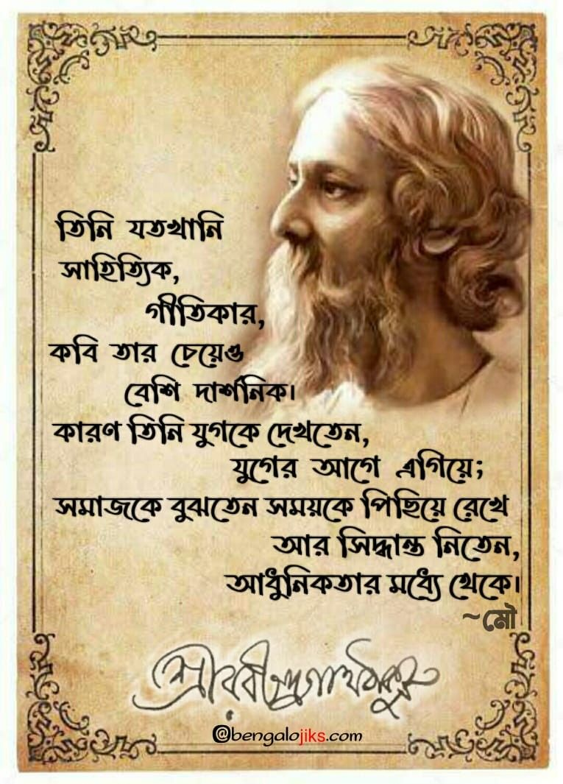
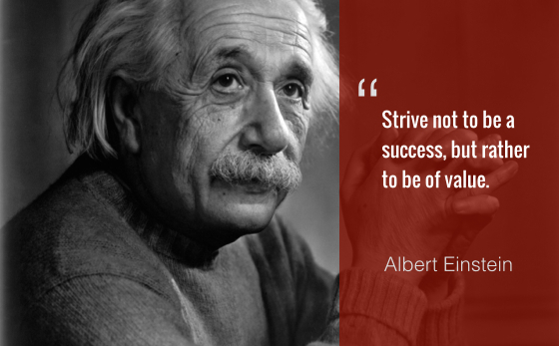
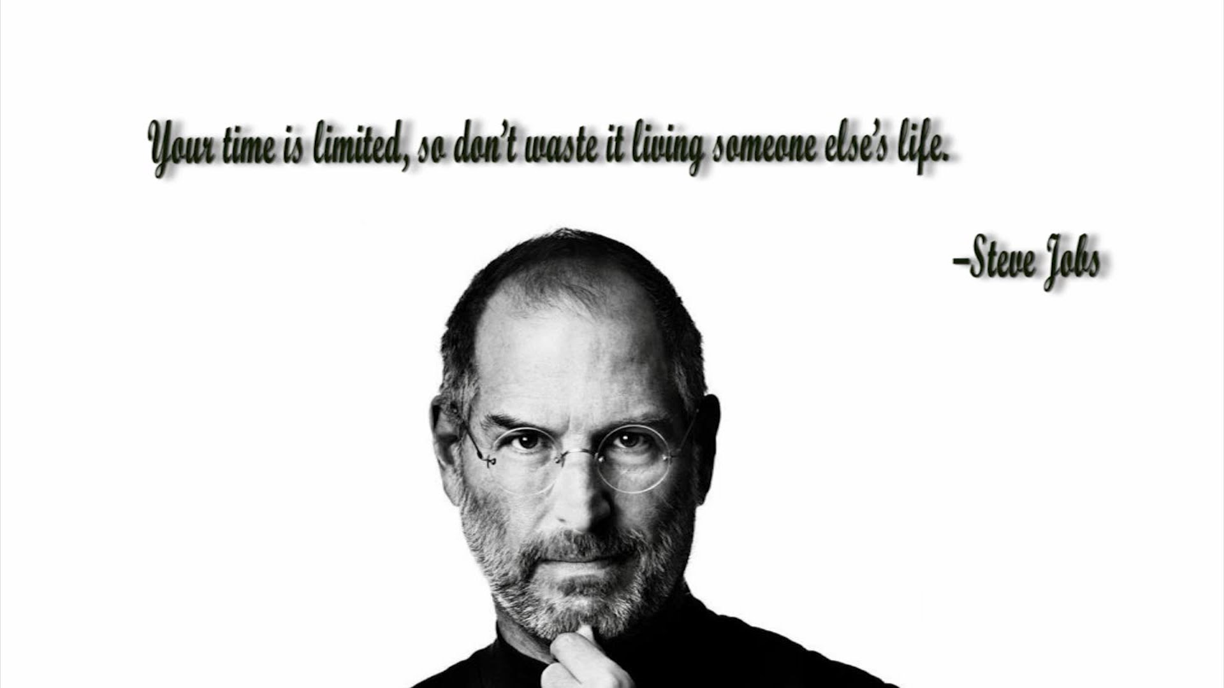
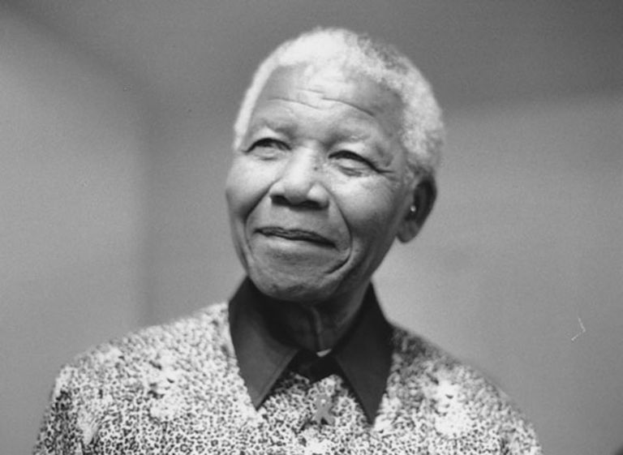
Look at the pictures and change the sentence
Pair work
Madhu Sudan Das. BA (Hon’s), English; MA (Double); ELL & ELT, M.Ed.
4. Great men are remembered by us even after their death. (Active)
Ans: We remember great men even after their death.

Slide 10
Look at the pictures and change the sentence
Pair work
Madhu Sudan Das. BA (Hon’s), English; MA (Double); ELL & ELT, M.Ed.
5. Youth is the most valuable season of life. (Comparative)
Ans: Youth is more valuable than any other season of life.

Slide 11
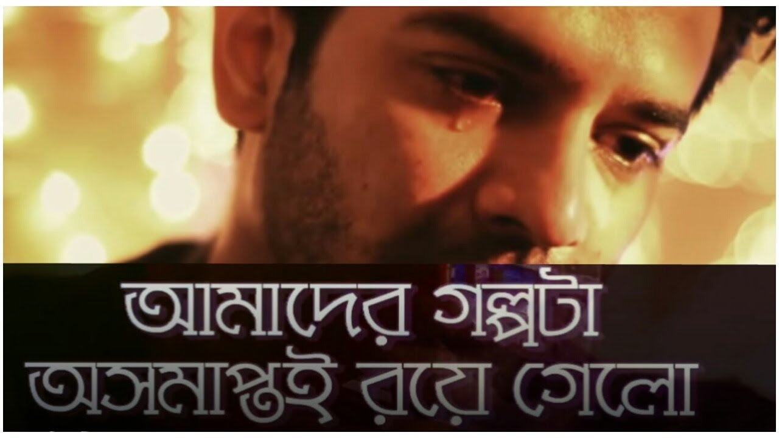
Look at the pictures and change the sentence
Pair work
Madhu Sudan Das. BA (Hon’s), English; MA (Double); ELL & ELT, M.Ed.
6. Nobody is absolutely happy on the earth.(Affirmative)
Ans: Everybody is somewhat unhappy on the earth.

Slide 12
Look at the pictures and change the sentence
Pair work
Madhu Sudan Das. BA (Hon’s), English; MA (Double); ELL & ELT, M.Ed.
7. So, we should not waste time in vain. (Passive)
Ans: So, time should not be wasted in vain by us.

Slide 13
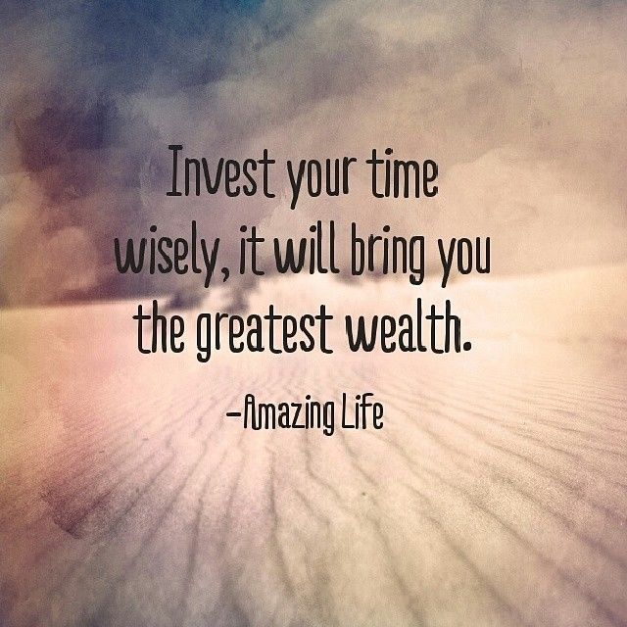
Look at the pictures and change the sentence
Pair work
Madhu Sudan Das. BA (Hon’s), English; MA (Double); ELL & ELT, M.Ed.
8. We should use time properly to be benefited. (Imperative)
Ans: Let’s use time properly to be benefited.

Slide 14
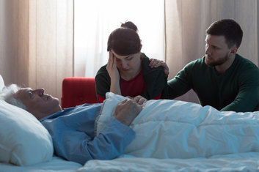
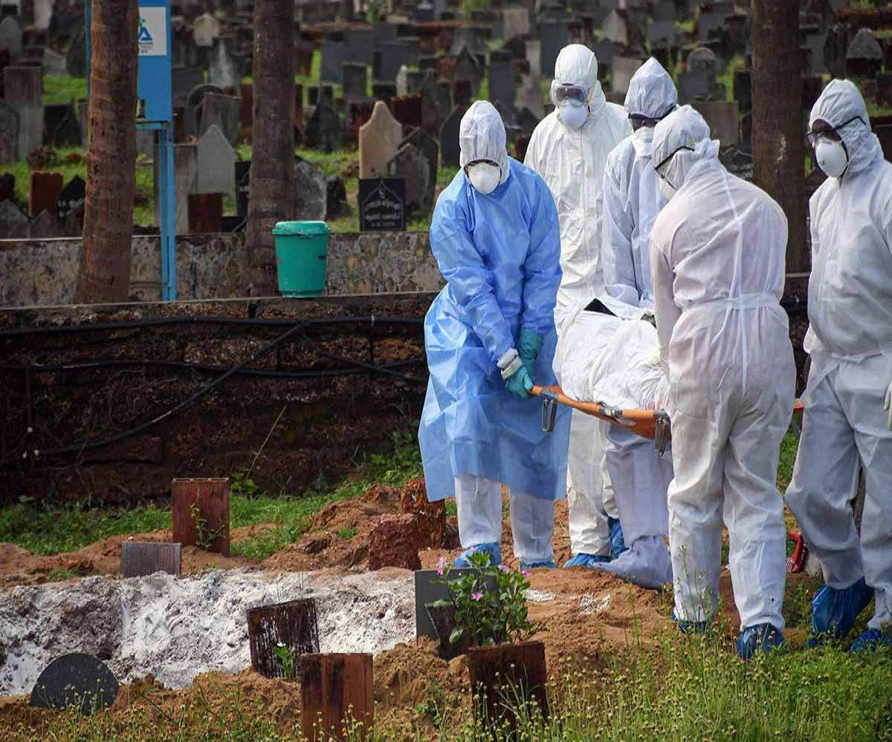
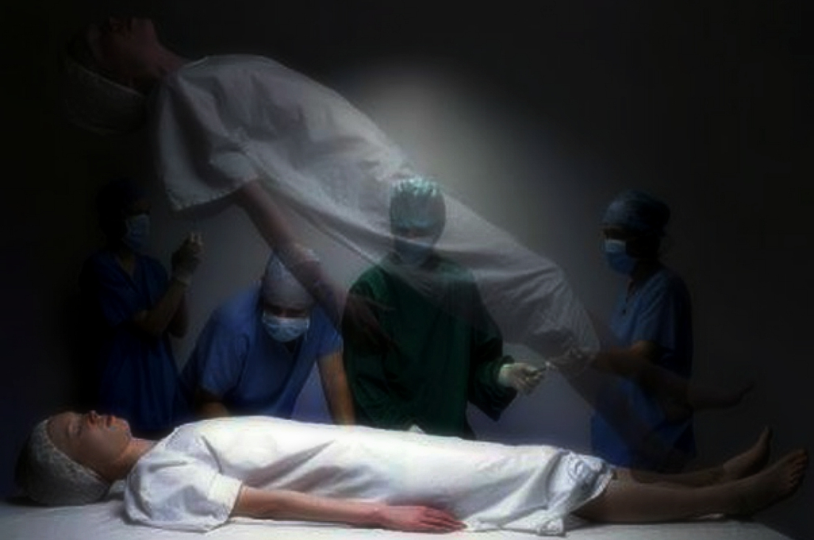
Look at the pictures and change the sentence
Madhu Sudan Das. BA (Hon’s), English; MA (Double); ELL & ELT, M.Ed.
9. All men must die. (Negative)
Ans: None can avoid death. Or, All men cannot but die.

Slide 15
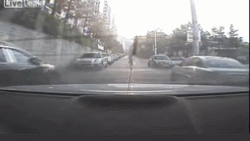
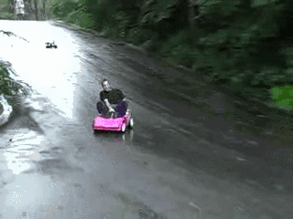
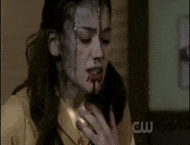
Look at the pictures and change the sentence
Pair work
Madhu Sudan Das. BA (Hon’s), English; MA (Double); ELL & ELT, M.Ed.
10. It is not possible to avoid death. (Affirmative)
Ans: It is impossible to avoid death.

Slide 16
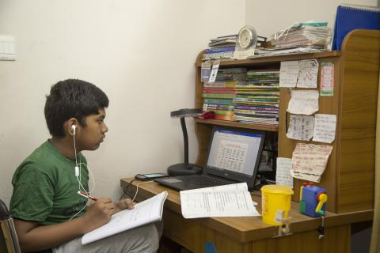
Home Work
Applications:
1. For taking steps against mosquito menace. (Chairman)
2. For setting up multimedia classroom. For sinking tube wells.
3. Improving sewerage system at West Bakalia.

