Slide 1
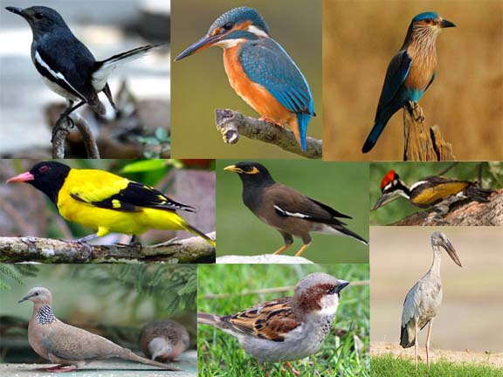

Slide 2
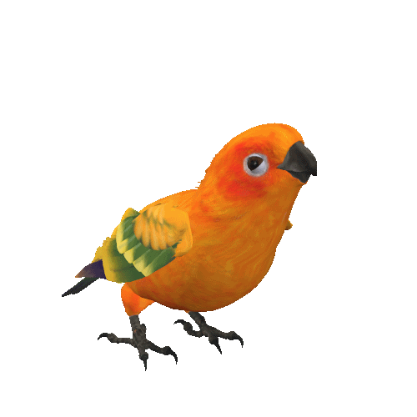
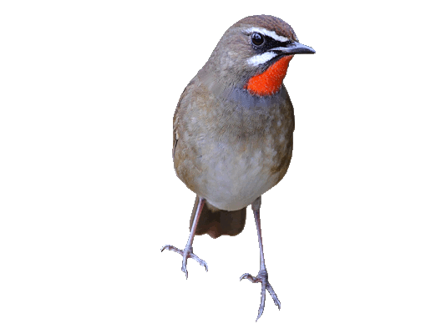
Introduction
Rajan Shaha
Assistant Teacher in English
Ispahani Public School & College
Cumilla Cantonment

Slide 3
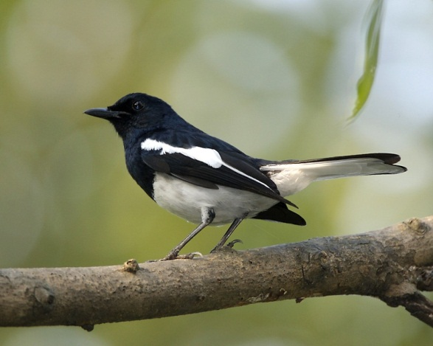
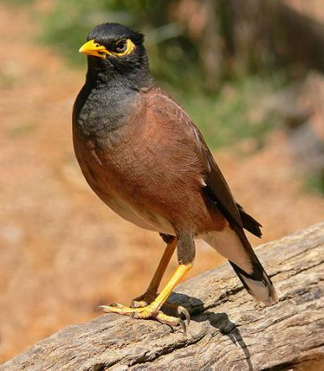
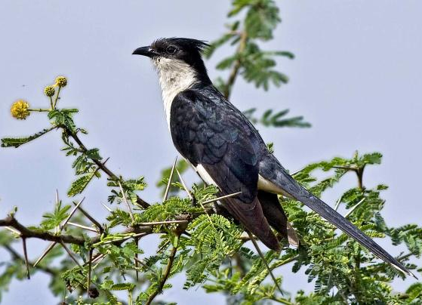
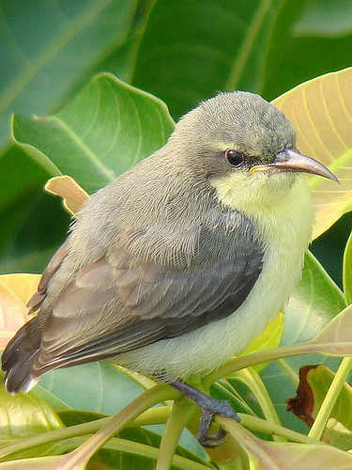
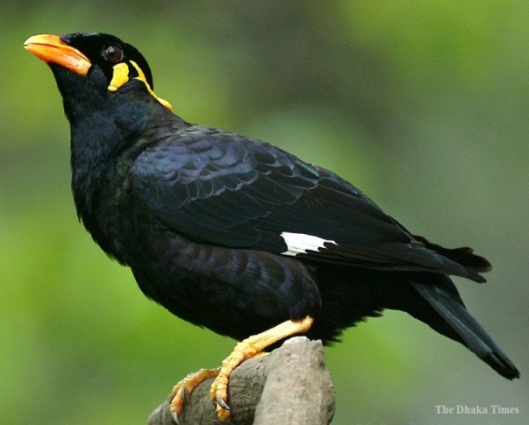
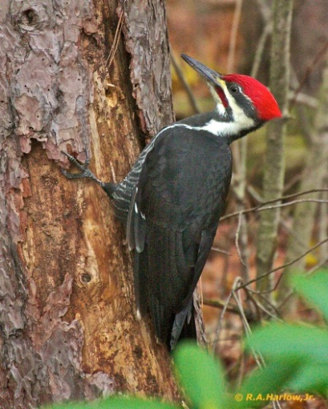
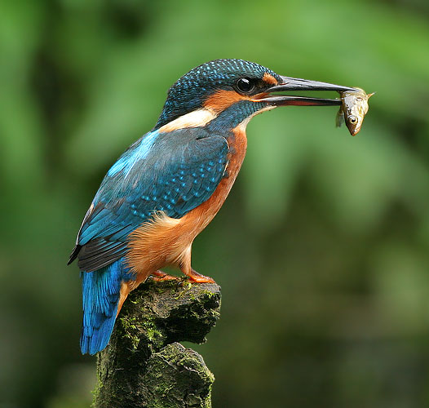
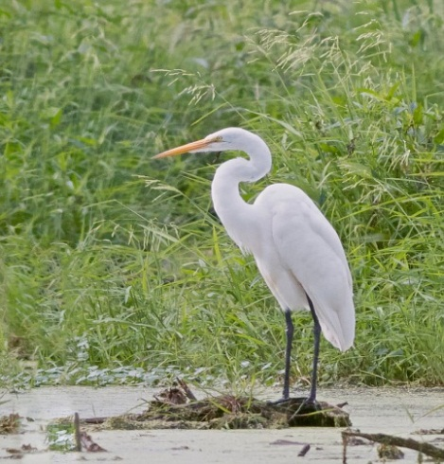
Tell the names of these birds.
Magpie Robin
Martin
Cuckoo
Tailorbird
Mynah
Woodpecker
Kingfisher
Heron

Slide 4
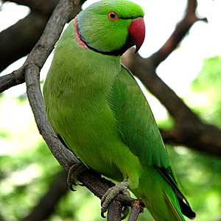
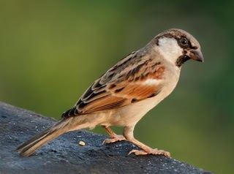
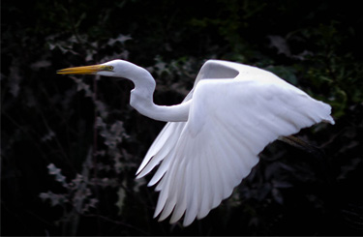
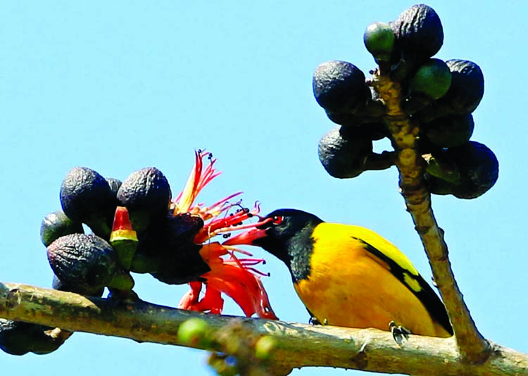
Tell the names of these birds.
Parrot
Sparrow
Egret
Blackheaded Oriole

Slide 5
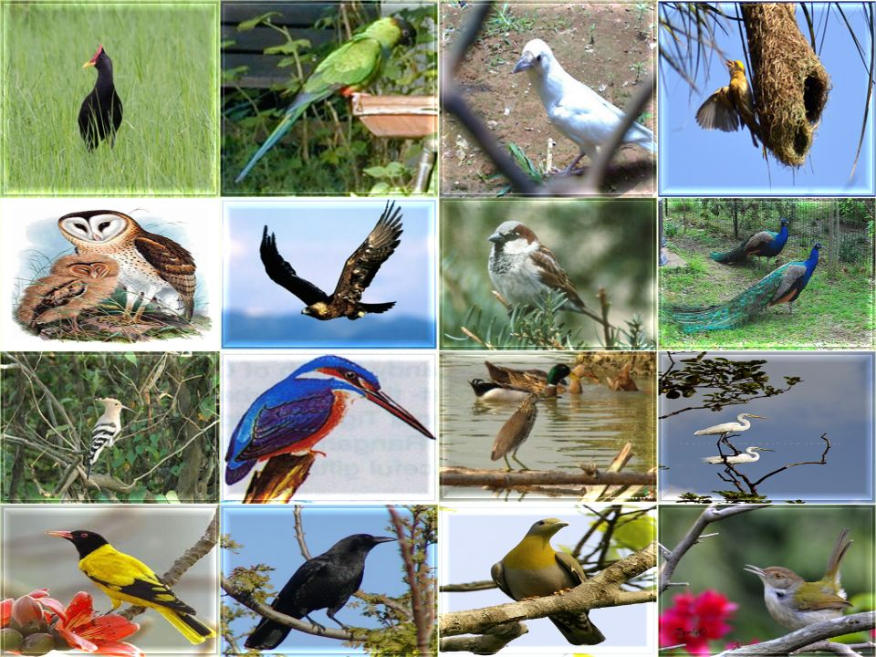
Birds are called the most beautiful creature of the god in nature.
In the pictures you all have seen the common birds of our country.

Slide 6
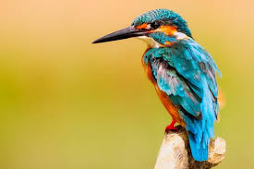
Birds of Bangladesh
Our today’s lesson is on them. And it is …
Lesson- 12

Slide 7
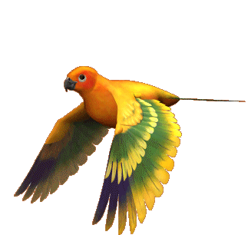
After completing the lesson the students will be able to …
write short paragraphs.
Talk about people, places and familiar objects in short simple sentences

Slide 9
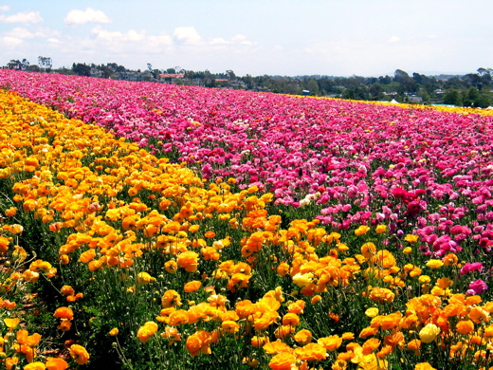
Plentiful
A lot of

Slide 10
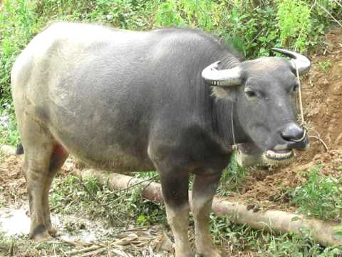
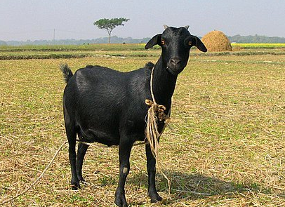
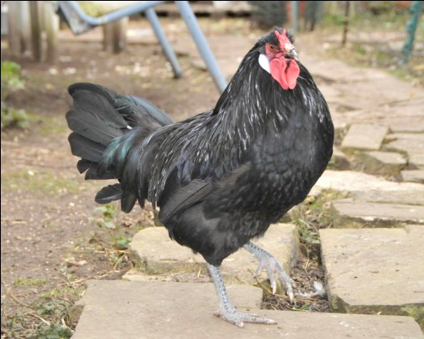
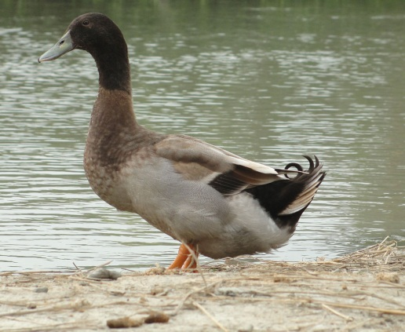
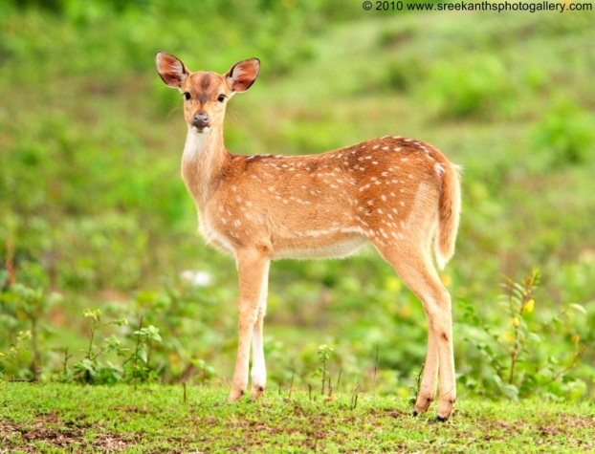
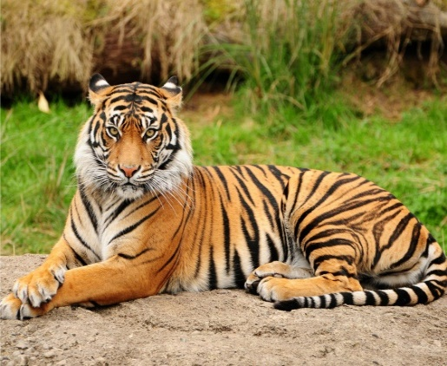
Fauna
The animals of a particular region.

Slide 11
Sprightly
Energetic & lively

Slide 12
Pleasant
Attractive

Slide 13
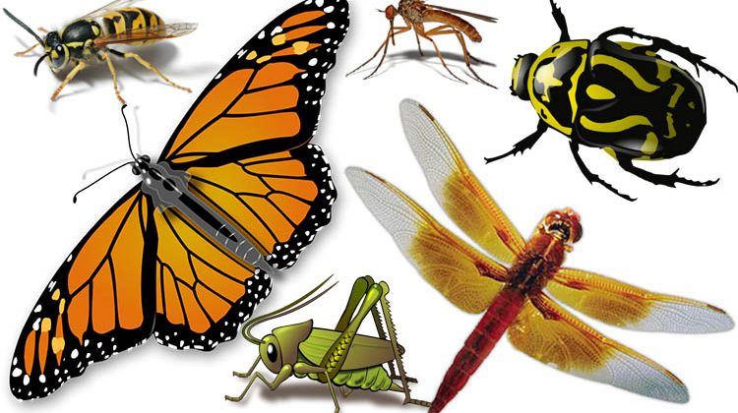
Worm
Insect

Slide 14
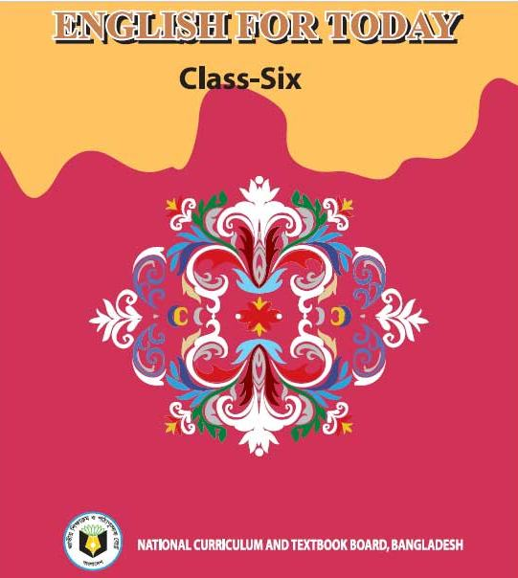
Let’s read the text.

Slide 15
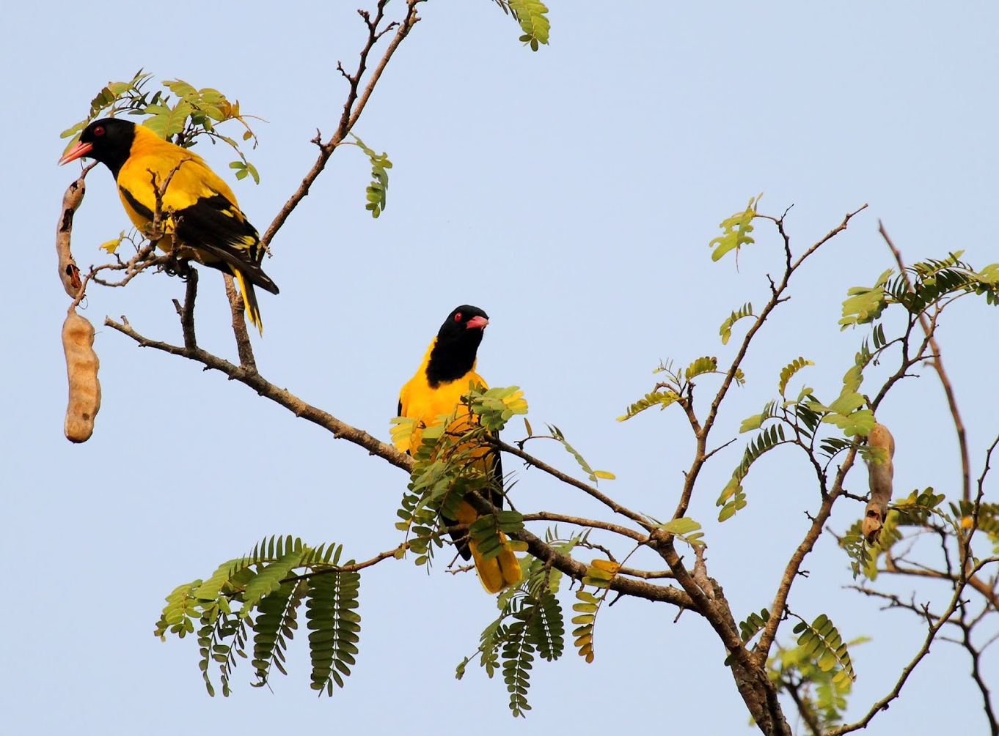
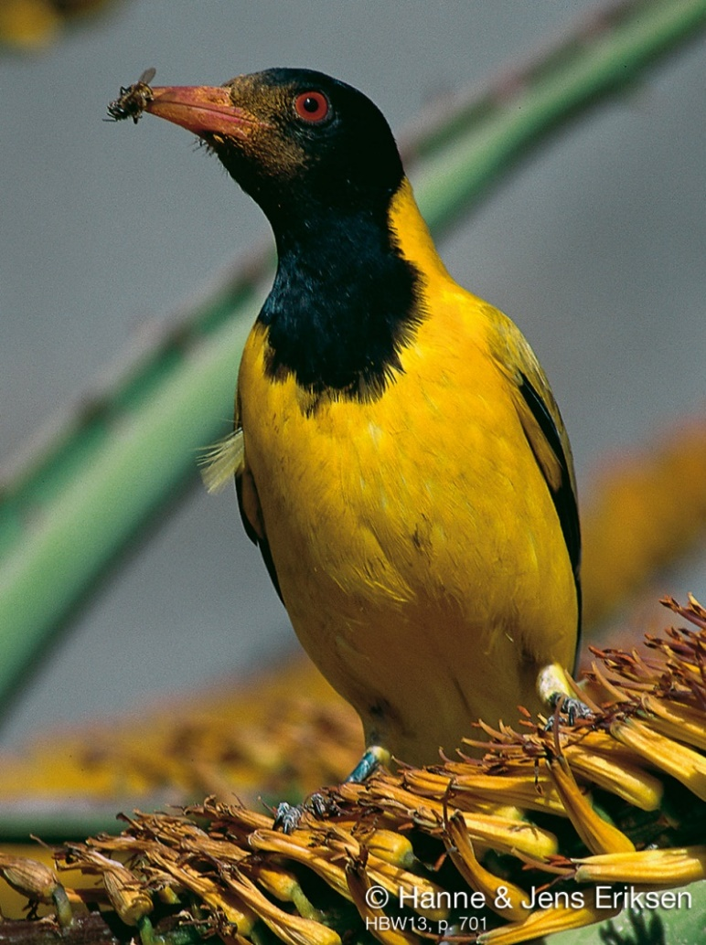
A. Read the following passage.
Blackheaded Oriole
Bangladesh is a country full of natural resources. We are proud of soil, forests, flowers, fruits and birds. The country is gifted with plentiful of fauna due to its geographical location. Birds are one of them. Today we will read about a bird known as ‘Benebau’ in Bangla, and ‘Blackheaded Oriole’ in English.

Slide 16
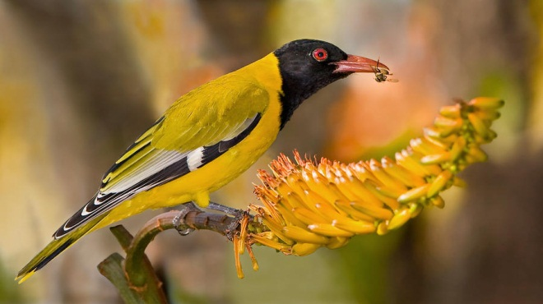
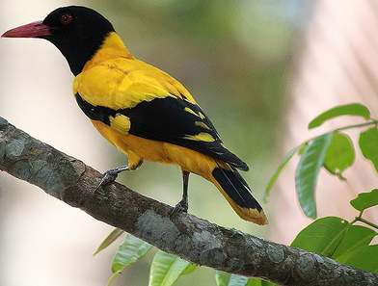
The Black-headed Oriole is a bird of the plain land of Bangladesh. Its body is deep yellow, its head, its tail and some parts of its wings are black; its beak is red. It looks like a Mayna and is about 25 cm in length. It is seen in Bangladesh, India, Srilanka, Myanmar and some other countries.

Slide 17
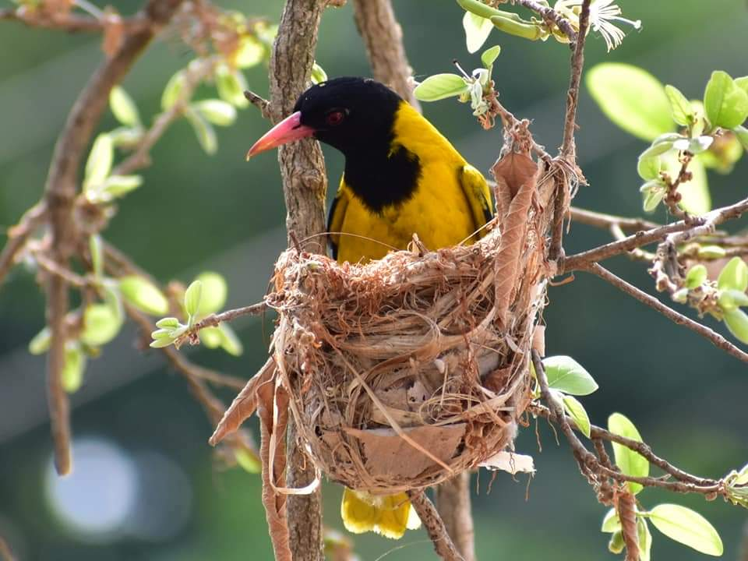
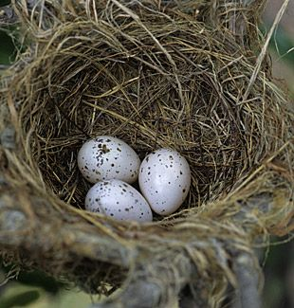
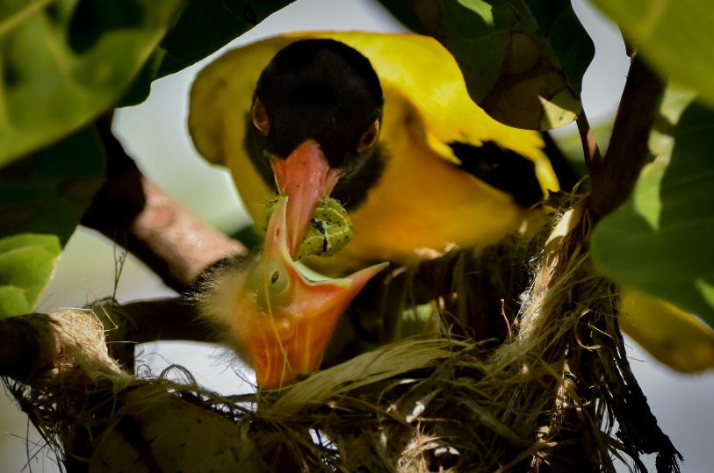
The black headed oriole is very sprightly and restless bird. It never stays at one spot for long. It eats all kinds of worms and insects. Its call is quite sweet and pleasant. The black-headed oriole builds round shaped beautiful nests with dry grass and barks of trees. Both the male and the female take part in building their nests. The black headed oriole lays two to three eggs at a time.

Slide 18
A1. Learn the meaning of these words:
Geographical
ভৌগলিক
Fauna
প্রাণীকুল
Resources
সম্পদ
Sprightly
চটপটে
Plentiful
প্রচুর
Beak
ঠোঁট/চঞ্চু
Lay
ডিম পাড়া

Slide 19
Answer the following questions
1. What are we proud of?
Answer: We are proud of our soil, forests, fruits and birds.
2. In which countries is Blackheaded Oriole seen?
Answer: It is seen in Bangladesh, India, Srilanka, Mayanmar and some countries.
3. How is its call?
Answer: Its call is sweet and pleasant.

Slide 20
Grammar Focus
চিরন্তন সত্য, অভ্যাস বা সাধারণ ঘটনা বোঝালে কিংবা বর্তমানকালে মাঝে মাঝে বা নিয়মিত ঘটে বোঝালে বাক্যটি Present Indefinit Tense হয়। যেমনঃ
আমি প্রথম আলো পত্রিকা পড়ি- I read the Prothom-Alo newspaper.
সূর্য পূর্ব দিকে ওঠে- The sun rises in the east.
Present Indefinite Tense- এর ক্ষেত্রে নিচের structure- টি ব্যবহৃত হয়।
Structure : Subject + verb- এর present form + বাকি অংশ।
Note: Subject যদি 3rd Person Singular Number (he/she/it/Jony/Jui etc.) হয় তাহলে Verb এর সাথে ‘s’ বা ‘es’ যুক্ত হয়।

Slide 21
Make five sentences from the substitution table.
 | lives | called Blackheaded Oriole in English.
Benebau | are | built with dry grass and barks of trees.
It | is | in round shaped nest.
The nests | resembles | a beautiful bird.
 |  | to the mynah, another familiar bird of Bangladesh.

Slide 22
Answer
Benebau is called Blackheaded Oriole in English.
It lives in round shaped nest.
The nests are built with dry grass and barks of trees.
It resembles to the mynah, another familiar bird of Bangladesh.
It is a beautiful bird.

Slide 23
Make another five sentences from the substitution table.
 | is | a very sprightly and restless bird.
 | eats | at one spot for long.
It never | takes part | all kinds of worms.
It | lays | round shaped beautiful nests.
 | makes | in building their nests.
 |  | two to three eggs at a time.

Slide 24
Answer
It is a very sprightly and restless bird.
It eats all kinds of worms.
It takes part in building their nests.
It makes round shaped beautiful nests.
It lays two or three eggs at a time.

Slide 25
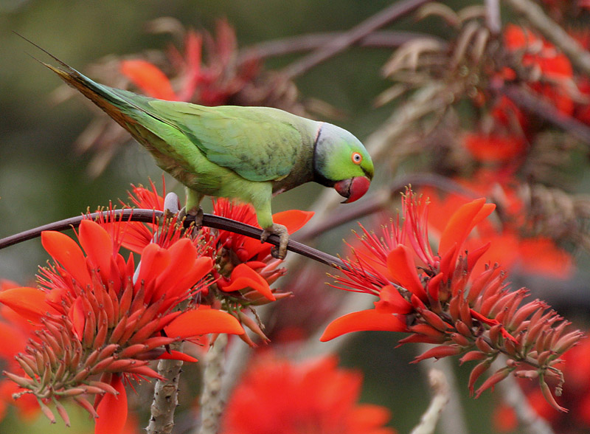
A2. Look at the picture of the ‘Tia’ (Parakeet) below. And then write a paragraph on the bird using the clues given.
Clues: found all over Bangaladesh – about 42 cm – whole body green – strong, curved beak, bright red – eyes round and yellow – feet red – tall, slim tail – around its neck black and red coloured rings – eats grass, nuts, chilli, ripe banana and other fruits – live in flocks – builds nets in tall shimul trees/in holes of empty buildings – lays four to six eggs.

Slide 26
Let’s see a Tia chirping in nature.

Slide 27
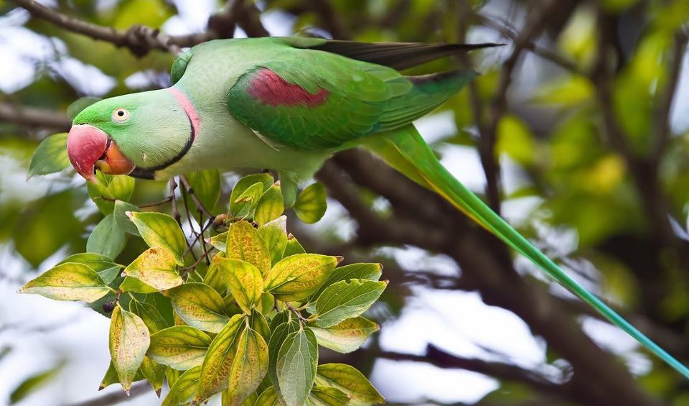
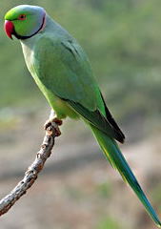
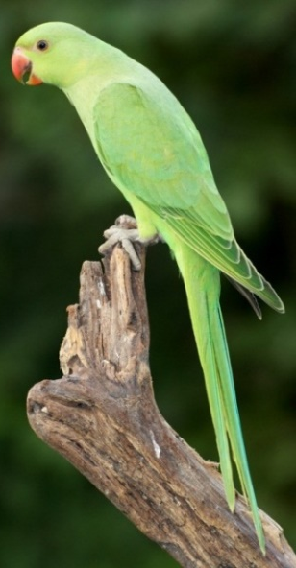
Tia or Parakeet is found in all over Bangladesh. It is about 42 cm long. Its whole body is covered with green feathers. It has a bright red coloured strong curved beak. Its eyes are round and yellow. It has tall red feet and a slim long tail. Around its neck it has a black and red coloured ring. It lives on grass, nuts, chilli, ripe banana and other fruits. Tia lives in flocks. It builds nests in tall shimul trees or in the holes of empty buildings. It lays four or six eggs at a time. It is one of the most beautiful birds found in our country.

Slide 28
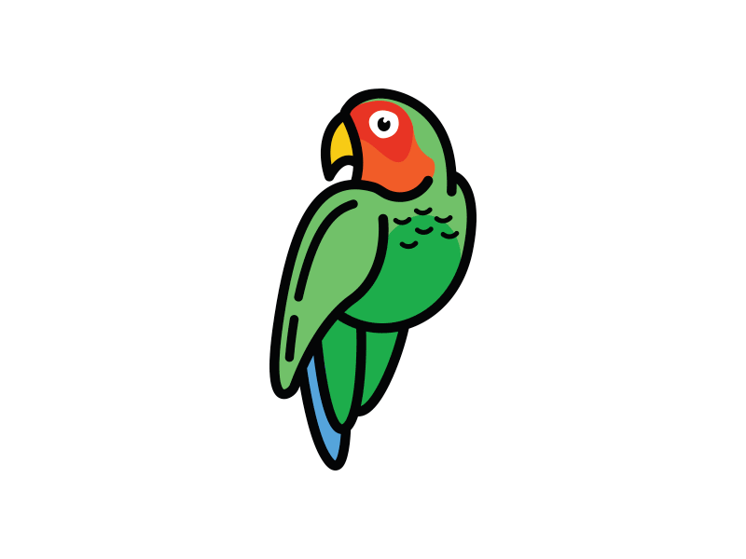
B. Do you know the name of our national bird? Can you describe it in simple words? You may follow the given model.

Slide 29
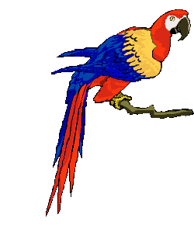
That’s all for today.

Slide 30
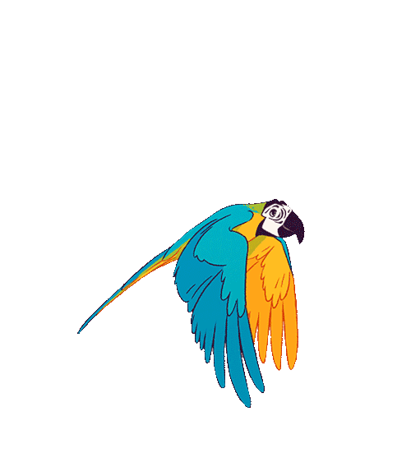
Thank you

