Slide 1
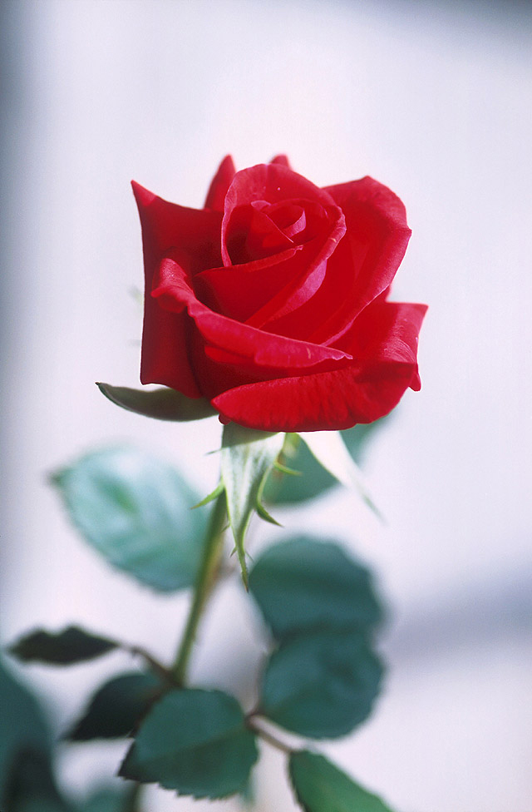
Welcome

Slide 2
English 1st paper
Unit 12
Lesson 3
Time 45 mnts
26/4/21
Md Hasanul Kabir
Lec in English
H. A, Harindia Alim Madrasa
Harindia , Kotchandpur, Jhenaidah

Slide 3
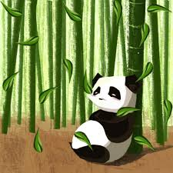

Slide 4
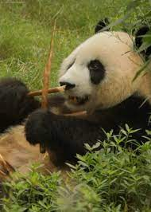

Slide 5
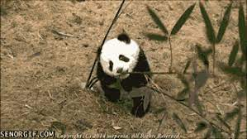

Slide 6
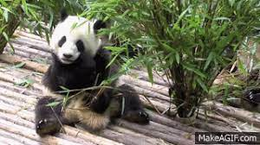

Slide 8
THE GIANT PANDAS

Slide 9
At the end of the lesson
The students are able to know
The life style of the giant pandas
Staple food
How they are being destroyed
How to preserve them
vocabulary

Slide 10
Panda is a beloved animal. They are very gentle to look. They eat different kinds of leave. They don’t like the severely tempered environment.

Slide 11
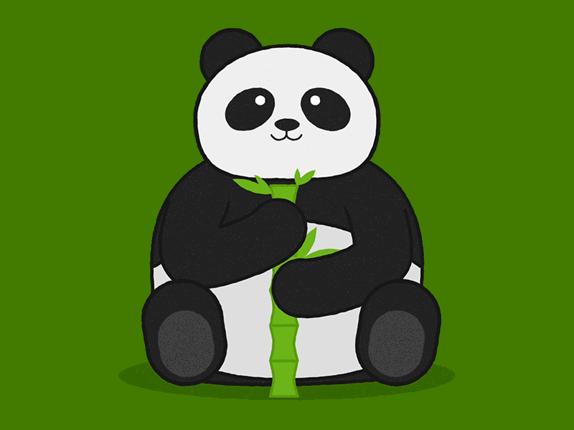
Staple food
About 99 % of pandas like to have bamboo trees. An adult panda need 38 k.g of bamboo.
Causes of extinction
the main causes of the extinction for pandas is the increasing temperature . And not to destroy the forest. In a word we can say, kind to animals is to kind to be human beings.

Slide 12
Survival condition
Not to kill them
Not to destroy the bamboo forest
To plant bamboo trees more and more
To be aware of climate change.

Slide 13
Single work
Read the vocabularies and make sentences with those.
Endangered ……….threatened
Several………...a number of
Diet ………….food
Predict……….forecast
Entire ………whole
Chance………livelihood
Tough………….difficult
Expert………….specialist.

Slide 14
Group work
Discuss about the pandas’ life style.
Discuss how to preserve the pandas from being extinction.

Slide 15
Home work
Answer the following questions
Where do you find the giant pandas?
How do they live?
Why are they on the verge of extinction?

Slide 16
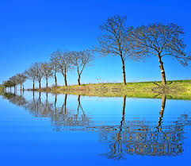
No more today
When more again

