Slide 1
Welcome

Slide 2
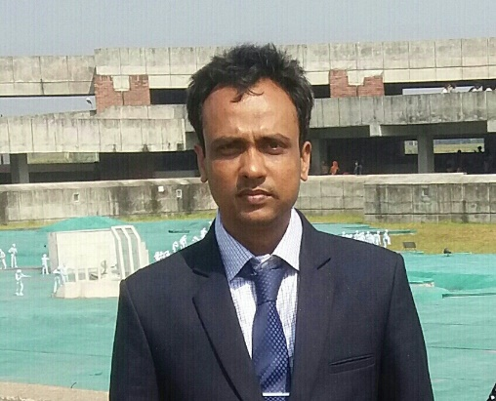
English 2nd paper
participle
Time 45 mnts
3/5/21
Md Hasanul Kabir
Lec in English
H. A, Harindia Alim Madrasa
Harindia , Kotchandpur, Jhenaidah

Slide 3
At the end of the lesson , you will be able to know
What is participle
Kinds of participle
Example of different types of participles
How to make participle phrase.
Difference between participle and gerund.

Slide 4
Participle
Actually participle is a kind of non-finite verb. It represents an adjective.

Slide 5
How does it work?
It works in a sentence as a verb and adjective together.
A swimming fish attracts us very much
Verb +adjective

Slide 6
Kinds
It is of three kinds .
Present participle
Past participle
Perfect participle

Slide 7
Present participle
It works in a sentence as continuous process
Such as : I saw a swimming bird
I saw a flying bird. ( a bird flying )
A drowning should be rescued.
It is a picture of sleeping baby.

Slide 8
So whenever you will see anything to going on , you can use participle there.
আমি একটি ঘুমন্ত শিশু দেখলাম।
এখন যদি প্রশ্ন করি, শিশু টি কী অবস্থায় ছিলো, ঘূমাচ্ছিলো।
I saw a sleeping baby.

Slide 9
Past participle
When the happening is finished , you have to use past participle.
Such as: it is a broken glass.
I saw a killed man.
He was an educated man.
He came here to see the written documents.
বাংলাতে যদি ইত অনুসর্গ পাওয়া যায়। তাহলে আমরা past participle ব্যবহার করতে পারি।

Slide 10
Perfect participle (having +v³
Having seen you , I fall in love with you.
Having done the work , I came here to see me.
Having taken this , you did the work.
Having taken tea , I got fresh.

Slide 11
Difference between participle and gerund
Gerund functions as noun in a sentence
On the other hand , participle works as adjective.
Ex:
Swimming is good for health. ( gerund) as noun
I saw a swimming boy. (Participle) as adjective.
Ving + noun
বেশির ভাগ ক্ষেত্রে participle হতে পারে।
Hv + ving
অথএব ing এর পরে noun না থাকলে ঐ ing যুক্ত word টী সাধারণত gerund হতে পারে।

Slide 12
Participle phrase
Participle + noun /pronoun /adverb…..
Seeing him, I cannot but speak with him.

Slide 13
No more today
When more again

