Slide 1
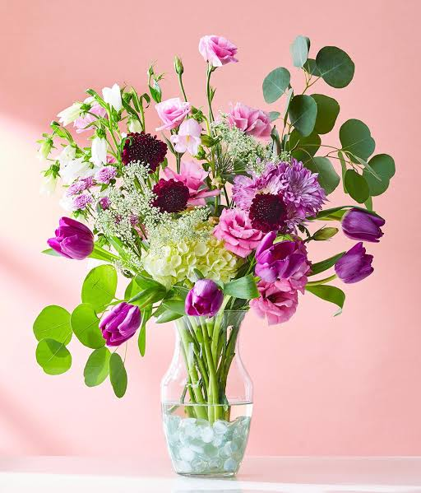
WELCOME

Slide 2
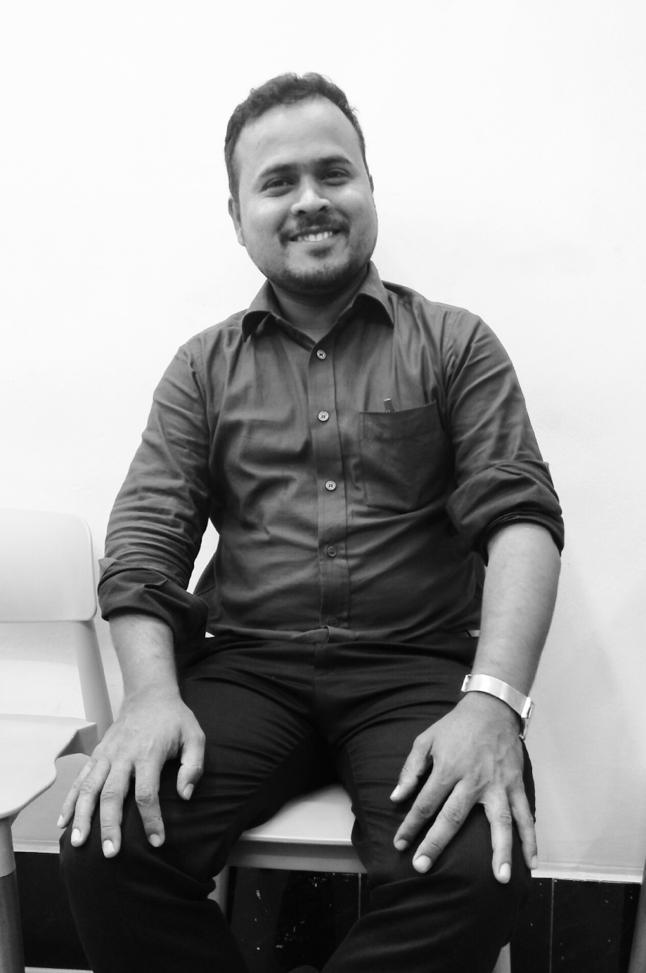
Teacher’s introduction
Md. Rafiqul Hasan
Assistant Teacher
Khonkarkhil Government Primary School
Sadar, Cox's Bazar.

Slide 3
Lesson’s introduction
Class- Four
WH questions
WHOM

Slide 4
Let's see some words
What
class
Who
student
Why
school
When
play
Whom
Farmers

Slide 5
Remember the note:
Whom is used for asking what or which person or people (object)

Slide 6
1. Make WH questions of the following sentences.
a) I saw my friend.
Ans: Whom did you see?

Slide 7
1. Make WH questions of the following sentences.
b) I should help the poor.
Ans: Whom should you help?

Slide 8
1. Make WH questions of the following sentences.
c) They should call the police.
Ans: Whom should they call?

Slide 9
1. Make WH questions of the following sentences.
d) He gave a pen to Mina.
Ans: Whom did he give a pen?

Slide 10
1. Make WH questions of the following sentences.
e) Father loves his son.
Ans: Whom does father love?

Slide 11
1. Make WH questions of the following sentences.
f) Mother loves her daughter.
Ans: Whom does mother love?

Slide 12
1. Make WH questions of the following sentences.
g) Ali gives a pen to his brother.
Ans: Whom does Ali give a pen?

Slide 13
1. Make WH questions of the following sentences.
h) I want to see my mother.
Ans: Whom do you want to see?

Slide 14
1. Make WH questions of the following sentences.
i) He wants to see his friend.
Ans: Whom does he want to see?

Slide 15
1. Make WH questions of the following sentences.
j) I am going to invite Tamim.
Ans: Whom are you going to invite?

Slide 16
1. Make WH questions of the following sentences.
k) They are going to invite Musa.
Ans: Whom are they going to invite?

Slide 17
1. Make WH questions of the following sentences.
l) He is going to invite his uncle.
Ans: Whom is he going to invite?

Slide 18
1. Make WH questions of the following sentences.
m) Hasan will invite his teachers.
Ans: Whom will Hasan invite?

Slide 19
HOMEWORK
1. Make WH questions of the following sentences.
a) He gave a pen to Tina.
b) They are going to invite Ali.
c) I saw my friend.
d) He gave a pen to Mina.
e) I should help the poor.

Slide 20
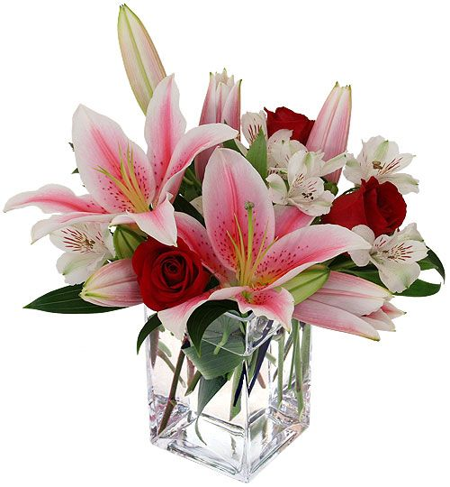
THANK YOU
THAT'S ALL FOR TODAY

